Slide 1
Containerizing .NET Core Applications with Microsoft Azure
Manoj Ganapathi, Chief Architect, CodeOps

Slide 2

About Me – Manoj Ganapathi
Manoj is a seasoned IT professional with more than 19 years of experience. He has extensive experience in enterprise & solution architecture, design and implementation of large & complex enterprise systems. As an architect and technology consultant, he has consulted with several large, fortune 500 enterprises and also worked with ISVs and startups. In his career, he has worked in multiple technology-oriented and leadership roles across all phases of software development life cycle. He is experienced in building and running technical communities and has been a speaker in several technology conferences.
Over the last five years, he has worked extensively on consulting, architecture and implementation of Cloud-based solutions, specializing on building highly scalable, resilient systems and DevOps practices.
Currently, he is the Chief Architect at CodeOps Technologies (http://codeops.tech/) and a Digital Technology Consultant.
LinkedIn profile: https://www.linkedin.com/in/manojg
@manojgr, manoj@codeops.tech

Slide 3
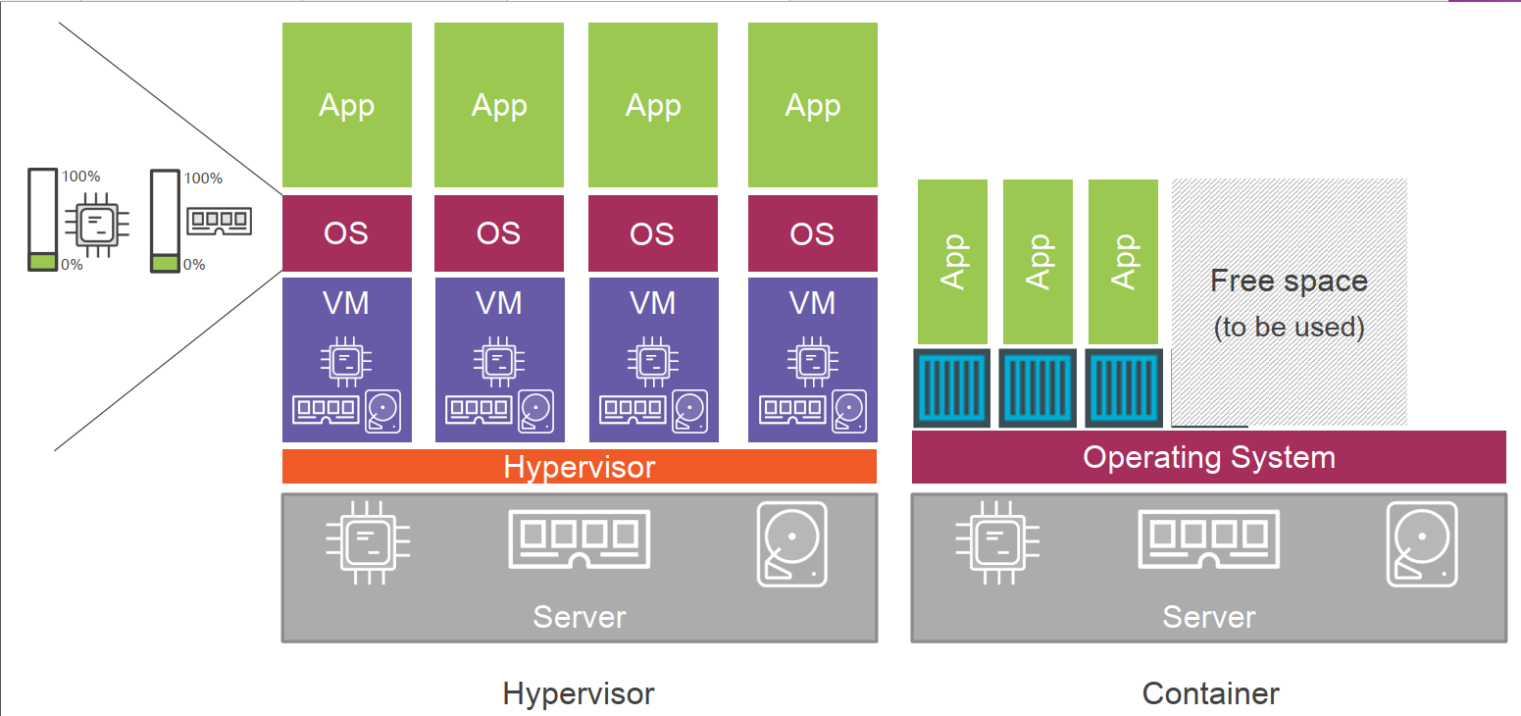
Containers v/s VMs
Image Ref:Nigel Poulton

Slide 4
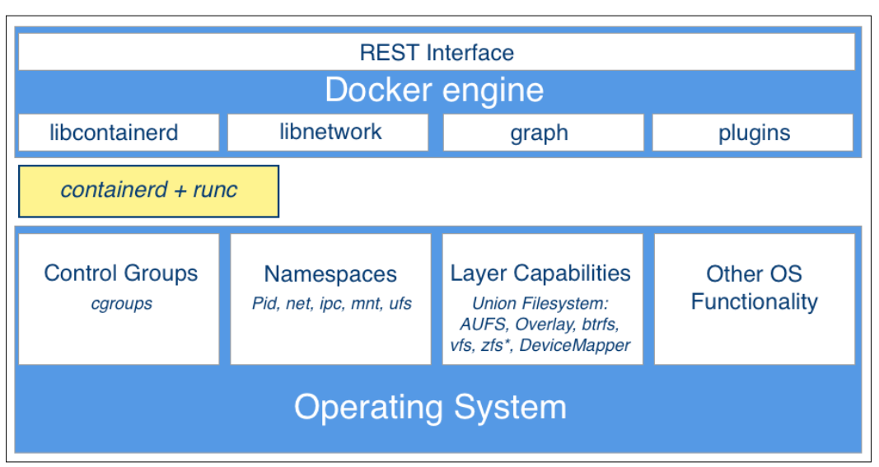
Docker Architecture
Ref: Containerize your apps with Docker & Kubernetes - book

Slide 5
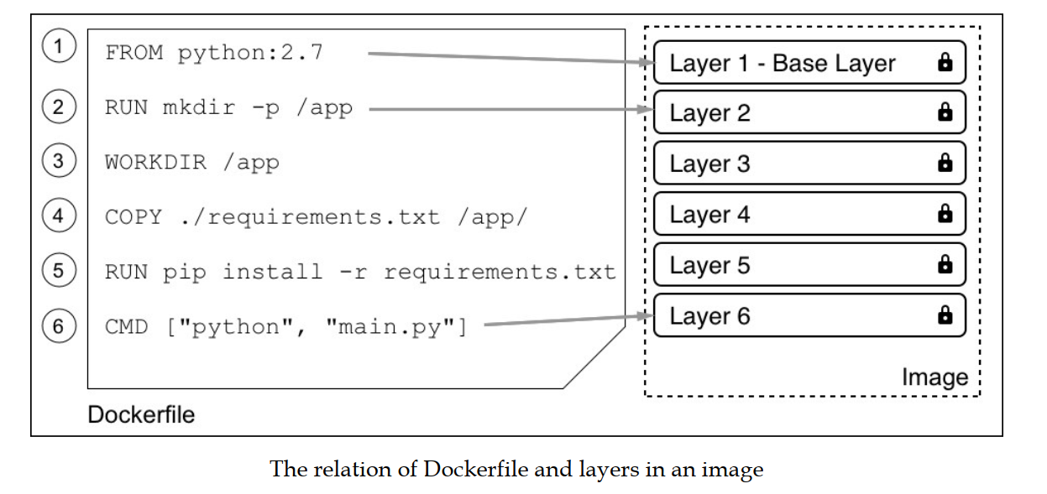
Dockerfile
Ref: Containerize your apps with Docker & Kubernetes - book

Slide 6
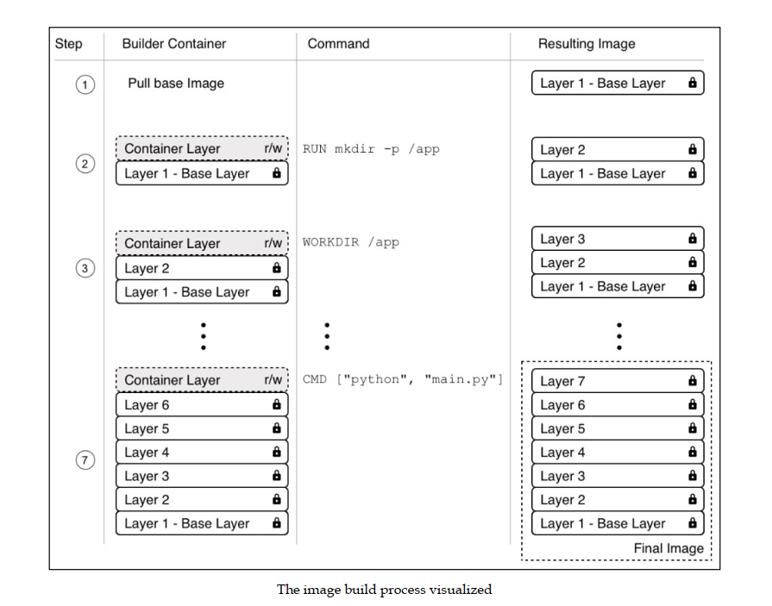
Ref: Containerize your apps with Docker & Kubernetes - book

Slide 7
Resources
K8s Learning Path - https://aka.ms/ws/k8slearning
Docker on Azure - https://aka.ms/ws/DockerOnAzure
Containerize your apps with Docker & Kubernetes - https://aka.ms/ws/ebook
Learning path for Containers & Kubernetes on MS Learn - https://aka.ms/ws/containerization
Azure Learning - https://aka.ms/ws/learnaz
Newsletter, Events: https://aka.ms/ws/Microsoft.source
Sample apps: https://github.com/ManojG1978/dotnetcoreworkshop

