Slide 1
Exploratory Data Analysis
EDA on wine reviews

Slide 2
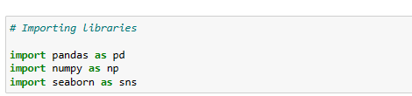
Import Libraries

Slide 3
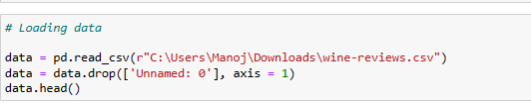
Loading Data

Slide 4
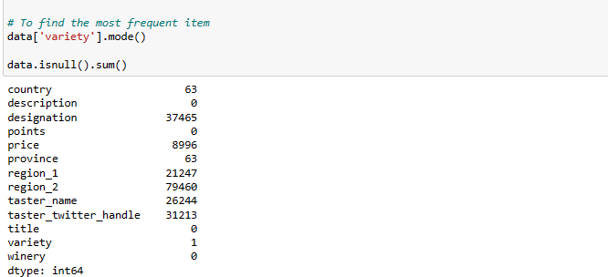
Null values detection

Slide 5
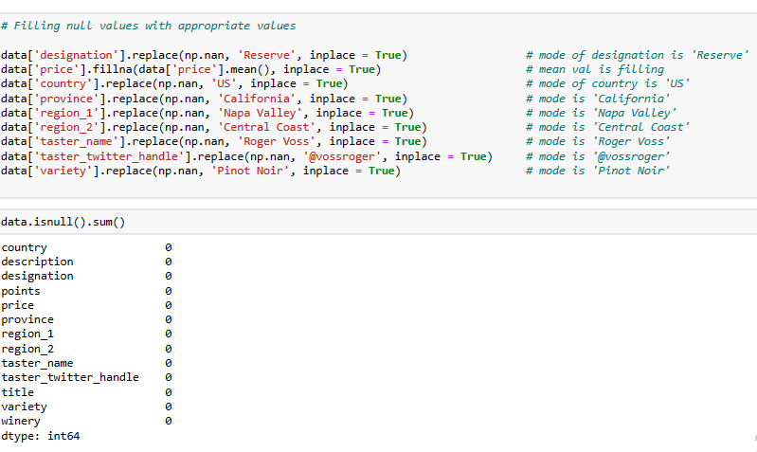
Filling null values

Slide 6
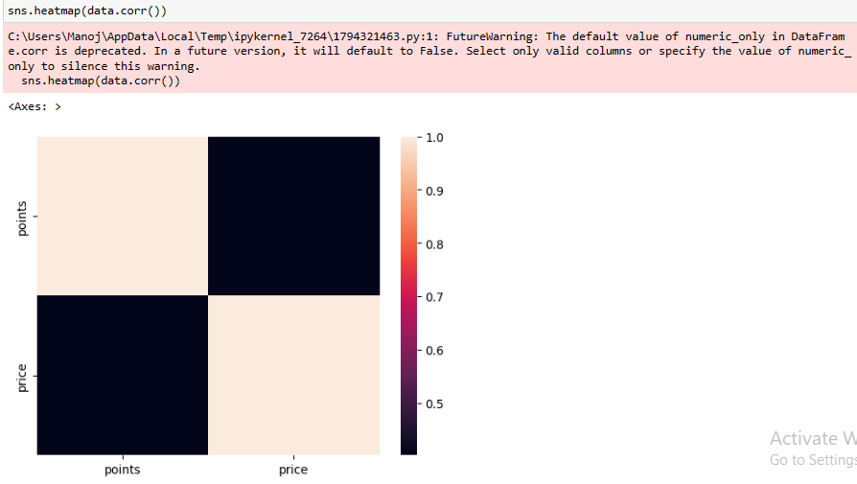
Correlation among items

Slide 7
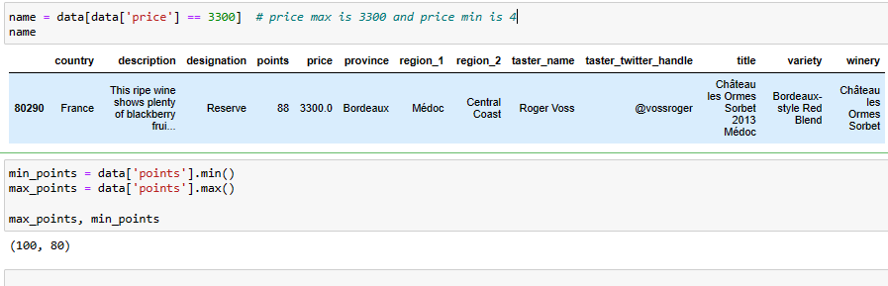
Finding better ratings

Slide 8
Conclusion
By observing heatmap, we can clearly say that there is no any relation between price of the wine and points given by consumer
With Exploratory Data Analysis, I can say that the wine production is pretty well. And the price of wine in France is huge when compared to other countries and Spain, US, Argentina and Romania has cheaper wine

Slide 9
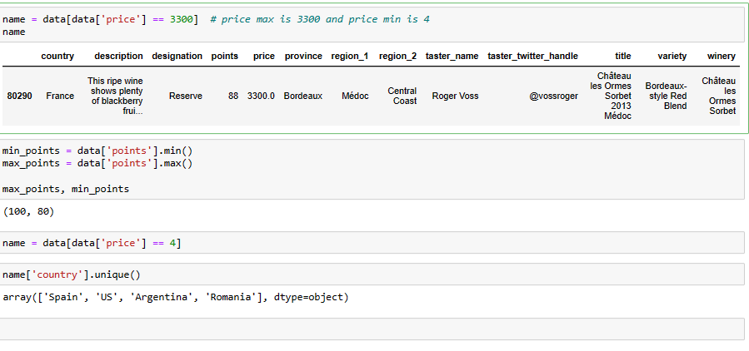
Proof

