Slide 1
Javascript 6/ ES 6

Slide 2
Index
Why ES 6?
New Features in ES 6
Compatibility with browsers
Conclusion

Slide 3
Why use ES2015 or ES6 ?
Some of the new things available in ES2015 are things that can already be accomplished in ES5. Then why to switch to ES6
Cleaner, more readable and maintainable code.
Removes some of the confusing areas and help to reduce boilerplate code cutting down on the size of applications.
New powerful and useful features which are cannot be created in ES5.

Slide 4
Features in ES6
Some of the important features in ES6 :
Block scoping (let and const)
Arrow Functions
Classes
Generators
Maps and Sets
Template String Literals
Default and Rest Parameters
Object Destructuring & Spread operator
In-built promises
TODO: Study Symbol use case

Slide 5
Block Scoping (let & const)
Create variable in the scope where it's actually needed and meaningful.
Remove problems due to variable hoisting with var.
Use of ‘const’ to declare constant values and avoid accidental changes of a variable value.
Even solve some closure problems like the classic for loop scope confusion problem.
ES 5 confusing code:
var links = [];
for(var i=0; i<5; i++) {
links[i].onclick = function() {
console.log('link: ', i);
}
}
links[0].onclick(); // link: 5
links[1].onclick(); // link: 5
ES6 code :
var links = [];
for(let i=0;i<5;i++) {
links[i].onclick = function() { // links[i].onclick = i => console.log('link: ', i);
console.log('link: ', i);
}
}
links[0].onclick(); // link: 0
links[1].onclick(); // link: 1

Slide 6
Arrow Functions
A new shorthand way of declaring functions
let addOne = a => a + 1;
addOne(1); // 2
var add = (a, b) => a + b;
add(1,2); // 3
var addLogged = (a, b) => {
let c = a + b;
console.log(a, '+', b, '=', c);
return c;
};
addLogged(1, 2); // 1 + 2 = 3 (returns 3)
Also share scope with their parent
ES 5 code:
var self = this;
el.onclick = function() {
self.doSomething();
};
ES 6 code:
el.onclick = () => this.doSomething()
The keyword ‘this’ refers to the parent this. Now inside call-backs we can access ‘this’ without having to wrap the handler inside a closure or use function binding).

Slide 7
Classes
Classes creation and usage in ES5 was a pain in the rear, because there wasn’t a keyword class (it was reserved but did nothing). Also inheritance was not as straight forward using prototypes. But this has been solved in ES6 with use class keyword for creating classes. –
Although it’s not new conceptually, but provides a way for clean, easy to understand and maintainable code and syntactic sugar on top of tricky concepts.
We can also attach methods and properties to the main class so that they can accessed without an instance i.e. static properties using the static keyword.
class Animal {
constructor(name, voice) {
this.name = name;
this.voice = voice;
this._eyes = 2;
}
speak() {
console.log(`The ${this.name} says ${this.voice}.`);
}
}
var foo = new Animal('dog', 'woof');
foo.speak(); // The dog says woof.
console.log(`${foo.name} has ${foo.eyes} eyes.`); // dog has 2 eyes

Slide 8
ES6 compatibility with browsers
Can we use these features without worrying that it’ll break in older browsers?
Edge, Chrome, Firefox and Safari all have most of the ES6 features implemented.
Compatibility matrix: http://kangax.github.io/compat-table/es6/
With older browsers, we have the following options:
We will either need a shim for some parts of ES6 (for IE11 in most cases).
Blindly convert all ES6 code into ES5 using a tool/transpiler such as Babel ( https://babeljs.io/ ). We can run it as a standalone tool or use with your build system. There are Babel plugins for Grunt, Gulp and Webpack.

Slide 9
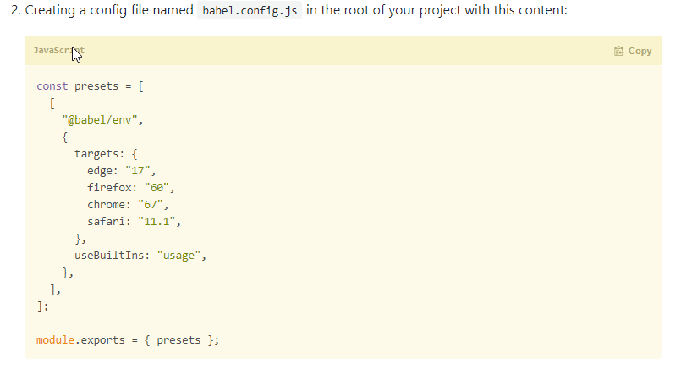
Babel presets for different browsers

Slide 10
Conclusion

