Slide 1

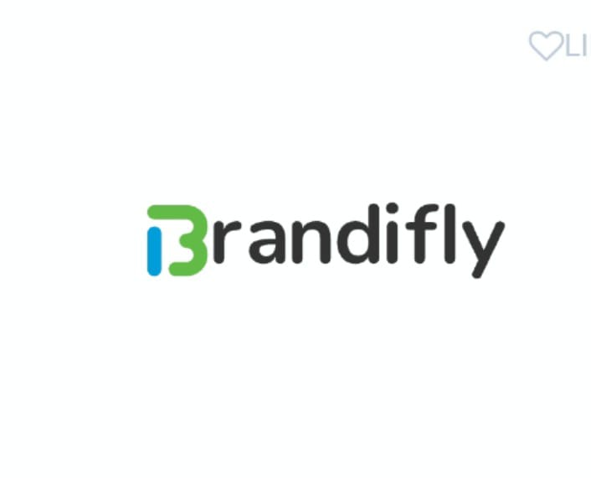
Brandifly
1. Ankit Kashyap
2. Manoj Kumar Chouhan
3. Chandan Kumar
4. Kuldeep Singh Songara
5. Shashi Ranjan

Slide 2
01
02
03
Problem 1
Problem 2
Problem 3
India has over 3.5-4 million influencers who are divided into buckets like elite, mega, macro and micro depending on their follower. Still difficulties to find perfect influencer according to need
As many as 118 million Indians have tried products or services promoted by influencer ads, says a report by Redseer.
Even after having such big influencer market, many potential influencers are still facing difficulties to form collaboration with companies.

Slide 3

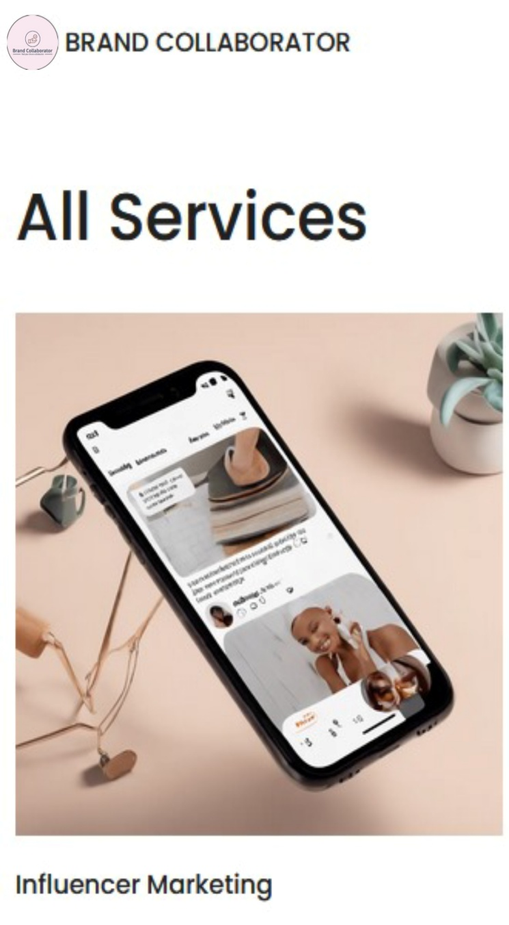
Solution 1
01
We will provide a platform where they can form collaboration.
Solution 2
02
We will provide potential influencer as per company demand so they can hire influencer at very compatible price.
Solution 3
03
Brandifly
We will provide a framework that will directly link influencer to the market.

Slide 4
Key
Features
Feature 1
We will provide influencer to companies not only on the basis of the number of follower but also include the recent engagement of the influencer’s account.
Feature 2
Feature 3
Feature 4
There are very few platforms who provides collaboration but they take huge portion as their handling fee.
We will develop a system that will make the influencers available to the company according to their necessities.
We will take less charge from the initial users and our main focus will be on those who have high potential to develop.

Slide 5
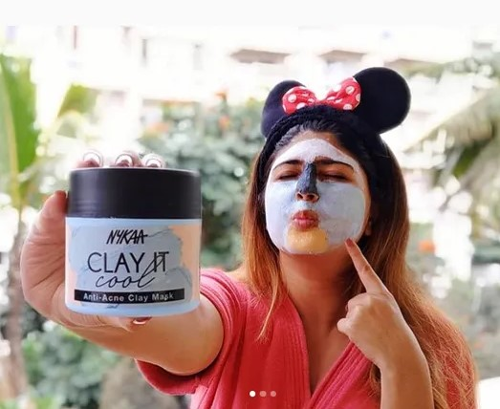
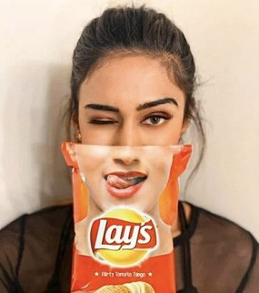
Target User
User 1
User 2
Our basic target will be those influencers that have high potential and less opportunities to them .
The companies that faces challenges to find
right influencers according to their need.

Slide 6




Competitive Analysis
Your main Competitors and their products, how are they different and what value do you provide to your customers?
Kolabster will provide customers to companies not only on the basis on their follower but also analysis the past engagements of the influencer
Brandbuddies,
KoFluence, Flytant
PulpKey, Freeskout
Peppercontent,
helplama.
Difficult to find the companies for influencer having less followers and many of them charge subscription fees before there first collaboration.
We will improvise the delay in KYC process, ease in connectivity, fast response to user if they face any issues.

Slide 7

Financial Assessment
The cost of creating a prototype for a brand collaborator company can vary significantly depending on various factors such as the complexity of the service, the materials involved, the technology required, and the expertise of the team involved. We need around Rs.2-3 lakh to launch our prototype and most portion of the investment will be spend on the advertisement at various social media platform.

Slide 8
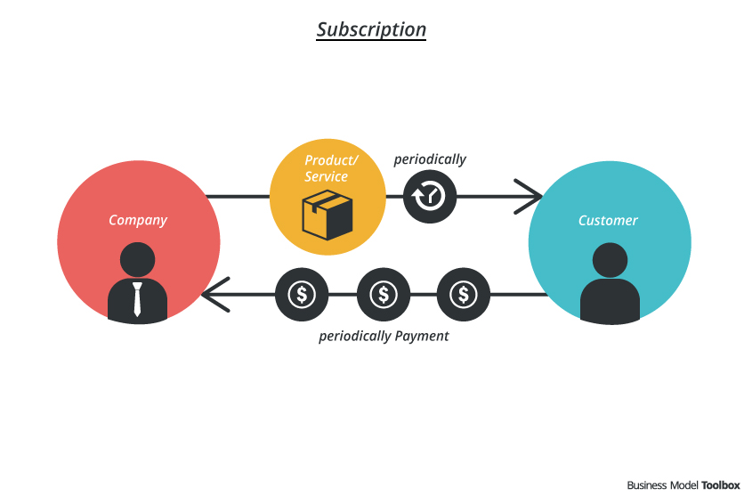
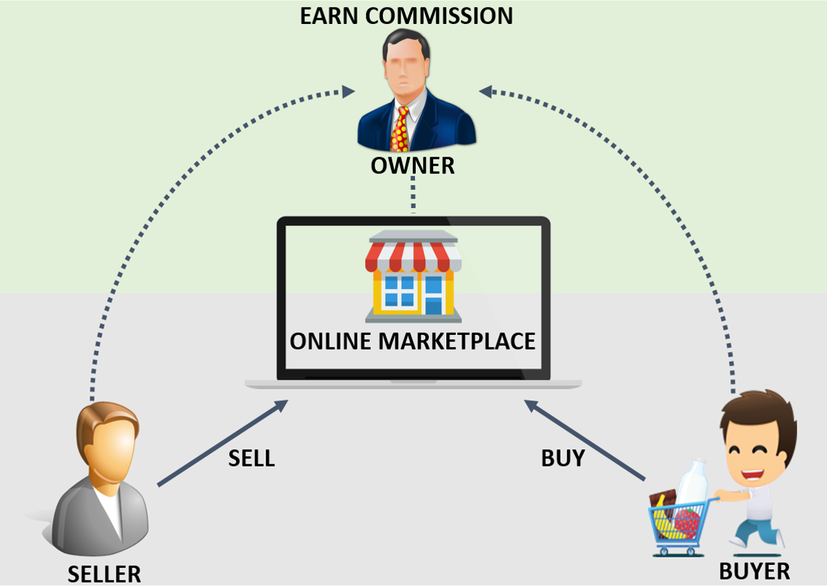
Revenue Model
Subscription Revenue Model
Commison Marketplace Model

Slide 9
Thank You

