Slide 1
External Memory (Algorithms and Data Structures)

Slide 2
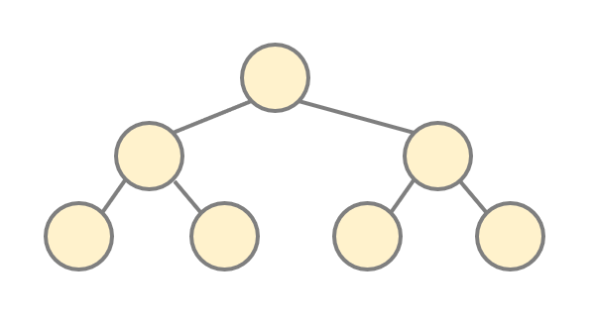
File Systems and Databases
balanced search trees are working extremely
fine and they can be stored in the
main memory (RAM)
WHAT IF WE WANT TO STORE > 1GB HUGE DATA?

Slide 3
File Systems and Databases
There are 2 types of memory:
1.) main memory (RAM): all the data structures considered so far are
stored in the main memory
→ stack memory and heap memory are located in the
main memory as well
2.) external memory (peripheral memory): hard disk, CD-ROM etc.
→ hard drive storage can store large amounts and sizes of files
such as file systems or databases

Slide 4
File Systems and Databases
There are 2 types of memory:
1.) main memory (RAM): all the data structures considered so far are
stored in the main memory
→ stack memory and heap memory are located in the
main memory as well
2.) external memory (peripheral memory): hard disk, CD-ROM etc.
→ hard drive storage can store large amounts and sizes of files
such as file systems or databases
F A S T

Slide 5
File Systems and Databases
There are 2 types of memory:
1.) main memory (RAM): all the data structures considered so far are
stored in the main memory
→ stack memory and heap memory are located in the
main memory as well
2.) external memory (peripheral memory): hard disk, CD-ROM etc.
→ hard drive storage can store large amounts and sizes of files
such as file systems or databases
F A S T
S L O W

Slide 6
File Systems and Databases
EXTERNAL MEMORY
hard drive disk (HDD) is one or more
rigid rapidly rotating platters coated
with magnetic material
CAN RETAIN DATA EVEN
WHEN POWERED OFF !!!

Slide 7
File Systems and Databases
EXTERNAL MEMORY
track is a circular path on the surface
of the HDD on which information
is recorded and read
hard drive disk (HDD) is one or more
rigid rapidly rotating platters coated
with magnetic material
CAN RETAIN DATA EVEN
WHEN POWERED OFF !!!

Slide 8
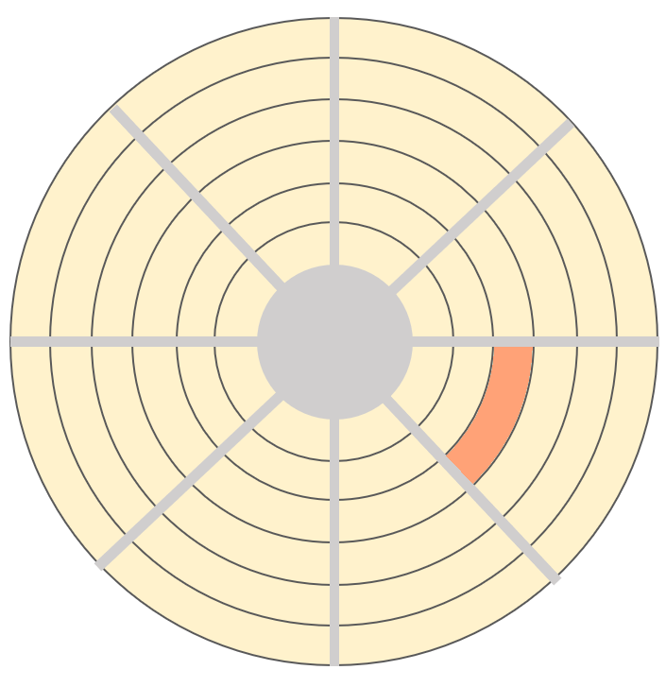
File Systems and Databases
EXTERNAL MEMORY
hard drive disk (HDD) is one or more
rigid rapidly rotating platters coated
with magnetic material
CAN RETAIN DATA EVEN
WHEN POWERED OFF !!!
a block is a subdivision of the
hard drive disk (HDD) storing
512 bytes

Slide 9

File Systems and Databases
the data located on the hard drive disk (HDD) can not be proccessed explicitly
it must be brought into the main memory
in the main memory (RAM) we can use either the stack memory or the heap memory
we can manipulate (read or write) the blocks which means at least 512 bytes
ACCESSING THE BLOCKS IS SLOW !!!
DISK MEMORY (HDD)
MAIN MEMORY

Slide 10
File Systems and Databases
the data located on the hard drive disk (HDD) can not be proccessed explicitly
it must be brought into the main memory
in the main memory (RAM) we can use either the stack memory or the heap memory
we can manipulate (read or write) the blocks which means at least 512 bytes
ACCESSING THE BLOCKS IS SLOW !!!
DISK MEMORY (HDD)
MAIN MEMORY
PROGRAM

Slide 11
File Systems and Databases
the data located on the hard drive disk (HDD) can not be proccessed explicitly
it must be brought into the main memory
in the main memory (RAM) we can use either the stack memory or the heap memory
we can manipulate (read or write) the blocks which means at least 512 bytes
ACCESSING THE BLOCKS IS SLOW !!!
DISK MEMORY (HDD)
MAIN MEMORY
PROGRAM

Slide 12
File Systems and Databases
DISK MEMORY (HDD)
MAIN MEMORY
organizing the data efficiently
stored on the hard drive disk (HDD)
has something to do with database
management systems (DBMS)
storing the data efficiently
on the main memory (RAM)
has something to do with
data structures

Slide 13
External Memory Access Time (Algorithms and Data Structures)

Slide 14
File Systems and Databases
accessig items on the external memory (HDD) is way slower than manipulating the mian memory
we need totally different data structures
EXTERNAL MEMORY ACCES TIME: 12 ms
RAM ACCESS TIME: 0.0001 ms
so far we have manipulated data present on the main memory but now we have to fetch the data from the external memory first

Slide 15
File Systems and Databases
recursive approaches are working quite fine when using the main memory (RAM)
doing the same on the external memory (HDD) is slow because of the access time
we can manipulate (read or write) the blocks which means at least 512 bytes
ACCESSING THE BLOCKS IS SLOW !!!
conclusion: we should minimize the amount of read operations
this is why B-trees are shallow structures
12
4
20
5
23
1

Slide 16
File Systems and Databases
recursive approaches are working quite fine when using the main memory (RAM)
doing the same on the external memory (HDD) is slow because of the access time
we can manipulate (read or write) the blocks which means at least 512 bytes
ACCESSING THE BLOCKS IS SLOW !!!
conclusion: we should minimize the amount of read operations
this is why B-trees are shallow structures
12
4
20
5
23
1

Slide 17
File Systems and Databases
recursive approaches are working quite fine when using the main memory (RAM)
doing the same on the external memory (HDD) is slow because of the access time
we can manipulate (read or write) the blocks which means at least 512 bytes
ACCESSING THE BLOCKS IS SLOW !!!
conclusion: we should minimize the amount of read operations
this is why B-trees are shallow structures
12
4
20
5
23
1

Slide 18
File Systems and Databases
recursive approaches are working quite fine when using the main memory (RAM)
doing the same on the external memory (HDD) is slow because of the access time
we can manipulate (read or write) the blocks which means at least 512 bytes
ACCESSING THE BLOCKS IS SLOW !!!
conclusion: we should minimize the amount of read operations
this is why B-trees are shallow structures
12
4
20
5
23
1

Slide 19
File Systems and Databases
recursive approaches are working quite fine when using the main memory (RAM)
doing the same on the external memory (HDD) is slow because of the access time
we can manipulate (read or write) the blocks which means at least 512 bytes
ACCESSING THE BLOCKS IS SLOW !!!
conclusion: we should minimize the amount of read operations
this is why B-trees are shallow structures
12
4
20
5
23
1

Slide 20
B-Trees (Algorithms and Data Structures)

Slide 21
B-Trees
it was first constructed in 1971 by Rudolf Bayer and Ed McCreight
B-trees are self balancing tree like data structures
supports operations such as insertion, deletion, sequential access and searching in O(logN) time complexity
the nodes may have more than 2 children + multipley keys
B-tree data sturctures are optimized for systems that read and write large blocks of data
B-trees are a good example of a data structure for external memory
commonly used in databases and filesystems

Slide 22

B-Trees
Every node may have multiple children (more than 2) but the running time is still O(logN) logartithmic
log_{b}N = $\frac{logaN}{logab}$
log_{a}b is just a
constant so does
not matter
→ we can change the base of the logarithm and the
running time complexity for the algorithm stay the same
O(c logN) = c O(logN) = O(logN)
→ thats why the branching factor does not matter
in the running time complexities
*
*

Slide 23
B-Trees
8
12
20
-2
9
11
12
14
19
32

Slide 24
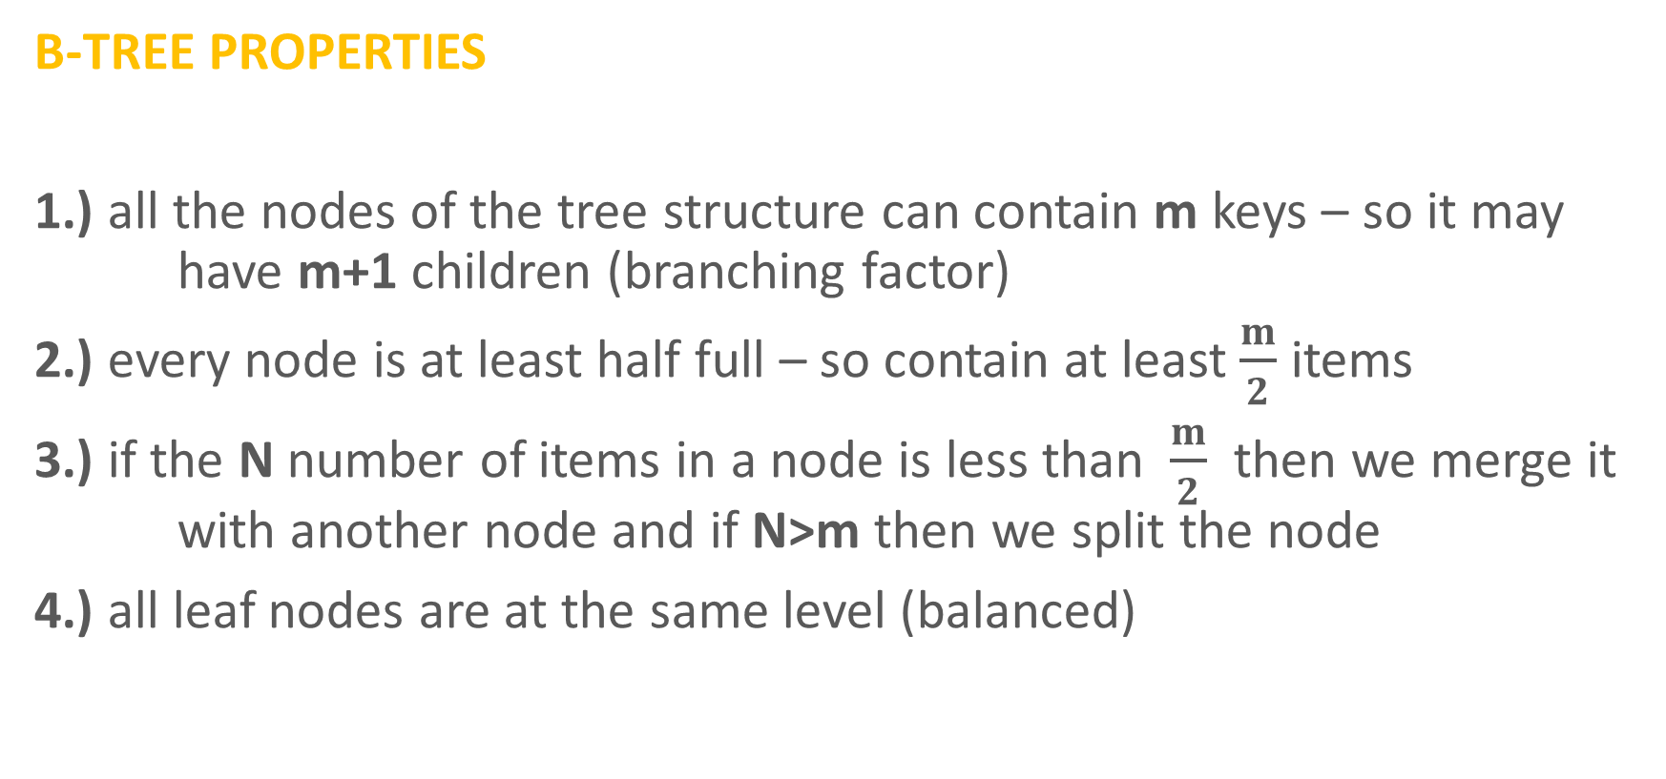
B-Trees
B-TREE PROPERTIES
1.) all the nodes of the tree structure can contain m keys – so it may have m+1 children (branching factor)
2.) every node is at least half full – so contain at least $\frac{m}{2}$ items
3.) if the N number of items in a node is less than $\frac{m}{2}$ then we merge it with another node and if N>m then we split the node
4.) all leaf nodes are at the same level (balanced)

Slide 25
B-Trees Insertion (Algorithms and Data Structures)

Slide 26
B-Trees
INSERT(1)

Slide 27
B-Trees
INSERT(1)
1

Slide 28
B-Trees
1

Slide 29
B-Trees
INSERT(2)
1
2

Slide 30
B-Trees
1
2

Slide 31
B-Trees
INSERT(3)
1
2

Slide 32
B-Trees
INSERT(3)
1
2

Slide 33
B-Trees
INSERT(3)
1
2
3

Slide 34
B-Trees
INSERT(3)
1
2
3
we always promote the
middle value in these cases

Slide 35
B-Trees
INSERT(3)
1
2
3
we always promote the
middle value in these cases

Slide 36
B-Trees
INSERT(3)
2
1
3

Slide 37
B-Trees
2
1
3

Slide 38
B-Trees
INSERT(4)
2
1
3

Slide 39
B-Trees
INSERT(4)
2
1
3

Slide 40
B-Trees
INSERT(4)
2
1
3

Slide 41
B-Trees
INSERT(4)
2
1
3

Slide 42
B-Trees
INSERT(4)
2
1
3
4

Slide 43
B-Trees
2
1
3
4

Slide 44
B-Trees
INSERT(5)
2
1
3
4

Slide 45
B-Trees
INSERT(5)
2
1
3
4

Slide 46
B-Trees
INSERT(5)
2
1
3
4

Slide 47
B-Trees
INSERT(5)
2
1
3
4

Slide 48
B-Trees
INSERT(5)
2
1
3
4

Slide 49
B-Trees
INSERT(5)
2
1
3
4
5

Slide 50
B-Trees
INSERT(5)
2
1
3
4
5
we always promote the
middle value in these cases

Slide 51
B-Trees
INSERT(5)
2
4
1
3
5

Slide 52
B-Trees
INSERT(5)
2
4
1
3
5

Slide 53
B-Trees
2
4
1
3
5

Slide 54
B-Trees
INSERT(6)
2
4
1
3
5

Slide 55
B-Trees
INSERT(6)
2
4
1
3
5

Slide 56
B-Trees
INSERT(6)
2
4
1
3
5

Slide 57
B-Trees
INSERT(6)
2
4
1
3
5

Slide 58
B-Trees
INSERT(6)
2
4
1
3
5

Slide 59
B-Trees
2
4
1
3
5
6

Slide 60
B-Trees
INSERT(7)
2
4
1
3
5
6

Slide 61
B-Trees
INSERT(7)
2
4
1
3
5
6

Slide 62
B-Trees
INSERT(7)
2
4
1
3
5
6

Slide 63
B-Trees
INSERT(7)
2
4
1
3
5
6

Slide 64
B-Trees
INSERT(7)
2
4
1
3
5
6

Slide 65
B-Trees
INSERT(7)
2
4
1
3
5
6

Slide 66
B-Trees
INSERT(7)
2
4
1
3
5
6
7
we always promote the
middle value in these cases

Slide 67
B-Trees
INSERT(7)
2
4
1
3
5
6
7

Slide 68
B-Trees
INSERT(7)
2
4
6
1
3
5
7

Slide 69
B-Trees
INSERT(7)
we always promote the
middle value in these cases
2
4
6
1
3
5
7

Slide 70
B-Trees
INSERT(7)
2
4
6
1
3
5
7

Slide 71
B-Trees
INSERT(7)
4
2
6
1
3
5
7

Slide 72
B-Trees
INSERT(7)
4
2
6
1
3
5
7

Slide 74
B-Trees
INSERT(4)
17
3
37
51
1
7
17
18
39
78
89

Slide 75
B-Trees
INSERT(4)
17
3
37
51
1
7
17
18
39
78
89

Slide 76
B-Trees
INSERT(4)
17
3
37
51
1
7
17
18
39
78
89

Slide 77
B-Trees
INSERT(4)
17
3
37
51
1
7
17
18
39
78
89

Slide 78
B-Trees
INSERT(4)
17
3
37
51
1
7
17
18
39
78
89

Slide 79
B-Trees
INSERT(4)
17
3
37
51
1
7
17
18
39
78
89

Slide 80
B-Trees
INSERT(4)
17
3
37
51
1
4
7
17
18
39
78
89

Slide 81
B-Trees
17
3
37
51
1
4
7
17
18
39
78
89

Slide 82
B-Trees
INSERT(9)
17
3
37
51
1
4
7
17
18
39
78
89

Slide 83
B-Trees
INSERT(9)
17
3
37
51
1
4
7
17
18
39
78
89

Slide 84
B-Trees
INSERT(9)
17
3
37
51
1
4
7
17
18
39
78
89

Slide 85
B-Trees
INSERT(9)
17
3
37
51
1
4
7
17
18
39
78
89

Slide 86
B-Trees
INSERT(9)
17
3
37
51
1
4
7
17
18
39
78
89

Slide 87
B-Trees
INSERT(9)
17
3
37
51
1
4
7
17
18
39
78
89

Slide 88
B-Trees
INSERT(9)
17
3
37
51
1
4
7
9
17
18
39
78
89

Slide 89
B-Trees
INSERT(9)
17
3
37
51
1
4
7
9
17
18
39
78
89
we always promote the
middle value in these cases

Slide 90
B-Trees
INSERT(9)
17
3
7
37
51
1
4
9
17
18
39
78
89

Slide 91
B-Trees
INSERT(9)
17
3
7
37
51
1
4
9
17
18
39
78
89

Slide 92
B-Trees
17
3
7
37
51
1
4
9
17
18
39
78
89

Slide 93
B-Trees
INSERT(11)
17
3
7
37
51
1
4
9
17
18
39
78
89

Slide 94
B-Trees
INSERT(11)
17
3
7
37
51
1
4
9
17
18
39
78
89

Slide 95
B-Trees
INSERT(11)
17
3
7
37
51
1
4
9
17
18
39
78
89

Slide 96
B-Trees
INSERT(11)
17
3
7
37
51
1
4
9
17
18
39
78
89

Slide 97
B-Trees
INSERT(11)
17
3
7
37
51
1
4
9
17
18
39
78
89

Slide 98
B-Trees
INSERT(11)
17
3
7
37
51
1
4
9
17
18
39
78
89

Slide 99
B-Trees
INSERT(11)
17
3
7
37
51
1
4
9
11
17
18
39
78
89

Slide 100
B-Trees
17
3
7
37
51
1
4
9
11
17
18
39
78
89

Slide 101
B-Trees
INSERT(10)
17
3
7
37
51
1
4
9
11
17
18
39
78
89

Slide 102
B-Trees
INSERT(10)
17
3
7
37
51
1
4
9
11
17
18
39
78
89

Slide 103
B-Trees
INSERT(10)
17
3
7
37
51
1
4
9
11
17
18
39
78
89

Slide 104
B-Trees
INSERT(10)
17
3
7
37
51
1
4
9
11
17
18
39
78
89

Slide 105
B-Trees
INSERT(10)
17
3
7
37
51
1
4
9
11
17
18
39
78
89

Slide 106
B-Trees
INSERT(10)
17
3
7
37
51
1
4
9
11
17
18
39
78
89

Slide 107
B-Trees
INSERT(10)
17
3
7
37
51
1
4
9
11
17
18
39
78
89

Slide 108
B-Trees
INSERT(10)
17
3
7
37
51
1
4
9
11
17
18
39
78
89

Slide 109
B-Trees
INSERT(10)
17
3
7
37
51
1
4
9
11
17
18
39
78
89

Slide 110
B-Trees
INSERT(10)
17
3
7
37
51
1
4
9
10
11
17
18
39
78
89

Slide 111
B-Trees
INSERT(10)
17
3
7
37
51
1
4
9
10
11
17
18
39
78
89
we always promote the
middle value in these cases

Slide 112
B-Trees
INSERT(10)
17
3
7
37
51
1
4
9
11
17
18
39
78
89

Slide 113
B-Trees
INSERT(10)
17
3
7
10
37
51
1
4
9
11
17
18
39
78
89

Slide 114
B-Trees
INSERT(10)
we always promote the
middle value in these cases
17
3
7
10
37
51
1
4
9
11
17
18
39
78
89

Slide 115
B-Trees
INSERT(10)
17
3
7
10
37
51
1
4
9
11
17
18
39
78
89

Slide 116
B-Trees
INSERT(10)
7
17
3
10
37
51
1
4
9
11
17
18
39
78
89

Slide 117
B-Trees
INSERT(10)
7
17
3
10
37
51
1
4
9
11
17
18
39
78
89

Slide 118
B-Trees Removal (Algorithms and Data Structures)

Slide 119

B-Tree Removal
1.) REMOVING AN INTERNAL ITEM
We remove an item from the node and does not violate the B-tree properties
so the number of items remains in the range [$\frac{m}{2}$, m]

Slide 120
B-Trees
17
3
37
51
1
7
18
19
39
78
89

Slide 121
B-Trees
REMOVE(19)
17
3
37
51
1
7
18
19
39
78
89

Slide 122
B-Trees
REMOVE(19)
17
3
37
51
1
7
18
19
39
78
89

Slide 123
B-Trees
REMOVE(19)
17
3
37
51
1
7
18
19
39
78
89

Slide 124
B-Trees
REMOVE(19)
17
3
37
51
1
7
18
19
39
78
89

Slide 125
B-Trees
REMOVE(19)
17
3
37
51
1
7
18
19
39
78
89

Slide 126
B-Trees
17
3
37
51
1
7
18
39
78
89

Slide 127

B-Tree Removal
2.) REMOVING A INTERNAL ITEM
We remove an item from the node and the B-tree properties are violated
as there will be less than $\frac{m}{2}$items in the given node
WE CAN GET AN ITEM FROM THE LEFT SIBLING !!!

Slide 128
B-Tree
17
3
37
51
1
7
18
20
39
78

Slide 129
B-Tree
REMOVE(39)
17
3
37
51
1
7
18
20
39
78

Slide 130
B-Tree
REMOVE(39)
17
3
37
51
1
7
18
20
39
78

Slide 131
B-Tree
REMOVE(39)
17
3
37
51
1
7
18
20
39
78

Slide 132
B-Tree
REMOVE(39)
17
3
37
51
1
7
18
20
39
78

Slide 133
B-Tree
REMOVE(39)
17
3
37
51
1
7
18
20
78

Slide 134
B-Tree
REMOVE(39)
17
3
37
51
1
7
18
20
78

Slide 135
B-Tree
REMOVE(39)
17
3
20
51
1
7
18
37
78

Slide 136
B-Tree
17
3
20
51
1
7
18
37
78

Slide 137

B-Tree Removal
3.) REMOVING A INTERNAL ITEM
We remove an item from the node and the B-tree properties are violated
as there will be less than $\frac{m}{2}$items in the given node
WE CAN GET AN ITEM FROM THE RIGHT SIBLING !!!

Slide 138
B-Tree
17
3
37
51
1
7
18
39
78
91

Slide 139
B-Tree
REMOVE(39)
17
3
37
51
1
7
18
39
78
91

Slide 140
B-Tree
REMOVE(39)
17
3
37
51
1
7
18
39
78
91

Slide 141
B-Tree
REMOVE(39)
17
3
37
51
1
7
18
39
78
91

Slide 142
B-Tree
REMOVE(39)
17
3
37
51
1
7
18
39
78
91

Slide 143
B-Tree
REMOVE(39)
17
3
37
51
1
7
18
78
91

Slide 144
B-Tree
REMOVE(39)
17
3
37
51
1
7
18
78
91

Slide 145
B-Tree
REMOVE(39)
17
3
37
78
1
7
18
51
91

Slide 146
B-Tree
17
3
37
78
1
7
18
51
91

Slide 147
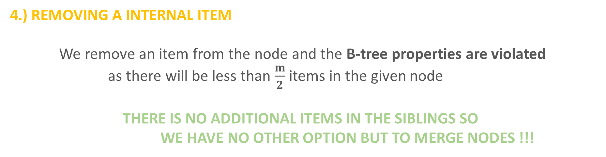
B-Tree Removal
4.) REMOVING A INTERNAL ITEM
We remove an item from the node and the B-tree properties are violated
as there will be less than $\frac{m}{2}$items in the given node
THERE IS NO ADDITIONAL ITEMS IN THE SIBLINGS SO
WE HAVE NO OTHER OPTION BUT TO MERGE NODES !!!

Slide 148
B-Tree
17
3
37
78
1
7
18
51
91

Slide 149
B-Tree
REMOVE(51)
17
3
37
78
1
7
18
51
91

Slide 150
B-Tree
REMOVE(51)
17
3
37
78
1
7
18
51
91

Slide 151
B-Tree
REMOVE(51)
17
3
37
78
1
7
18
51
91

Slide 152
B-Tree
REMOVE(51)
17
3
37
78
1
7
18
51
91

Slide 153
B-Tree
REMOVE(51)
17
3
37
78
1
7
18
91

Slide 154
B-Tree
REMOVE(51)
17
3
78
1
7
18
37
91

Slide 155
B-Tree
REMOVE(51)
17
3
78
1
7
18
37
91

Slide 156
B-Tree
REMOVE(51)
17
3
78
1
7
18
37
91

Slide 157
B-Tree
REMOVE(51)
17
3
78
1
7
18
37
91

Slide 158
B-Tree Variants (Algorithms and Data Structures)

Slide 159
B-Trees Advantages and Disadvantages
there are several advantages of B-trees
there is a guaranteed O(logN) logarithmic running time
BUT THERE MAY BE SEVERAL EMPTY CELLS
we can decrease the h height of the B-tree
this is why better variants came to be

Slide 160
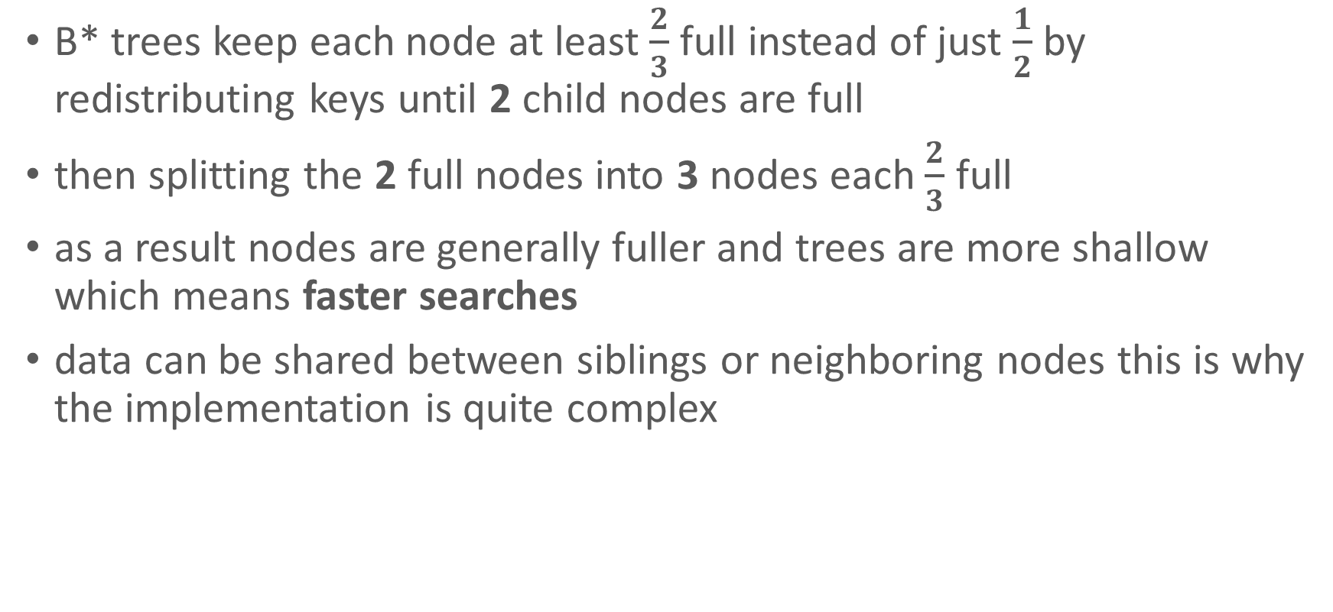
B* Trees
B* trees keep each node at least $\frac{2}{3}$ full instead of just $\frac{1}{2}$ by redistributing keys until 2 child nodes are full
then splitting the 2 full nodes into 3 nodes each $\frac{2}{3}$ full
as a result nodes are generally fuller and trees are more shallow which means faster searches
data can be shared between siblings or neighboring nodes this is why the implementation is quite complex

Slide 161
B+ Trees
it is the original B-tree like tree structure
but the leaf nodes are connected with references (pointers) in a linked list manner
the primary value of a B+ tree is in storing data for efficient retrieval in a block-oriented storage context like file systems
almost every operating system (MacOS, Linux or Windows) rely heavily on B+ trees
NTFS file system is first constructed at Microsoft
APFS (Apple File System) is the file system of MacOS

