Slide 1
SHORTEST PATH
APPLICATIONS OF SHORTEST PATH ALGORITHMS

Slide 2
DAG shortest path
If the graph is a DAG, so there is no directed cycles, it is easier to find the shortest path
We sort the vertices into topological order: we iterate throught the topological order relaxing all edges from the actual vertex
Topological sort algorithm computes shortest path tree in any edge weighted (can be negative!!!) DAG in time O(E+V)
It is much faster than Bellman-Ford or Dijkstra
Applications: solving Knapsack problem

Slide 3
GPS, vehicle routing and navigation
Detecting arbitrage situations in FX
RIP „Routing Information Protocol”
This is a distributed algorithm
1.) Each node calculates the distances between itself and all other nodes and stores this information as a table
2.) Each node sends its table to all adjacent nodes
3.) When a node receives distance tables from its neighbors, it calculates the shortest routes to all other nodes and updates its own table to reflect any changes

Slide 4
Avidan-Shamir method
When we want to shrink an image for example in the browser or on a smartphone without distortion
We want to make sure the image will not deform
We have to eliminate the least significant bit strings
We set up an „energy function”: and remove the connected string of pixels containing the least energy
Photoshop, GIMP use it
We build a huge graph: vertices are the pixels and the edges are pointing from every vertex to its downward 3 neighbours
The energy function determines what the edge weights will be
It’s acyclic: we can use topological order shortest path to find the string of pixels to be removed

Slide 5
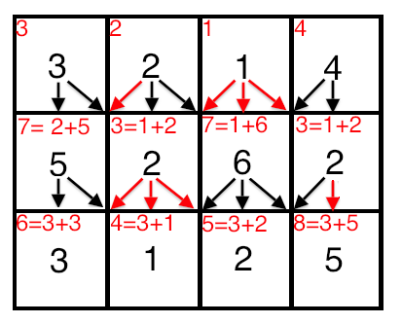
Avidan-Shamir method

Slide 6
Longest path problem
Problem of finding a simple path of maximum length in a given graph
No polynomial time algorithm !!!
It is an NP-hard problem
It has a linear time solution for directed acyclic graphs (DAG) which has important applications in finding the critical path in scheduling problems

Slide 7
Longest path problem
Problem of finding a simple path of maximum length in a given graph
No polynomial time algorithm !!! NP-hard problem
It has a linear time solution for directed acyclic graphs (DAG) which has important applications in finding the critical path in scheduling problems
We just have to negate the edge weights and run shortest path algorithm
We have to use Bellman-Ford algorithm because negative edges can occur
Application: Parallel job scheduling problem
Given a set of jobs with durations and precedence constraints, schedule the jobs - by finding a start time to each - so as to achive the minimum completion time, while respecting the constraints

Slide 8
CPM: critical path method
The method was first used between 1940 and 1943 in the Manhattan project
Problem formulation: we want an algorithm for scheduling a set of project activities so that the total running time will be as minimal as possible
The algorithm needs
A list of all activities required to complete the project
The time (duration) that each activity will take to complete
The dependencies between the activities

Slide 9
CPM: critical path method
We create an edge weighted DAG
Add edges with 0 weight for each precedence constraint
We have to find the longest path in order to solve the problem
There are no cycles in such a graph

