Slide 1
Dijkstra’s Algorithm (Algorithms and Data Structures)

Slide 2
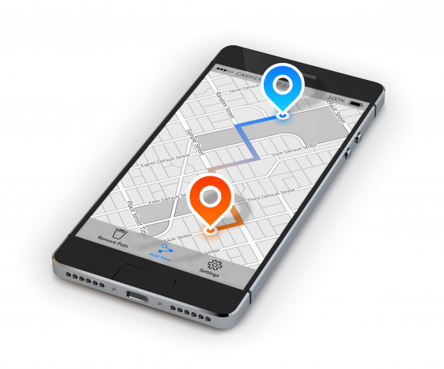
Dijkstra’s Algorithm
“In graph theory the shortest path problem is the problem of finding a path between two vertices in a graph such that the sum of the weights of its constituent edges is minimized”

Slide 3
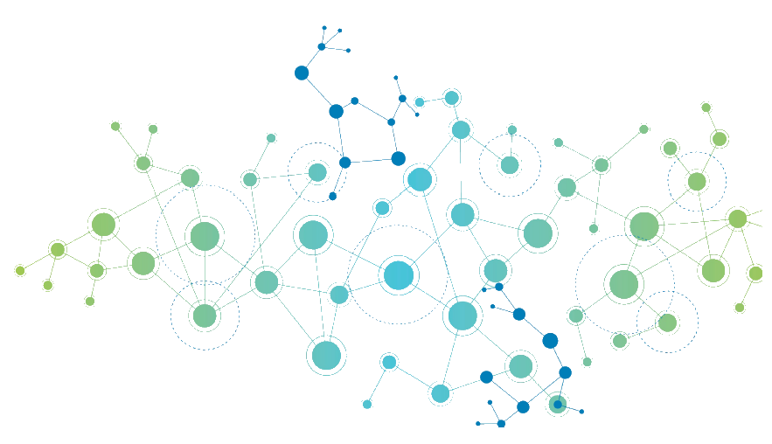
Dijkstra’s Algorithm
Finding a path between two vertices in a G(V,E) graph such that the sum of the weights of its edges is minimized.
ALGORITHMS
1.) Dijkstra’s algorithm
2.) Bellman-Ford algorithm
3.) A* search
4.) Floyd-Warshall algorithm

Slide 4
Dijkstra’s Algorithm
it was constructed by computer scientist Edsger Dijkstra in 1956
Dijkstra’s method can handle positive edge weights - Bellman-Ford algorithm can have negative weights as well
it can find the shortest path in a G(V,E) graph from v to u but it is able to construct a shortest path tree as well
the shortest path tree defines the shortest paths from a source to all the other nodes
it is asymptotically the fastest known single-source shortest-path algorithm for arbitrary directed graphs with unbounded non-negative weights

Slide 5
Dijkstra’s Algorithm
Dijkstra’s algorithm has O(VlogV + E) running time complexity
it is a greedy approach – it tries to find the global optimum with the help of local optimum
on every iteration we want to find the minimum distance to the next vertex possible
the appropriate data structure is a priority queue (heap)

Slide 6
Dijkstra’s Algorithm
B
15
D
5
3
A
4
12
C
8
7
H
9
1
9
6
11
5
F
13
4
E
20
G

Slide 7
Dijkstra’s Algorithm
∞
∞
B
15
D
5
0
3
4
12
∞
A
C
8
7
∞
H
9
1
9
6
∞
11
5
F
13
4
∞
∞
20
E
G

Slide 8
Dijkstra’s Algorithm
HEAP: [ B-5 H-8 E-9 ]
5
∞
B
15
D
5
0
3
4
12
∞
A
C
8
7
8
H
9
1
9
6
∞
11
5
F
13
4
9
∞
E
20
G

Slide 9
Dijkstra’s Algorithm
HEAP: [ B-5 H-8 E-9 ]
5
∞
B
15
D
5
0
3
4
12
∞
A
C
8
7
8
H
9
1
9
6
∞
11
5
F
13
4
9
∞
E
20
G

Slide 10
Dijkstra’s Algorithm
HEAP: [ B-5 H-8 E-9 ]
5
∞
B
15
D
5
0
3
4
12
∞
A
C
8
7
8
H
9
1
9
6
∞
11
5
F
13
4
9
∞
E
20
G

Slide 11
Dijkstra’s Algorithm
HEAP: [ H-8 E-9 ]
5
∞
B
15
D
5
0
3
4
12
∞
A
C
8
7
8
H
9
1
9
6
∞
11
5
F
13
4
9
∞
E
20
G

Slide 12
Dijkstra’s Algorithm
HEAP: [ H-8 E-9 ]
5
20
B
15
D
5
0
3
4
12
17
A
C
8
7
8
H
9
1
9
6
∞
11
5
F
13
4
9
∞
E
20
G

Slide 13
Dijkstra’s Algorithm
HEAP: [ H-8 E-9 D-20 C-17 ]
5
20
B
15
D
5
0
3
4
12
17
A
C
8
7
8
H
9
1
9
6
∞
11
5
F
13
4
9
∞
E
20
G

Slide 14
Dijkstra’s Algorithm
HEAP: [ H-8 E-9 D-20 C-17 ]
5
20
B
15
D
5
0
3
4
12
17
A
C
8
7
8
H
9
1
9
6
∞
11
5
F
13
4
9
∞
E
20
G

Slide 15
Dijkstra’s Algorithm
HEAP: [ E-9 D-20 C-17 ]
5
20
B
15
D
5
0
3
4
12
17
A
C
8
7
8
H
9
1
9
6
∞
11
5
F
13
4
9
∞
E
20
G

Slide 16
Dijkstra’s Algorithm
HEAP: [ E-9 D-20 C-17 ]
5
20
B
15
D
5
0
3
4
12
17
A
C
8
7
8
H
9
1
9
6
∞
11
5
F
13
4
9
∞
E
20
G

Slide 17
Dijkstra’s Algorithm
HEAP: [ E-9 D-20 C-15 ]
5
20
B
15
D
5
0
3
4
12
15
A
C
8
7
8
H
9
1
9
6
∞
11
5
F
13
4
9
∞
E
20
G

Slide 18
Dijkstra’s Algorithm
HEAP: [ E-9 D-20 C-15 ]
5
20
B
15
D
5
0
3
4
12
15
A
C
8
7
8
H
9
1
9
6
14
11
5
F
13
4
9
∞
E
20
G

Slide 19
Dijkstra’s Algorithm
HEAP: [ E-9 D-20 C-15 F-14 ]
5
20
B
15
D
5
0
3
4
12
15
A
C
8
7
8
H
9
1
9
6
14
11
5
F
13
4
9
∞
E
20
G

Slide 20
Dijkstra’s Algorithm
HEAP: [ E-9 D-20 C-15 F-14 ]
5
20
B
15
D
5
0
3
4
12
15
A
C
8
7
8
H
9
1
9
6
14
11
5
F
13
4
9
∞
E
20
G

Slide 21
Dijkstra’s Algorithm
HEAP: [ D-20 C-15 F-14 ]
5
20
B
15
D
5
0
3
4
12
15
A
C
8
7
8
H
9
1
9
6
14
11
5
F
13
4
9
∞
E
20
G

Slide 22
Dijkstra’s Algorithm
HEAP: [ D-20 C-15 F-14 ]
5
20
B
15
D
5
0
3
4
12
15
A
C
8
7
8
H
9
1
9
6
14
11
5
F
13
4
9
∞
E
20
G

Slide 23
Dijkstra’s Algorithm
HEAP: [ D-20 C-15 F-13 ]
5
20
B
15
D
5
0
3
4
12
15
A
C
8
7
8
H
9
1
9
6
13
11
5
F
13
4
9
∞
E
20
G

Slide 24
Dijkstra’s Algorithm
HEAP: [ D-20 C-15 F-13 ]
5
20
B
15
D
5
0
3
4
12
15
A
C
8
7
8
H
9
1
9
6
13
11
5
F
13
4
9
29
E
20
G

Slide 25
Dijkstra’s Algorithm
HEAP: [ D-20 C-15 F-13 G-29 ]
5
20
B
15
D
5
0
3
4
12
15
A
C
8
7
8
H
9
1
9
6
13
11
5
F
13
4
9
29
E
20
G

Slide 26
Dijkstra’s Algorithm
HEAP: [ D-20 C-15 F-13 G-29 ]
5
20
B
15
D
5
0
3
4
12
15
A
C
8
7
8
H
9
1
9
6
13
11
5
F
13
4
9
29
E
20
G

Slide 27
Dijkstra’s Algorithm
HEAP: [ D-20 C-15 F-13 G-29 ]
5
20
B
15
D
5
0
3
4
12
15
A
C
8
7
8
H
9
1
9
6
13
11
5
F
13
4
9
29
E
20
G

Slide 28
Dijkstra’s Algorithm
HEAP: [ D-20 C-15 G-29 ]
5
20
B
15
D
5
0
3
4
12
15
A
C
8
7
8
H
9
1
9
6
13
11
5
F
13
4
9
29
E
20
G

Slide 29
Dijkstra’s Algorithm
HEAP: [ D-20 C-15 G-29 ]
5
20
B
15
D
5
0
3
4
12
15
A
C
8
7
8
H
9
1
9
6
13
11
5
F
13
4
9
29
E
20
G

Slide 30
Dijkstra’s Algorithm
HEAP: [ D-20 C-14 G-29 ]
5
20
B
15
D
5
0
3
4
12
14
A
C
8
7
8
H
9
1
9
6
13
11
5
F
13
4
9
29
E
20
G

Slide 31
Dijkstra’s Algorithm
HEAP: [ D-20 C-14 G-29 ]
5
20
B
15
D
5
0
3
4
12
14
A
C
8
7
8
H
9
1
9
6
13
11
5
F
13
4
9
29
E
20
G

Slide 32
Dijkstra’s Algorithm
HEAP: [ D-20 C-14 G-26 ]
5
20
B
15
D
5
0
3
4
12
14
A
C
8
7
8
H
9
1
9
6
13
11
5
F
13
4
9
26
E
20
G

Slide 33
Dijkstra’s Algorithm
HEAP: [ D-20 C-14 G-26 ]
5
20
B
15
D
5
0
3
4
12
14
A
C
8
7
8
H
9
1
9
6
13
11
5
F
13
4
9
26
E
20
G

Slide 34
Dijkstra’s Algorithm
HEAP: [ D-20 C-14 G-26 ]
5
20
B
15
D
5
0
3
4
12
14
A
C
8
7
8
H
9
1
9
6
13
11
5
F
13
4
9
26
E
20
G

Slide 35
Dijkstra’s Algorithm
HEAP: [ D-20 G-26 ]
5
20
B
15
D
5
0
3
4
12
14
A
C
8
7
8
H
9
1
9
6
13
11
5
F
13
4
9
26
E
20
G

Slide 36
Dijkstra’s Algorithm
HEAP: [ D-20 G-26 ]
5
20
B
15
D
5
0
3
4
12
14
A
C
8
7
8
H
9
1
9
6
13
11
5
F
13
4
9
26
E
20
G

Slide 37
Dijkstra’s Algorithm
HEAP: [ D-17 G-26 ]
5
17
B
15
D
5
0
3
4
12
14
A
C
8
7
8
H
9
1
9
6
13
11
5
F
13
4
9
26
E
20
G

Slide 38
Dijkstra’s Algorithm
HEAP: [ D-17 G-26 ]
5
17
B
15
D
5
0
3
4
12
14
A
C
8
7
8
H
9
1
9
6
13
11
5
F
13
4
9
26
E
20
G

Slide 39
Dijkstra’s Algorithm
HEAP: [ D-17 G-25 ]
5
17
B
15
D
5
0
3
4
12
14
A
C
8
7
8
H
9
1
9
6
13
11
5
F
13
4
9
25
E
20
G

Slide 40
Dijkstra’s Algorithm
HEAP: [ D-17 G-25 ]
5
17
B
15
D
5
0
3
4
12
14
A
C
8
7
8
H
9
1
9
6
13
11
5
F
13
4
9
25
E
20
G

Slide 41
Dijkstra’s Algorithm
HEAP: [ D-17 G-25 ]
5
17
B
15
D
5
0
3
4
12
14
A
C
8
7
8
H
9
1
9
6
13
11
5
F
13
4
9
25
E
20
G

Slide 42
Dijkstra’s Algorithm
HEAP: [ G-25 ]
5
17
B
15
D
5
0
3
4
12
14
A
C
8
7
8
H
9
1
9
6
13
11
5
F
13
4
9
25
E
20
G

Slide 43
Dijkstra’s Algorithm
HEAP: [ G-25 ]
5
17
B
15
D
5
0
3
4
12
14
A
C
8
7
8
H
9
1
9
6
13
11
5
F
13
4
9
25
E
20
G

Slide 44
Dijkstra’s Algorithm
HEAP: [ G-25 ]
5
17
B
15
D
5
0
3
4
12
14
A
C
8
7
8
H
9
1
9
6
13
11
5
F
13
4
9
25
E
20
G

Slide 45
Dijkstra’s Algorithm
HEAP: [ ]
5
17
B
15
D
5
0
3
4
12
14
A
C
8
7
8
H
9
1
9
6
13
11
5
F
13
4
9
25
E
20
G

Slide 46
Dijkstra’s Algorithm
HEAP: [ ]
5
17
B
15
D
5
0
3
4
12
14
A
C
8
7
8
H
9
1
9
6
13
11
5
F
13
4
9
25
E
20
G

Slide 47
Dijkstra’s Algorithm (Algorithms and Data Structures)

Slide 48
Dijkstra’s Algorithm
2
D
A
5
10
C
2
7
B
4
F
8
E
3
6

Slide 49
Dijkstra’s Algorithm
D
A B C D E F
A
2
A
B
C
D
E
F
0 7 5 2 0 0
7 0 0 0 3 0
5 0 0 10 4 0
2 0 10 0 0 2
0 3 4 0 0 6
0 8 0 2 6 0
5
10
C
2
7
B
4
F
8
E
3
6

Slide 50
Dijkstra’s Algorithm
v
A B C D E F
2
D
A
5
10
C
2
7
B
4
F
8
E
3
6

Slide 51
Dijkstra’s Algorithm
v
A B C D E F
2
D
A
0 ∞ ∞ ∞ ∞ ∞
5
10
C
2
7
B
4
F
8
E
3
6

Slide 52
Dijkstra’s Algorithm
v
A B C D E F
2
D
A
A 0 ∞ ∞ ∞ ∞ ∞
5
10
C
2
7
B
4
F
8
E
3
6

Slide 53
Dijkstra’s Algorithm
v
A B C D E F
2
D
A
A 0 ∞ ∞ ∞ ∞ ∞
5
10
C
2
7
B
4
F
8
E
3
6

Slide 54
Dijkstra’s Algorithm
v
A B C D E F
2
D
A
A 0 ∞ ∞ ∞ ∞ ∞
A 7
5
10
C
2
7
B
4
F
8
E
3
6

Slide 55
Dijkstra’s Algorithm
v
A B C D E F
2
D
A
A 0 ∞ ∞ ∞ ∞ ∞
A 7 5
5
10
C
2
7
B
4
F
8
E
3
6

Slide 56
Dijkstra’s Algorithm
v
A B C D E F
2
D
A
A 0 ∞ ∞ ∞ ∞ ∞
A 7 5 2
5
10
C
2
7
B
4
F
8
E
3
6

Slide 57
Dijkstra’s Algorithm
v
A B C D E F
2
D
A
A 0 ∞ ∞ ∞ ∞ ∞
A 7 5 2 ∞
5
10
C
2
7
B
4
F
8
E
3
6

Slide 58
Dijkstra’s Algorithm
v
A B C D E F
2
D
A
A 0 ∞ ∞ ∞ ∞ ∞
A 7 5 2 ∞ ∞
5
10
C
2
7
B
4
F
8
E
3
6

Slide 59
Dijkstra’s Algorithm
v
A B C D E F
2
D
A
A 0 ∞ ∞ ∞ ∞ ∞
A 7 5 2 ∞ ∞
5
10
C
2
7
B
4
F
8
E
3
6

Slide 60
Dijkstra’s Algorithm
v
A B C D E F
2
D
A
A 0 ∞ ∞ ∞ ∞ ∞
A 7 5 2 ∞ ∞
5
10
D
C
2
7
B
4
F
8
E
3
6

Slide 61
Dijkstra’s Algorithm
v
A B C D E F
2
D
A
A 0 ∞ ∞ ∞ ∞ ∞
A 7 5 2 ∞ ∞
5
10
D 7
C
2
7
B
4
F
8
E
3
6

Slide 62
Dijkstra’s Algorithm
v
A B C D E F
2
D
A
A 0 ∞ ∞ ∞ ∞ ∞
A 7 5 2 ∞ ∞
5
10
D 7 5
C
2
7
B
4
F
8
E
3
6

Slide 63
Dijkstra’s Algorithm
v
A B C D E F
2
D
A
A 0 ∞ ∞ ∞ ∞ ∞
A 7 5 2 ∞ ∞
5
10
D 7 5 ∞
C
2
7
B
4
F
8
E
3
6

Slide 64
Dijkstra’s Algorithm
v
A B C D E F
2
D
A
A 0 ∞ ∞ ∞ ∞ ∞
A 7 5 2 ∞ ∞
5
10
D 7 5 ∞ 4
C
2
7
B
4
F
8
E
3
6

Slide 65
Dijkstra’s Algorithm
v
A B C D E F
2
D
A
A 0 ∞ ∞ ∞ ∞ ∞
A 7 5 2 ∞ ∞
5
10
D 7 5 ∞ 4
C
2
7
B
4
F
8
E
3
6

Slide 66
Dijkstra’s Algorithm
v
A B C D E F
2
D
A
A 0 ∞ ∞ ∞ ∞ ∞
A 7 5 2 ∞ ∞
5
10
D 7 5 ∞ 4
C
2
7
B
4
F
8
E
3
6

Slide 67
Dijkstra’s Algorithm
v
A B C D E F
2
D
A
A 0 ∞ ∞ ∞ ∞ ∞
A 7 5 2 ∞ ∞
5
10
D 7 5 ∞ 4
C
2
7
F
B
4
F
8
E
3
6

Slide 68
Dijkstra’s Algorithm
v
A B C D E F
2
D
A
A 0 ∞ ∞ ∞ ∞ ∞
A 7 5 2 ∞ ∞
5
10
D 7 5 ∞ 4
C
2
7
F
B
4
F
8
E
3
6

Slide 69
Dijkstra’s Algorithm
v
A B C D E F
2
D
A
A 0 ∞ ∞ ∞ ∞ ∞
A 7 5 2 ∞ ∞
5
10
D 7 5 ∞ 4
C
2
7
F 7
B
4
F
8
E
3
6

Slide 70
Dijkstra’s Algorithm
v
A B C D E F
2
D
A
A 0 ∞ ∞ ∞ ∞ ∞
A 7 5 2 ∞ ∞
5
10
D 7 5 ∞ 4
C
2
7
F 7 5
B
4
F
8
E
3
6

Slide 71
Dijkstra’s Algorithm
v
A B C D E F
2
D
A
A 0 ∞ ∞ ∞ ∞ ∞
A 7 5 2 ∞ ∞
5
10
D 7 5 ∞ 4
C
2
7
F 7 5 10
B
4
F
8
E
3
6

Slide 72
Dijkstra’s Algorithm
v
A B C D E F
2
D
A
A 0 ∞ ∞ ∞ ∞ ∞
A 7 5 2 ∞ ∞
5
10
D 7 5 ∞ 4
C
2
7
F 7 5 10
B
4
F
8
E
3
6

Slide 73
Dijkstra’s Algorithm
v
A B C D E F
2
D
A
A 0 ∞ ∞ ∞ ∞ ∞
A 7 5 2 ∞ ∞
5
10
D 7 5 ∞ 4
C
2
7
F 7 5 10
B
4
F
8
E
3
6

Slide 74
Dijkstra’s Algorithm
v
A B C D E F
2
D
A
A 0 ∞ ∞ ∞ ∞ ∞
A 7 5 2 ∞ ∞
5
10
D 7 5 ∞ 4
C
2
7
F 7 5 10
C
B
4
F
8
E
3
6

Slide 75
Dijkstra’s Algorithm
v
A B C D E F
2
D
A
A 0 ∞ ∞ ∞ ∞ ∞
A 7 5 2 ∞ ∞
5
10
D 7 5 ∞ 4
C
2
7
F 7 5 10
C
B
4
F
8
E
3
6

Slide 76
Dijkstra’s Algorithm
v
A B C D E F
2
D
A
A 0 ∞ ∞ ∞ ∞ ∞
A 7 5 2 ∞ ∞
5
10
D 7 5 ∞ 4
C
2
7
F 7 5 10
C 7
B
4
F
8
E
3
6

Slide 77
Dijkstra’s Algorithm
v
A B C D E F
2
D
A
A 0 ∞ ∞ ∞ ∞ ∞
A 7 5 2 ∞ ∞
5
10
D 7 5 ∞ 4
C
2
7
F 7 5 10
C 7 9
B
4
F
8
E
3
6

Slide 78
Dijkstra’s Algorithm
v
A B C D E F
2
D
A
A 0 ∞ ∞ ∞ ∞ ∞
A 7 5 2 ∞ ∞
5
10
D 7 5 ∞ 4
C
2
7
F 7 5 10
C 7 9
B
4
F
8
E
3
6

Slide 79
Dijkstra’s Algorithm
v
A B C D E F
2
D
A
A 0 ∞ ∞ ∞ ∞ ∞
A 7 5 2 ∞ ∞
5
10
D 7 5 ∞ 4
C
2
7
F 7 5 10
C 7 9
B
4
F
8
E
3
6

Slide 80
Dijkstra’s Algorithm
v
A B C D E F
2
D
A
A 0 ∞ ∞ ∞ ∞ ∞
A 7 5 2 ∞ ∞
5
10
D 7 5 ∞ 4
C
2
7
F 7 5 10
C 7 9
B
4
F
8
E
3
6

Slide 81
Dijkstra’s Algorithm
v
A B C D E F
2
D
A
A 0 ∞ ∞ ∞ ∞ ∞
A 7 5 2 ∞ ∞
5
10
D 7 5 ∞ 4
C
2
7
F 7 5 10
C 7 9
B
4
F
B
8
E
3
6

Slide 82
Dijkstra’s Algorithm
v
A B C D E F
2
D
A
A 0 ∞ ∞ ∞ ∞ ∞
A 7 5 2 ∞ ∞
5
10
D 7 5 ∞ 4
C
2
7
F 7 5 10
C 7 9
B
4
F
B 9
8
E
3
6

Slide 83
Dijkstra’s Algorithm
v
A B C D E F
2
D
A
A 0 ∞ ∞ ∞ ∞ ∞
A 7 5 2 ∞ ∞
5
10
D 7 5 ∞ 4
C
2
7
F 7 5 10
C 7 9
B
4
F
B 9
8
E
3
6

Slide 84
Dijkstra’s Algorithm
v
A B C D E F
2
D
A
A 0 ∞ ∞ ∞ ∞ ∞
A 7 5 2 ∞ ∞
5
10
D 7 5 ∞ 4
C
2
7
F 7 5 10
C 7 9
B
4
F
B 9
8
E
3
6

Slide 85
Dijkstra’s Algorithm
v
A B C D E F
2
D
A
A 0 ∞ ∞ ∞ ∞ ∞
A 7 5 2 ∞ ∞
5
10
D 7 5 ∞ 4
C
2
7
F 7 5 10
C 7 9
B
4
F
B 9
8
E
E
3
6

Slide 86
Dijkstra’s Algorithm
v
A B C D E F
2
D
A
A 0 ∞ ∞ ∞ ∞ ∞
A 7 5 2 ∞ ∞
5
10
D 7 5 ∞ 4
C
2
7
F 7 5 10
C 7 9
B
4
F
B 9
8
E
E
3
6

Slide 87
Dijkstra’s Algorithm
v
A B C D E F
2
D
A
A 0 ∞ ∞ ∞ ∞ ∞
A 7 5 2 ∞ ∞
5
10
D 7 5 ∞ 4
C
2
7
F 7 5 10
C 7 9
B
4
F
B 9
8
E
E
3
6
Dijkstra’s algorithm with adjacency matrix representation has O(V²) quadratic running time

Slide 88
Shortest Path Algorithms Application (Algorithms and Data Structures)

Slide 89
Shortest Path Algorithms Application
1.) GPS and navigation
Maybe navigation is the most crucial application of the shortest path
problem and Dijkstra’s algorithm
Google Maps
Apple Maps
Waze

Slide 90

Shortest Path Algorithms Application
2.) RIP – routing information protocol
Shortest path approaches are important in computer networking as well such as
with the routing information protocol in the application layer
data is splitted into packages and these packages are sent
one by one – with the UDP protocol
the packages follow the shortest path

Slide 91
Shortest Path Algorithms Application
2.) RIP – routing information protocol
Shortest path approaches are important in computer networking as well such as
with the routing information protocol in the application layer
each node calculates the distances between itself and all other
nodes and stores this information as a table
each node sends its table to all adjacent nodes
when a node receives distance tables from its neighbors
it calculates the shortest routes to all other nodes
and updates its own table to reflect any changes

Slide 92

Shortest Path Algorithms Application
3.) Avidan-Shamir method
When we want to shrink an image for example in the browser
or on a smartphone without distortion
it is important to make sure the image will not deform
we have to eliminate the least significant bit strings
construct a so-called energy function – and remove the
connected string of pixels containing the least energy
Photoshop and GIMP use this method

Slide 93
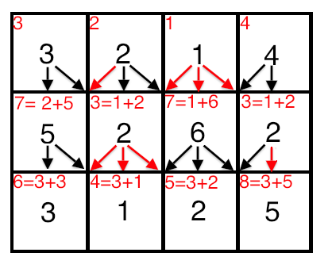
Shortest Path Algorithms Application
3.) Avidan-Shamir method
When we want to shrink an image for example in the browser
or on a smartphone without distortion
we build a huge graph: vertices are the pixels and the edges are
pointing from every vertex to its downward 3 neighbours
the energy function determines the edge weights
we can use topological order shortest path to
find the string of pixels to be removed

Slide 94
Critical Path Method (CPM) (Algorithms and Data Structures)

Slide 95
Longest Path Problem
we have discussed how to find the shortest path in a G(V,E) graph from s source vertex to a d destionation vertex
but what if we are looking for the longest path?
it is an NP-hard problem with no known polynomial running time algorithm to solve
but if the G(V,E) graph is a directed acyclic graph (DAG) then we can solve the problem in linear running time
SCHEDULING ALGORITHMS RELY HEAVILY ON LONGEST PATHS

Slide 96
Longest Path Problem
is it possible to tranform longest path problem into a shortest path problem?
we just have to negate the edge weights – multiply them by -1 and run the standard shortest path algorithms
because of the negative edge weights we have to use Bellman-Ford algorithm for finding the shortest path
it can solve the parallel job scheduling problem
given a set of V jobs with d_{i} durations and precedence constraints: schedule the jobs - by finding a start time to each - so as to achive the minimum completion time while respecting the constraints

Slide 97
Critical Path Method (CPM)
the critical path method was first used between 1940 and 1943 in the Manhattan project
the first time CPM was used for major skyscraper development was in 1966 while constructing the world trade center
we want an algorithm for scheduling a set of project activities so that the total running time will be as minimal as possible

Slide 98
Critical Path Method (CPM)
CPM ALGORITHM NEEDS:
1.) a list of all activities required to complete the project
2.) the time (duration) that each activity will take to complete
3.) the dependencies between the activities

Slide 99
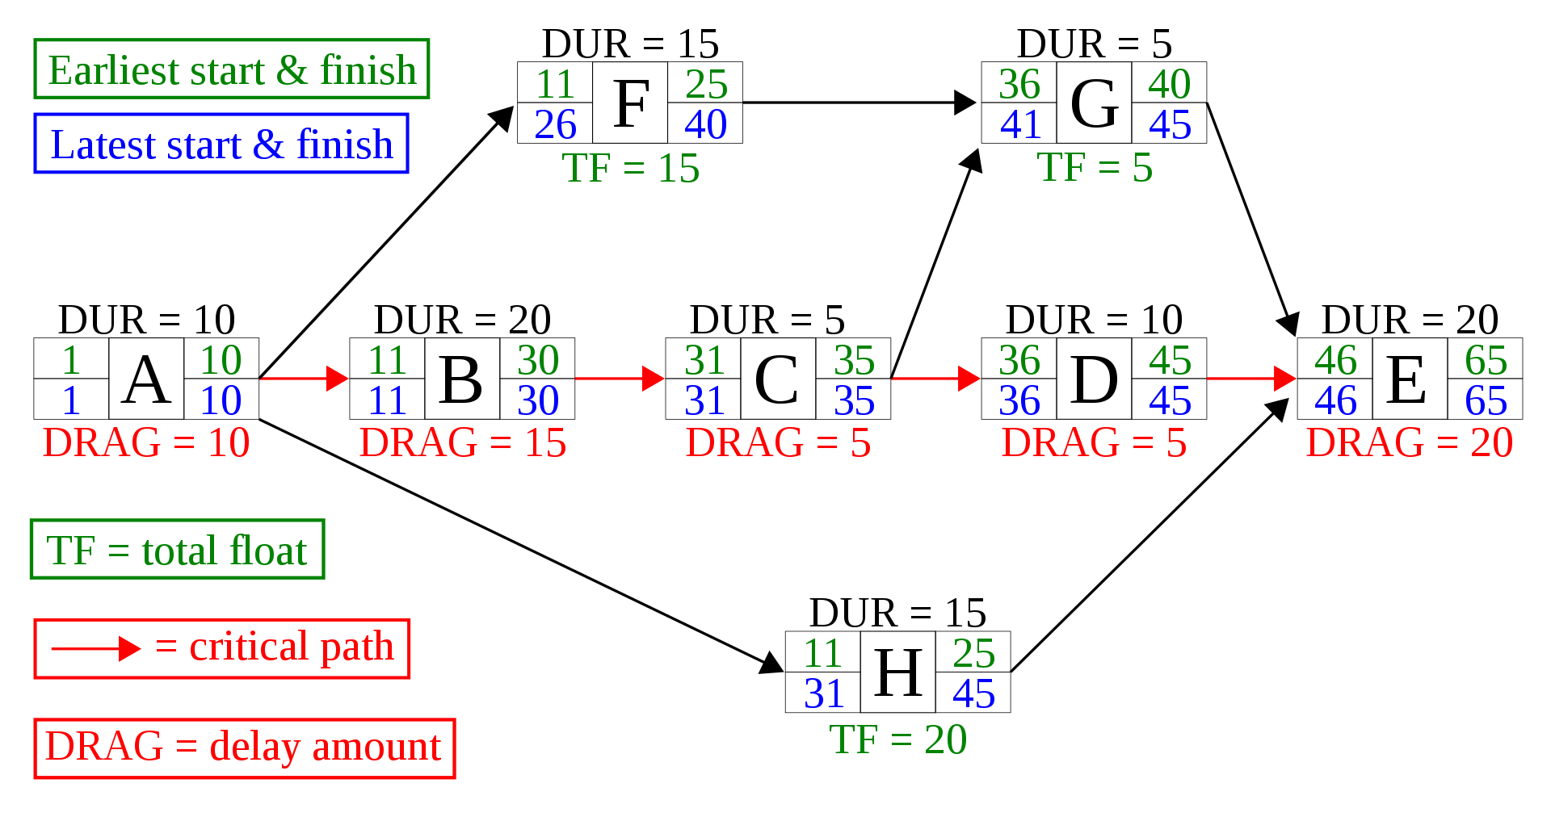
Critical Path Method (CPM)
we construct an edge weighted G(V,E) directed acyclic graph (DAG) because it can be solved in linear running time
add edges with 0 weight for each precedence constraint
we have to find the longest path in
order to solve the problem
there are no cycles in such graphs

Slide 100
Bellman-Ford Algorithm (Algorithms and Data Structures)

Slide 101
Bellman-Ford Algorithm
it was first constructed in 1958 by Bellman and Ford independently
slower than Dijkstra’s algorithm but it is more robust – it can handle negative edge weights too
Dijkstra’s algorithm chooses the edges greedely in every iteration with the lowest cost
Bellman-Ford relaxes all edges in a G(V,E) graph at the same time for V-1 iterations

Slide 102
Bellman-Ford Algorithm
Bellman-Ford relaxes all edges in a G(V,E) graph at the same time for V-1 iterations
the running time complexity is O(V*E)
there is a minor problem: because of the negtive edge weights there may be negative cycles
so it does V-1 iterations and then an extra one to detect cycles: if cost decreases in the Vth iteration than there is a negative cycle because all the paths are traversen up to the V-1 iteration

Slide 103
Bellman-Ford Algorithm
why does Bellman-Ford algorithm make V-1 iterations?
because the maximal length of a shortest path between v_{i} and v_{j} arbitrary nodes in a G(V,E) graph is |V|-1 (without cycles)
A
D
C
B
F
E

Slide 104
Bellman-Ford Algorithm
why does Bellman-Ford algorithm make V-1 iterations?
because the maximal length of a shortest path between v_{i} and v_{j} arbitrary nodes in a G(V,E) graph is |V|-1 (without cycles)
A
D
C
B
F
E

Slide 105
Bellman-Ford Algorithm
why does Bellman-Ford algorithm make V-1 iterations?
because the maximal length of a shortest path between v_{i} and v_{j} arbitrary nodes in a G(V,E) graph is |V|-1
so we know that if we make an additional iteration after V-1 iterations and the there is a change in the shortest path then there is a negative cycle in the G(V,E) graph

Slide 106
Bellman-Ford Algorithm
B
7
D
5
12
3
A
4
C
9
6
-6
9
1
G
E
F
2
4

Slide 107
Bellman-Ford Algorithm
B
7
D
5
12
3
A
4
C
9
6
-6
9
1
G
E
F
2
4
if we want to find the shortest path then
we make infinite loops in the cycle because
every loop decreases the total cost

Slide 108
Bellman-Ford Algorithm
for {v₁ v₂ ... v_{n}} all nodes in G(V,E):
for each edge (u,v) with weight w in edges
dist = distance[u] + w
if dist < distance[v]
distance[v] = dist
predecessor[v] = u
for each edge (u,v) with weight w in edges
if distance[u] + w < distance[v]
error: „Negative cycle detected”

Slide 109
Bellman-Ford Algorithm
for {v₁ v₂ ... v_{n}} all nodes in G(V,E):
for each edge (u,v) with weight w in edges
dist = distance[u] + w
if dist < distance[v]
distance[v] = dist
predecessor[v] = u
for each edge (u,v) with weight w in edges
if distance[u] + w < distance[v]
error: „Negative cycle detected”
consider all the v_{i} nodes in the G(V,E) graph
in O(V) running time

Slide 110
Bellman-Ford Algorithm
for {v₁ v₂ ... v_{n}} all nodes in G(V,E):
for each edge (u,v) with weight w in edges
dist = distance[u] + w
if dist < distance[v]
distance[v] = dist
predecessor[v] = u
for each edge (u,v) with weight w in edges
if distance[u] + w < distance[v]
error: „Negative cycle detected”
in every iteration we consider all the (u,v) edges
with w edge weight in O(E) running time

Slide 111
Bellman-Ford Algorithm
for {v₁ v₂ ... v_{n}} all nodes in G(V,E):
for each edge (u,v) with weight w in edges
dist = distance[u] + w
if dist < distance[v]
distance[v] = dist
predecessor[v] = u
for each edge (u,v) with weight w in edges
if distance[u] + w < distance[v]
error: „Negative cycle detected”
this is the so-called RELAXATION
we calculate the possible shortest paths
to the given nodes in O(1) running time

Slide 112
Bellman-Ford Algorithm
for {v₁ v₂ ... v_{n}} all nodes in G(V,E):
for each edge (u,v) with weight w in edges
dist = distance[u] + w
if dist < distance[v]
distance[v] = dist
predecessor[v] = u
for each edge (u,v) with weight w in edges
if distance[u] + w < distance[v]
error: „Negative cycle detected”
after making V-1 iterations we have
found even the longest shortest path
so we make an additional loop to check
negative cycles in O(E) running time

Slide 113
Bellman-Ford Algorithm
for {v₁ v₂ ... v_{n}} all nodes in G(V,E):
for each edge (u,v) with weight w in edges
dist = distance[u] + w
if dist < distance[v]
distance[v] = dist
predecessor[v] = u
for each edge (u,v) with weight w in edges
if distance[u] + w < distance[v]
error: „Negative cycle detected”
RUNNGINT TIME ANALYSIS
O(V) * [ O(E) * O(1) ] + O(E) =
O(V) * O(E) + O(E) =
O(V*E) + O(E) =
O(V*E)

Slide 114
Bellman-Ford Algorithm
there may be a slight optimization for Bellman-Ford algorithm
it was first introduced by Yen back in 1970
we can terminate the algorithm if there is no change in the distances between two iterations (in the relaxation phases)
we use the same technique in bubble sort

Slide 115
Bellman-Ford Algorithm (Algorithms and Data Structures)

Slide 116
Bellman-Ford Algorithm
B
5
A
4
12
C
8
7
H
1
9
6
5
F
4
E

Slide 117
Bellman-Ford Algorithm
∞
B
5
0
∞
A
4
12
C
8
7
∞
H
1
9
6
∞
5
F
4
E
∞

Slide 118
Bellman-Ford Algorithm
ITERATION #1

Slide 119
Bellman-Ford Algorithm
∞
B
5
0
∞
A
4
12
C
8
7
∞
H
1
9
6
∞
5
F
4
E
∞

Slide 120
Bellman-Ford Algorithm
∞
B
5
0
∞
A
4
12
C
8
7
∞
H
1
9
6
∞
5
F
4
E
∞

Slide 121
Bellman-Ford Algorithm
∞
B
5
0
∞
A
4
12
C
8
7
∞
H
1
9
6
∞
5
F
4
E
∞

Slide 122
Bellman-Ford Algorithm
∞
B
5
0
∞
A
4
12
C
8
7
∞
H
1
9
6
∞
5
F
4
E
∞

Slide 123
Bellman-Ford Algorithm
∞
B
5
0
∞
A
4
12
C
8
7
∞
H
1
9
6
∞
5
F
4
E
∞

Slide 124
Bellman-Ford Algorithm
∞
B
5
0
∞
A
4
12
C
8
7
∞
H
1
9
6
∞
5
F
4
E
∞

Slide 125
Bellman-Ford Algorithm
∞
B
5
0
∞
A
4
12
C
8
7
∞
H
1
9
6
∞
5
F
4
E
∞

Slide 126
Bellman-Ford Algorithm
5
B
5
0
∞
A
4
12
C
8
7
∞
H
1
9
6
∞
5
F
4
E
∞

Slide 127
Bellman-Ford Algorithm
5
B
5
0
∞
A
4
12
C
8
7
8
H
1
9
6
∞
5
F
4
E
∞

Slide 128
Bellman-Ford Algorithm
5
B
5
0
∞
A
4
12
C
8
7
8
H
1
9
6
∞
5
F
4
E
9

Slide 129
Bellman-Ford Algorithm
5
B
5
0
∞
A
4
12
C
8
7
8
H
1
9
6
∞
5
F
4
E
9

Slide 130
Bellman-Ford Algorithm
ITERATION #2

Slide 131
Bellman-Ford Algorithm
5
B
5
0
17
A
4
12
C
8
7
8
H
1
9
6
∞
5
F
4
E
9

Slide 132
Bellman-Ford Algorithm
5
B
5
0
15
A
4
12
C
8
7
8
H
1
9
6
∞
5
F
4
E
9

Slide 133
Bellman-Ford Algorithm
5
B
5
0
15
A
4
12
C
8
7
8
H
1
9
6
∞
5
F
4
E
9

Slide 134
Bellman-Ford Algorithm
5
B
5
0
15
A
4
12
C
8
7
8
H
1
9
6
5
F
14
4
E
9

Slide 135
Bellman-Ford Algorithm
5
B
5
0
15
A
4
12
C
8
7
8
H
1
9
6
5
F
13
4
E
9

Slide 136
Bellman-Ford Algorithm
5
B
5
0
15
A
4
12
C
8
7
8
H
1
9
6
5
F
13
4
E
9

Slide 137
Bellman-Ford Algorithm
5
B
5
0
15
A
4
12
C
8
7
8
H
1
9
6
5
F
13
4
E
9

Slide 138
Bellman-Ford Algorithm
5
B
5
0
15
A
4
12
C
8
7
8
H
1
9
6
5
F
13
4
E
9

Slide 139
Bellman-Ford Algorithm
5
B
5
0
15
A
4
12
C
8
7
8
H
1
9
6
5
F
13
4
E
9

Slide 140
Bellman-Ford Algorithm
5
B
5
0
15
A
4
12
C
8
7
8
H
1
9
6
5
F
13
4
E
9

Slide 141
Bellman-Ford Algorithm
5
B
5
0
15
A
4
12
C
8
7
8
H
1
9
6
5
F
13
4
E
9

Slide 142
Bellman-Ford Algorithm
ITERATION #3

Slide 143
Bellman-Ford Algorithm
5
B
5
0
15
A
4
12
C
8
7
8
H
1
9
6
5
F
13
4
E
9

Slide 144
Bellman-Ford Algorithm
5
B
5
0
15
A
4
12
C
8
7
8
H
1
9
6
5
F
13
4
E
9

Slide 145
Bellman-Ford Algorithm
5
B
5
0
15
A
4
12
C
8
7
8
H
1
9
6
5
F
13
4
E
9

Slide 146
Bellman-Ford Algorithm
5
B
5
0
15
A
4
12
C
8
7
8
H
1
9
6
5
F
13
4
E
9

Slide 147
Bellman-Ford Algorithm
5
B
5
0
14
A
4
12
C
8
7
8
H
1
9
6
5
F
13
4
E
9

Slide 148
Bellman-Ford Algorithm
5
B
5
0
14
A
4
12
C
8
7
8
H
1
9
6
5
F
13
4
E
9

Slide 149
Bellman-Ford Algorithm
5
B
5
0
14
A
4
12
C
8
7
8
H
1
9
6
5
F
13
4
E
9

Slide 150
Bellman-Ford Algorithm
5
B
5
0
14
A
4
12
C
8
7
8
H
1
9
6
5
F
13
4
E
9

Slide 151
Bellman-Ford Algorithm
5
B
5
0
14
A
4
12
C
8
7
8
H
1
9
6
5
F
13
4
E
9

Slide 152
Bellman-Ford Algorithm
5
B
5
0
14
A
4
12
C
8
7
8
H
1
9
6
5
F
13
4
E
9

Slide 153
Bellman-Ford Algorithm
5
B
5
0
14
A
4
12
C
8
7
8
H
1
9
6
5
F
13
4
E
9

Slide 154
Bellman-Ford Algorithm
5
B
5
0
14
A
4
12
C
8
7
8
H
1
9
6
5
F
13
4
E
9

Slide 155
Bellman-Ford Algorithm
ITERATION #4

Slide 156
Bellman-Ford Algorithm
5
B
5
0
14
A
4
12
C
8
7
8
H
1
9
6
5
F
13
4
E
9

Slide 157
Bellman-Ford Algorithm
5
B
5
0
14
A
4
12
C
8
7
8
H
1
9
6
5
F
13
4
E
9

Slide 158
Bellman-Ford Algorithm
5
B
5
0
14
A
4
12
C
8
7
8
H
1
9
6
5
F
13
4
E
9

Slide 159
Bellman-Ford Algorithm
5
B
5
0
14
A
4
12
C
8
7
8
H
1
9
6
5
F
13
4
E
9

Slide 160
Bellman-Ford Algorithm
5
B
5
0
14
A
4
12
C
8
7
8
H
1
9
6
5
F
13
4
E
9

Slide 161
Bellman-Ford Algorithm
5
B
5
0
14
A
4
12
C
8
7
8
H
1
9
6
5
F
13
4
E
9

Slide 162
Bellman-Ford Algorithm
5
B
5
0
14
A
4
12
C
8
7
8
H
1
9
6
5
F
13
4
E
9

Slide 163
Bellman-Ford Algorithm
5
B
5
0
14
A
4
12
C
8
7
8
H
1
9
6
5
F
13
4
E
9

Slide 164
Bellman-Ford Algorithm
5
B
5
0
14
A
4
12
C
8
7
8
H
1
9
6
5
F
13
4
E
9

Slide 165
Bellman-Ford Algorithm
5
B
5
0
14
A
4
12
C
8
7
8
H
1
9
6
5
F
13
4
E
9

Slide 166
Bellman-Ford Algorithm
5
B
5
0
14
A
4
12
C
8
7
8
H
1
9
6
5
F
13
4
E
9

Slide 167
Bellman-Ford Algorithm
ITERATION #5

Slide 168
Bellman-Ford Algorithm
5
B
5
0
14
A
4
12
C
8
7
8
H
1
9
6
5
F
13
4
E
9

Slide 169
Bellman-Ford Algorithm
5
B
5
0
14
A
4
12
C
8
7
8
H
1
9
6
5
F
13
4
E
9

Slide 170
Bellman-Ford Algorithm
5
B
5
0
14
A
4
12
C
8
7
8
H
1
9
6
5
F
13
4
E
9

Slide 171
Bellman-Ford Algorithm
5
B
5
0
14
A
4
12
C
8
7
8
H
1
9
6
5
F
13
4
E
9

Slide 172
Bellman-Ford Algorithm
5
B
5
0
14
A
4
12
C
8
7
8
H
1
9
6
5
F
13
4
E
9

Slide 173
Bellman-Ford Algorithm
5
B
5
0
14
A
4
12
C
8
7
8
H
1
9
6
5
F
13
4
E
9

Slide 174
Bellman-Ford Algorithm
5
B
5
0
14
A
4
12
C
8
7
8
H
1
9
6
5
F
13
4
E
9

Slide 175
Bellman-Ford Algorithm
5
B
5
0
14
A
4
12
C
8
7
8
H
1
9
6
5
F
13
4
E
9

Slide 176
Bellman-Ford Algorithm
5
B
5
0
14
A
4
12
C
8
7
8
H
1
9
6
5
F
13
4
E
9

Slide 177
Bellman-Ford Algorithm
5
B
5
0
14
A
4
12
C
8
7
8
H
1
9
6
5
F
13
4
E
9

Slide 178
Bellman-Ford Algorithm
5
B
5
0
14
A
4
12
C
8
7
8
H
1
9
6
5
F
13
4
E
9

Slide 179
Bellman-Ford Algorithm
5
B
5
0
14
A
4
12
C
8
7
8
H
1
9
6
5
F
13
4
E
9

Slide 180
Bellman-Ford Algorithm
5
B
5
0
14
A
4
12
C
8
7
8
H
1
9
6
5
F
13
4
E
9

Slide 181
Greedy vs Dynamic Programming (Algorithms and Data Structures)

Slide 182
Greedy Algorithms and Dynamic Programming
GREEDY ALGORITHM is an algorithmic paradigm that constructs the final solution by choosing the best option possible in every iteration
It combines locally optimal solutions to get the global solution (final result)
DYNAMIC PROGRAMMING is an algorithmic paradigm that avoids recalculating the same problems over and over again
It uses extra memory (memoization or tabulation) to store the subresults

Slide 183
Dynamic Programming Paradigm
dynamic programming is both an optimization technique and a computer programming method
it was introduced by Richard Bellman in 1953
the main idea is that we can break down complicated problems into smaller subproblems usually in a recursive manner
then we find the solutions for these subproblems and finally we combine the subresults to find the final solution

Slide 184
Dynamic Programming Paradigm
We can apply dynamic programming approach if the problem has the following features:
1.) OPTIMAL SUBSTRUCTURE
In computer science a problem is said to have optimal substructure if an optimal solution can be constructed from optimal solutions of its subproblems
2.) OVERLAPPING SUBPROBLEMS
The given subproblems are not independent of each other

Slide 185
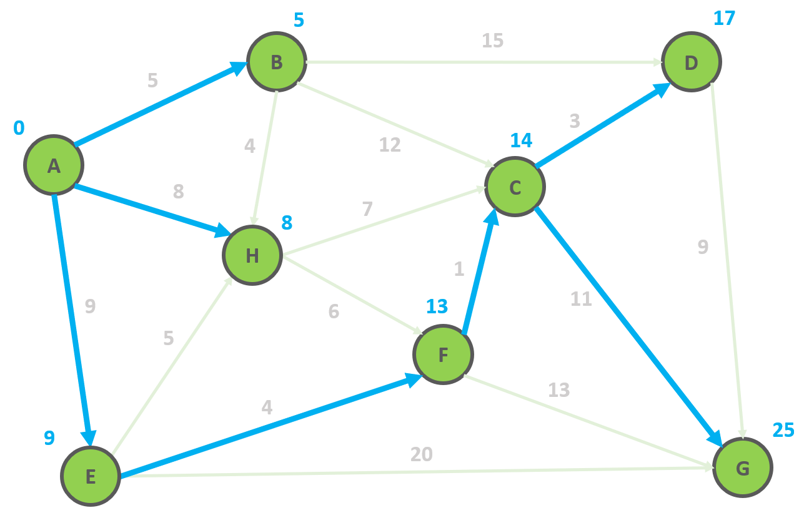
Dynamic Programming Paradigm
finding the shortest paths to vertex G and to vertex C
are not independent of each other
δ(A,G) = δ(A,C) + δ(C,G)
if a vertex x lies in the shortest path from A source
to G destination then the shortest path δ(A,G)
is the combination of shortest
path from A to x and shortest path from x to G

