Slide 1
Meta-Heuristics
(Algorithms and Data Structures)

Slide 2
Meta-Heuristics
there are several algorithms and optimization problems that are NP-hard or NP-complete
these problems usually have a huge search space – so there are way to many possible states to consider one by one

Slide 3
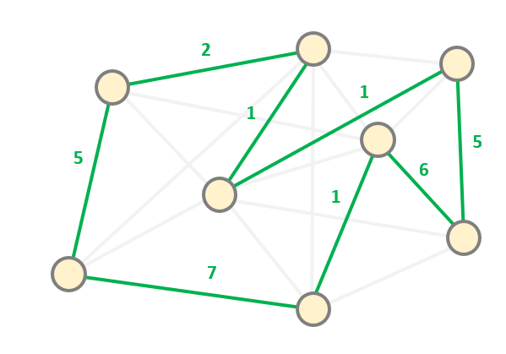
Meta-Heuristics
there are several algorithms and optimization problems that are NP-hard or NP-complete
these problems usually have a huge search space – so there are way to many possible states to consider one by one
for example the travelling salesman problem
has O(N!) different permutations so the size of the
search space is enormous

Slide 4
Meta-Heuristics
there algorithms that solve these NP-complete problems have factorial O(N!) or exponential O(2^{N}) running time complexity
this is way too slow for practical applications
BUT THESE PROBLEMS ARE QUITE COMMON

Slide 5
Meta-Heuristics
EXACT SOLUTIONS
APPROXIMATE SOLUTIONS
most of the NP-complete and NP-hard
problems have exponential (or factorial) search
space and this is why the calculations take so long
THE PROBLEM IS THAT WE WANT TO GET
THE EXACT SOLUTION !!!
we do not want to get the exact solution
but we want to get it as fast as possible
META-HEURISTICS ARE PROBLEM INDEPENDENT
ALGORITHMS THAT USUALLY FIND THE
LOCAL OPTIMUM BUT WAY FASTER THAN
THE STANDARD APPROACHES !!!

Slide 6
Meta-Heuristics
approximate solution but
it can be found quite fast
(META-HEURISTICS)
f(x)
exact solution of the
problem but takes too
much time to find
x

Slide 7
Meta-Heuristics
1.) GENETIC ALGORITHMS
approximate solution but
it can be found quite fast
(META-HEURISTICS)
f(x)
exact solution of the
problem but takes too
much time to find
x

Slide 8
Meta-Heuristics
1.) GENETIC ALGORITHMS
2.) SIMULATE ANNEALING
approximate solution but
it can be found quite fast
(META-HEURISTICS)
f(x)
exact solution of the
problem but takes too
much time to find
x

Slide 9
Meta-Heuristics
1.) GENETIC ALGORITHMS
2.) SIMULATE ANNEALING
3.) TABU SEARCH
approximate solution but
it can be found quite fast
(META-HEURISTICS)
f(x)
exact solution of the
problem but takes too
much time to find
x

Slide 10
Meta-Heuristics
1.) GENETIC ALGORITHMS
2.) SIMULATE ANNEALING
3.) TABU SEARCH
approximate solution but
it can be found quite fast
(META-HEURISTICS)
4.) SWARM OPTIMIZATION
f(x)
exact solution of the
problem but takes too
much time to find
x

