Slide 1
SPRINT
MAIN PROJECT
COHORT :
GROUP N0 : 4

Slide 2
TEAM MEMBERS:

Slide 3
KEY AUTOMATION SCOPE:
1) Handling browser window
2) Navigating to the required page (with the help of URL)
3) Creating and saving details of sprint, Team, Releases
4) Filling forms and saving the details
5) Capture warning message

Slide 4
PREREQUISITES:
Website Used:
https://pratesting.cognizant.com/
Software's Used:
Eclipse – Integrated Development Environment for various ‘Languages’.
Java – High level Programming Language.
Selenium – Portable Framework for testing Web Applications and automating the testing process.

Slide 5
TOOLS AND FRAMEWORKS USED:
TestNG – Open source testing framework to cover all categories of tests: unit, functional, end-to-end, integration, etc..
Maven – Software for Building and project Management Tool.
POM – Object repository design pattern to help Maven to build projects.
Apache POI – It is a POI library written in Java that gives users an API for manipulating Microsoft document.
Cucumber– To run functional tests written in a plain text Cucumber tool is used. It is written in a Ruby programming language.

Slide 6
TESTING FLOW FOR USER INTERFACE SPRINT AUTOMATION:
Open Browser and load the URL
Login using the cognizant credentials
Hover over the Hamburger icon Under the Project/Program, select COF_onsite
Enter with blank input data, click on save
Enter all the valid data save the page
Select Sprint Under Plan
Capture the Screenshot
Close the Browser

Slide 7
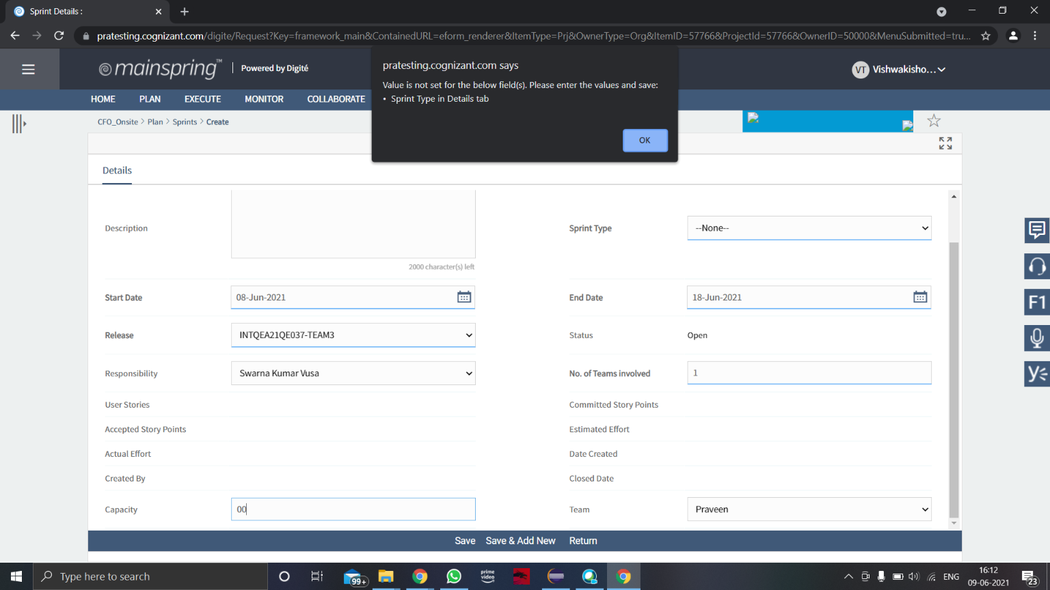
OUTPUT :

Slide 8
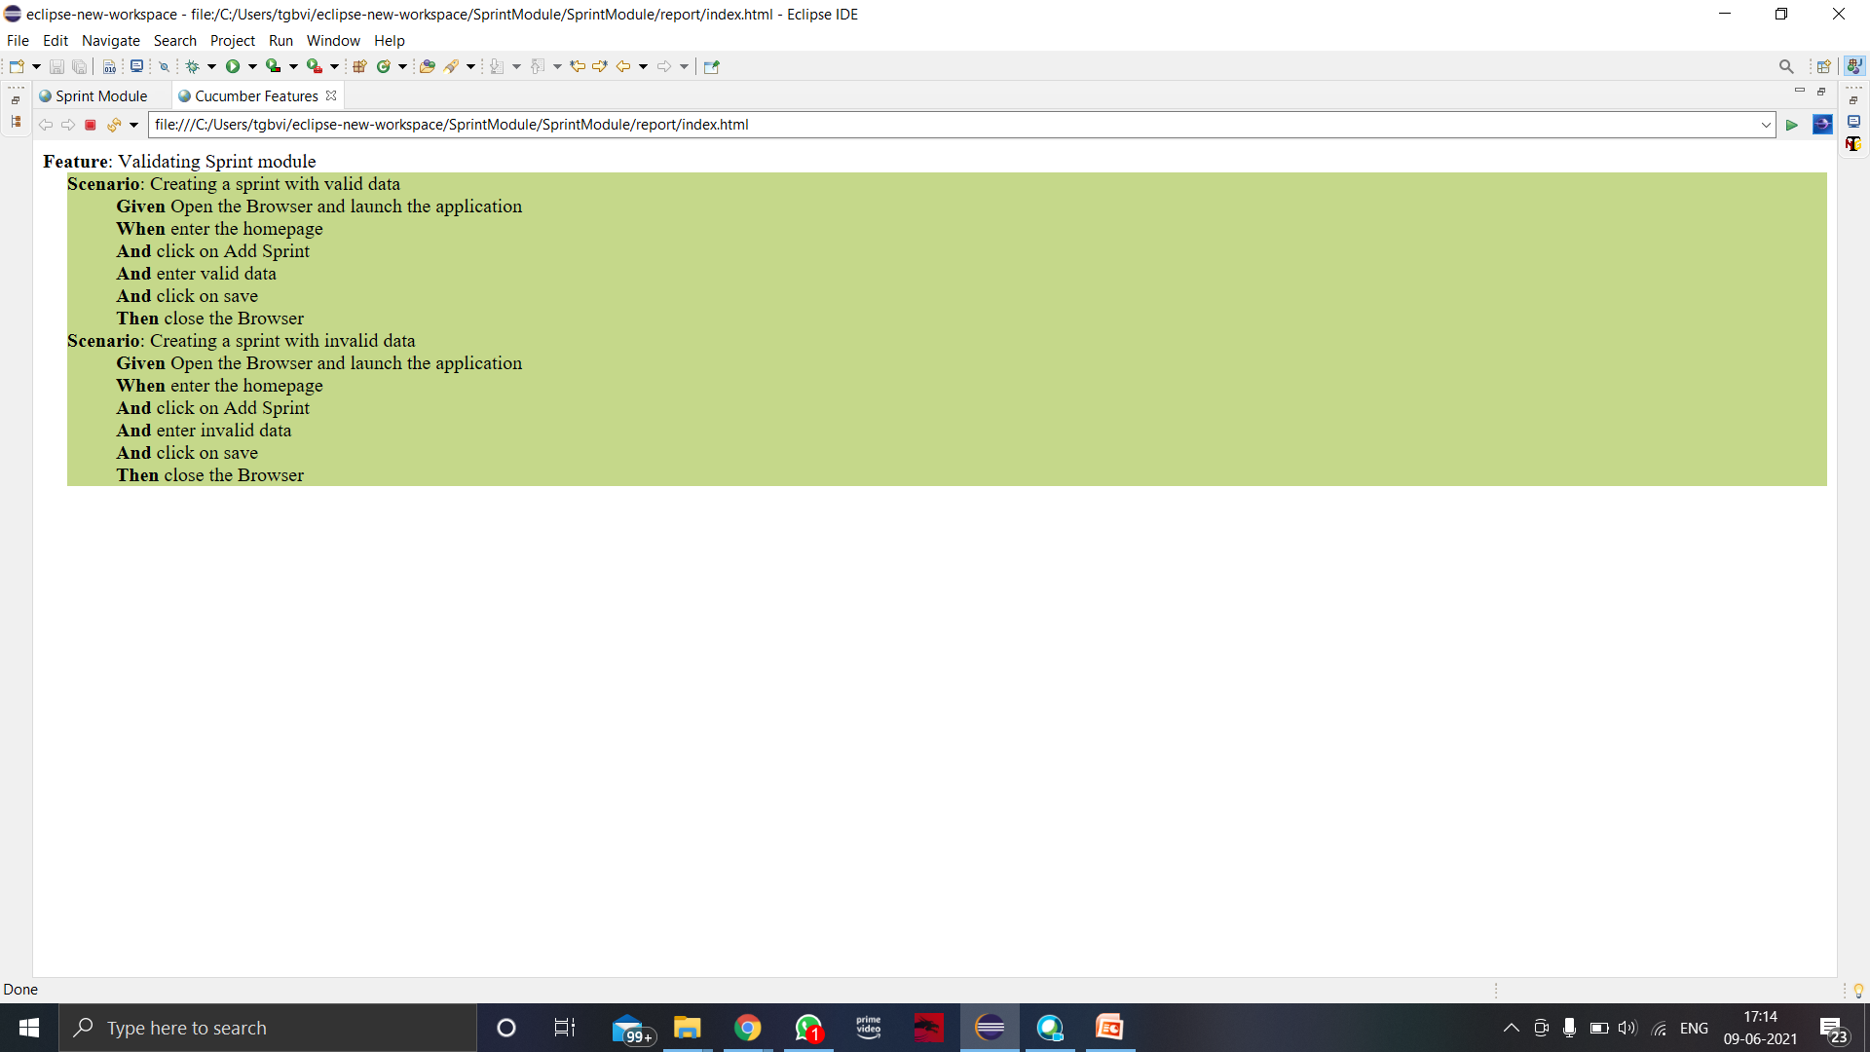
REPORT:

Slide 9
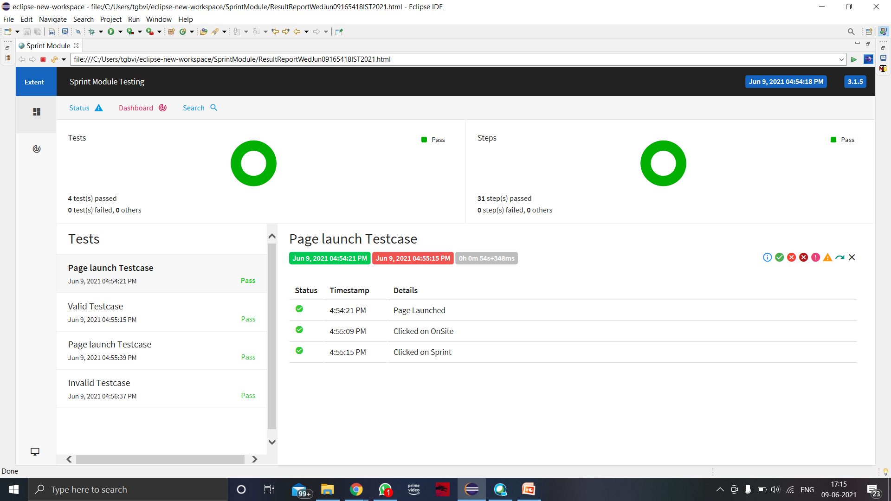

Slide 10
THANK YOU

