Slide 1
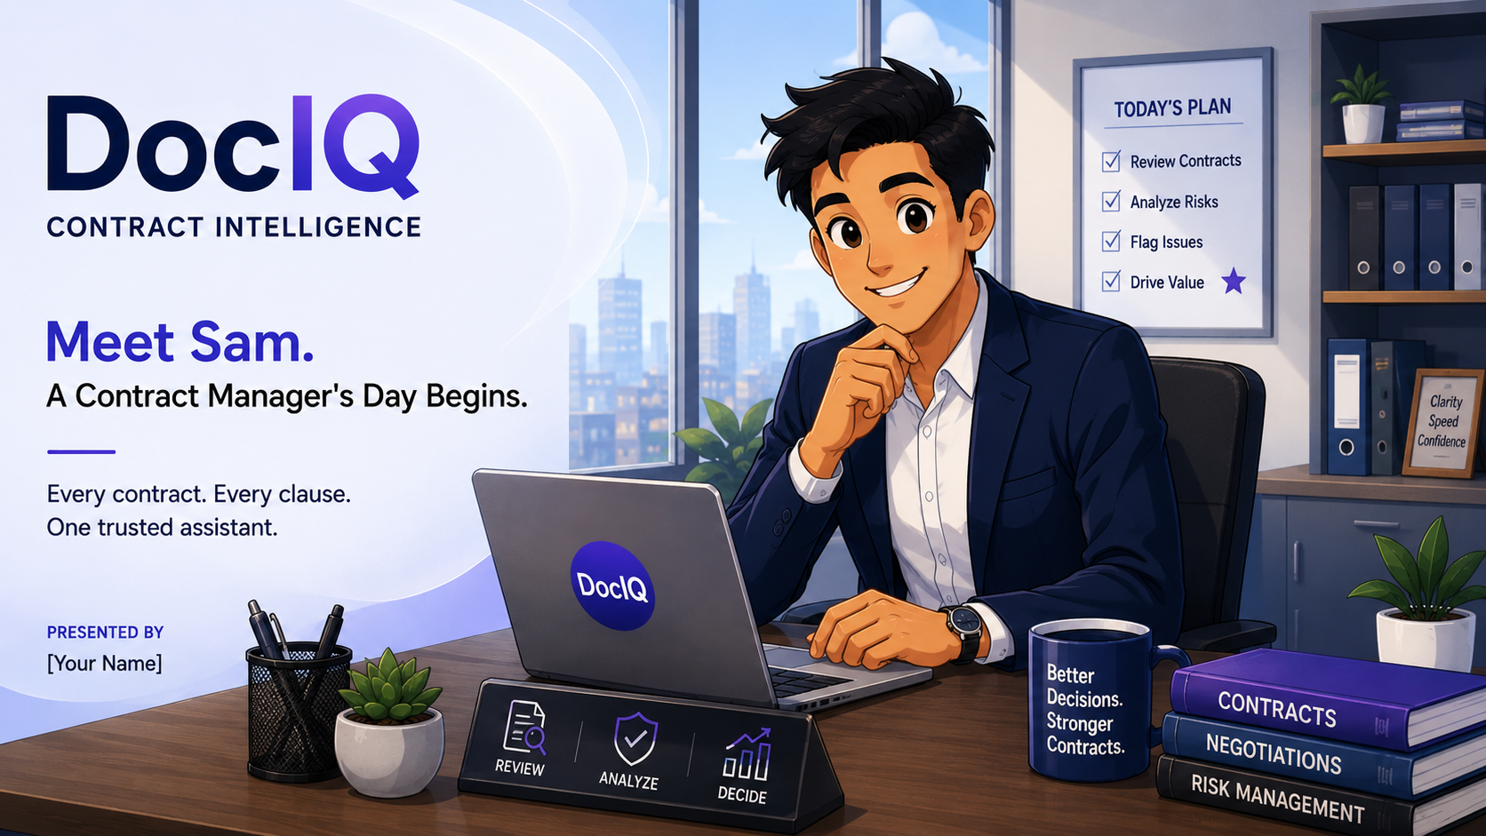
DOCIQ · CONTRACT INTELLIGENCE
Meet Sam.
A Contract Manager's
Day Begins.
Every contract. Every clause. One trusted assistant.

Slide 2
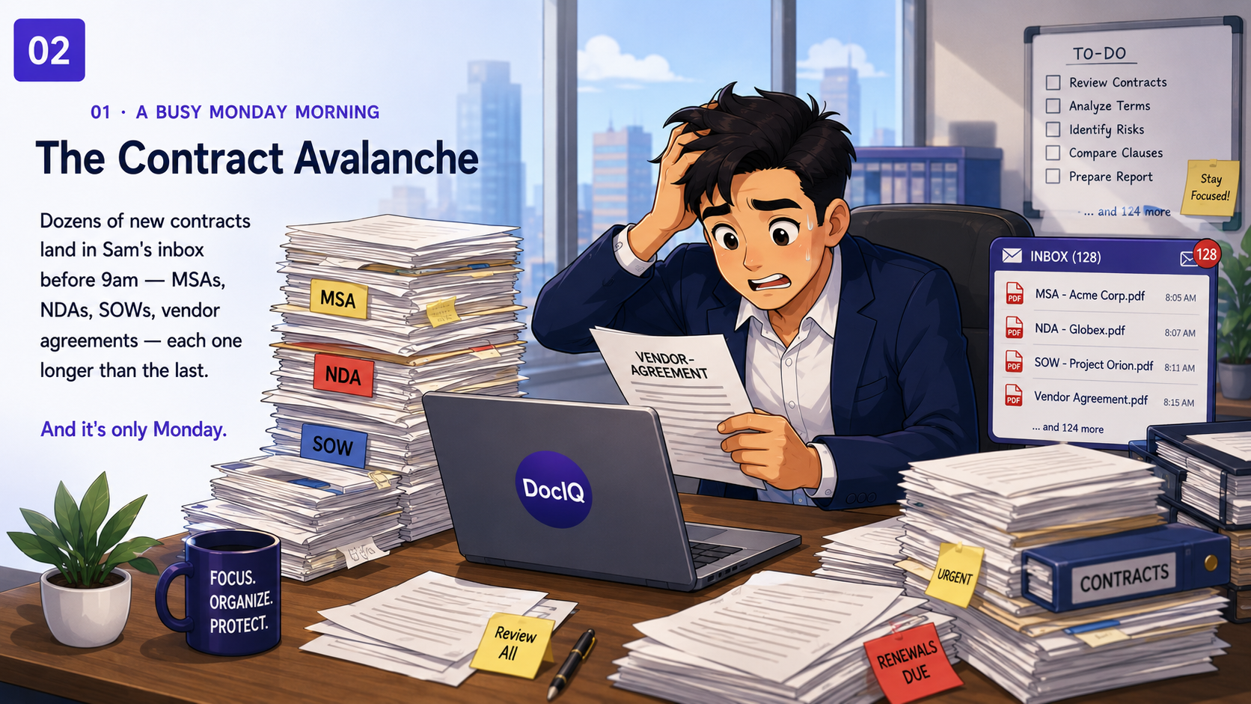
01 · A BUSY MONDAY MORNING
The Contract Avalanche
Dozens of new contracts land in Sam's inbox before 9am — MSAs, NDAs, SOWs, vendor agreements — each one longer than the last.
And it's only Monday.
02

Slide 3
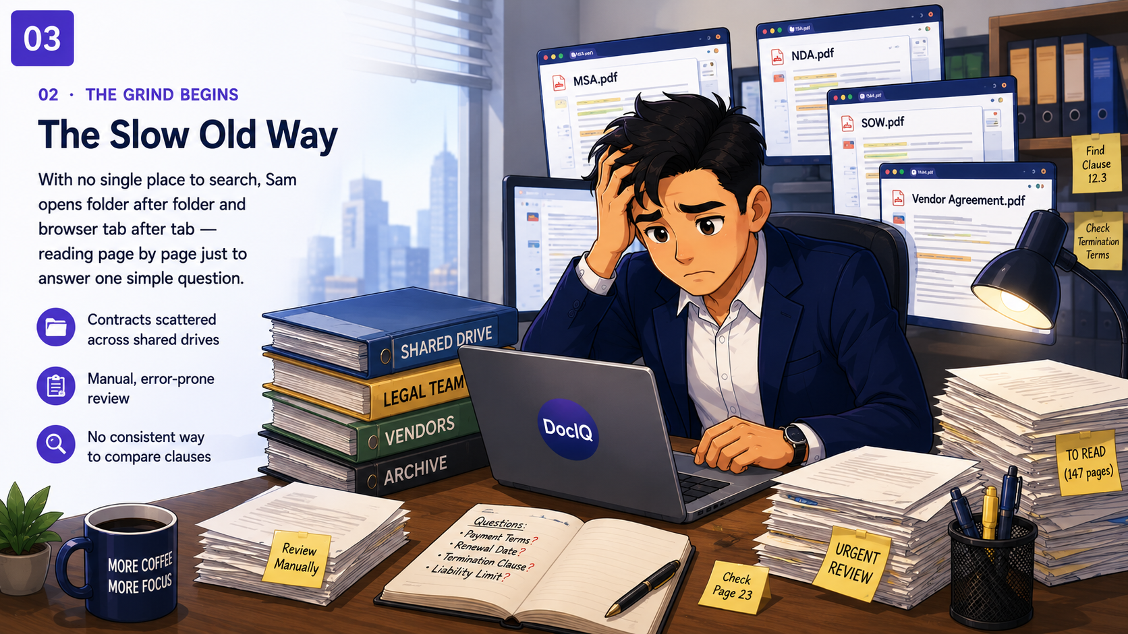
02 · THE GRIND BEGINS
The Slow Old Way
With no single place to search, Sam opens folder after folder
and browser tab after tab — reading page by page just to answer one simple question.
Contracts scattered across shared drives
Manual, error-prone review
No consistent way to compare clauses
03

Slide 4
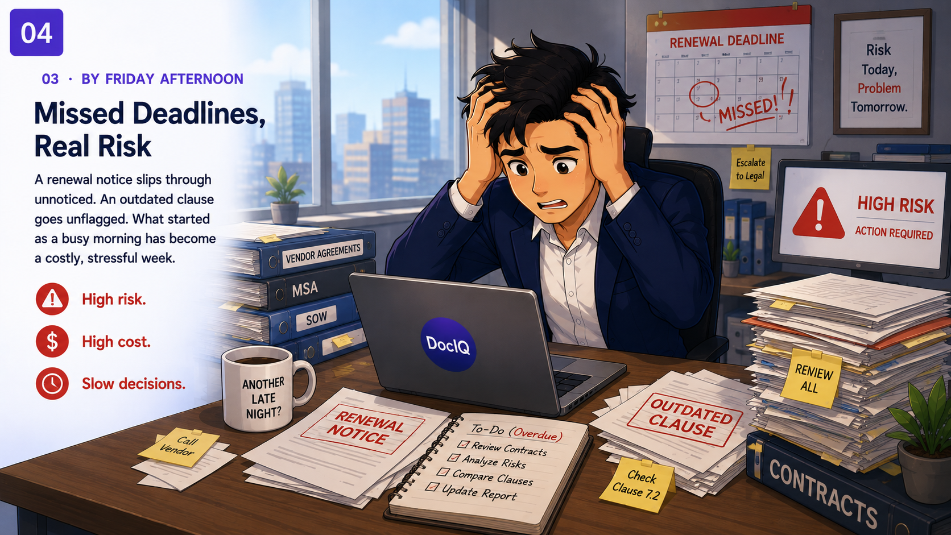
03 · BY FRIDAY AFTERNOON
Missed Deadlines, Real Risk
A renewal notice slips through unnoticed.
An outdated clause goes unflagged. What started as a
busy morning has become a costly, stressful week.
High risk. High cost. Slow decisions.
04

Slide 5
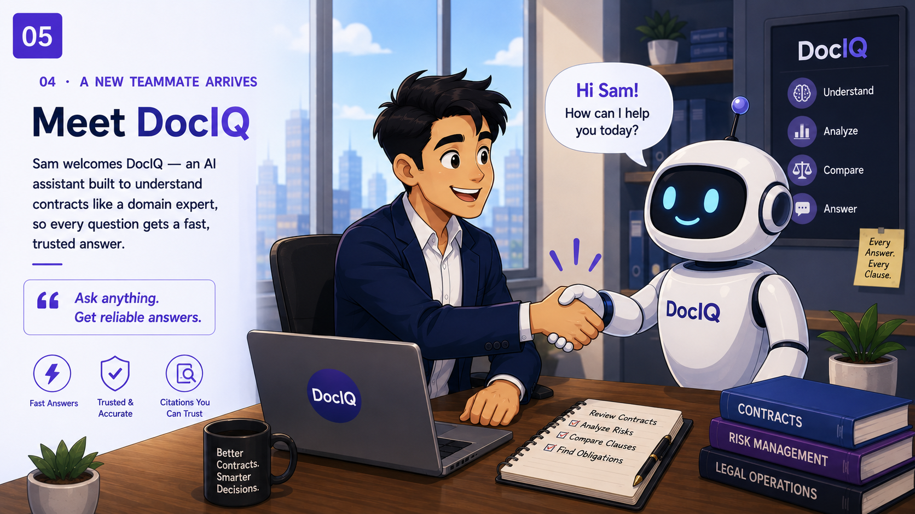
04 · A NEW TEAMMATE ARRIVES
Meet DocIQ
Sam welcomes DocIQ — an AI assistant built to understand contracts like a domain expert, so every question gets a fast, trusted answer.
“Ask anything. Get reliable answers.”
05

Slide 6
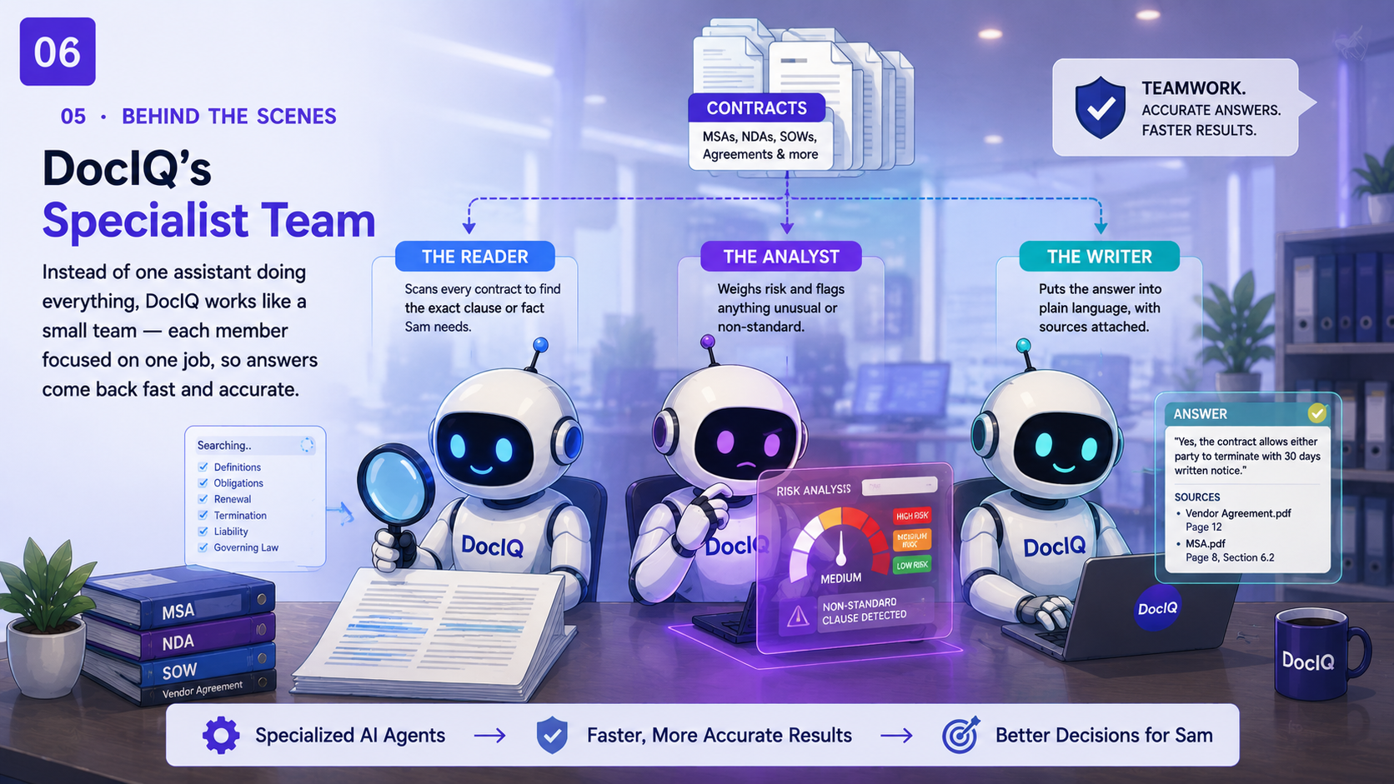
05 · GETTING STARTED
One-Click Upload
Sam simply drops the contracts in
From there, DocIQ takes over quietly organizing everything
so it's ready to search in moments.
1
Upload
Contracts added as simple PDF files.
2
Organize
DocIQ reads, sorts and safely files everything.
3
Secure Storage
Originals are protected; nothing sits around unprotected.
4
Ready to Chat
Sam can start asking questions right away.
06

Slide 7
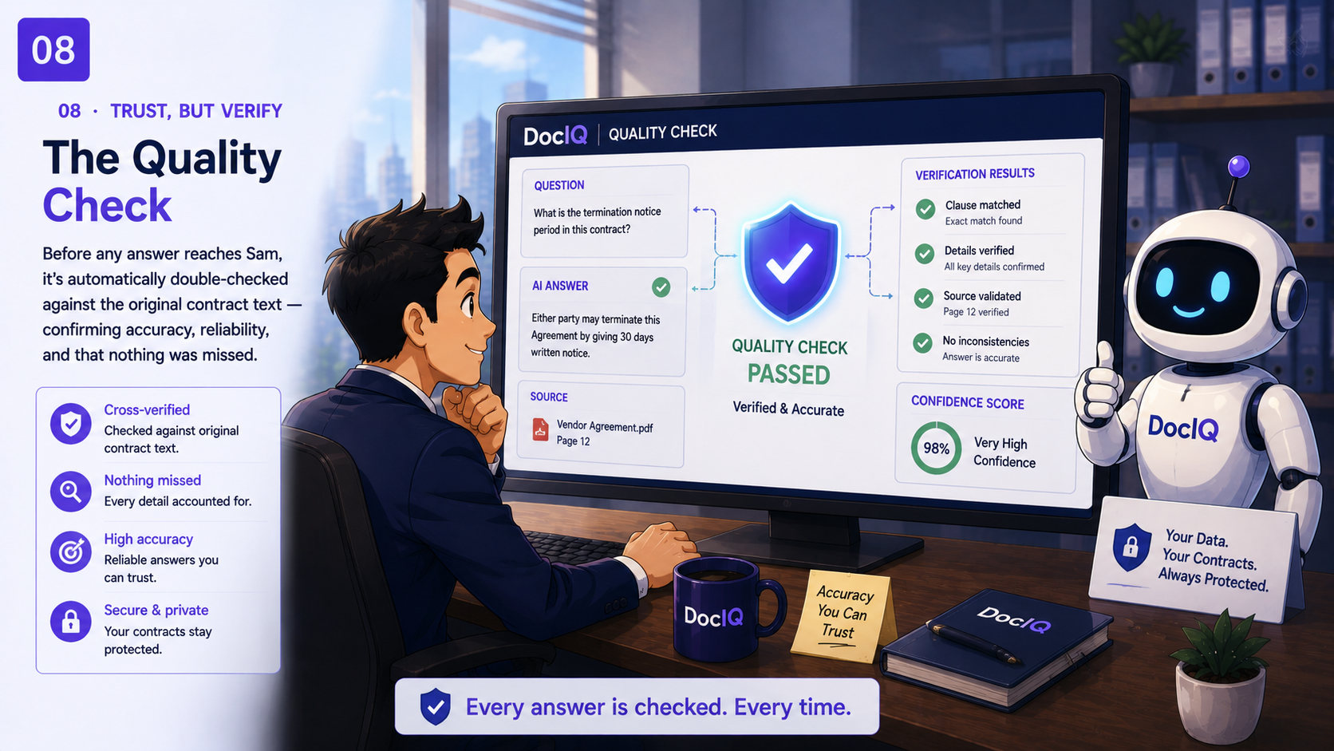
06 · TRUST, BUT VERIFY
The Quality Check
Before any answer reaches Sam, it's automatically double-checked against the original contract text — confirming accuracy, reliability,
and that nothing was missed.
09

Slide 8
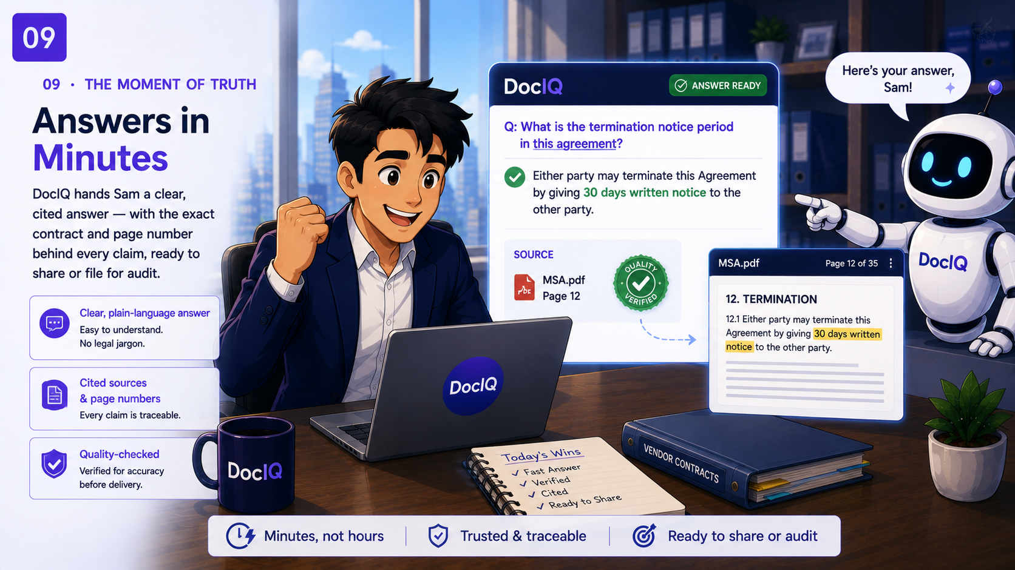
07 · THE MOMENT OF TRUTH
Answers in Minutes
DocIQ hands Sam a clear, cited answer — with the exact contract and page number behind every claim, ready to share or file for audit.
Clear, plain-language answer
Cited sources & page numbers
Quality-checked before delivery
10

Slide 9
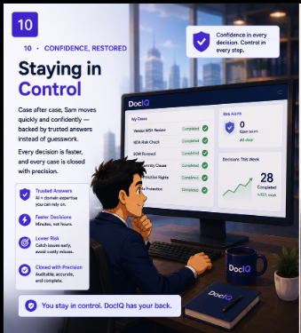
08· CONFIDENCE, RESTORED
Staying in Control
Case after case, Sam moves quickly and confidently — backed by trusted answers instead of guesswork. Every decision is faster, and every case is closed with precision.
11

Slide 10
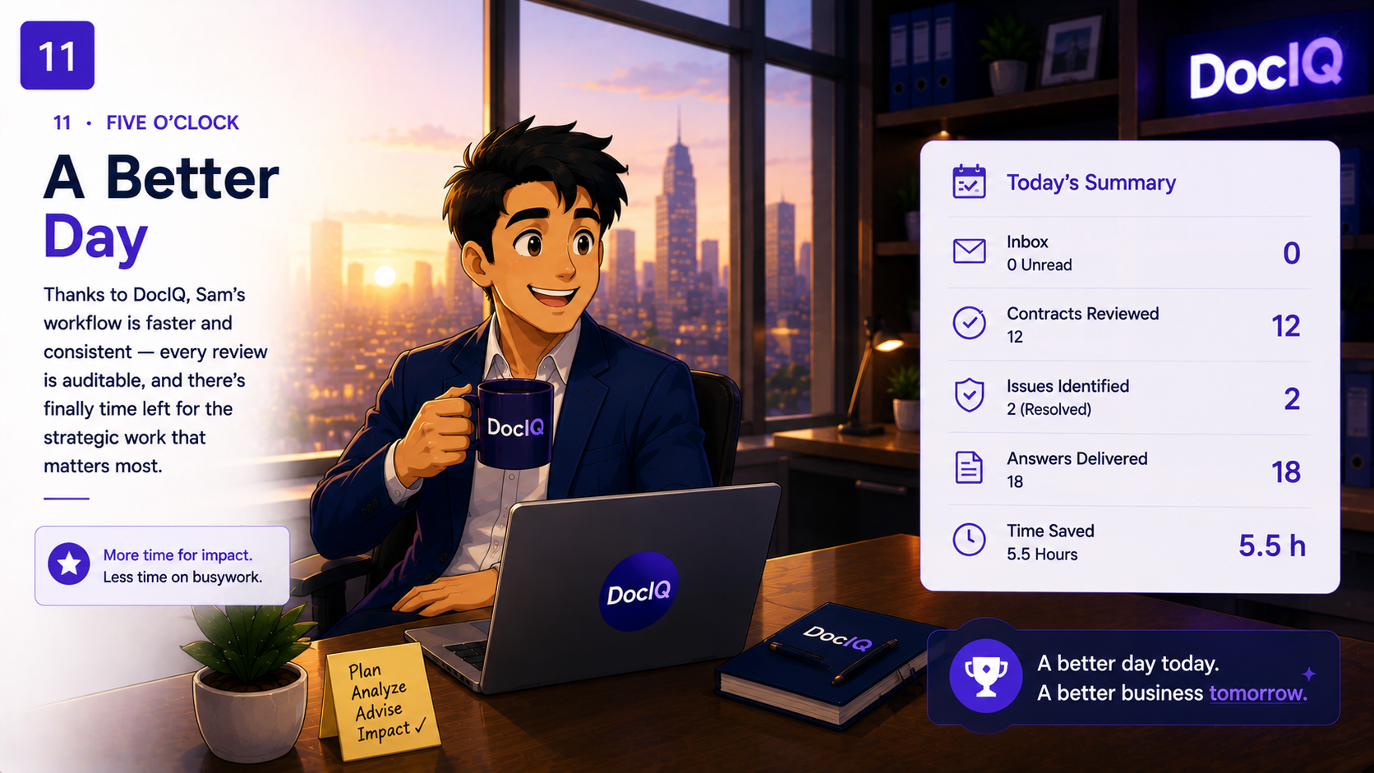
09· FIVE O'CLOCK
A Better Day
Thanks to DocIQ, Sam's workflow is faster and consistent
every review is auditable, and there's finally time left for the strategic work that matters most.
12

Slide 11


Stop Searching.
Start Deciding.
18

