Slide 1

EduTrack

Slide 2
Our Team
01
MANOJ MAURYA
02
DHRUV KUSHVAHA
03
ANKIT PRAJAPATI

Slide 3
Problem Statement
The education system is an essential pillar of society, and schools play a vital role in shaping young minds. However, managing a school’s data smoothly can be a challenging task. Traditional paper-based methods for attendance tracking, grade management, student information storage, and teacher-subject allocation can be complex and Problematic. Additionally, communication between teachers, students, and administrators often suffers due to a lack of streamlined systems.

Slide 4


Technologies Used
Python
MySQL
Library like Customtkinter, ttk, pymysql for making an attractive and responsive user interface.
For saving, extracting and updating the data with relational operations

Slide 5




Modules Included
Login/Sign up
Admin
Student
Teacher
To validate relevant and authentic users
To coordinate and manage the school data and work flow
To give access of software features to student
To give access of attendance and other features to teachers.

Slide 6
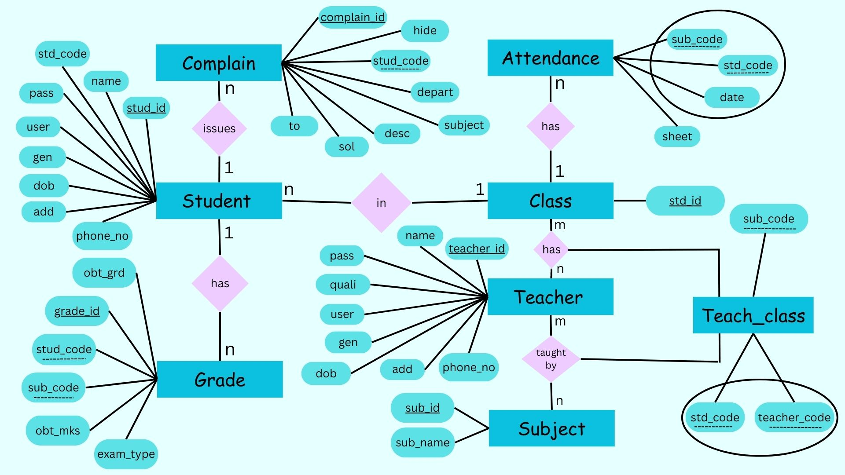
ER Diagram

Slide 7
Our Learning
Consistency
Hard work
Team Work
Time Management

Slide 8
Thank You!

