Slide 1
Sustainable Development
From Development to a Global Sustainability Agenda
DEVELOPMENT
RESOURCE FOOTPRINT
SUSTAINABILITY
SDGs
→
→
→
Environmental Studies • Module II

Slide 2

What Do We Mean by Development?
Development is the process of improving human well-being, opportunities and quality of life.
• Housing and basic services
• Water supply and sanitation
• Energy and transportation
• Healthcare and education
• Employment, industry and infrastructure
Development is necessary for human well-being.
2

Slide 3
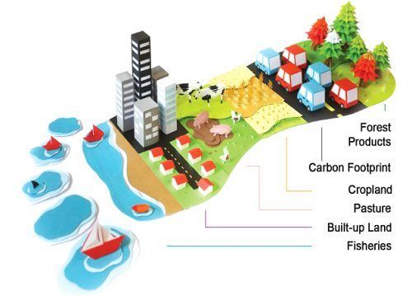
Development Has a Larger Resource Footprint:
LAND + WATER + ENERGY + MATERIALS
BUILDINGS • ROADS • INDUSTRIES • CITIES
RESOURCE USE • WASTE • EMISSIONS
→
→
Every development activity requires resources and creates impacts.
• Resource extraction
• Land transformation
• Energy and material consumption
• Waste and emissions
3

Slide 4

The Development Dilemma
DEVELOPMENT IS NEEDED
• Improve living standards
• Reduce poverty
• Provide infrastructure
• Create employment
• Improve health and education
BUT CAN ALSO CREATE
• Resource depletion
• Pollution
• Land degradation
• Ecosystem loss
• Climate impacts
• Social inequalities
THE CHALLENGE
• Not to stop development
• but to change how development is planned, delivered and sustained.
4

Slide 5
Why Sustainable Development?
How can we improve human well-being today
without reducing the ability of future generations to meet their needs?
PRESENT NEEDS
DEVELOPMENT
FUTURE NEEDS
→
→
This is the fundamental question behind sustainable development.
5

Slide 6
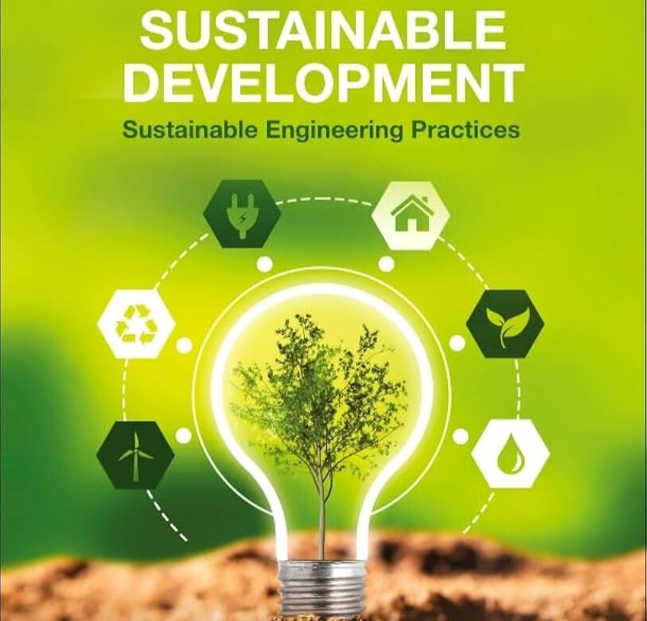
What Is Sustainable Development?
“Development that meets the needs of the present without compromising the ability of future generations to meet their own needs.”
Brundtland Commission, 1987
PRESENT
DEVELOPMENT
FUTURE
→
→
Sustainability connects present development with long-term capacity.
6

Slide 7
Three Dimensions of Sustainable Development
ENVIRONMENT
• Natural resources
• Ecosystems
• Environmental quality
SOCIETY
• Health
• Equity
• Safety
• Quality of life
ECONOMY
• Employment
• Productivity
• Affordability
• Prosperity
• Environmental: Can the natural system support it?
• Social: Does it serve people fairly and safely? Is it socially acceptable ??
• Economic: Can it remain viable and affordable?
SUSTAINABLE DEVELOPMENT requires all three dimensions.
7

Slide 8
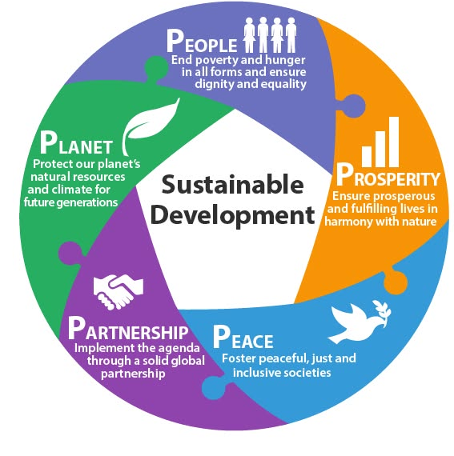
5 Ps of Sustainable development…

Slide 9
The Need for a Shared Global Agenda:
What should the world collectively aim to achieve?
GLOBAL CHALLENGES
SUSTAINABLE DEVELOPMENT
SHARED GOALS
GLOBAL ACTION
→
→
→
Sustainable development needed a common language, shared priorities and measurable goals.
The framework is designed for universal application — all countries have responsibilities.
An SDG is a broad destination, not a single project or technology.
10

Slide 10
The 2030 Agenda
Transforming Our World: The 2030 Agenda for Sustainable Development
17 GOALS
169 TARGETS
236 INDICATORS
→
→
GOALS
• Broad global objectives
• What we aim to achieve
TARGETS
• Specific commitments
• Make goals more concrete
INDICATORS
• Measures of progress
• Track change over time
12

Slide 11
The 17 Sustainable Development Goals
PEOPLE
1 No Poverty • 2 Zero Hunger • 3 Good Health • 4 Quality Education • 5 Gender Equality
PLANET
6 Clean Water • 12 Responsible Consumption • 13 Climate Action • 14 Life Below Water • 15 Life on Land
PROSPERITY
7 Clean Energy • 8 Decent Work • 9 Industry & Infrastructure • 10 Reduced Inequalities • 11 Sustainable Cities
PEACE
16 Peace, Justice & Strong Institutions
PARTNERSHIP
17 Partnerships for the Goals
The 17 goals form an integrated framework — not 17 independent subjects.
13

Slide 12
From Sustainable Development to Engineering Responsibility
GLOBAL CHALLENGES
SUSTAINABLE DEVELOPMENT
SDGs
ENGINEERING DECISIONS
→
→
→
SUSTAINABLE INFRASTRUCTURE
QUALITY OF LIFE
→
If engineers shape the built environment, how can they help achieve the SDGs?
16

