Slide 1
AIR, WATER AND SOIL POLLUTION
Understanding Environmental Impacts and Environmental Quality
Environmental Studies – Module 3 | Civil Engineering Perspective
1

Slide 2
Why Air, Water and Soil Matter
• Air: provides oxygen, supports atmospheric processes, controls climate/weather and transports pollutants.
• Water: essential for drinking, sanitation, agriculture and industry; supports aquatic ecosystems.
• Soil: supports vegetation and food production, stores/transforms nutrients, filters water and supports infrastructure.
• Key message: Damage to one environmental compartment can affect the other two.
2

Slide 3
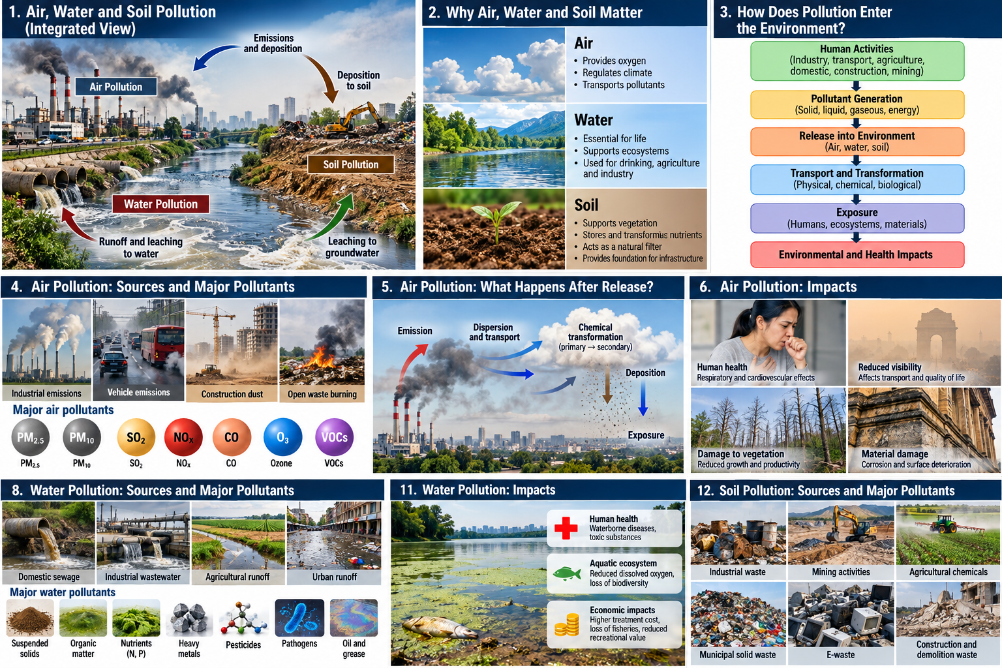

Slide 5
How Does Pollution Enter the Environment?
• Pollution occurs when unwanted substances or energy enter the environment at levels that cause adverse effects.
• Major sources: industries, transportation, agriculture, construction, mining, energy production, domestic activities and waste disposal.
• Remember: Source ≠ Pollutant ≠ Impact.
• Example: Vehicle → PM₂.₅ / NOₓ → respiratory and environmental impacts.
3

Slide 7
Air Pollution: Sources and Major Pollutants
• Stationary sources: industries, power plants and boilers.
• Mobile sources: cars, buses, trucks and construction equipment.
• Area sources: road dust, open waste burning, construction dust and agricultural activities.
• Major pollutants: PM₁₀, PM₂.₅, SO₂, NOₓ, CO, O₃ and VOCs.
4

Slide 8
Air Pollution: What Happens After Release?
• An emitted pollutant may travel far from its source.
• Atmospheric processes: dispersion, transport, chemical transformation and deposition.
• SO₂ → reactions → sulphate particles → acid deposition.
• NOₓ + VOCs + sunlight → photochemical reactions → ground-level ozone.
• PM can be transported by wind and deposited on buildings, vegetation and soil.
5

Slide 9
Air Pollution: Impacts
• Human health: respiratory irritation, asthma/breathing difficulties, reduced lung function and cardiovascular impacts.
• Environment: reduced visibility, vegetation damage, acid deposition, ecosystem disturbance and climate effects.
• Infrastructure: corrosion, surface deterioration and soiling of buildings/monuments.
• Pollutant concentration + exposure duration + receptor sensitivity → potential impact.
6

Slide 10
How Do We Know Air Is Polluted?
• Key parameters: PM₂.₅, PM₁₀, SO₂, NO₂, CO and O₃.
• AQI converts pollutant concentrations into an easy-to-understand numerical/category representation.
• Monitoring → concentration → AQI → public interpretation → action.
• Civil engineering applications: urban planning, traffic planning, construction management, industrial-area planning and environmental monitoring.
7

Slide 11
Water Pollution: Sources and Major Pollutants
• Domestic: sewage, detergents and organic matter.
• Industrial: chemicals, heavy metals, oils and thermal pollution.
• Agricultural: fertilizers, pesticides and sediments.
• Urban runoff: oil, grease, suspended solids and litter.
• Mining: acidity, metals, suspended solids and dissolved salts.
8

Slide 12
Water Pollution: Major Pollutant Groups
• Physical: suspended solids, sediments, colour and heat.
• Chemical: organic matter, nutrients, heavy metals, pesticides, oil/grease, acids/alkalis and dissolved salts.
• Biological: pathogenic bacteria, viruses, protozoa and parasites.
• Nutrient pollution: excess nitrogen/phosphorus → algal growth → oxygen depletion → aquatic stress.
• Key term: Eutrophication.
9

Slide 13
Water Pollution: How Do We Know Water Is Polluted?
• Physical indicators: temperature, turbidity, colour and electrical conductivity.
• Chemical indicators: pH, DO, BOD, COD, TDS, nutrients and heavy metals.
• Biological indicators: coliform organisms, algal growth and aquatic organisms.
• Concept: More biodegradable organic pollution → greater oxygen consumption → lower DO → greater aquatic stress.
• Detailed BOD/COD calculations can be addressed later in Environmental Engineering.
10

Slide 14
Water Pollution: Impacts
• Human health: waterborne diseases, toxic chemical exposure, heavy-metal accumulation and unsafe drinking water.
• Aquatic ecosystem: reduced DO, toxicity, habitat deterioration and biodiversity loss.
• Economic impacts: higher treatment cost, reduced fisheries/recreation, agricultural impacts and increased health expenditure.
• Civil engineering systems can either prevent pollution—or become pollution pathways.
11

Slide 15
Soil Pollution: Sources and Major Pollutants
• Sources: industrial waste, mining, agricultural chemicals, municipal solid waste, e-waste and C&D waste.
• Other sources: oil/petroleum leakage, wastewater irrigation and atmospheric deposition.
• Major pollutants: heavy metals, pesticides, petroleum hydrocarbons, persistent organic pollutants, excess salts, plastics and microplastics.
12

Slide 16
Soil Pollution: Fate and Impacts
• Pollutants may remain in soil, leach to groundwater, move by runoff, enter plants/food chains or become airborne as dust.
• Soil impacts: reduced fertility, altered properties and reduced microbial activity.
• Plant impacts: reduced growth, toxicity and lower productivity.
• Human/animal impacts: direct exposure, food-chain contamination and groundwater contamination.
• Key message: Soil is an active environmental system, not simply a waste disposal medium.
13

Slide 17
How Do We Know Soil Is Polluted?
• Physical indicators: texture, structure, moisture and bulk density.
• Chemical indicators: pH, electrical conductivity, organic carbon, nutrients, heavy metals and pesticide residues.
• Biological indicators: microbial activity, soil organisms and plant response.
• Soil quality = ability of soil to perform ecological and productive functions.
• Soil quality is more than simply measuring contaminant concentration.
14

Slide 18
One Pollutant, Multiple Environmental Compartments
• Example: Heavy metals released by mining or industrial activity.
• Air: particulate-bound metals can be transported and deposited.
• Soil: metals can accumulate and alter soil quality.
• Water: runoff/leaching can transport metals to surface water and groundwater.
• Plants and aquatic organisms can transfer contaminants into food chains → human exposure.
15

Slide 19
Air–Water–Soil Interaction
• Air pollution → deposition → soil → runoff → water pollution.
• Soil contamination → leaching → groundwater contamination.
• Contaminated water → irrigation → soil accumulation → crop uptake.
• Poor waste management → soil contamination + leachate + gas/dust emissions.
• Central concept: Environmental pollution is a connected system.
16

Slide 20
Pollution and Human Exposure
• Exposure framework: Source → Pathway → Receptor.
• Inhalation: air pollutants, dust and vapours.
• Ingestion: contaminated water, food and soil/dust.
• Dermal contact: contaminated water, soil and chemicals.
• Exposure depends on concentration, duration, frequency, route and individual sensitivity.
• Key concept: Hazard does not automatically mean risk; exposure is the connecting factor.
17

Slide 21
Comparing Air, Water and Soil Pollution
Aspect | Air | Water | Soil
Major sources | Traffic, industry, construction | Sewage, industry, agriculture | Waste, industry, agriculture, mining
Main pollutants | PM, SO₂, NOₓ, CO, O₃ | Organics, nutrients, pathogens, metals | Metals, pesticides, hydrocarbons
Main transport | Wind | Flow, runoff, groundwater | Leaching, runoff, dust
Key indicators | PM, gases, AQI | DO, BOD, COD, pH, turbidity | pH, EC, organic carbon, contaminants
Major exposure | Inhalation | Drinking, food, contact | Food chain, contact, dust
Typical impacts | Health, climate, vegetation | Health, aquatic life | Fertility, food chain, groundwater
18

Slide 22
Pollution Prevention and Management
• Preferred sequence: Prevent → Reduce → Reuse/Recover → Treat → Dispose safely.
• At source: cleaner production, process modification, material substitution, energy efficiency and good housekeeping.
• During transport: containment, drainage management, dust suppression and spill control.
• At receiving environment: treatment, monitoring, restoration and remediation.
• Principle: Prevention at source is generally better than treating pollution after it enters the environment.
19

Slide 23
Role of Civil Engineers
• Planning: sustainable urban development, land-use planning, transportation planning and green infrastructure.
• Water: water supply, sewerage, wastewater treatment, stormwater, rivers and watersheds.
• Waste: solid, hazardous and C&D waste management.
• Air/soil: dust control, construction pollution management, contaminated-site remediation and monitoring.
• Emerging skills: GIS, data analytics, sensors, AI/ML and environmental modelling.
20

Slide 24
Integrated Case Study: Mining-Affected Region
• Scenario: mining/mineral processing generates dust, gaseous emissions, contaminated runoff and waste.
• Pollution chain: Mining → airborne dust → deposition → soil contamination → runoff → surface-water contamination → groundwater/food-chain exposure.
• Engineering response: source control, dust suppression, runoff collection/treatment, safe waste management, air–water–soil monitoring and remediation.
• Discussion: If you were the environmental engineer, which parameter would you monitor first—and why?
21

Slide 25
Key Takeaways
• 1. Pollution has multiple sources: domestic, industrial, agricultural, transportation, construction and mining.
• 2. Pollution affects interconnected compartments: air, water and soil.
• 3. Pollutants move and transform through dispersion, runoff, leaching, deposition and chemical/biological processes.
• 4. Environmental quality must be measured using appropriate indicators, standards and monitoring.
• 5. Civil engineers must design infrastructure for functionality, economy, environmental protection and long-term sustainability.
• Pollution is an interconnected environmental-system problem—not three isolated problems.
22

