Slide 1
Climate Change: Science, Evidence and Impacts
Environmental Studies – Module IV | S.Y. B.Tech. Civil Engineering
Understanding the science, observed changes and implications for society and infrastructure
Climate System
Greenhouse Effect
Human Influence
Evidence & Impacts
→
→
→
1

Slide 2
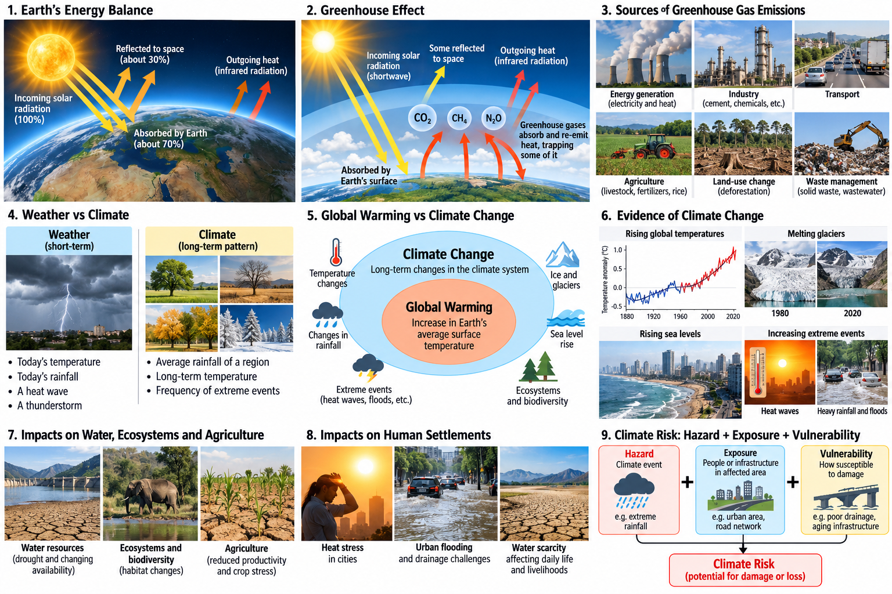
Weather vs Climate

Slide 3
Why Does Climate Change Matter?
Environmental systems
Engineering systems
• Water resources – availability, droughts and floods
• Agriculture and food security
• Ecosystems and biodiversity
• Human health and settlements
• Buildings and infrastructure
• Transport systems
• Water and drainage systems
• Urban planning and resilience
Climate conditions influence how we plan, design, construct and maintain infrastructure.
2

Slide 4
Earth's Energy Balance
Solar Energy
Reflection
Absorption & Warming
Heat Released to Space
→
→
→
• The Earth receives energy mainly from the Sun.
• Some incoming energy is reflected back to space.
• The Earth absorbs energy and warms, then releases heat toward space.
• Climate depends on the balance between incoming and outgoing energy.
4

Slide 6
The Greenhouse Effect
Natural greenhouse effect
Enhanced greenhouse effect
• Greenhouse gases absorb and re-emit part of the heat leaving Earth.
• Helps maintain a temperature suitable for life.
• Human activities increase greenhouse gas concentrations.
• Additional heat is retained in the Earth system.
• This contributes to global warming.
Natural greenhouse effect ≠ the problem; human-driven enhancement is the concern.
5

Slide 8
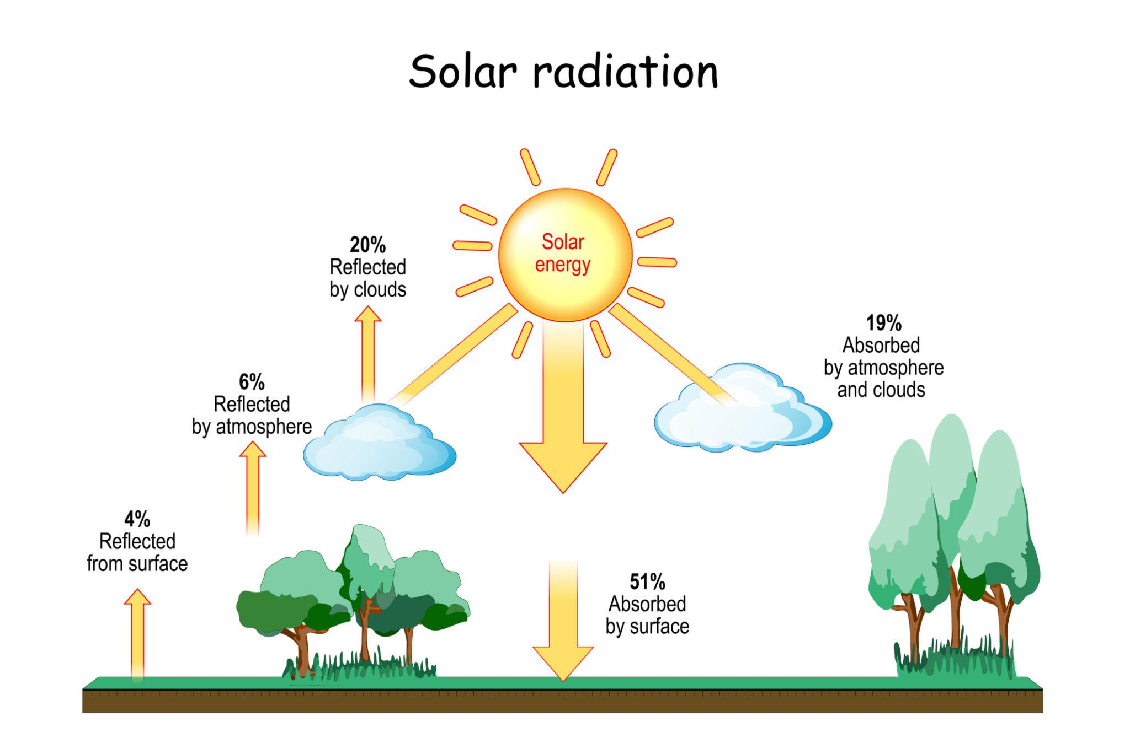
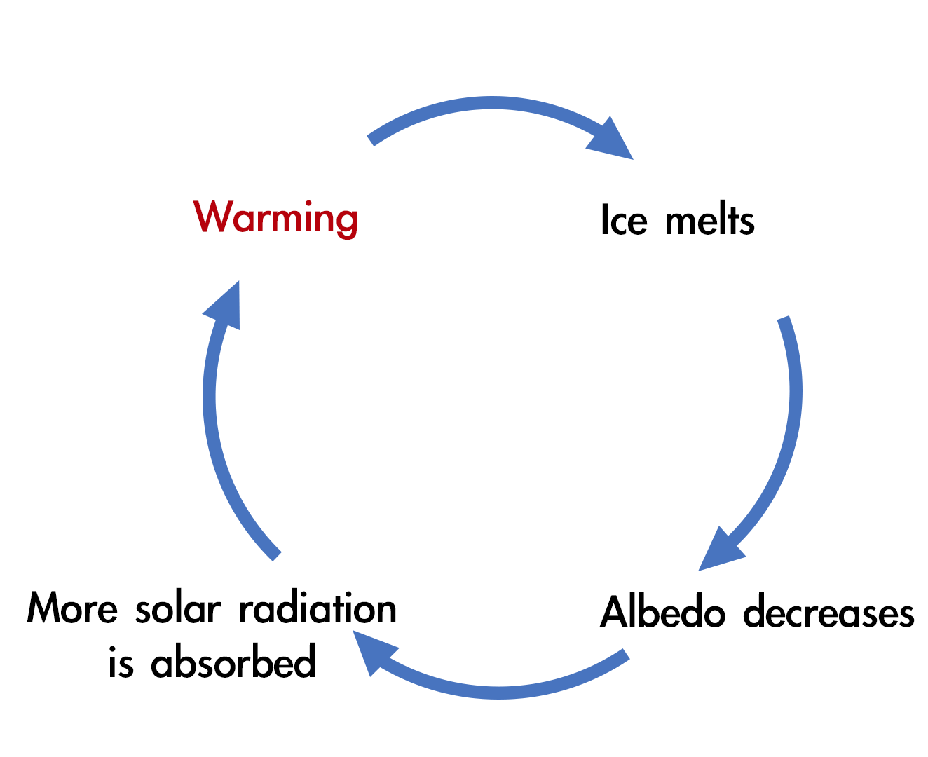

Slide 9
Greenhouse Gases and Human Activities
Major greenhouse gases
Major human sources
• Carbon dioxide (CO₂)
• Methane (CH₄)
• Nitrous oxide (N₂O)
• Water vapour and fluorinated gases
• Energy generation and use
• Industry and transport
• Agriculture and land-use change
• Waste and other activities
Civil Engineering relevance: buildings, construction, transport and urban infrastructure.
6

Slide 11
Global Warming vs Climate Change
Human Activities
GHG Increase
Global Warming
Climate System Changes
→
→
→
Global warming
Climate change
• Long-term increase in Earth's average surface temperature.
• Broader long-term changes in temperature, rainfall, extremes, sea level, ice and ecosystems.
Global warming is one important component of broader climate change.
7

Slide 12
• Rising global temperatures
• Changing precipitation patterns
• Increasing heat extremes
• Melting glaciers and ice loss
• Rising sea levels
• Changes in ecosystems and species distribution
Evidence comes from long-term observations and multiple independent indicators.
8

Slide 13
Evidence of Climate Change

Slide 14
Observed Environmental Impacts
Water & ecosystems
Agriculture & coasts
• Drought and changing water availability
• Flooding and altered hydrological patterns
• Habitat and biodiversity impacts
• Heat and water stress on crops
• Changing growing conditions
• Sea-level rise, coastal flooding and erosion
Climate change affects interconnected environmental systems.
9

Slide 15
Impacts on Human Settlements
Urban impacts
Societal impacts
• Heat stress
• Urban flooding
• Water scarcity
• Damage to infrastructure
• Transport disruption
• Health risks
• Economic losses
• Greater pressure on vulnerable communities
Rapidly growing and climate-sensitive settlements can face higher risks.
10

Slide 16
Climate Change in India
Major concerns
Other important concerns
• Heat waves
• Extreme rainfall and floods
• Drought and water stress
• Coastal risks
• Changing monsoon patterns
• Agricultural impacts
• Himalayan and glacier-related changes
• Urban climate risks
India's diverse geography creates diverse climate-related risks.
11

Slide 17
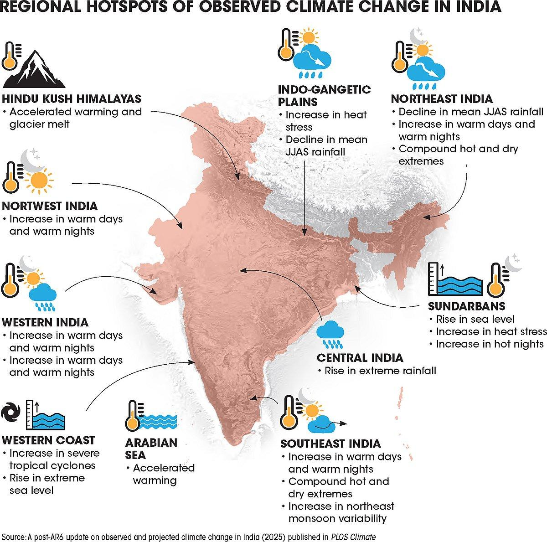

Slide 18
Climate Change and Civil Infrastructure
Infrastructure affected
Potential concerns
• Water supply and reservoirs
• Drainage and flood-management systems
• Buildings and thermal comfort
• Roads and transport systems
• Water availability
• Extreme rainfall and flooding
• Extreme heat
• Changing design and maintenance requirements
Infrastructure designed for yesterday's climate may not perform reliably under tomorrow's conditions.
12

Slide 19
Why Should Civil Engineers Care?
• Civil infrastructure often has a service life of several decades.
• Engineers influence location, design, materials, drainage, water systems and urban planning.
• Climate risks should therefore be considered during planning and design.
• Climate change should become a design consideration — not an afterthought.
Climate-aware engineering = better long-term infrastructure decisions
14

Slide 20
Key Takeaways
• Climate is different from weather.
• The greenhouse effect is natural; human activities are enhancing it.
• Multiple observations provide evidence of ongoing climate change.
• Climate change affects water, ecosystems, settlements and infrastructure.
• Civil Engineers need to consider future climate risks in planning and design.
Next: Climate Change – Mitigation, Adaptation and the Role of Engineers
15

