Slide 1
Climate Change: Mitigation, Adaptation and the Role of Engineers
Environmental Studies – Module IV | S.Y. B.Tech. Civil Engineering
From understanding climate change to climate action
1

Slide 2
From Climate Problem to Climate Action
MITIGATION
ADAPTATION
How can we reduce future climate change?
How can we reduce damage from climate impacts?
Reduce greenhouse gas emissions
Reduce vulnerability to climate impacts
Climate Action = Mitigation + Adaptation
2

Slide 3
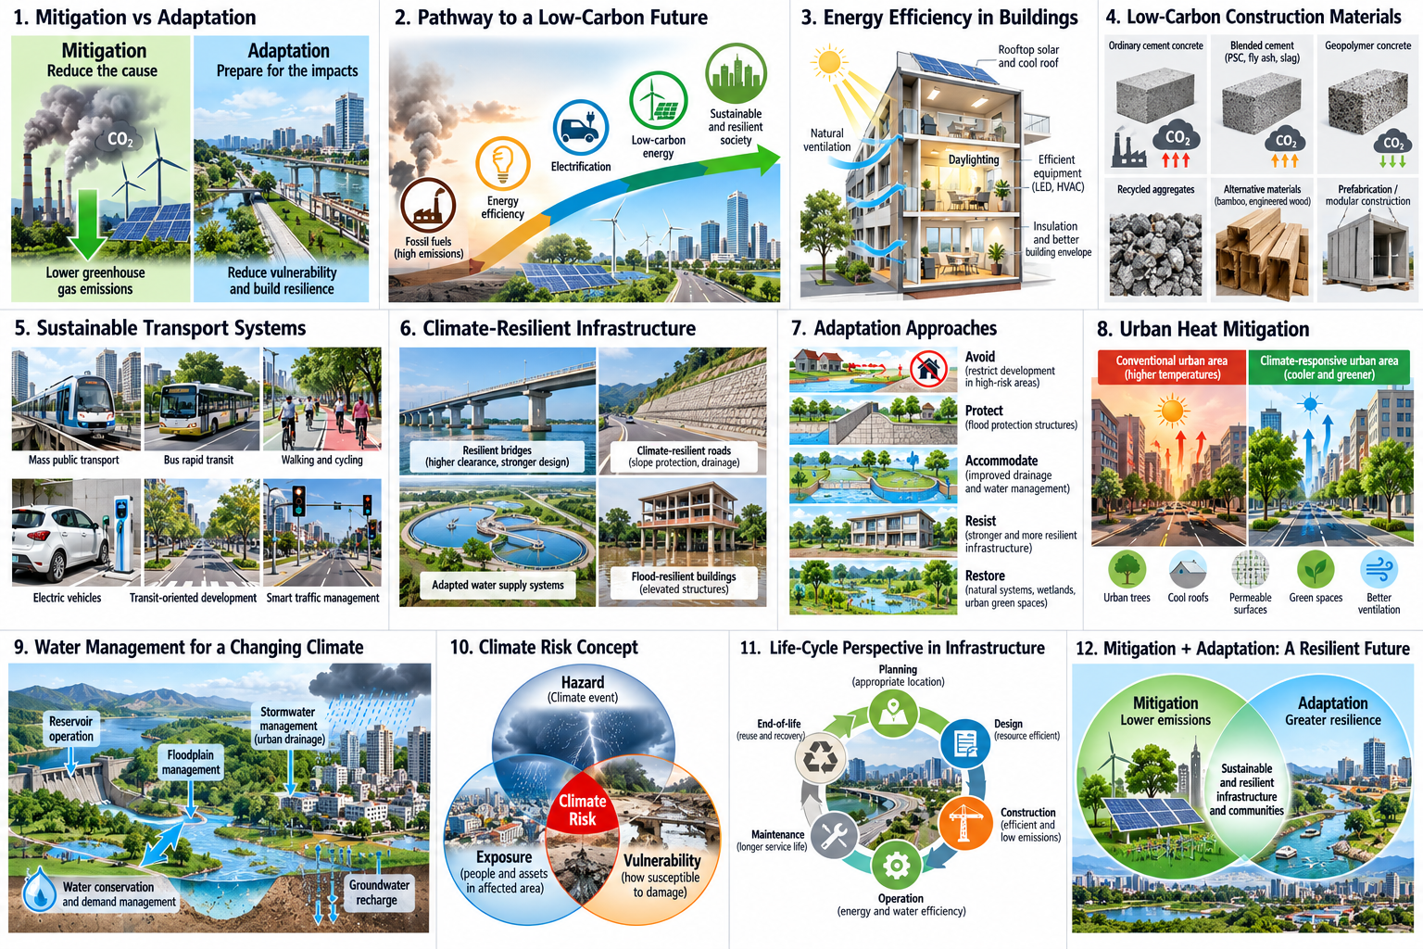

Slide 4
Mitigation vs Adaptation
Mitigation
Adaptation
• Addresses the cause
• Reduces greenhouse gas emissions
• Long-term global benefit
• Energy efficiency
• Low-carbon construction
• Cleaner transport
• Addresses the impacts
• Reduces vulnerability
• Local and regional benefits
• Flood-resilient infrastructure
• Heat-resilient buildings
• Improved stormwater management
Mitigation → Reduce the problem | Adaptation → Prepare for the problem
3

Slide 5
Mitigation Strategies: Reduce Emissions at Source
Avoid
Reduce
Improve
Substitute
• Reduce energy demand and improve energy efficiency
• Shift towards low-carbon energy and cleaner technologies
• Reduce carbon intensity of materials and processes
• Improve public and mass transportation
• Protect and enhance carbon sinks
Civil Engineering relevance: Buildings • Construction • Transport • Water infrastructure • Urban systems
4

Slide 6
Energy Transition
Moving from high-carbon to low-carbon energy
Fossil fuels
Energy efficiency
Electrification
Low-carbon electricity
Cleaner systems
• Electrification of transport
• Energy-efficient buildings
• Low-carbon electricity integration
• Cleaner industrial and infrastructure processes
Detailed renewable-energy technologies are covered in Module V.
5

Slide 7
Energy Efficiency: The First Fuel
Buildings
Infrastructure & Transport
• Passive design
• Natural lighting and ventilation
• Efficient equipment
• Better building envelopes
• Efficient pumping and treatment
• Smart street lighting
• Public transport
• Efficient traffic management
• Walking and cycling infrastructure
Energy efficiency = Delivering the same service with less energy
The cleanest unit of energy is often the unit we do not need to consume.
6

Slide 8
Technology for Climate Mitigation
• Low-carbon cement and concrete
• Alternative construction materials
• Prefabrication and modular construction
• Building energy-management systems
• Electric construction equipment
• Smart water and energy systems
• Digital monitoring and optimization
ENGINEER'S QUESTION
Can we provide the same function with fewer resources and lower emissions?
7

Slide 9
Low-Carbon Civil Infrastructure
Life-cycle thinking
Planning
Design
Construction
Operation
Maintenance
End-of-life
• Appropriate location and compact development
• Resource-efficient and climate-responsive design
• Efficient equipment and reduced material wastage
• Energy and water efficiency during operation
• Longer service life through effective maintenance
• Reuse, recovery and responsible demolition
8

Slide 10
Adaptation Strategies
Avoid
Protect
Accommodate
Resist
Restore
• Avoid development in high-risk locations
• Protect people and infrastructure from hazards
• Accommodate impacts through improved drainage and water management
• Strengthen vulnerable infrastructure
• Restore natural systems such as wetlands and urban green spaces
Good adaptation reduces vulnerability before a disaster occurs.
9

Slide 12
Climate-Resilient Infrastructure
Anticipate
Plan
Design
Construct
Operate & Maintain
Recover
• Understand future climate hazards
• Consider climate risks during project planning
• Provide appropriate safety and flexibility
• Ensure construction quality and robustness
• Monitor performance and maintain assets
• Restore services quickly after extreme events
Resilience = Prepare → Absorb → Recover → Adapt
10

Slide 14
Adaptation in Water, Drainage and Flood Management
Water Supply
Urban Drainage & Flood Management
• Diversified water sources
• Demand management
• Water conservation
• Improved storage and distribution
• Adequate drainage capacity
• Stormwater detention and retention
• Flood-risk mapping
• Floodplain management
• Early-warning systems
• Resilient infrastructure
11

Slide 16
Climate-Resilient Cities and Planning
Reduce Heat
Manage Rainfall & Mobility
• Urban trees and green spaces
• Cool roofs and appropriate materials
• Better ventilation corridors
• Permeable surfaces
• Rainwater management
• Detention and retention areas
• Compact development
• Public transport, walking and cycling
A resilient city is not only stronger infrastructure — it is smarter planning.
12

Slide 18
Role and Essential Skills of Civil Engineers
Technical + Digital Skills
Professional Skills
• Climate-risk assessment
• Sustainable and climate-responsive design
• Energy and resource efficiency
• Water and flood management
• Life-cycle thinking
• GIS and spatial analysis
• Data analysis and modelling
• Remote sensing and AI/ML applications
• Systems thinking
• Interdisciplinary collaboration
• Cost–benefit evaluation
• Risk-based decision making
• Communication
• Stakeholder engagement
Design not only for today's conditions, but for tomorrow's uncertainty.
14

Slide 20
Key Takeaways
• Mitigation reduces greenhouse gas emissions.
• Adaptation reduces vulnerability to climate impacts.
• Energy efficiency and low-carbon technologies are important mitigation pathways.
• Climate-resilient infrastructure must consider future climate risks.
• Water, drainage, buildings, transport and urban planning require climate-aware decisions.
• Civil Engineers have a critical role in both decarbonization and resilience.
The Civil Engineer of the future must design infrastructure that is both low-carbon and climate-resilient.
Module IV: Science → Evidence → Impacts → Mitigation → Adaptation → Climate Action
15

