Slide 1
Renewable Energy and Sustainable Technologies
Environmental Studies – Module V | S.Y. B.Tech. Civil Engineering
Understanding renewable energy technologies and their applications
1

Slide 2
Why Renewable Energy?
Population & urbanization
Energy demand
Resource pressure
Environmental impacts
Renewable energy can provide
The engineering challenge
• Naturally replenished energy sources
• Reduced dependence on finite fossil fuels
• Lower environmental impacts
• Opportunities for decentralized generation
• Meet growing energy demand
• Reduce environmental impacts
• Improve energy security
• Select suitable technologies for local conditions
2

Slide 3
What is Renewable Energy?
Energy obtained from natural processes that are continuously replenished on a human timescale.
Solar
Wind
Hydropower
Geothermal
Ocean
Bioenergy
Renewable ≠ impact-free
• Every technology has resource, land, environmental, economic and technical considerations.
3

Slide 4
Solar Energy: Two Major Pathways
SOLAR PHOTOVOLTAIC (PV)
Sunlight → Electricity
SOLAR THERMAL
Sunlight → Heat
PV applications
Solar thermal applications
• Rooftop systems
• Solar farms
• Street lighting
• Water pumping
• Off-grid systems
• Water heating
• Space heating
• Industrial process heat
• Solar thermal power
PV → electricity | Thermal → heat
4

Slide 5
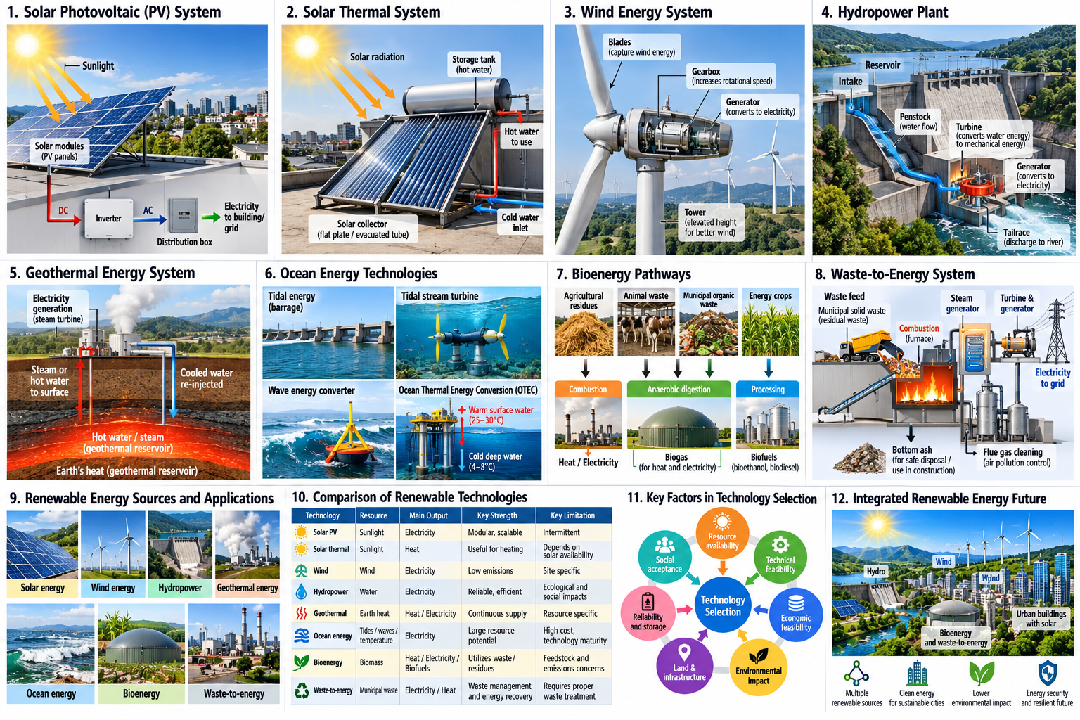

Slide 6
Solar PV: How Does It Work?
Sunlight
PV cells
DC electricity
Inverter
AC electricity
Building / Grid
Major components
Civil Engineering connection
• Solar modules
• Mounting structure
• Inverter
• Wiring and protection
• Battery storage — where required
• Rooftop structural assessment
• Foundations and mounting systems
• Solar-farm land planning
• Drainage and access roads
• Building integration
5

Slide 7
Solar Thermal Systems
Solar radiation
Collector
Heat-transfer fluid
Storage / Application
Common systems
Applications
• Flat-plate collectors
• Evacuated-tube collectors
• Solar water heaters
• Concentrated solar thermal systems
• Domestic hot water
• Hotels and hostels
• Hospitals
• Industries
• Institutional buildings
Solar thermal is particularly useful when the required output is heat rather than electricity.
6

Slide 8
Wind Energy
Wind
Rotor
Mechanical rotation
Generator
Electricity
Important factors
Civil Engineering role
• Wind speed and direction
• Turbine height
• Site characteristics
• Terrain
• Grid connectivity
• Site investigation
• Foundation design
• Access roads
• Crane platforms
• Tower foundation
• Construction planning
7

Slide 10
Hydropower
Stored / flowing water
Turbine
Generator
Electricity
Types & advantages
Key concerns
• Large hydropower
• Small hydropower
• Run-of-river systems
• Storage-based systems
• High conversion efficiency
• Long service life
• Land submergence
• Ecosystem impacts
• Displacement
• Sedimentation
• Downstream flow alteration
8

Slide 12
Geothermal Energy
Geothermal energy = heat stored within the Earth
Earth's internal heat
Hot water / steam
Heat or turbine
Useful energy
Applications
Characteristics
• Space heating
• Hot water
• Greenhouses
• Electricity generation where resources permit
• Continuous energy source
• Small land footprint
• Not dependent on sunlight or wind
• Highly site-specific resource
9

Slide 14
Ocean Energy
Tides
Tidal streams
Waves
Ocean temperature difference
• Tidal energy uses the periodic rise and fall of sea level.
• Tidal-stream systems use moving tidal currents.
• Wave energy uses the motion of ocean waves.
• OTEC uses the temperature difference between warm surface water and deeper cold water.
Challenges: high capital cost • marine corrosion • difficult maintenance • environmental considerations • limited suitable locations
10

Slide 16
Bioenergy
Biological resources → Useful energy
Sources
Conversion routes
• Agricultural residues
• Forestry residues
• Animal waste
• Energy crops
• Organic municipal waste
• Sewage and biodegradable materials
• Biomass → combustion → heat / electricity
• Organic matter → anaerobic digestion → biogas
• Biomass → processing → biofuels
Civil Engineering relevance: biogas plants • rural energy systems • wastewater-treatment integration • biomass handling and storage
11

Slide 18
Waste-to-Energy
Organic waste
↓
Anaerobic digestion
↓
Biogas
Combustible residual waste
↓
Thermal conversion
↓
Heat / Electricity
Landfill organic matter
↓
Biogas recovery
↓
Energy
Waste hierarchy…
Prevent
Reuse
Recycle
Recover energy
Dispose
Waste-to-energy is not a substitute for waste prevention, reuse and recycling; it is mainly relevant to appropriate residual waste streams.
12

Slide 20
Comparing Renewable Energy Technologies
Technology
Main resource
Major strength
Major limitation
Solar PV
Sunlight
Modular & scalable
Intermittent
Solar thermal
Sunlight
Useful heat
Solar availability
Wind
Wind
Low operational emissions
Site dependent
Hydropower
Water
Reliable & efficient
Ecological/social impacts
Geothermal
Earth heat
Continuous generation
Resource specific
Ocean
Tides/waves/temp.
Large resource potential
High cost & technology maturity
Bioenergy
Biomass
Uses biological resources/waste
Feedstock & emissions concerns
No single renewable technology is ideal everywhere.
13

Slide 21
How Should Engineers Select a Renewable Technology?
Resource
Technical feasibility
Economic feasibility
Environmental impact
Land & infrastructure
Reliability / storage
Social acceptance
• Is the energy resource available at the required scale?
• Can the technology operate effectively under local conditions?
• Is the project financially viable over its life cycle?
• What are the environmental and land-use consequences?
• Can energy be delivered when required, or is storage needed?
• Is the project acceptable to affected communities?
Choose the technology according to the site and application — not simply because it is renewable.
14

Slide 23
Key Takeaways
• Renewable energy sources are naturally replenished but are not impact-free.
• Solar PV converts sunlight into electricity; solar thermal provides useful heat.
• Wind and hydropower convert natural energy flows into electricity.
• Geothermal and ocean energy offer specialized opportunities.
• Bioenergy and waste-to-energy can convert biological resources into useful energy.
• Technology selection requires technical, economic, environmental and social assessment.
• Civil Engineers contribute through planning, structural design, infrastructure development and sustainable project implementation.
The future energy system will depend on intelligent integration of multiple sustainable energy solutions.
15

