Slide 1
Solid Waste, Plastic and E-Waste Management
From Waste Problem to Integrated Solutions
Environmental Studies • Module VI • Civil Engineering

Slide 2
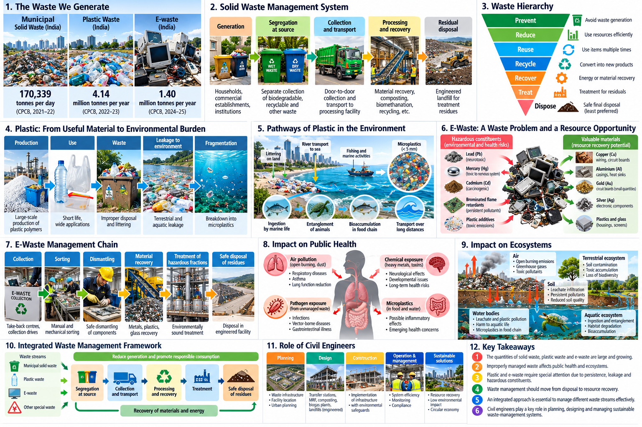

Slide 3
The Waste We Generate
Recent numbers help us understand the magnitude of the challenge.
170,339 TPD
Municipal solid waste generated in India, 2021–22
~4.14 Mt/year
Plastic waste generated in India, 2022–23
62 Mt
Global e-waste generated in 2022
These are continuous flows of materials, energy and resources — not simply “garbage”.
The engineering challenge is to collect, separate, recover, treat and safely manage these flows.
Environmental Studies • Module VI • Slide 2

Slide 5
Solid Waste Management – The Basic System
Generation
Segregation
Collection
Transport
Processing / Recovery
Treatment
Safe Disposal
The system must be planned as a chain — failure at one stage affects the next.
Source segregation is the foundation for efficient recovery and treatment.
The objective is not simply “getting waste out of sight”; it is controlling material and environmental flows.
Environmental Studies • Module VI • Slide 3

Slide 7
What Happens When Solid Waste Is Poorly Managed?
Public health
Ecosystems & cities
Breeding of flies, mosquitoes and rodents
Smoke and toxic emissions from open burning
Pathogen exposure and contaminated water
Occupational risks for waste workers
Leachate can contaminate soil and water
Drain blockage and urban flooding
Odour, litter and landscape degradation
Methane and other emissions from unmanaged organic waste
Environmental Studies • Module VI • Slide 4

Slide 8
Solid Waste Management: From Disposal to Resource Recovery
Prevent
Reduce
Reuse
Recycle
Recover
Treat
Dispose
Preferred approach: prevent waste first and retain material value for as long as possible.
Final disposal remains necessary for residuals that cannot be safely or economically recovered.
Civil engineers increasingly design systems around material recovery, resource efficiency and environmental control.
Environmental Studies • Module VI • Slide 5

Slide 10
Plastic Waste – A Contemporary Global Challenge
400+ Mt/year
Global plastic production
~4.14 Mt/year
India’s plastic waste generation, 2022–23
Persistent
Many plastics remain in the environment for very long periods
Plastic is lightweight, durable and versatile — exactly the properties that can make environmental leakage persistent.
The challenge is the linear pattern: short use → discard → leakage.
Environmental Studies • Module VI • Slide 6

Slide 11
Plastic: From Useful Material to Environmental Burden
Raw material
Plastic product
Use
Discard
Mismanaged waste
Environmental leakage
Leakage pathways include littering, inadequate collection, open dumping and uncontrolled burning.
Larger plastic items can fragment into smaller particles, including microplastics.
Impacts can extend from urban drains and rivers to terrestrial and marine ecosystems.
Environmental Studies • Module VI • Slide 7

Slide 14
Managing Plastic Waste
Management priorities
Engineering focus
Reduce unnecessary plastic use
Promote reuse and durable products
Segregate plastics at source
Improve collection and sorting
Recycle suitable polymer streams
Control difficult and residual fractions
Design for recyclability and material recovery
Improve material recovery facilities
Control rejects and residual waste
Avoid uncontrolled burning
Use life-cycle thinking for material choices
Environmental Studies • Module VI • Slide 8

Slide 15
E-Waste – A Rapidly Growing Waste Challenge
62 Mt
Global e-waste generated in 2022
22.3%
Formally collected and recycled in 2022
~1.40 Mt
India’s estimated e-waste generation, FY 2024–25
Electrical and electronic equipment becomes waste when it is discarded at end of use or life.
Rapid technology turnover and short replacement cycles can accelerate e-waste generation.
Environmental Studies • Module VI • Slide 9

Slide 17
Why Is E-Waste Different?
Resource potential
Hazard potential
Copper and aluminium
Iron and other metals
Small quantities of precious metals
Glass and recoverable plastics
Reusable or refurbishable components
Batteries and hazardous fractions
Heavy metals and other harmful constituents
Unsafe dismantling and open burning
Worker exposure
Contamination from poorly managed residues
Environmental Studies • Module VI • Slide 10

Slide 18
E-Waste Management Chain
Collection
Sorting
Dismantling
Material separation
Recovery / Recycling
Hazardous-fraction treatment
Safe residual disposal
Formal systems aim to recover valuable materials while controlling exposure and hazardous fractions.
Informal burning or uncontrolled dismantling can turn resource recovery into an occupational and environmental health problem.
Environmental Studies • Module VI • Slide 11

Slide 20
Waste and Public Health
Poorly managed waste
Air / Water / Soil contamination
Human exposure
Health risk
Exposure routes
Potential concerns
Inhalation
Ingestion / food chain
Dermal contact
Occupational exposure
Respiratory and toxic exposures
Water- and vector-related disease risks
Chemical exposure from hazardous fractions
Higher risks for workers and nearby communities
Environmental Studies • Module VI • Slide 12

Slide 22
Waste and Ecosystems
Waste leakage
Air
Water
Soil
Biota / food web
Air: open burning can release particulate and toxic pollutants.
Water: litter and leachate can affect rivers, drains, groundwater and aquatic organisms.
Soil: persistent materials and hazardous constituents can accumulate at poorly managed sites.
Biota: ingestion, entanglement and habitat degradation can affect terrestrial and aquatic organisms.
Environmental Studies • Module VI • Slide 13

Slide 24
Integrated Waste Management – Bringing It All Together
Different waste streams require different management options — there is no single “best technology” for all waste.
Integrated management combines prevention, segregation, collection, recycling, recovery, treatment and safe disposal.
The system should consider waste characteristics, quantity, environmental risk, economics, infrastructure and community participation.
Prevent / Reduce
Reuse
Segregate
Collect
Recover / Recycle
Treat
Safe Disposal
Environmental Studies • Module VI • Slide 14

Slide 26
Role of Civil Engineers + Key Takeaways
Civil Engineer’s role
Key takeaways
Plan collection and transport systems
Design recovery, processing and controlled-disposal infrastructure
Use GIS and data for planning and monitoring
Evaluate alternatives using environmental and life-cycle thinking
Protect public health and ecosystems
Waste is a material-flow problem, not simply a disposal problem.
Plastic and e-waste require special management attention.
Source segregation enables recovery.
Integrated management connects strategies into one system.
Goal: maximum resource recovery with minimum environmental risk.
Environmental Studies • Module VI • Slide 15

