Slide 1
Life Cycle Assessment (LCA)
Thinking Beyond the Project
From material selection to life-cycle decision making
Civil Engineering Perspective
EVS | Module VI | Presentation 2 1

Slide 2
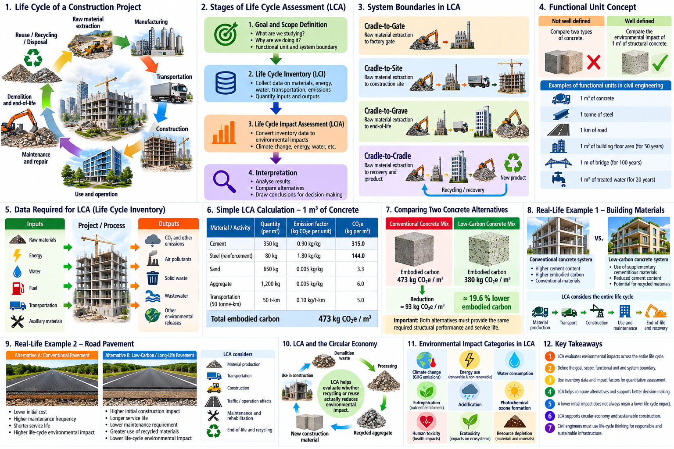

Slide 3
Why Do We Need Life-Cycle Thinking?
A project may look sustainable during construction—but what happens afterward?
• Where did the materials come from?
• How much energy was used to manufacture them?
• How far were they transported?
• How long will the structure last?
• What maintenance will it require?
• What happens at the end of its life?
A sustainable decision considers the entire life cycle—not only the construction stage.
EVS | Module VI | Presentation 2 2

Slide 5
What is Life Cycle Assessment (LCA)?
LCA is a systematic method for evaluating environmental impacts associated with a product, material, process or project throughout its life cycle.
Raw materials
→
Manufacturing
→
Transport
→
Construction / Use
→
Maintenance
→
End-of-life
Typical pathway: cradle → use → end-of-life → recovery / disposal
Standards: ISO 14040 and ISO 14044
EVS | Module VI | Presentation 2 3

Slide 6
The Four Stages of LCA
1. Goal & Scope
2. Life Cycle Inventory — LCI
What are we studying and why?
What materials, energy and emissions are involved?
3. Life Cycle Impact Assessment — LCIA
4. Interpretation
What environmental impacts result?
What do the results mean for decision-making?
LCA is iterative: interpretation can lead back to the goal, scope or inventory.
EVS | Module VI | Presentation 2 4

Slide 8
Goal, Scope and Functional Unit
Before calculating anything, define exactly what is being compared.
Example of a functional unit
“Environmental impact of producing 1 m³ of structural concrete.”
Functional unit = a common basis for a fair comparison
Same function → fair comparison
EVS | Module VI | Presentation 2 5

Slide 9
Defining the System Boundary
Cradle
→
Gate
→
Site
→
Use
→
End-of-life
Cradle-to-Gate
Cradle-to-Grave
Cradle-to-Cradle
Raw material → manufacturing
Stops at factory gate
Raw material → use → end-of-life
Raw material → use → recovery → new product
For buildings: materials → construction → operation → maintenance → demolition → recycling
EVS | Module VI | Presentation 2 6

Slide 11
Life Cycle Inventory: What Data Do We Need?
Inputs
Outputs
Raw materials
Energy
Water
Fuel
Transportation
Auxiliary materials
CO₂ emissions
Air pollutants
Waste
Wastewater
Other environmental releases
Simple quantitative principle
Quantity of activity × Environmental impact factor
EVS | Module VI | Presentation 2 7

Slide 12
A Simple LCA Calculation
Illustrative embodied-carbon example for 1 m³ of concrete
Material / Activity | Quantity | Emission Factor | Impact
Cement | 350 kg | 0.90 kg CO₂e/kg | 315
Steel | 80 kg | 1.80 kg CO₂e/kg | 144
Sand | 650 kg | 0.005 kg CO₂e/kg | 3.25
Aggregate | 1200 kg | 0.005 kg CO₂e/kg | 6
Transport | 50 tonne-km | 0.10 kg CO₂e/tonne-km | 5
Total ≈ 473 kg CO₂e / m³
Illustrative emission factors for learning the method—not project certification values.
EVS | Module VI | Presentation 2 8

Slide 13

Using LCA to Compare Alternatives
Conventional mix
Illustrative embodied carbon:
≈ 473 kg CO₂e/m³
Lower-carbon alternative
Lower cement content + suitable supplementary materials + optimized transport ≈ 380 kg CO₂e/m³
Reduction = 473 − 380 = 93 kg CO₂e/m³
Percentage reduction ≈ 19.6%
Engineering check: Does the alternative provide the required performance and service life?
EVS | Module VI | Presentation 2 9

Slide 14
What Environmental Impacts Can LCA Assess?
LCA is not only about carbon dioxide.
Climate change
Energy / resource use
Water consumption
Eutrophication
Acidification
Photochemical ozone formation
Human toxicity
Ecotoxicity
Resource depletion
For introductory Civil Engineering applications: climate change + energy + water + resource use are useful starting points.
EVS | Module VI | Presentation 2 10

Slide 16
Real-Life Example 1: Building Materials
Question: Which building system is environmentally preferable?
Material production
→
Transport
→
Construction
→
Maintenance
→
End-of-life
• A material with a higher initial impact may perform better over the entire life cycle.
• Longer service life can reduce replacement and maintenance impacts.
• Energy and water use during operation can dominate some building life cycles.
• End-of-life reuse or recycling can change the overall result.
Lowest initial impact ≠ lowest life-cycle impact
EVS | Module VI | Presentation 2 11

Slide 18
Real-Life Example 2: Road Pavement
Alternative A
Alternative B
Conventional pavement
• Lower initial construction impact
• More frequent maintenance
• More rehabilitation stages
Higher initial construction impact
• Longer service life
• Lower maintenance requirement
• Greater recovery potential
Materials
→
Transport
→
Construction
→
Traffic / operation
→
Maintenance
→
End-of-life
EVS | Module VI | Presentation 2 12

Slide 20
LCA and the Circular Economy
LCA helps answer: Is recycling or reuse actually environmentally beneficial?
Demolition waste
→
Collection
→
Processing
→
Recycled material
→
New construction
Compare two pathways
Virgin material pathway
Recycled material pathway
Extraction → processing → transport → use
Collection → transport → processing → use
“Recycled” does not mean “zero environmental impact.”
EVS | Module VI | Presentation 2 13

Slide 22
LCA as a Decision-Making Tool for Civil Engineers
Materials
Infrastructure
Construction
Operation
Concrete, steel, asphalt, bricks, recycled materials
Roads, bridges, buildings, water systems
Equipment, transport, construction methods
Energy and water efficiency
End-of-Life
Reuse, recycling, recovery and disposal
Essential skills
Data collection
→
Quantification
→
Comparison
→
Interpretation
→
Engineering decision
EVS | Module VI | Presentation 2 14

Slide 23
Software | Level | Main use | Relevance to Civil Engineering
openLCA | Beginner → Advanced | General LCA, databases, comparative studies | ⭐⭐⭐⭐⭐
SimaPro | Professional | Detailed LCA and impact assessment | ⭐⭐⭐⭐⭐
GaBi / Sphera LCA for Experts | Professional | Industrial and product LCA | ⭐⭐⭐⭐
One Click LCA | Beginner → Professional | Buildings, infrastructure, embodied carbon | ⭐⭐⭐⭐⭐
eToolLCD | Professional | Building life-cycle carbon/LCA | ⭐⭐⭐⭐
EC3 | Specialized | Embodied carbon of construction materials | ⭐⭐⭐⭐
Athena Impact Estimator | Civil/Building | Building materials and assemblies | ⭐⭐⭐⭐
Brightway2 | Advanced | Open-source Python-based LCA | ⭐⭐⭐
Umberto | Professional | Material/energy flow + LCA | ⭐⭐⭐

Slide 24
Key Takeaways
LCA changes the engineering question
“Which material is cheapest?”
“Which material has the lowest initial impact?”
↓
“Which alternative provides the required function with the lowest overall life-cycle impact?”
Good engineering designs the project. Better engineering considers its entire life cycle.
EVS | Module VI | Presentation 2 15

