Slide 1
Environmental Governance
Policies, Legislation and Compliance
From Environmental Policy to Engineering Practice
Civil Engineering Perspective
EVS | Module VI | Presentation 3 1

Slide 2
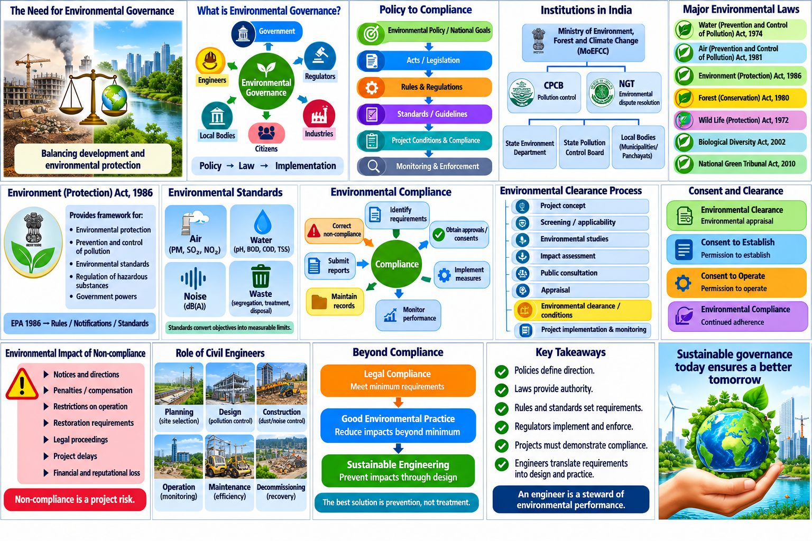

Slide 3
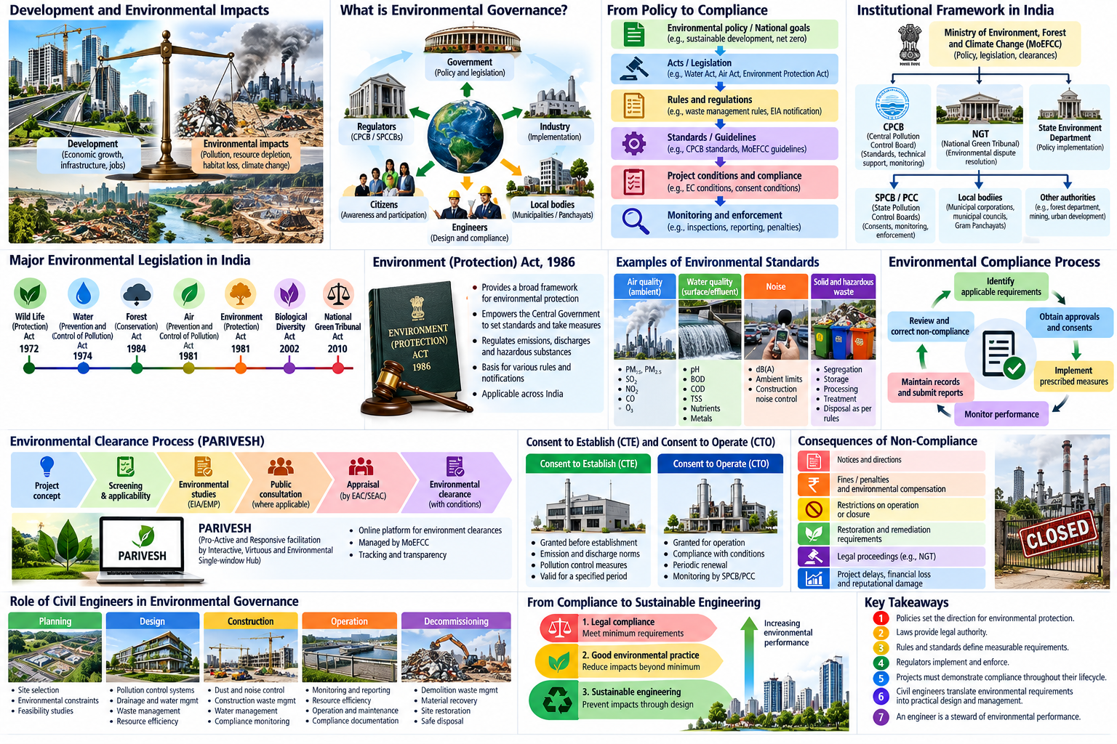

Slide 4
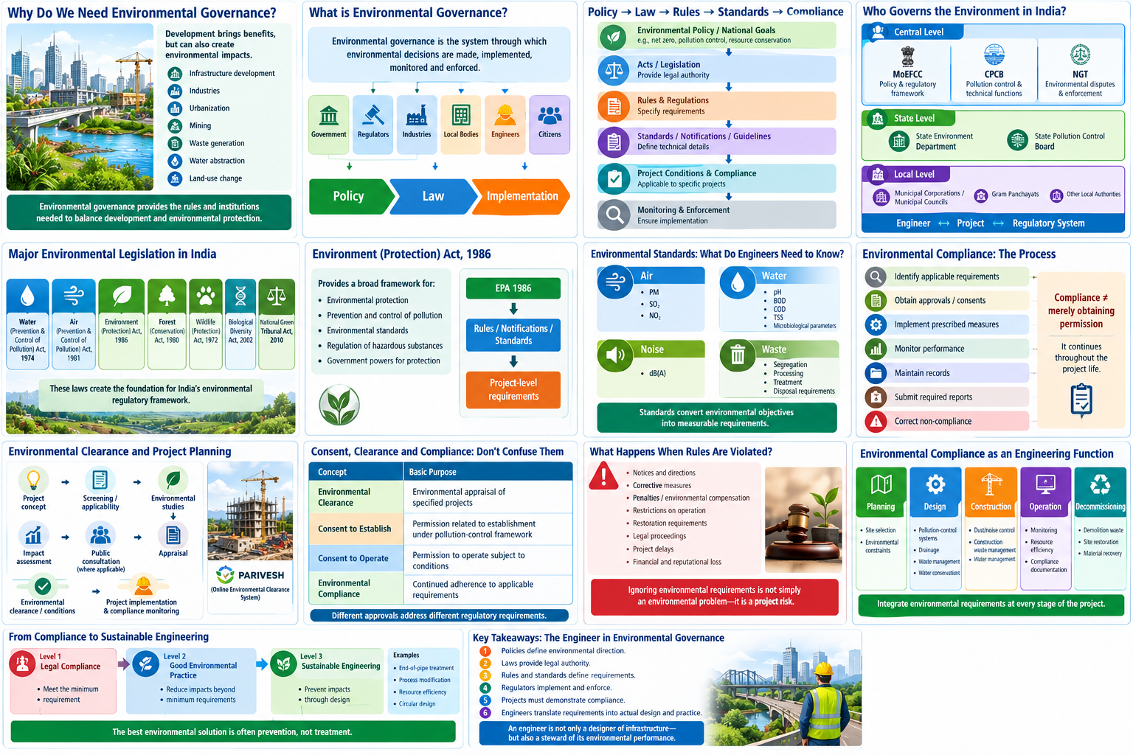

Slide 5
Why Do We Need Environmental Governance?
Development creates benefits—but can also create environmental impacts.
Infrastructure
Industry
Urbanization
Mining
Waste
Roads, buildings, dams
Production and emissions
Land, water and waste
Land and resource impacts
Generation and disposal
Environmental governance
Rules
→
Institutions
→
Implementation
→
Monitoring
→
Enforcement
EVS | Module VI | Presentation 3 2

Slide 7
What is Environmental Governance?
Environmental governance is the system through which environmental decisions are made, implemented, monitored and enforced.
Government
→
Regulators
→
Industries / Projects
→
Engineers
→
Local bodies & citizens
Three connected elements
POLICY
LAW
IMPLEMENTATION
Sets direction and priorities
Creates legal authority
Turns requirements into practice
EVS | Module VI | Presentation 3 3

Slide 9
Policy → Law → Rules → Standards → Compliance
Environmental policy / goals
→
Acts / legislation
→
Rules & notifications
→
Standards / conditions
→
Project compliance
The regulatory chain translates broad environmental objectives into measurable project requirements.
Policy
Law
Compliance
What should society achieve?
What is legally required?
What must the project demonstrate?
Policy expresses intent; legislation provides authority; standards and conditions make requirements actionable.
EVS | Module VI | Presentation 3 4

Slide 10
Who Governs the Environment in India?
Central level
State level
Local level
MoEFCC
Policy and regulatory framework
CPCB
Pollution control, technical guidance and national functions
NGT
Specialized environmental adjudication
State Environment Department
State Pollution Control Board
Implementation, consent, monitoring and enforcement functions under applicable laws
Municipal corporations / councils
Gram Panchayats
Local planning and service delivery
Engineers work across these levels through projects, consultants, contractors and authorities.
CPCB was constituted under the Water Act framework and has functions under the Air Act; NGT was established under the NGT Act, 2010.
EVS | Module VI | Presentation 3 5

Slide 12
Major Environmental Laws in India
Introductory overview — not a legal interpretation
Water Act, 1974
Air Act, 1981
Prevention and control of water pollution
Prevention and control of air pollution
Environment Protection Act, 1986
Wild Life (Protection) Act, 1972
Umbrella framework for environmental protection
Protection of wildlife and habitats
Biological Diversity Act, 2002
Forest conservation law
Conservation and sustainable use of biological resources
Forest diversion / conservation framework; updated terminology under 2023 amendments
National Green Tribunal Act, 2010
Specialized environmental dispute resolution
The framework also includes rules, notifications, standards and sector-specific requirements.
EVS | Module VI | Presentation 3 6

Slide 14
Environment (Protection) Act, 1986
Why is it important?
• Provides a broad legal framework for protection and improvement of environmental quality.
• Empowers the Central Government to take measures for preventing, controlling and abating environmental pollution.
• Supports environmental standards, rules, notifications and regulatory mechanisms.
• Provides the framework under which several important environmental requirements are issued.
EPA 1986
→
Rules / notifications
→
Standards / conditions
→
Project requirements
Think of it as a major umbrella framework—not as a single approval.
EVS | Module VI | Presentation 3 7

Slide 15
Environmental Standards: What Do Engineers Need to Know?
Standards convert environmental objectives into measurable requirements.
Engineering role: identify the applicable requirement → design for it → monitor performance → document compliance.
EVS | Module VI | Presentation 3 8

Slide 16
Environmental Compliance: What Does It Mean?
EVS | Module VI | Presentation 3 9

Slide 17
Environmental Compliance: What Does It Mean?
Compliance is a continuing project function—not a one-time permission.
Before project
During project
During operation
Applicability
Approvals / consents
Conditions
Implementation
Monitoring
Records
Reporting
Corrective action
Continued compliance
Compliance ≠ merely obtaining permission.
EVS | Module VI | Presentation 3 9

Slide 18
Environmental Clearance and Project Planning
Project concept
→
Applicability / screening
→
Environmental studies
→
Appraisal / consultation where applicable
→
Decision & conditions
→
Implementation + compliance
In India, the EIA Notification, 2006 and subsequent amendments establish the framework for prior environmental clearance for specified projects / activities.
Project planning
Design
Execution
Identify environmental constraints early
Integrate mitigation and environmental management
Meet clearance conditions and monitor compliance
PARIVESH is the Government's online platform for environmental, forest, wildlife and related clearances.
EVS | Module VI | Presentation 3 10

Slide 20
What Happens When Environmental Rules Are Violated?
Non-compliance can become a technical, financial and legal project risk.
Violation / non-compliance
→
Notice / direction
→
Corrective action
→
Penalty / compensation / legal action where applicable
Project impacts
Environmental impacts
Professional impacts
Delays
Additional cost
Operational restrictions
Pollution
Resource damage
Restoration needs
Reputation
Documentation scrutiny
Accountability
Engineering lesson: environmental compliance is part of project risk management.
EVS | Module VI | Presentation 3 12

Slide 23
Environmental Compliance as an Engineering Function
The engineer translates regulatory requirements into practical design, construction and operational controls.
Regulatory requirement
→
Engineering interpretation
→
Design / implementation
→
Measured performance

Slide 24
Key Takeaways: The Engineer in Environmental Governance
• Policies define environmental direction.
• Laws provide legal authority.
• Rules, notifications and standards define requirements.
• Regulators implement, monitor and enforce.
• Projects must demonstrate continuing compliance.
• Engineers translate environmental requirements into actual design and practice.
Engineer = Designer + Decision-maker + Environmental steward
An engineer is not only a designer of infrastructure—but also a steward of its environmental performance.
EVS | Module VI | Presentation 3 15

