Slide 1
From a task's type to its screen
THE TASK-UX MODEL
THE TEN TYPES
Decide
Answer
Make
Assess
Record
Report
Ask
Carry through
Chase
Run a batch
Ten types of task, tried on the team's role files, and the screen each type takes.
Contracts & Services Procurement Officer seat · October 2026
Notes:
This deck takes the Task-UX Model from the task's end. It writes a taxonomy of tasks, checks it against the tasks the team has already written (430 tasks of 30 roles), and then reasons, type by type, about which screen suits a task of that type. It assumes the listener knows this seat's earlier model: the three blocks of show, capture and CnC, and the seven patterns. It is one seat's proposal, and one reader made the classification. The taxonomy is written out in full in taxonomy.md, beside the classification.

Slide 2
The idea, in three steps
THE IDEA
›
›
1
2
3
Write a taxonomy
Test it
Reason to a screen
Ten types of task, read off the role file's row.
On 430 real tasks of 30 roles.
For each type: which block leads, which pattern.
If it holds: the row gives the type, and the type suggests the kind of screen, before any card is filled.
2
Notes:
Three steps. Write a taxonomy of tasks that can be read off a row of the role file. Test it on the tasks the team has already written. Then, for each type, reason about which screen suits it: what the person needs in front of them, what they put in, what follows, and what would not suit. The answers say which block leads, and that names the pattern. If it holds, the role file's own row gives the type, and the type suggests the kind of screen, before any card is filled. The card still says what is on the screen. The step from type to screen is a design proposal, to be tested; it is not shown by the classification.

Slide 3
Built on the role format's own endings
THE TAXONOMY
THE FORMAT SAYS A TASK IS DONE BY
THE TYPE
a decision made
→
Decide
a question answered
→
Answer
a message sent
→
Chase about something already asked
Report a statement, for a reader
a change in the system
→
Make the role decides it
Record the world gives it
Run a batch over a whole set
the work handed over
→
Ask someone else's to do
something understood
→
Assess one conclusion about a whole list
not in the format's list
→
Carry through every step of a case
The endings are the format's; the ten types are this seat's reading of them. Each task's type is one reader's judgement, and the screens are untested.
3
Notes:
The team's documents were searched for a taxonomy of tasks and none exists. What the shared role format does say is how a task starts (something arriving, a date, someone asking, or work coming back), how it ends, and that working through a list item by item is one task done many times. The types come out of its endings. A decision made is Decide; a question answered is Answer. A message sent is a Chase when it is about something already asked, and a Report when it is a statement for a reader. A change in the system splits by who decides its content: the role (Make), the world (Record), or the system over a whole set (Run a batch). The work handed over is an Ask. Something understood about a whole list is an Assess. And one type has no ending in the format: Carry through, a case done only when all its steps are done: it is an addition, and the format's rule that handing over ends a task would cut it into several. So three things are kept apart: the endings are the format's words; the ten types are this seat's reading of them; the type of each task is one reader's judgement, checked by nobody else; and the screens, later, are a proposal no occupier has tested. (Source: roles/README.md on the team's main branch.)

Slide 4
The ten types
THE TAXONOMY
THE TYPE
SIGNATURE HAPPENINGS THAT IDENTIFY IT
FOR EXAMPLE
Decide
An outcome is chosen among finite options for something that arrived
Decide an order sent for credit review
Make
A thing is created or updated, and the role decided its content
Raise a PO
Record
What happened recorded, as it happened - i.e without change
Record a delivery
Ask
A request is sent to someone who has the ability to act on it
Request a credit-hold release
Chase
Reminding whoever is sitting on a request/decision for too long
Remind an approver who has not decided
Answer
Answer a Question/Query someone asked
Answer where inbound goods are
Assess
Looking across a whole list to draw one conclusion about it
Find where differences concentrate
Report
A summary or explanation is prepared and sent to its reader
Explain DPO
Carry through
Seeing a case through all its steps, across several people
Run an exit
Run a batch
One system run, started by the role, acts on a whole set
Calculate the payroll
4
Notes:
One line for each type, with a task from the team's role files. The type is told by what is true when the task is done: the role file's Done when column. Decide: An outcome is chosen among finite options for something that arrived; for example, decide an order sent for credit review, of the Credit Controller. Make: A thing is created or updated, and the role decided its content; for example, raise a po, of the Procurement Officer. Record: What happened recorded, as it happened - i.e without change; for example, record a delivery, of the Stores Officer, Inbound. Ask: A request is sent to someone who has the ability to act on it; for example, request a credit-hold release, of the Credit Controller. Chase: Reminding whoever is sitting on a request/decision for too long; for example, remind an approver who has not decided, of the Expense Coordinator. Answer: Answer a Question/Query someone asked; for example, answer where inbound goods are, of the Stores Officer, Inbound. Assess: Looking across a whole list to draw one conclusion about it; for example, find where differences concentrate, of the Inventory Controller. Report: A summary or explanation is prepared and sent to its reader; for example, explain dpo, of the Procurement Manager. Carry through: Seeing a case through all its steps, across several people; for example, run an exit, of the Onboarding Coordinator. Run a batch: One system run, started by the role, acts on a whole set; for example, calculate the payroll, of the Payroll Operations Specialist.

Slide 5
Telling near neighbours apart
THE TAXONOMY
Make
or
Record
Make
or
Ask
Who decides what is entered?
Whose is the substance?
Ask
or
Chase
Decide
or
Assess
Was it asked before?
Each item, or the whole list?
Assess
or
Report
Carry through
or
the rest
Kept, or sent to a reader?
Done at the first hand-over?
One question per pair, answered from the role file's row. Where the row does not answer it, the task sits between two types.
5
Notes:
Six pairs are easy to confuse, and one question separates each. Make or Record: who decides what is entered, the role or the world? Make or Ask: is the substance this role's work, sent for approval, or someone else's to do? Ask or Chase: the first time hands the item over; after that nothing is handed over. Decide or Assess: a decision on each item, or one conclusion about the whole list? Assess or Report: is the conclusion the end, or is a statement sent to a reader? Carry through or the rest: is it done at the first hand-over? Where a row does not answer the question, the task sits between two types.

Slide 6
A list is not a type; a conclusion about one is
THE TAXONOMY
“Working through a list item by item is one task done many times. Looking across the whole list for a pattern is one task.” The role format.
One item
Many at once
The whole list, judged
DECIDE
STILL DECIDE
ASSESS
contract ending
SHOW the evidence
renew
SHOW grouped: where it concentrates
contract ending
renew
contract ending
let lapse
the conclusion
nothing found
approve
Decide · Review
Still Decide · Worklist
Assess · A conclusion, kept
e.g. Decide an order sent for credit review
e.g. Review renewals and expiry
e.g. Find where differences concentrate
How many at once changes the screen, not the type. Only one conclusion about the whole list is a type of its own.
6
Notes:
The role format says working through a list item by item is one task done many times, and looking across the whole list for a pattern is one task. So a task that does the same thing to each item on a list keeps the type of what it does to one item: this seat's monthly review of renewals is a Decide, met many at once, on a date. 37 tasks in the role files are like it, 27 of them Decide. It changes the screen and not the type: one item with evidence to read is a Review; a run of light items is a Worklist with the ending on the row. Only a task that draws one conclusion about the whole list is a type of its own, Assess: where differences concentrate, the pattern of price overrides, an audit review. It is done when there is a conclusion, and “nothing found” is one. There are 11 such tasks.

Slide 7
Tried on 430 tasks of 30 roles
DOES IT HOLD?
Decide
105
Every row was given one of the ten.
Record
78
One reader placed them all; that does not prove none is missing.
Ask
46
Answer
45
Make
39
81 sit between two types.
Chase
30
Most are two tasks in one row.
Carry through
30
Report
29
Cases and batches sit in the people roles.
Run a batch
17
28 of 30 and 16 of 17, in these files.
Assess
11
Every row, with its type, is in a file beside this deck. Any row can be checked, and any type argued with.
7
Notes:
430 tasks of 30 roles: 355 in the team's 26 role files on its main branch, 13 October (10 finance, stores and sales roles; 16 people roles), and 75 of the four seats this seat tried its model on, marked experiment. One reader gave each a type. Decide 105. Record 78. Ask 46. Answer 45. Make 39. Chase 30. Carry through 30. Report 29. Run a batch 17. Assess 11. Every row was given a type; that one reader could place them all does not prove no type is missing. 81 tasks could as well be a second type; most are two tasks in one row, such as assign and chase required learning. In these files Carry through and Run a batch are almost all in the people roles: 28 of 30 and 16 of 17, cases and payroll cycles; that may say as much about how the files were written as about the roles. Each type also tends to start its own way, on a rough reading of the words: 39 of 45 answers start with someone asking, 22 of 30 chases on a wait, 9 of 11 assessments on a date. And 48 tasks begin with a word that hides how they end, such as maintain, run or track. Every row and its type are in classification.md, beside this deck.

Slide 8
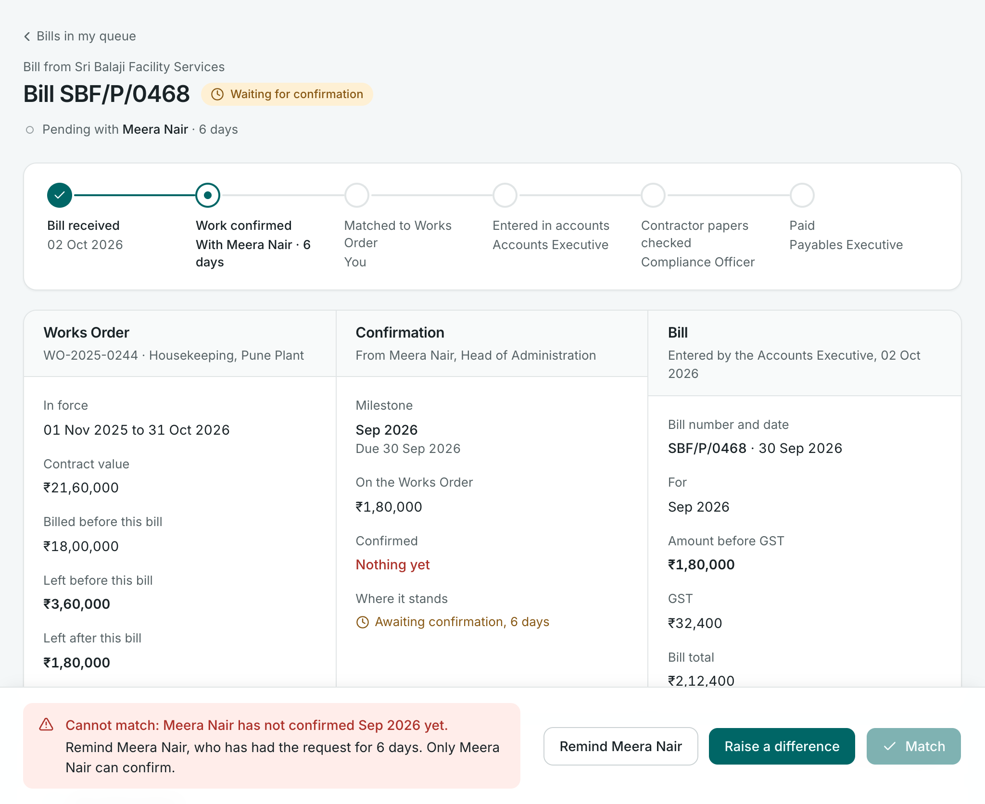
Decide: the evidence first, the endings at the foot
THE TYPES · 1 OF 10 · 105 TASKS
NEEDS
The item and its evidence, side by side.
HOLDER
SHOW
PUTS IN
The choice; a reason only on departure.
THEN
Someone else's move, at once.
NOT
Approve on a list row: it hides the evidence.
FROM THE ROLE FILES
· Decide an order sent for credit review
· Decide a stock adjustment
· Review renewals and expiry (many at once)
CHECK
A CHASE
THE ENDINGS
This seat's app: matching a service bill to its Works Order
Show leads. Pattern: Review.
8
Notes:
Decide. One of several outcomes is chosen for something that arrived ready-made, from another seat or the system. For example: decide an order sent for credit review, of the Credit Controller; decide a stock adjustment, of the Inventory Controller; review renewals and expiry, of the Contracts & Services Procurement Officer, this seat. Needs in front of them: The item and its evidence, side by side. Puts in: The choice; a reason only on departure. What follows: Someone else's move, at once. Would not suit: Approve on a list row: it hides the evidence. So: show leads; the pattern is review. On screen, this seat's task of matching a service bill to its Works Order, on a bill that cannot yet be matched. The check sits with what it guards: the department head has not confirmed the month. The two endings are together at the foot. The reminder on the same screen is a Chase, another type, made here because the item is here. Whose move it is sits under the title, in none of the three blocks. A Decide met many at once, such as the monthly review of renewals, takes a Worklist instead. The people named on the screen are of the made-up sample company.

Slide 9
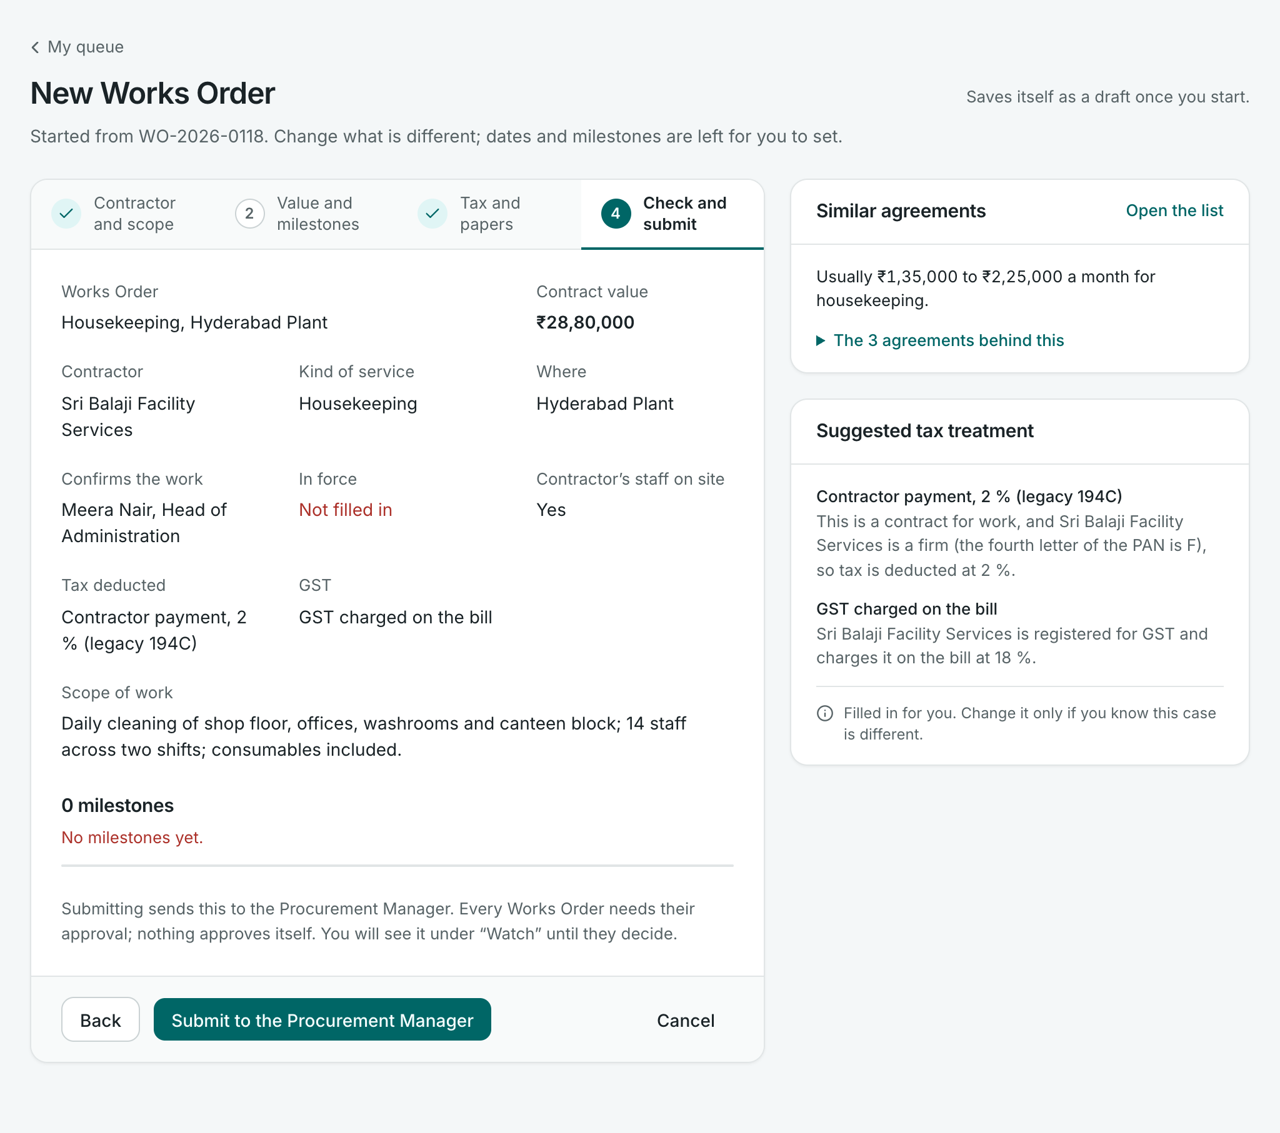
Make: a start that is not blank, saved as it goes
THE TYPES · 2 OF 10 · 39 TASKS
NEEDS
A start that is not blank: the last one like it.
PUTS IN
Many inputs, with interruptions; it saves itself.
THEN
Usually an approver's move.
NOT
One long page; it loses the place.
CHECK
SHOW
FROM THE ROLE FILES
· Raise a PO
· Prepare a workforce plan
· Plan a count cycle
HAND-OVER
CAPTURE
This seat's app: raising a Works Order, last stage
Capture leads. Pattern: Flow, or a Form when small.
9
Notes:
Make. A new thing exists, or a thing is changed, and the role decided what is in it. For example: raise a po, of the Procurement Officer; prepare a workforce plan, of the Workforce Planning Lead; plan a count cycle, of the Inventory Controller. Needs in front of them: A start that is not blank: the last one like it. Puts in: Many inputs, with interruptions; it saves itself. What follows: Usually an approver's move. Would not suit: One long page; it loses the place. So: capture leads; the pattern is flow, or a Form when small. On screen, raising a Works Order at the last of its four stages, started from an earlier one. Show sits beside the form and each fact answers an input. What is still missing shows in red before the press, as a prompt. The button names the next holder, the Procurement Manager.

Slide 10
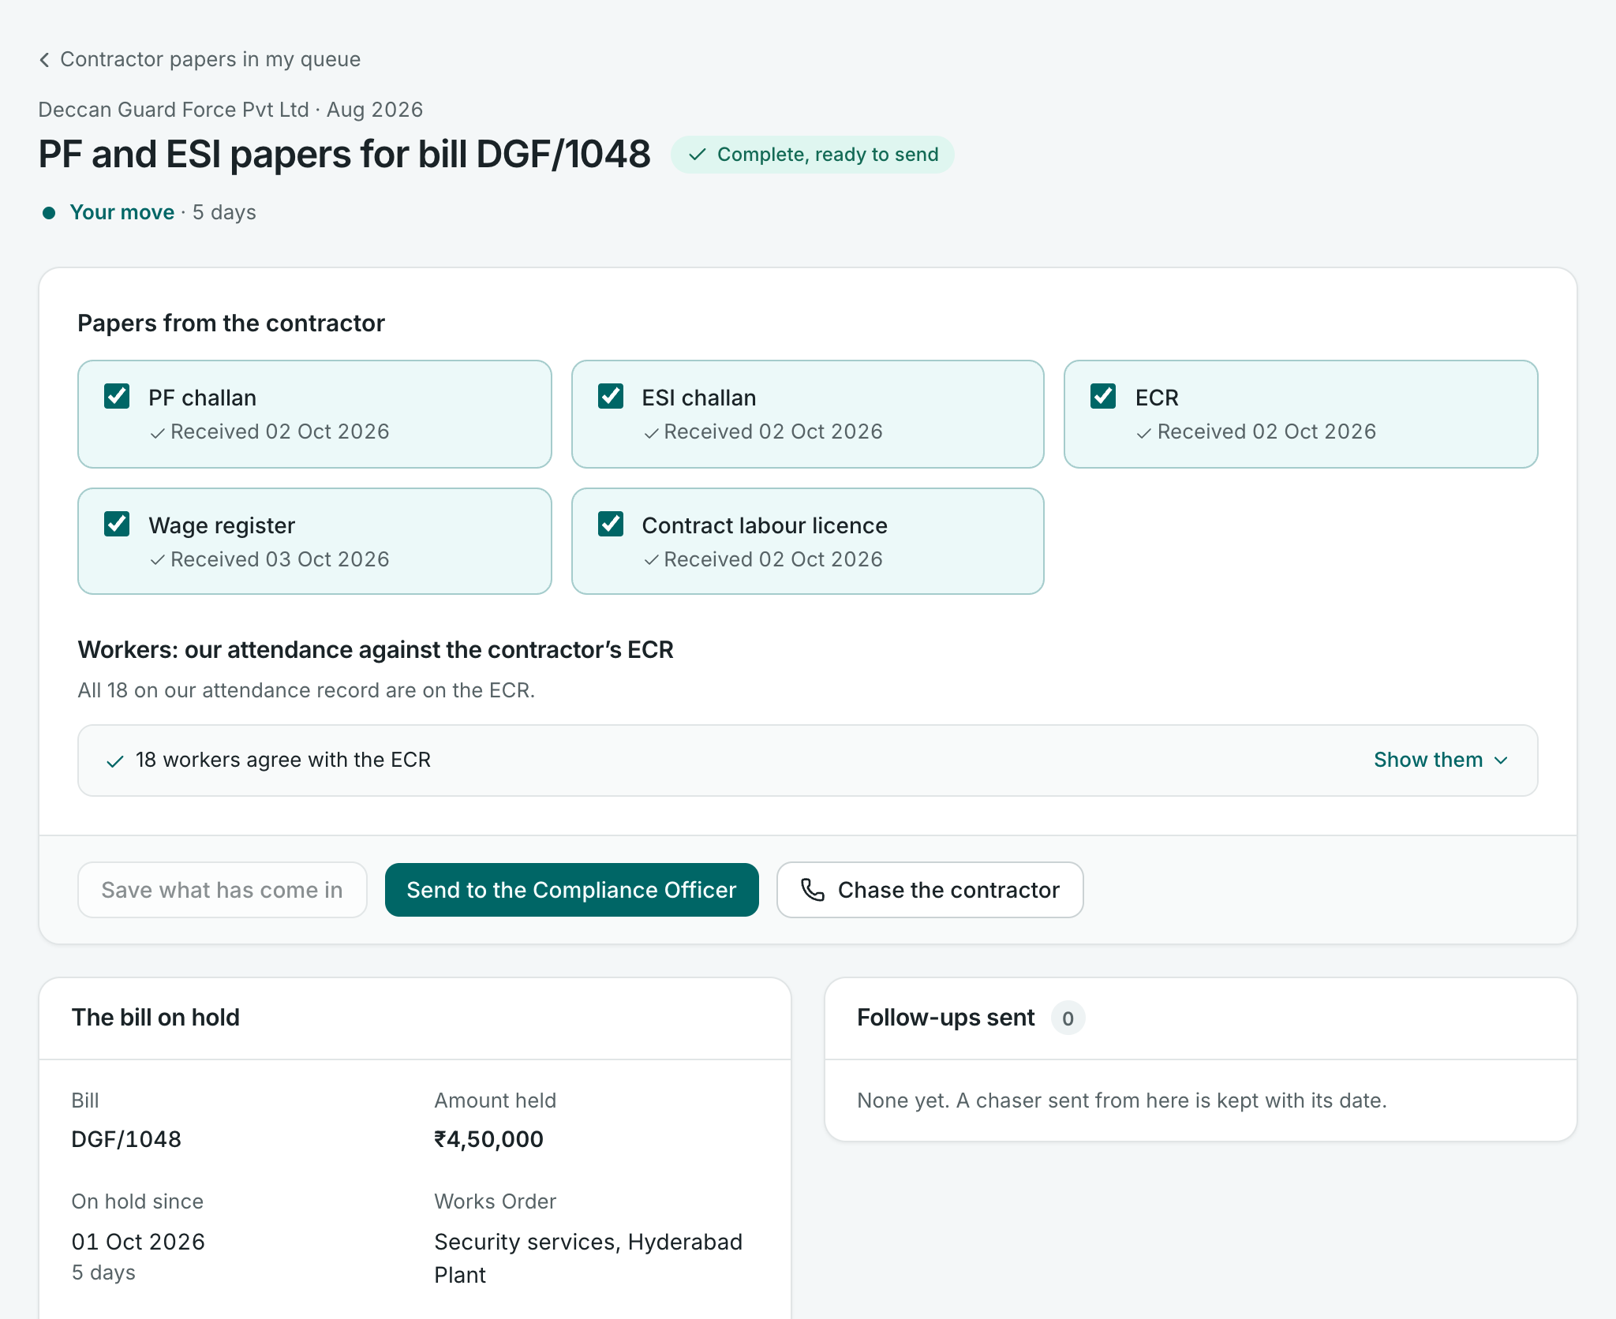
Record: filled in from what was expected
THE TYPES · 3 OF 10 · 78 TASKS
NEEDS
What was expected: the order, the challan, the change.
CAPTURE
PUTS IN
Only what differs, and fast.
THEN
Often nobody: the record is the end.
CHECK
NOT
A blank form that retypes what is known.
FORM-ACTIONS
FROM THE ROLE FILES
SHOW
· Record a delivery
· Capture a document
· Update an employee's details
This seat's app: a contractor's papers for a month
Capture leads, filled in already. Pattern: Form, filled in from what was expected.
10
Notes:
Record. What happened is on the record as it happened; the content is given by an event, a paper or an approved change. For example: record a delivery, of the Stores Officer, Inbound; capture a document, of the Procurement Officer; update an employee's details, of the HR Operations Administrator. Needs in front of them: What was expected: the order, the challan, the change. Puts in: Only what differs, and fast. What follows: Often nobody: the record is the end. Would not suit: A blank form that retypes what is known. So: capture leads, filled in already; the pattern is form, filled in from what was expected. On screen, a contractor's provident fund and insurance papers for a billed month. The officer ticks what has come in against what was expected. The check compares our attendance with the contractor's own return. Save is the record; send on is the hand-over; chase is another type. This app sends the papers only when complete; the role file says with every gap flagged.

Slide 11
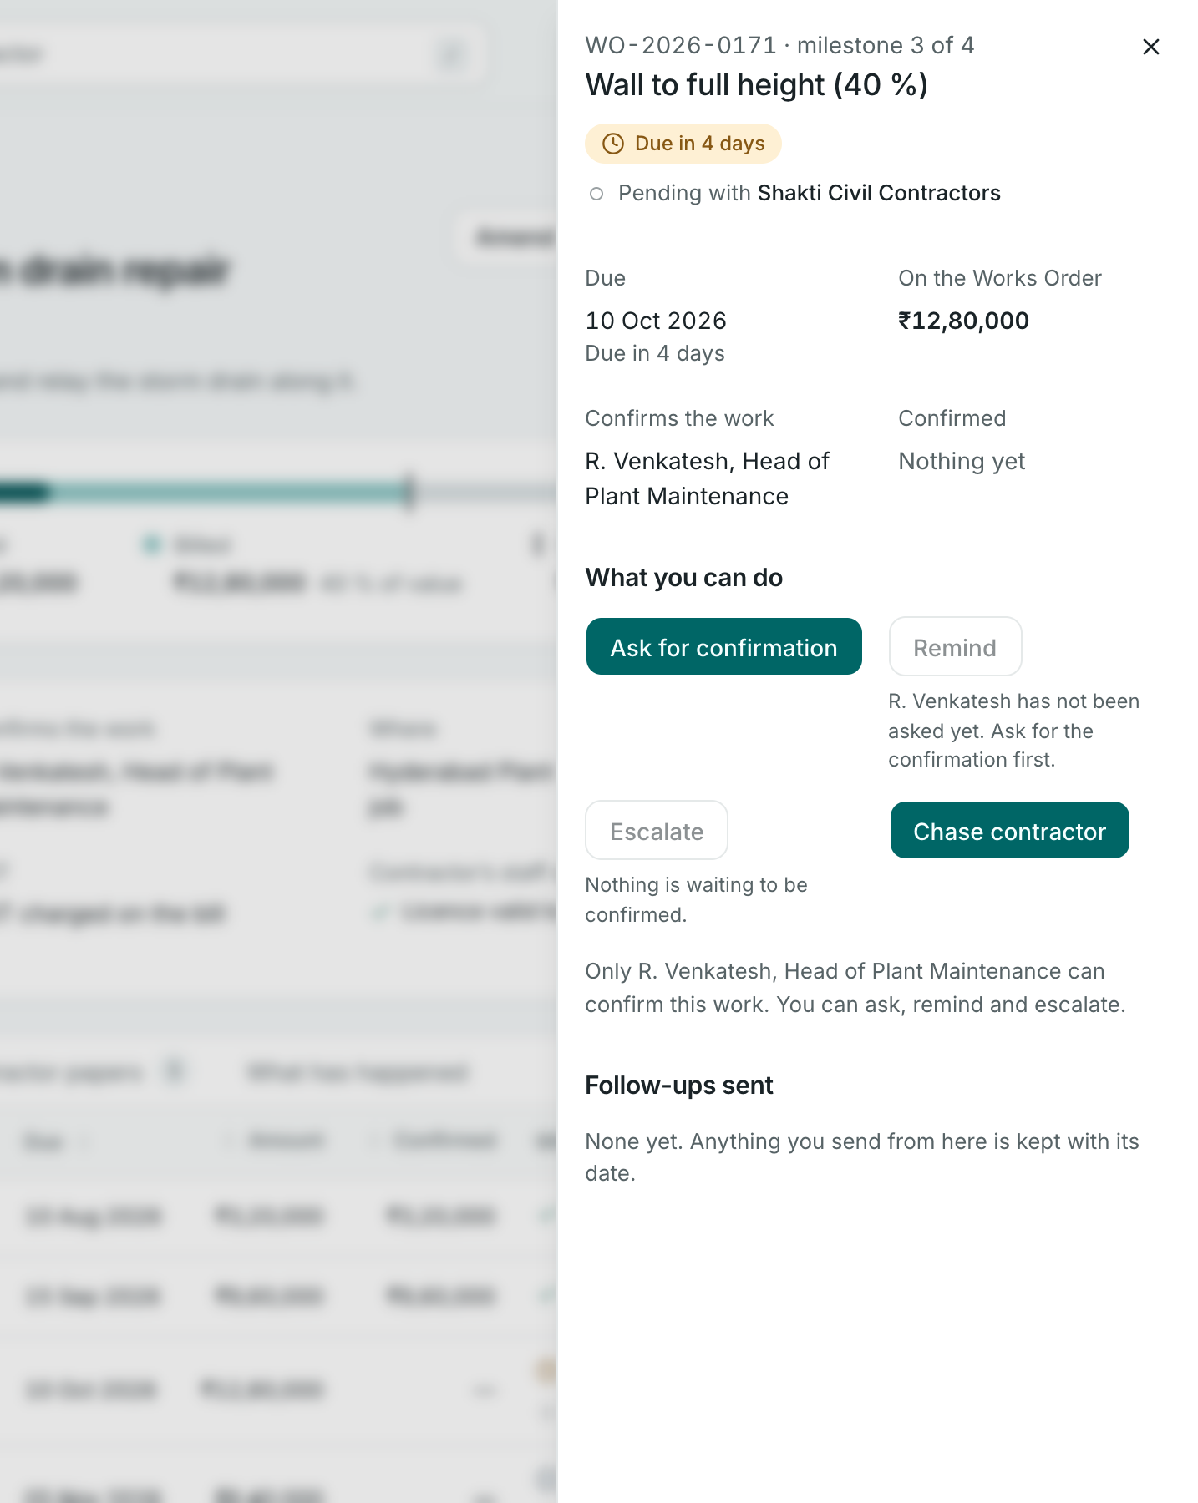
Ask: a small form, opened on the item
THE TYPES · 4 OF 10 · 46 TASKS
NEEDS
The item, and what the receiver needs to say yes.
PUTS IN
What is asked, and why; often one press.
SHOW
THEN
The receiver's move; a chase if it waits.
CAPTURE
CHECK
NOT
A page of its own, away from the item.
WHO CAN
KEPT
FROM THE ROLE FILES
· Request a credit-hold release
· Raise an indent
· Ask for a new item
This seat's app: asking for a confirmation
Capture leads, and it is small. Pattern: Form, opened on the item.
11
Notes:
Ask. A request is with someone who can do or decide what this role cannot, so the task ends by handing over. For example: request a credit-hold release, of the Credit Controller; raise an indent, of the Stores Officer, Inbound; ask for a new item, of the Stores Officer, Inbound. Needs in front of them: The item, and what the receiver needs to say yes. Puts in: What is asked, and why; often one press. What follows: The receiver's move; a chase if it waits. Would not suit: A page of its own, away from the item. So: capture leads, and it is small; the pattern is form, opened on the item. On screen, asking a department head to confirm a milestone's work. It opens on the milestone, inside the Works Order. Capture is one press. The neighbouring Remind is refused until someone has been asked, which keeps an Ask before a Chase. Only the department head can confirm, and what is sent is kept with its date.

Slide 12
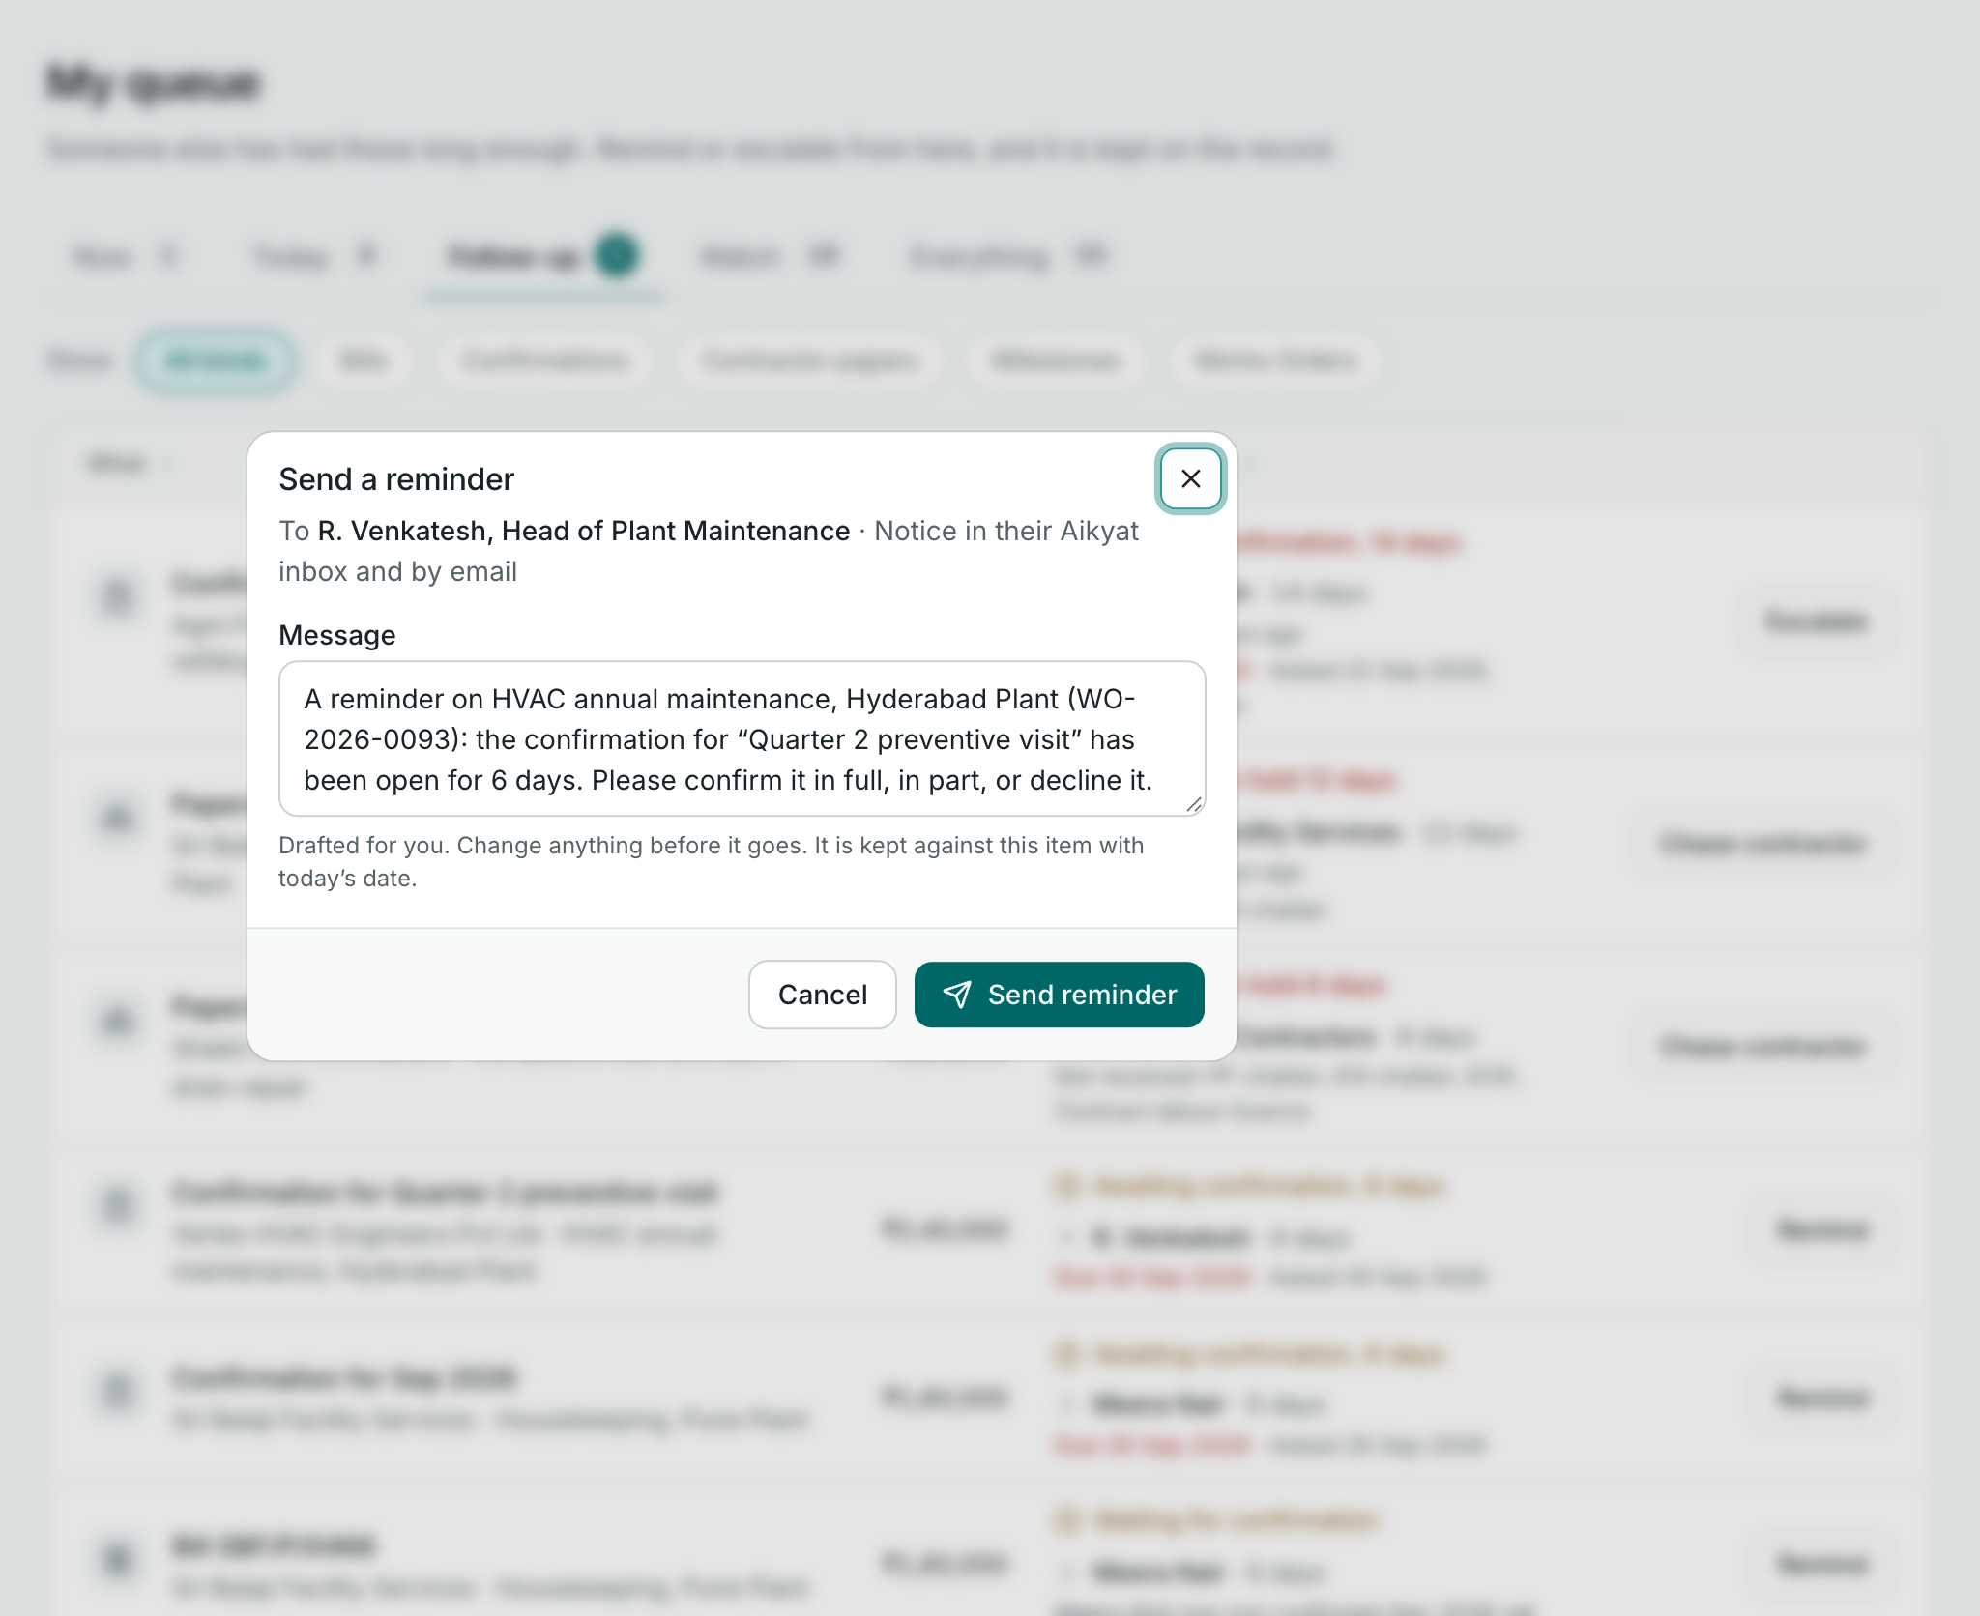
Chase: one press, on the item
THE TYPES · 5 OF 10 · 30 TASKS
NEEDS
Who has it, since when, what was sent.
PUTS IN
One press; the words drafted.
THE CHASE
THEN
Nothing changes hands; the count restarts.
DRAFTED
NOT
A screen of its own; a chat with no trace.
KEPT
FROM THE ROLE FILES
· Remind an approver who has not decided
· Chase feedback
· Chase a transfer still on the road
This seat's app: a reminder, from the queue
Neither block leads. Pattern: One form-action, on the item.
12
Notes:
Chase. Whoever has had the item too long has been reminded; nothing is handed over. For example: remind an approver who has not decided, of the Expense Coordinator; chase feedback, of the Talent Acquisition Specialist; chase a transfer still on the road, of the Inventory Controller. Needs in front of them: Who has it, since when, what was sent. Puts in: One press; the words drafted. What follows: Nothing changes hands; the count restarts. Would not suit: A screen of its own; a chat with no trace. So: neither block leads; the pattern is one form-action, on the item. On screen, the queue, on the items someone else has had long enough; Remind was pressed on one row. The words are drafted and can be changed; it is kept against the item with the date, and the count of days restarts. This seat treats a reminder as a form-action; every other seat puts it in CnC, and that is still open between the seats.

Slide 13
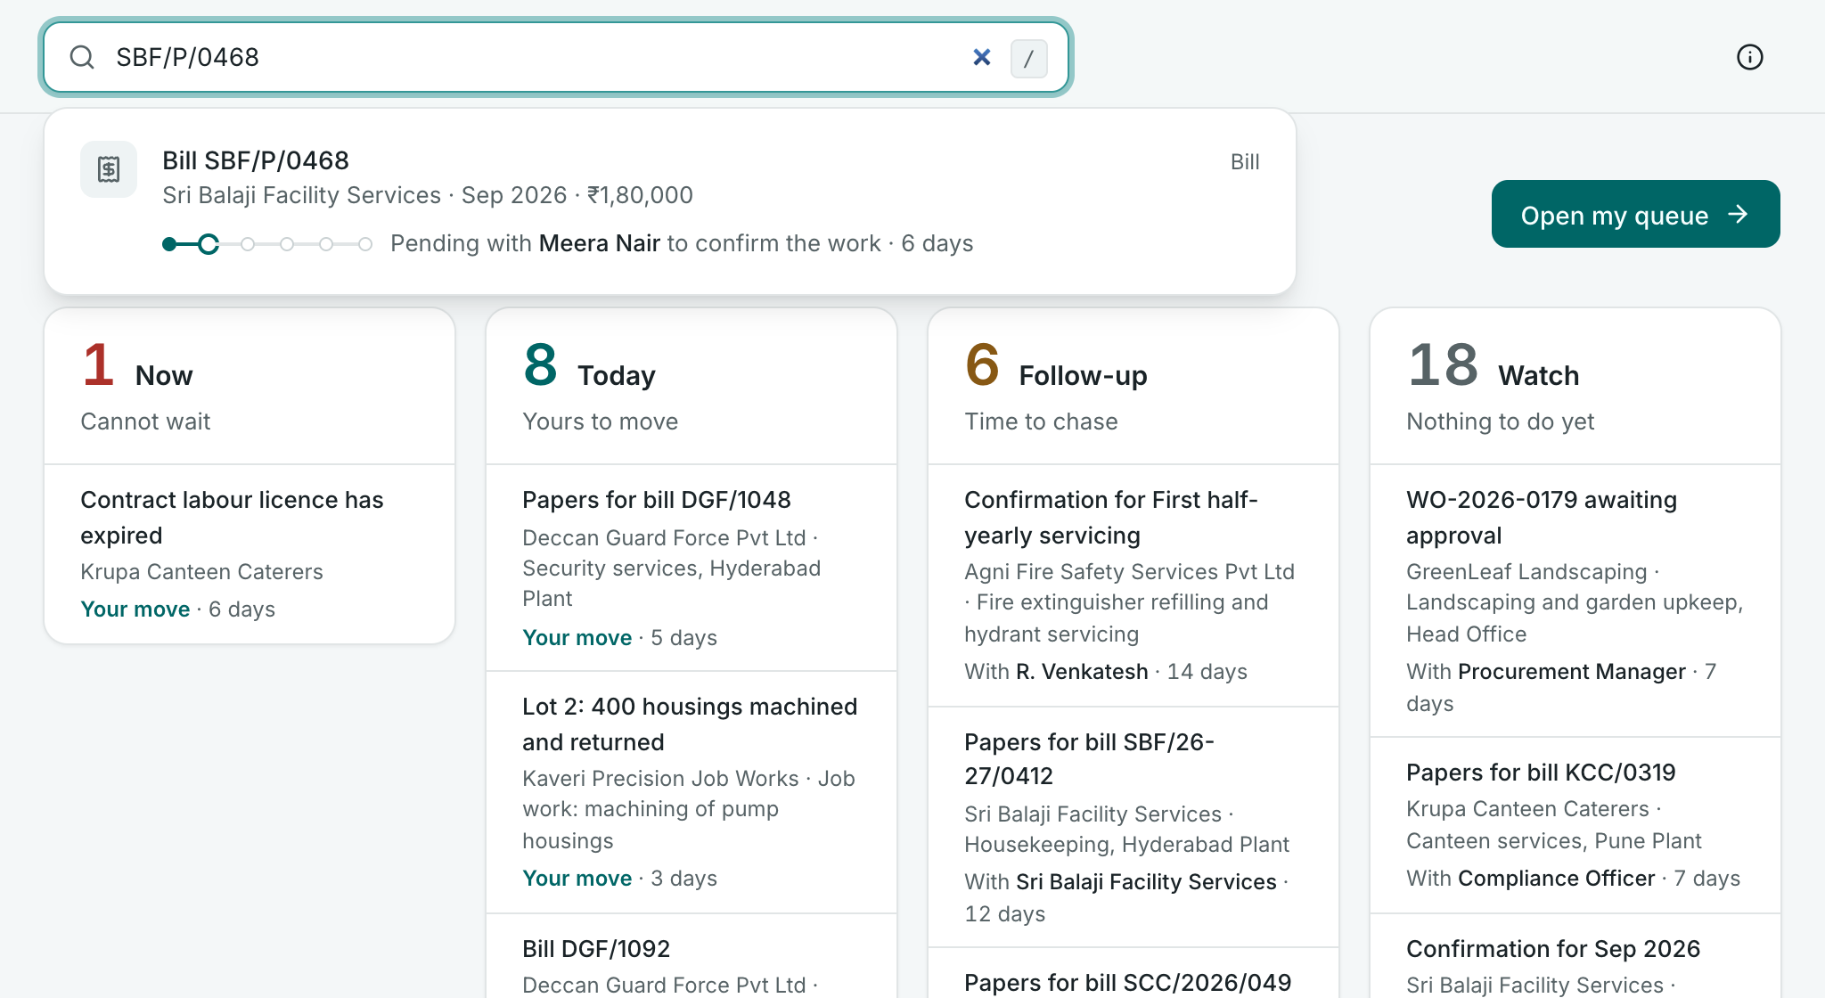
Answer: search, and the answer in one line
THE TYPES · 6 OF 10 · 45 TASKS
NEEDS
The one thing asked about, in seconds.
ASKED
THE ANSWER
PUTS IN
Nothing; the reply goes to the person.
THEN
Nothing, unless the answer shows a problem.
NOT
A report to scroll while someone waits.
FROM THE ROLE FILES
· Answer where inbound goods are
· Answer a pay query
· Answer whether a customer can take an order
This seat's app: “where is my bill?”
Show leads, then CnC. Pattern: Search, and the item's own page.
13
Notes:
Answer. The person who asked has the answer, and nothing in the system has changed. For example: answer where inbound goods are, of the Stores Officer, Inbound; answer a pay query, of the Payroll Operations Specialist; answer whether a customer can take an order, of the Credit Controller. Needs in front of them: The one thing asked about, in seconds. Puts in: Nothing; the reply goes to the person. What follows: Nothing, unless the answer shows a problem. Would not suit: A report to scroll while someone waits. So: show leads, then cnc; the pattern is search, and the item's own page. On screen, a contractor phones to ask where a bill is. The officer types the bill number, and the answer is one line without opening anything: how far along it is, and that it is with the department head, six days. Nothing is written. Sending the answer on, as a link to the bill, is CnC and is not built in this app.

Slide 14
Assess: the whole list, and a conclusion kept
THE TYPES · 7 OF 10 · 11 TASKS
NEEDS
The whole list, arranged to show a pattern: grouped, compared, over time.
A WHOLE LIST, JUDGED
this quarter, by godown
the list, cut to the question
PUTS IN
The conclusion, and what it rests on; “nothing found” is one.
SHOW the whole list, grouped to show where it concentrates:
by godown · by person · month on month
THEN
Often a Report or an Ask carries the conclusion on.
NOT
Rows to act on one by one: that is another type, many at once.
CAPTURE
the conclusion, with what it rests on
keep the conclusion
FROM THE ROLE FILES
nothing found
· Find where differences concentrate
· Review the discount and price-override pattern
· Carry out a review from the audit plan
Show
Capture
a form-action
a check
CnC
not in the model yet
Show leads. Pattern: None of the seven: it must keep a conclusion.
14
Notes:
Assess. There is one conclusion about a whole list or a period, which no other task draws; “nothing found” is a conclusion. For example: find where differences concentrate, of the Inventory Controller; review the discount and price-override pattern, of the Sales Manager; carry out a review from the audit plan, of the Internal Auditor, a tried seat. Needs in front of them: The whole list, arranged to show a pattern: grouped, compared, over time. Puts in: The conclusion, and what it rests on; “nothing found” is one. What follows: Often a Report or an Ask carries the conclusion on. Would not suit: Rows to act on one by one: that is another type, many at once. So: show leads; the pattern is none of the seven: it must keep a conclusion. This seat has no task of this type, so it is a drawing. The whole list is shown so that the pattern can be seen, and the conclusion is kept, including that nothing was found. None of the seven patterns keeps a conclusion: a Register shows the list and nothing records that the look was made. One tried seat invented a sign-off for it.

Slide 15
Report: a statement drawn up, then sent
THE TYPES · 8 OF 10 · 29 TASKS
NEEDS
The statement, drawn up already, with what moved.
A STATEMENT, SENT TO ITS READER
SHOW
the statement, drawn up already:
this period, last period, what moved
CAPTURE
the explanation, line by line
PUTS IN
A word on each line that moved; then send.
THEN
The reader's: management, an authority.
a line that moved needs a word
NOT
A blank document; a list that cannot be sent.
FROM THE ROLE FILES
send to management
no pattern says “publish”
· Explain DPO
· Report workforce measures
· Prepare the Audit Committee summary
Show
Capture
a form-action
a check
CnC
not in the model yet
Show leads: the statement is the item. Pattern: Nearest is a Review; no pattern fits.
15
Notes:
Report. A statement (a summary, an explanation, a return) is with its reader. For example: explain dpo, of the Procurement Manager; report workforce measures, of the Workforce Planning Lead; prepare the audit committee summary, of the Internal Auditor, a tried seat. Needs in front of them: The statement, drawn up already, with what moved. Puts in: A word on each line that moved; then send. What follows: The reader's: management, an authority. Would not suit: A blank document; a list that cannot be sent. So: show leads: the statement is the item; the pattern is nearest is a Review; no pattern fits. This seat has no task of this type, so it is a drawing. The statement is the item: drawn up already, with what moved since last time, and a word wanted on each line that moved. Nothing among the seven patterns says publish.

Slide 16
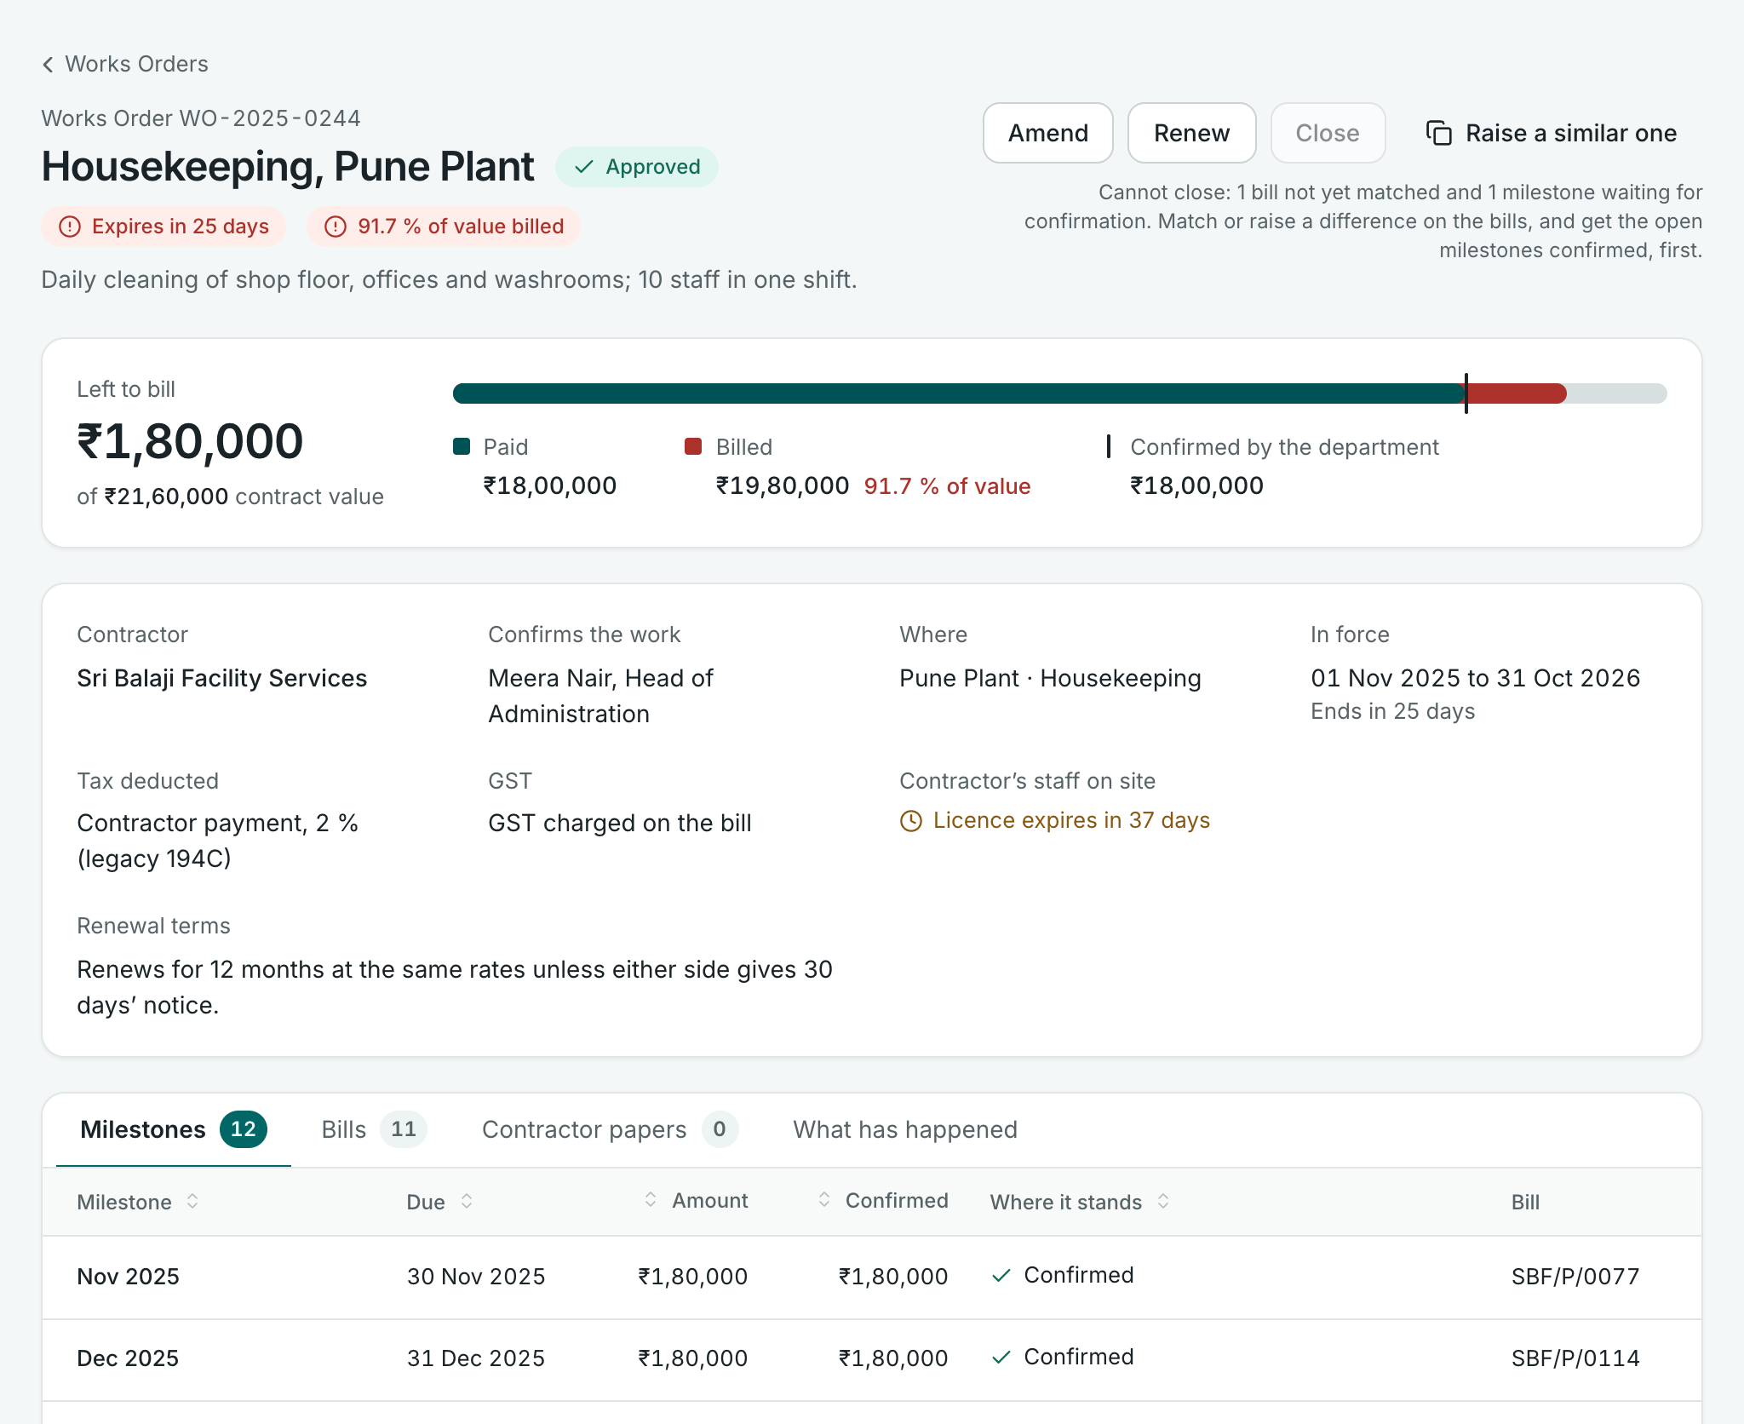
Carry through: the case, with its steps inside
THE TYPES · 9 OF 10 · 30 TASKS
NEEDS
The case: its steps, who has each, what is late.
ON THE CASE
PUTS IN
Each step's own form-action.
THEN
Most of its life is with other people.
NOT
A Flow for one sitting; a list that loses the case.
SHOW
FROM THE ROLE FILES
ITS STEPS
· Run an exit
· Investigate and close a case
· Negotiate purchase rates
This seat's app: the Works Order, a case in all but name
Show leads. Pattern: The case's own page, with its steps inside.
16
Notes:
Carry through. Every step of a case, done by several people, is done, or the late ones are chased. For example: run an exit, of the Onboarding Coordinator; investigate and close a case, of the Compliance and Labour Relations; negotiate purchase rates, of the Procurement Manager. Needs in front of them: The case: its steps, who has each, what is late. Puts in: Each step's own form-action. What follows: Most of its life is with other people. Would not suit: A Flow for one sitting; a list that loses the case. So: show leads; the pattern is the case's own page, with its steps inside. This seat has no task of this type, but it has the screen: the Works Order is a case in all but name. Its steps, twelve milestones, are inside it, each with where it stands. Whether a role file keeps a case as one task or cuts it into small ones, this is the screen that holds it together. The earlier model calls this pattern a Record; it is named here as the case's own page, so as not to be confused with the type Record.

Slide 17
Run a batch: a gate, one press, then what was held
THE TYPES · 10 OF 10 · 17 TASKS
NEEDS
Is the set ready? What is missing, from whom.
ONE PRESS, OVER A WHOLE SET
SHOW the gate: is the set ready?
✓ attendance in ✓ claims checked
✗ 3 joiners with no bank account
CHECK what blocks, and who can clear it
PUTS IN
One press, often one-way.
THEN
What was done, and what was held, with why.
calculate, for 312
NOT
A list pressed 300 times; a bare button.
AFTER 309 done · 3 held, each with why
one form-action on many items: no pattern has it
FROM THE ROLE FILES
· Calculate the payroll
· Freeze payroll inputs
· Bring in the day’s bank statement
Show
Capture
a form-action
a check
CnC
not in the model yet
Show leads, as a gate. Pattern: Nearest is a Review; no pattern fits.
17
Notes:
Run a batch. The system has done one thing to a whole set, at the role's word. For example: calculate the payroll, of the Payroll Operations Specialist; freeze payroll inputs, of the Attendance and Leave Specialist; bring in the day’s bank statement, of the Reconciliation Executive, a tried seat. Needs in front of them: Is the set ready? What is missing, from whom. Puts in: One press, often one-way. What follows: What was done, and what was held, with why. Would not suit: A list pressed 300 times; a bare button. So: show leads, as a gate; the pattern is nearest is a Review; no pattern fits. This seat has no task of this type, so it is a drawing. The screen is a gate: is the set ready, and what is missing, from whom. Then one press, often one-way, and what was done and what was held, each with why. Nothing among the seven patterns says one press over many items.

Slide 18
The whole map, and what the patterns cannot hold
FROM THE TYPE TO THE SCREEN
THE TYPE
WHICH BLOCK LEADS
THE SCREEN
IN THIS SEAT'S APP
Decide
Show leads
Review
the bill
Make
Capture leads
Flow, or a Form when small
a new Works Order
Record
Capture leads, filled in already
Form, filled in from what was expected
contractor papers
Ask
Capture leads, and it is small
Form, opened on the item
a milestone
Chase
Neither block leads
One form-action, on the item
the reminder
Answer
Show leads, then CnC
Search, and the item's own page
search
Assess
Show leads
None of the seven: it must keep a conclusion
none
Report
Show leads: the statement is the item
Nearest is a Review; no pattern fits
none
Carry through
Show leads
The case's own page, with its steps inside
the Works Order
Run a batch
Show leads, as a gate
Nearest is a Review; no pattern fits
none
As this seat reasons it, six types take a pattern. Chase takes none, by design. Assess, Report and Run a batch need one.
18
Notes:
The whole map on one slide, as this seat reasons it: a proposal to be tested, not a finding. Six of the ten types take one of the seven patterns cleanly. Chase takes none, by design: it is one form-action on the item. Three need something the patterns do not have: Assess, a conclusion kept; Report, a statement that is sent; Run a batch, one press over many items. The last of these is also what every type needs when many items are confirmed at one word. A fourth gap is known from before: the reply to a question is CnC, and starting a conversation from an item is built in none of the five apps this model was tried on. The last column says whether this seat's app has a screen of the type.

Slide 19
A possibility: the role app may follow the task mix
WHAT FOLLOWS
HEAVY IN
THE OPENING PAGE COULD BE
FOR EXAMPLE
Decide
An inbox of what is to be decided
Credit Controller
Record
Today's expected events, entry one step away
Stores Officer, Inbound
Make and Ask
My items in flight, by whose move it is
Sales Executive
Chase and Answer
Who has what, for how long; search in front
Treasury Head, a tried seat
Assess and Report
What is due this week and month
Procurement Manager
Carry through
A board of open cases and their steps
Learning and Performance Manager
Run a batch
The cycle itself, step by step, with gates
Payroll Operations Specialist
A thought, not a finding. Counts are not hours, and most roles are mixed.
19
Notes:
A thought beyond the Task-UX. If the types a role is heavy in shape its day, they may also shape its app: what the opening page is, and how work is brought to the person. A role heavy in deciding might open on an inbox; one heavy in recording, on today's expected events; one heavy in making and asking, on its items in flight by whose move it is, as this seat's app does; one heavy in chasing and answering, on who has what with search in front; one heavy in assessments and reports, on what is due; one heavy in cases, on a board of cases; and a batch role, payroll above all, on the cycle itself. The last column names the role with the largest share of each group. Cautions: counts are not hours, and the role files do not say how often a task is done; most roles are mixed. It would be a way to start modelling the role app from the task mix.

Slide 20
What is asked of the team
1
Check the types against your own role
2
Say whether the type belongs in the role file
Each owner knows what their rows mean.
One column, and anyone can derive the kind of screen.
3
Re-cut the tasks that take two types
4
Decide the three missing patterns
81 rows; most are two tasks.
A conclusion kept; a statement sent; one press over many.
Limits. One reader, and no owner asked · role files of 13 October · this seat's screens only, on a stand-in engine · argument, not test: no occupier has seen a screen.
One seat's proposal, and one reader's classification. The team has not settled the Task-UX.
Notes:
Four asks. Each owner checks the types against their own role: where a type looks wrong, either the classification is wrong or the row says something other than what was meant. Say whether the type belongs in the role file as one more column, so that anyone can derive the kind of screen. Re-cut the 81 tasks that take two types; by the format's own test most are two tasks. And decide the three missing patterns: a conclusion kept, a statement that is sent, and one press over many items. The earlier asks still stand: where a reminder sits, and who has an item between tasks. The limits: one reader, an AI assistant working for this seat, made the classification, and a second reader would move some rows; no owner was asked what a row meant; the role files are those of 13 October and change daily; every screen is this seat's, on a stand-in engine; the reasoning from type to screen is argument, not test; three types have only a drawing; and ten types is a first cut.

