Slide 1

Image processing using OpenCV

Slide 2
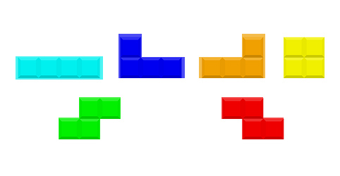
Counting objects

Slide 3
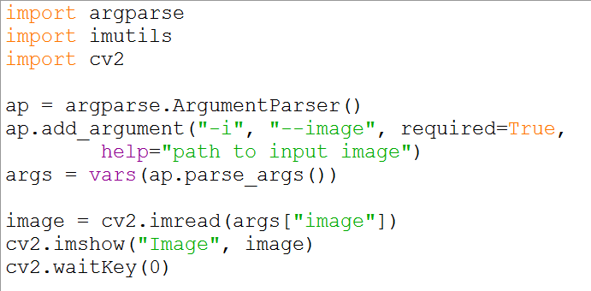
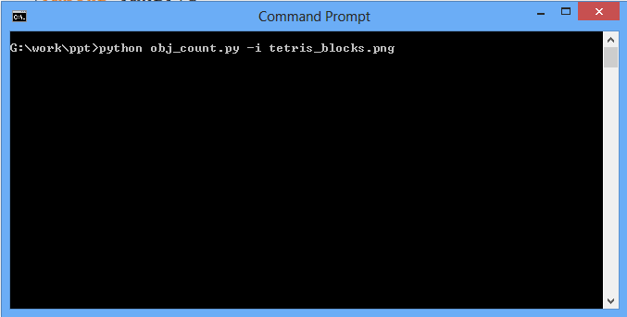
Arguments

Slide 4
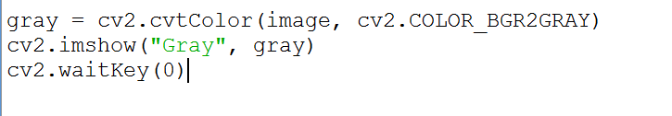
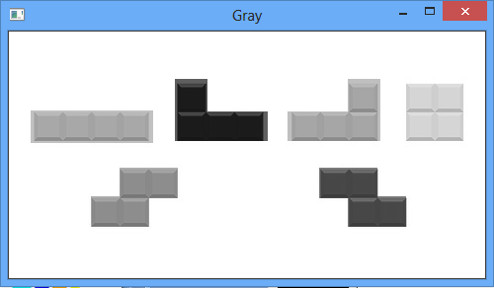
Converting an image to grayscale

Slide 5

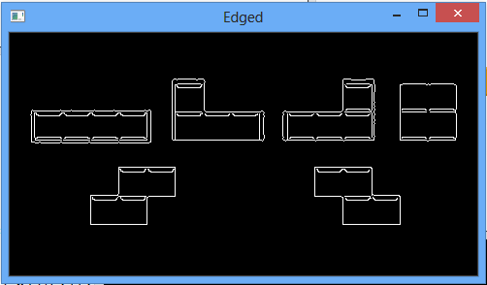
Edge detection

Slide 6
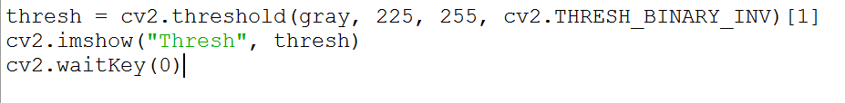
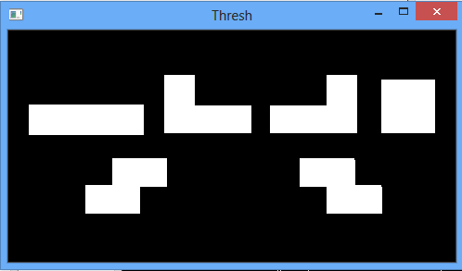
Thresholding

Slide 7
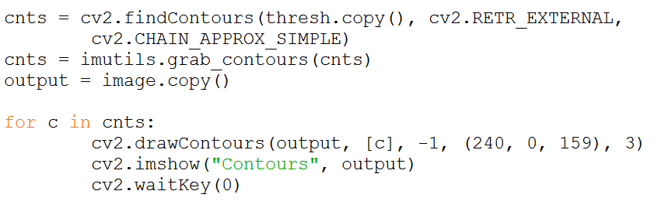
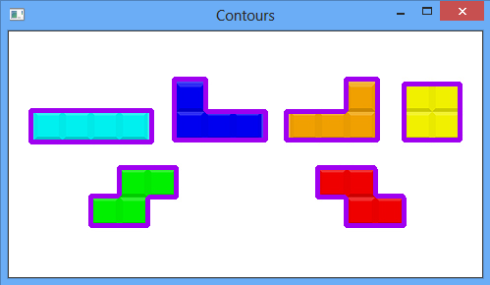
Detecting and drawing contours

Slide 8
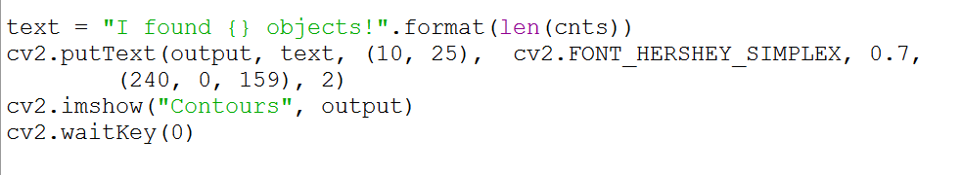
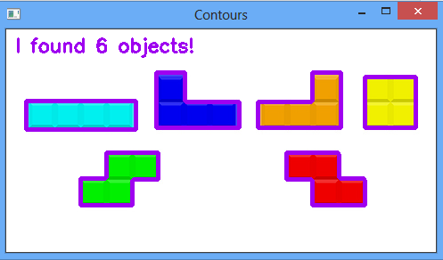
Final output

Slide 9

Contact
A.Arul Prabahar,
Deputy Manager,
NTSC, Ekkadu thangal,
Chennai -32.
Mob: 8754871885
E-mail: arulprabahar@gmail.com

