Slide 1

Image processing using OpenCV

Slide 2
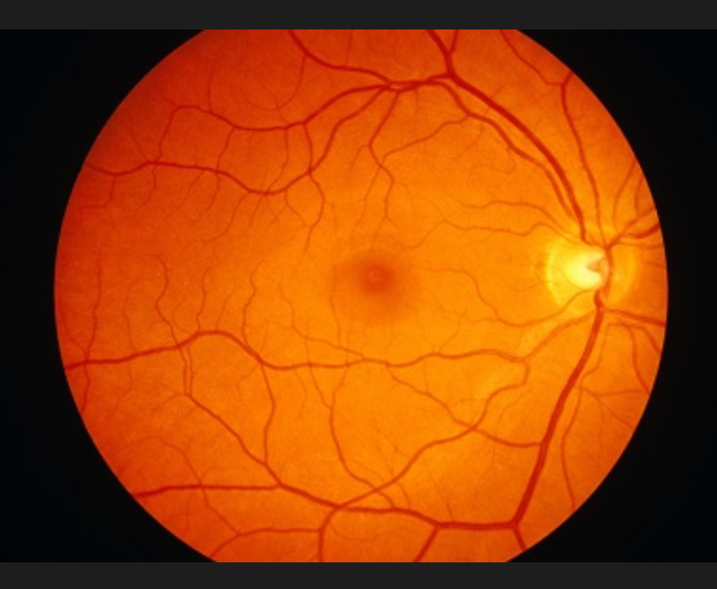
Finding brightest spot

Slide 3
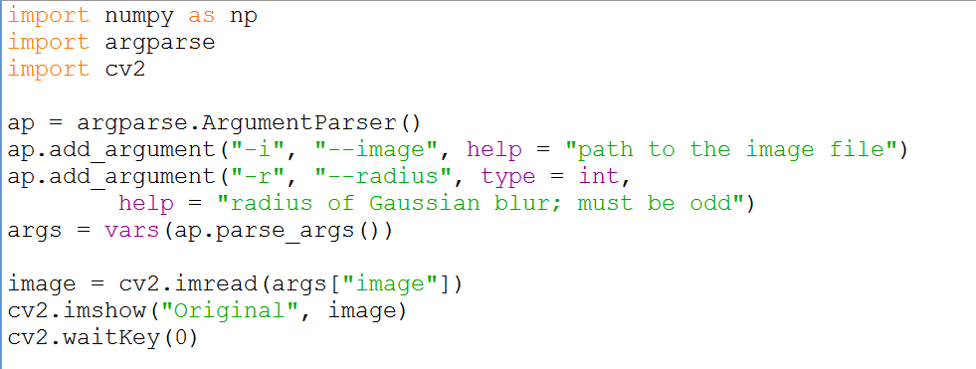
Arguments

Slide 4
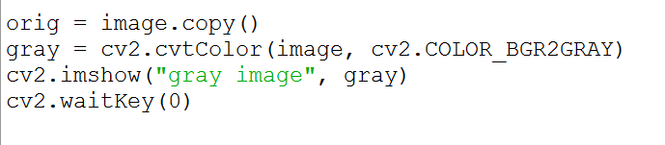
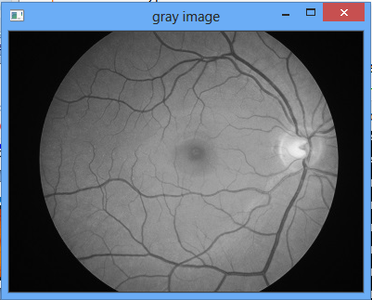
Converting an image to grayscale

Slide 5
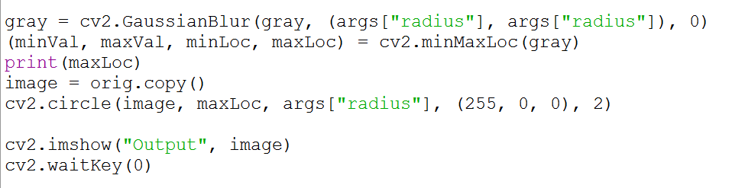
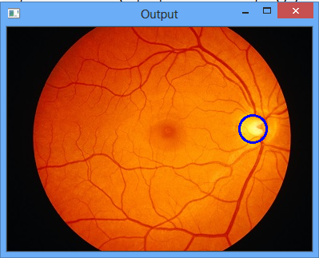
Finding brightest spot

Slide 6

Contact
A.Arul Prabahar,
Deputy Manager,
NTSC, Ekkadu thangal,
Chennai -32.
Mob: 8754871885
E-mail: arulprabahar@gmail.com

