Slide 1

Image processing using OpenCV

Slide 2
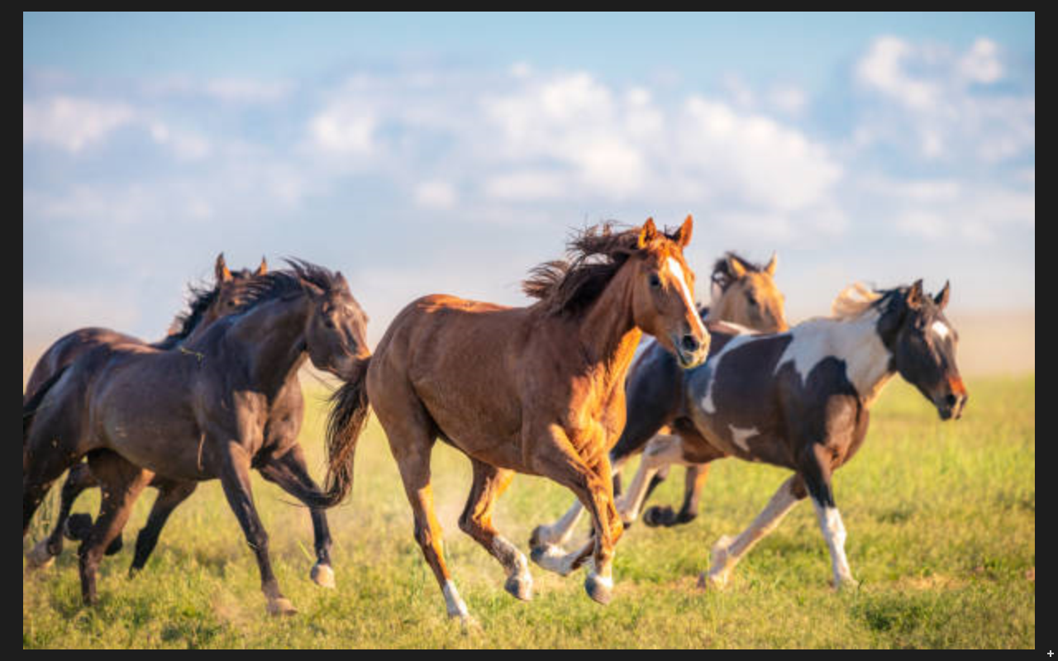
Object detection

Slide 3
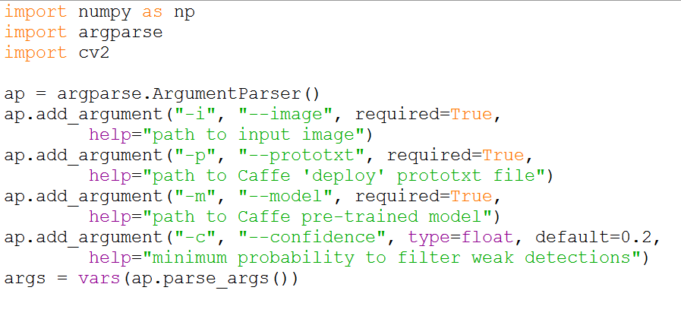
Arguments

Slide 4
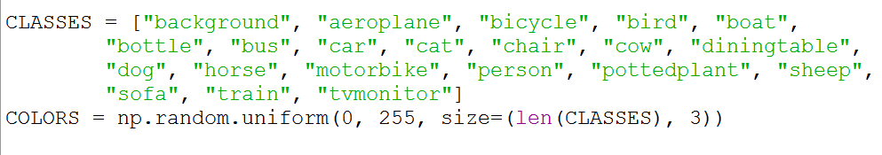
Class Labels of Mobilenet SSD

Slide 5
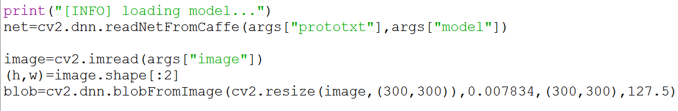
blobFromImage

Slide 6
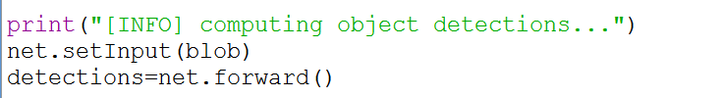
Object detections

Slide 7
Object detections

Slide 8
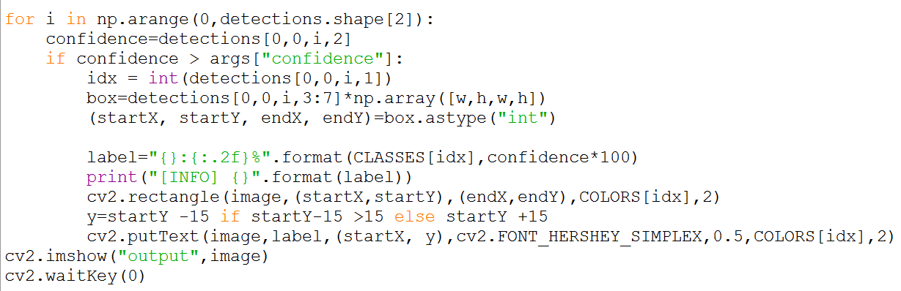
Final output

Slide 9
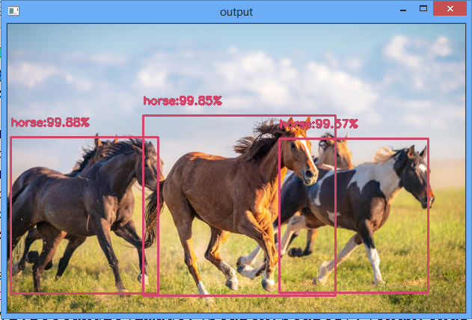
Final output

Slide 10
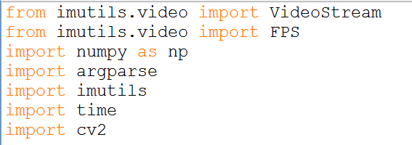
Realtime detection

Slide 11
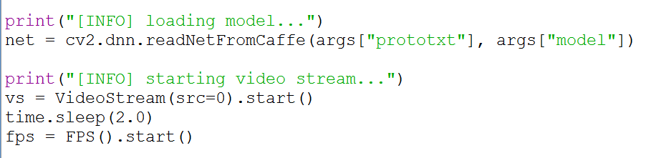
Realtime detection

Slide 12
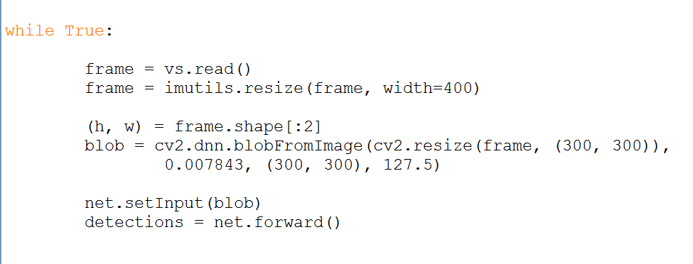
blobFromImage

Slide 13
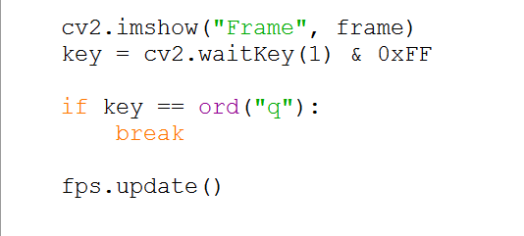
Showing the output frame

Slide 14
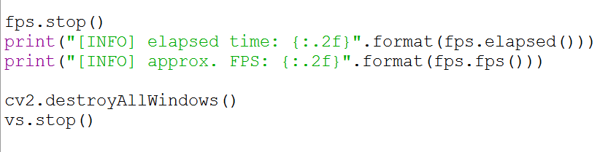
Final cleanup

Slide 15

Contact
A.Arul Prabahar,
Deputy Manager,
NTSC, Ekkadu thangal,
Chennai -32.
Mob: 8754871885
E-mail: arulprabahar@gmail.com

