Slide 1

Image processing using OpenCV

Slide 2

Face detection

Slide 3
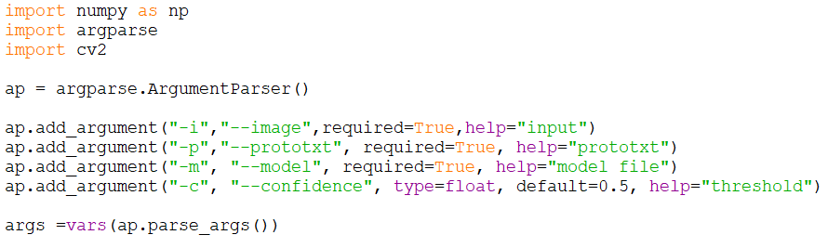
Arguments

Slide 4
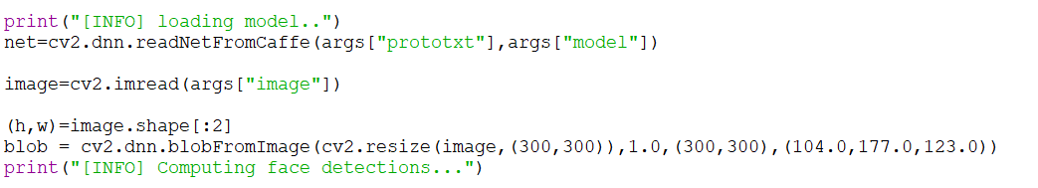
blobFromImage

Slide 5

Object detections

Slide 6
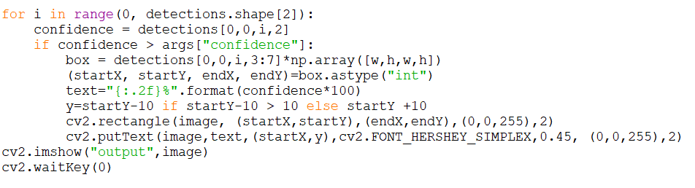
Final output

Slide 7
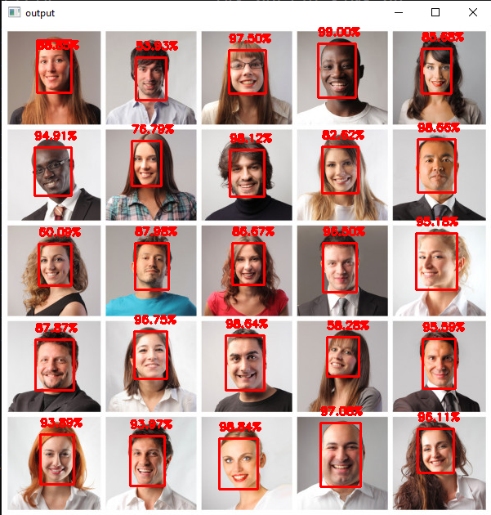
Final output

Slide 8

Contact
A.Arul Prabahar,
Deputy Manager,
NTSC, Ekkadu thangal,
Chennai -32.
Mob: 8754871885
E-mail: arulprabahar@gmail.com

