Slide 1


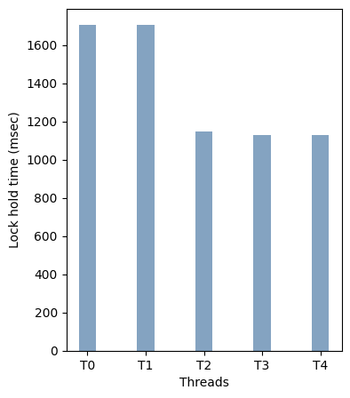
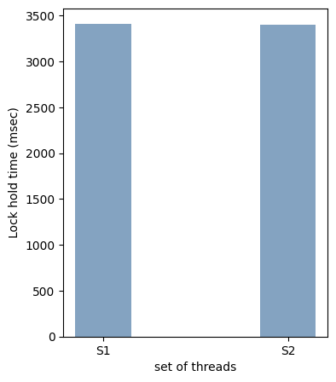
Generalised Hierarchical Fairness for Schedulable Entities Using SCLs
Gunuru Manoj Taraka Ramarao
Email : manoj.gtr@iitgn.ac.in, CSE discipline, IIT Gandhinagar
1. Scheduler Cooperative Lock (SCL)
3. Solution
Ensures fairness by providing a fair allocation of lock for each thread or process irrespective of their lock usage patterns
We can get hierarchical fairness
T2
T3
T4
A thread can acquire lock multiple times in a time slice, gets penalised if it uses more than alloted
Entities in the same level will be given same lock opportunity time
Threads wait at different levels until their slices become active
Lock accounting will be done when the slice of an entity is active and a correction term =
Slice time = 4ms
Waiting
T0 | CS0 | CS0 |  |  | CS0 | CS0
T1 |  |  | CS 1 |  |  |  | CS 1
S0
S0’s Slice alters
between S1 and S2
T1
Slice time = 2ms
S1
S2
Time (sec)
Waiting
T0
2. Hierarchical Fairness Problem
T0
T1
T2
T3
T4
Thread based fairness is not enough
Schedulable entities (threads, process, VMs, containers) demand a different share on a common resource
Demands of entities vary from an individual level to set level
Common Resource
Executing
Top-Down Approach
30%
20%
(number of children at the same level -1) * static slice will be added
Virtual machines
30%
20%
4. Results
With same priority:
Individual threads within a set have a fair share
Between sets S1 = {T0, T1} and S2 = {T2, T3, T4} also have a fair share
80%
70%
50%
60%
20%
50%
30%
40%
Threads
(or)
Processes
Constructing hierarchy using SCLs that rely on non-preemptive scheduling, provide required share for entities on the common resource
5. Reference
Avoiding Scheduler Subversion using Scheduler–Cooperative Locks,” Yuvraj Patel et al., EuroSys 2020

