Slide 1
Lesson 09 API Testing
Programming: Software Quality Assurance Techniques
Fall 2024
Aneesha Mathew
Amathew2@conestogac.on.ca

Slide 2
Today’s Lesson
9.1: Describe techniques to perform integration tests of an application's Application Programming Interface (API).
9.2: Explain the different types of integration tests.
9.3: Develop Application Programming Interface (API) tests

Slide 3
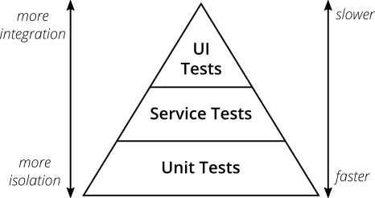
API Testing
API Testing is a form of Integration testing.
Image Source: Martin Fowler

Slide 4
API Testing
API Testing is a form of Integration testing.
That’s here
Image Source: Martin Fowler

Slide 5
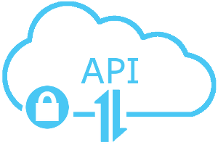
What is an API?
Short for Application Programming Interface
Have been around for many years, but historically were internal to the program only
This Photo by Unknown Author is licensed under CC BY-SA

Slide 6
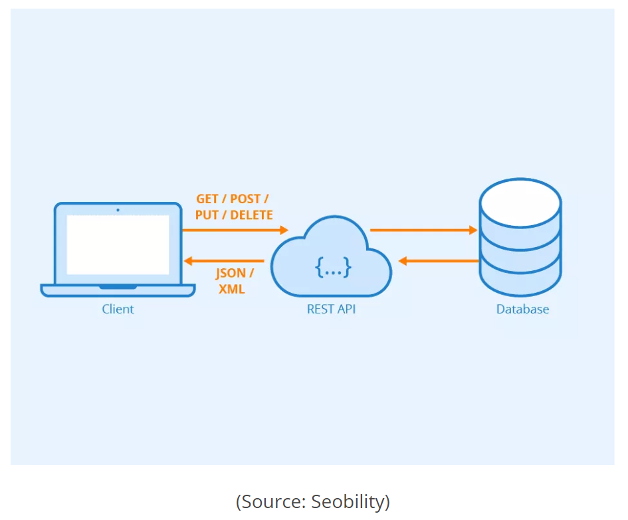
Webservice/REST
In most cases, when people are talking about APIs they are talking about webservice APIs.
The most common architecture for webservices is REST (based) – REpresentational State Transfer
You will often here the term REST API but more often than not it will just be referred to as the API.

Slide 7





APIs are prolific
The use of webservice APIs is a standard practice today – many organizations you are familiar with use them:
Google
Trello
Amazon
Dropbox
Slack
Etc.

Slide 8
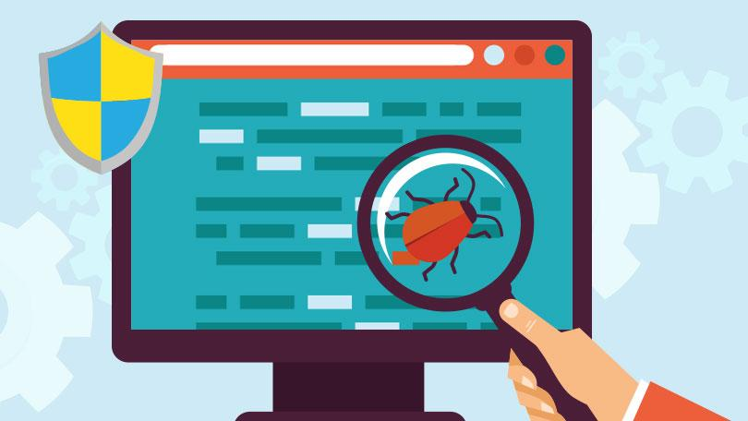
APIs need to be tested
High possibility that you will be working somewhere that develops APIs
The APIs you develop will need to be tested
This Photo by Unknown Author is licensed under CC BY-SA

Slide 9
API Terminology
Request
Response
Headers
JSON
Payload
API Methods
Verbs
Authentication
API Key
Token
Response Code
HTTP Client
Resource
Routes/Endpoints

Slide 10

Testing APIs
APIs need to be tested as with any other code
Some form of framework is needed to test them
The application under test needs to be built and integrated
As with UI test automation, API testing can be a programming endeavour in and amongst itself
This Photo by Unknown Author is licensed under CC BY-NC-ND

Slide 11
Application Programming Interfaces (APIs)
High Level View…
Consumer / Third Party
API
Original Program

Slide 12
Application Programming Interfaces (APIs)
More detailed view…
User Interface
API
API Tests
API Tests
Business Logic
Unit Tests
Module A
Module B
Unit Tests

Slide 13

API vs. UI Automated Tests
API testing tends to be more stable than UI testing as it does not have to invoke the User Interface
API tests are easier to run unattended (and therefore easier to include in build pipelines)
API tests tend to be less “flaky” than UI automated tests
This Photo by Unknown Author is licensed under CC BY-NC

Slide 14
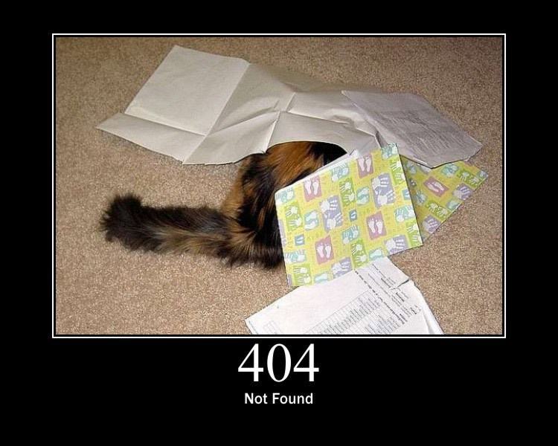
Know your response codes
HTTP status cats
4 main areas:
Success (2xx)
Redirection (3xx)
Client Error (4xx)
Server Error (5xx)
This Photo by Unknown Author is licensed under CC BY-SA-NC

Slide 15
Not all response codes are used
There are dozens of HTTP response code
In practice only a dozen or so are used
General convention is to use just enough to provide meaningful feedback to your users
This is important as developers and testers need to work together to determine what needs to be covered

Slide 16

Not all API documentation is created equally
The level and quality of API documentation varies from organization and from team to team
Tools such as Swagger help to simplify API documentation creation
This Photo by Unknown Author is licensed under CC BY

Slide 17

Is verifying the response code sufficient?
Two Perspectives…
Verify the response code and you are done
Need to also verify the response body
What happens if the developer uses the wrong response code?
This Photo by Unknown Author is licensed under CC BY-SA

Slide 18
Tools
Off the shelf tools
Postman is one example
Build your own framework

Slide 19

Postman Demo

Slide 20
Getting Started with APIs
If you are not familiar with APIs or want a refresher, this may be a helpful resource:
https://snipcart.com/blog/apis-integration-usage-benefits

Slide 21
API Testing – Hands On Work
Let’s try using Postman to test the API for the following site:
Dog API
Read the documentation on this site first and then try out your own tests through Postman while verifying the proper status code, and data (where appropriate).
Try both positive and negative tests

Slide 22

Questions?

