Slide 1
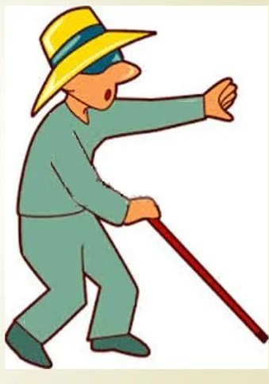
Blind Helper

Slide 2
Introduction
This project was conceived keeping in mind the day to day struggles such as reading , to know current location,to get weather detection, to see the phone battery status and time and date etc. faced by the blind and visually impaired people. So for that We have made one android application using google speech input where the blind user have to say certain words to open that particular tasks . This application has simple working like user has either swipe right or left on the screen to open the voice assistant and talk. We have also added text-to-speech method for listening the working and use of application.

Slide 3
Objectives
To enable the blind and elderly people enjoy a User-friendly computer interface.
App enables the camera to take pictures of printed material, rapidly convert the images into text. It also detect the object and say the name of that particular object.
To implement an isolated whole word speech synthesizer that is capable of converting text and responding with speech
Track the current location of the blind person

Slide 4
Methodology
First I have added the required dependencies that allows us to include external library or local jar files or other library modules in our Android project.
Then in the xml I have designed the user interface of the application.
In MainActivity java I have created all the methods that will help to user to open certain task by simple voice command.
By left swiping on the screen user will read the feature or operations of the app.
By right swiping on the screen voice input will start.
After user gives the voice command it will automatically redirected to that particular activity.
Let's say If user say “read” then it will automatically open read activity. So that user will just tap on the screen and take the picture and read aloud text in it.

Slide 5
Project requirements: -
The requirements were arranged in three groups: user interface, functional requirements.
(1) User interface
(i) Easily accessible
(ii) Flexibility of voice control (Set speed, pause speech)
(2) Functional requirements
(i) Switching among the different voices (ii) read the text (OCR Reader)
(iii) Calculator (iv) Weather
(v) Location (vi) Battery
(vii) Music (vii) time and date
(xii) Exit - close the app.

Slide 6
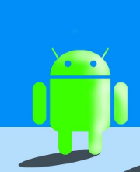
Tools and technology
Android studio
Language -: Java
Android SDKs are modules of Java code that required for accessing mobile device functions
The main component of the Android SDK is a library called Gradle to build our application.
Google Speech API is required

Slide 7
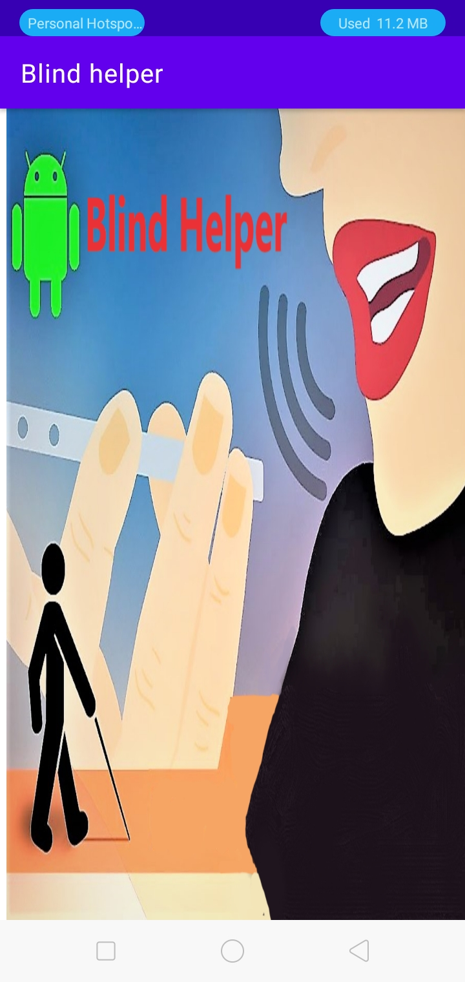
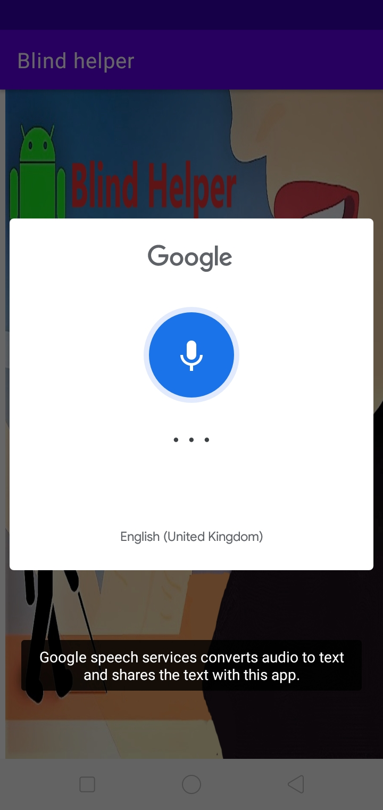
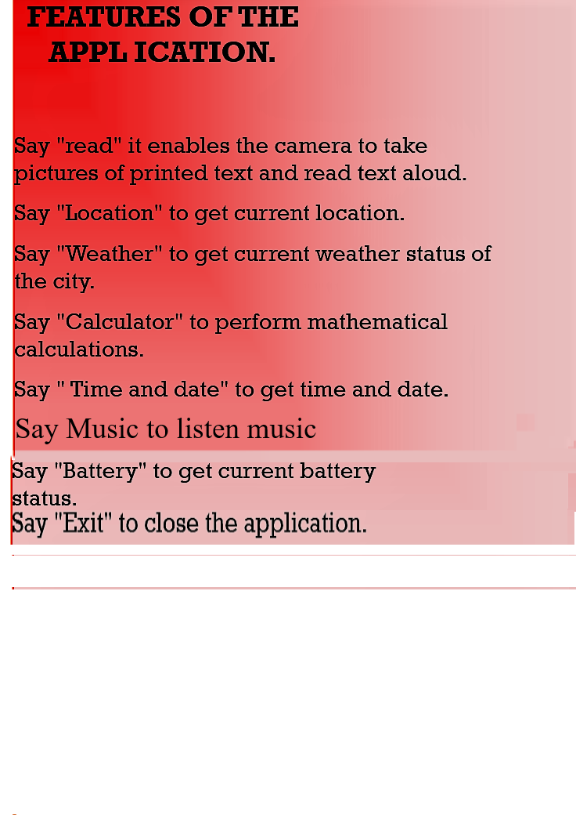
Result

Slide 8
Conclusion
At present, mobiles apps in smartphones are used to perform the most of our daily activities. But the people with vision impairment require assistance to access these mobile apps through handheld devices like mobile and tablets. Google, Android applications has been developing various mobile apps for visually impaired people Still it need to provide more effective facilities in app by adopting and synergizing suitable techniques from Artificial Intelligence.

Slide 9

THANK YOU

