Slide 1

R course for beginners
Dr. Manoj Kumar Gupta
Dr. Joachim Wolff
Clinical Department of Haematology, Haemostaseology, Oncology & Stem Cell Transplantation Medical School Hannover
Germany

Slide 2


Who we are
Dr. Joachim Wolff
AG-Heidel
Dr. Manoj Kumar Gupta
AG-Perner

Slide 3
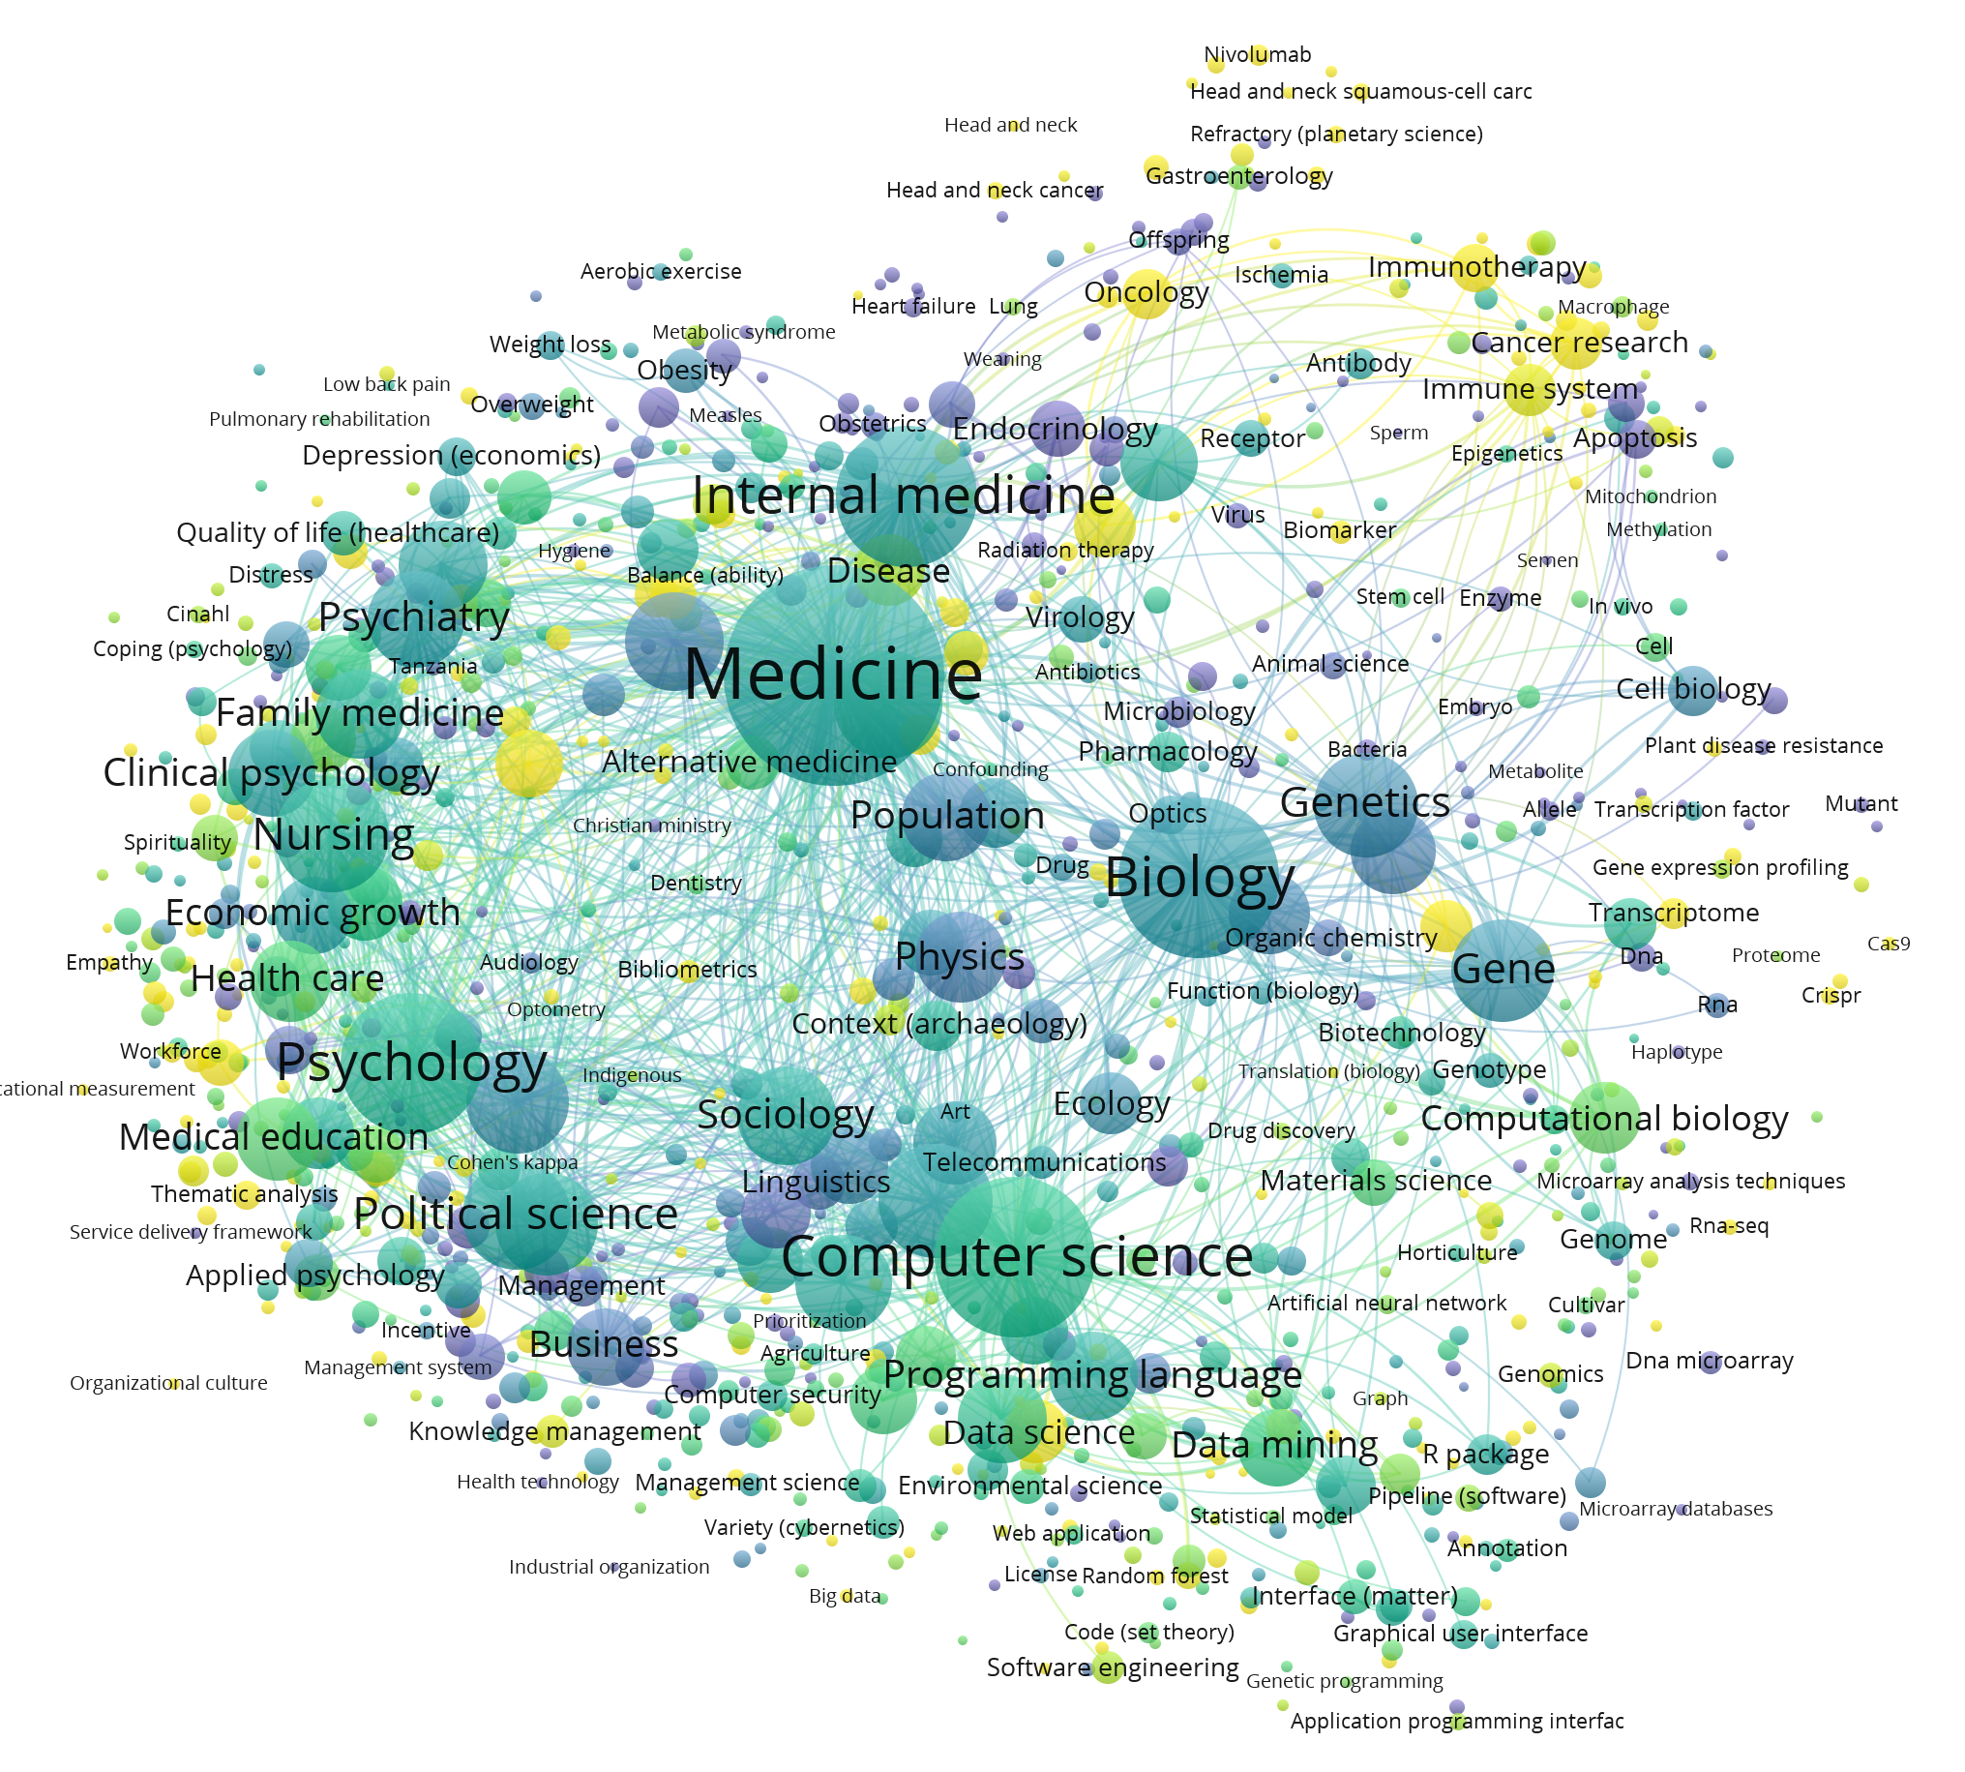
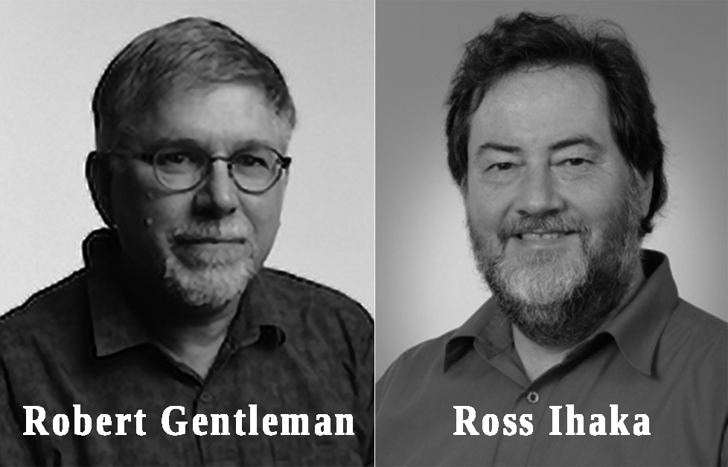

Background
R was developed by Ross Ihaka and Robert Gentleman in 1993
Source code freely available in 1995
Generated using VOSviewer
Credit: Google.com
Notes:
https://trevorfrench.github.io/R-for-Data-Analysis/p0c1-what-is-r.html

Slide 4
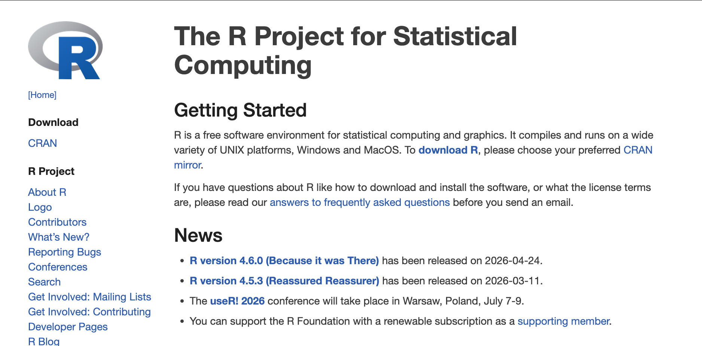
Download
https://www.r-project.org/

Slide 5
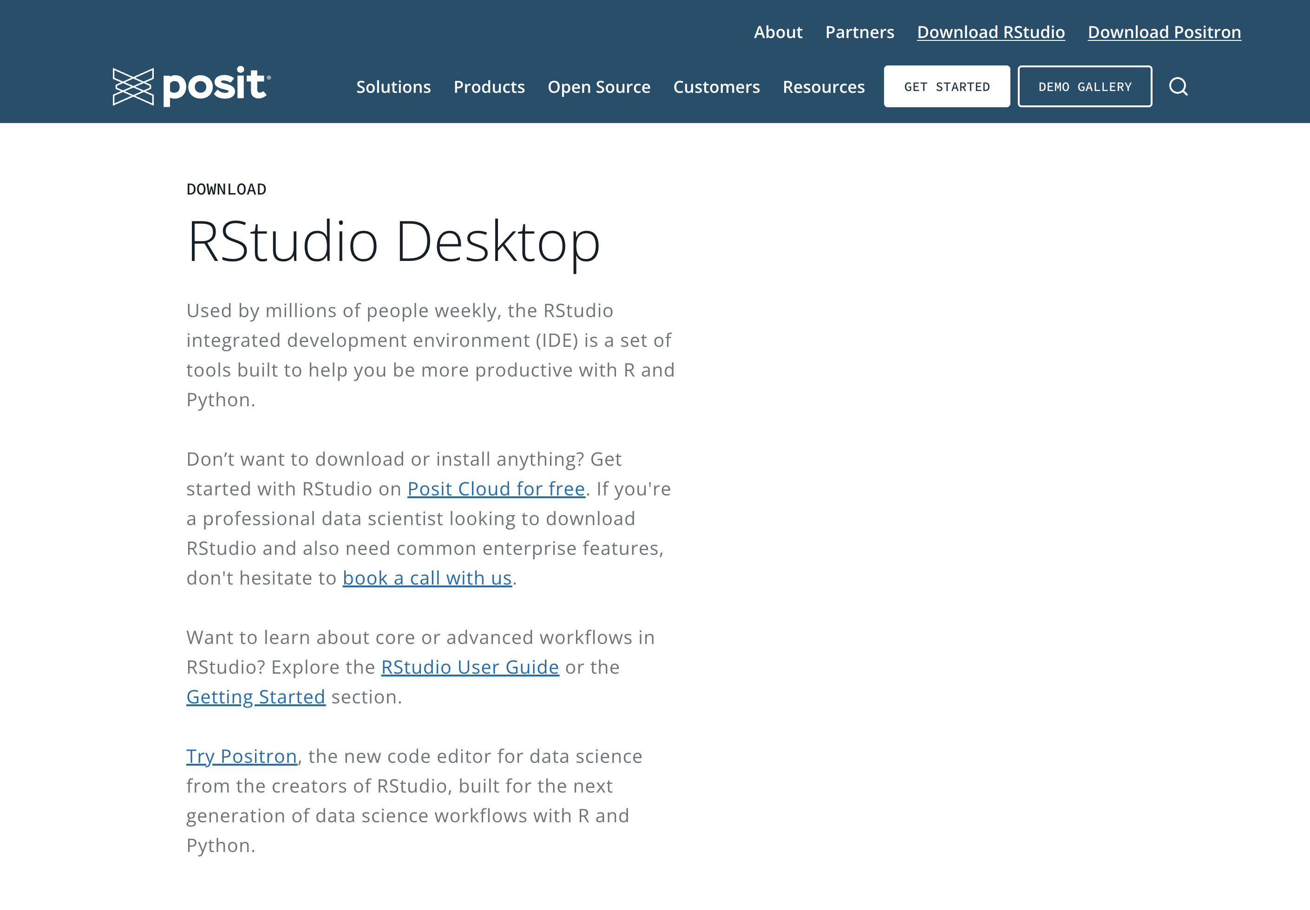
Download
https://posit.co/download/rstudio-desktop

Slide 6
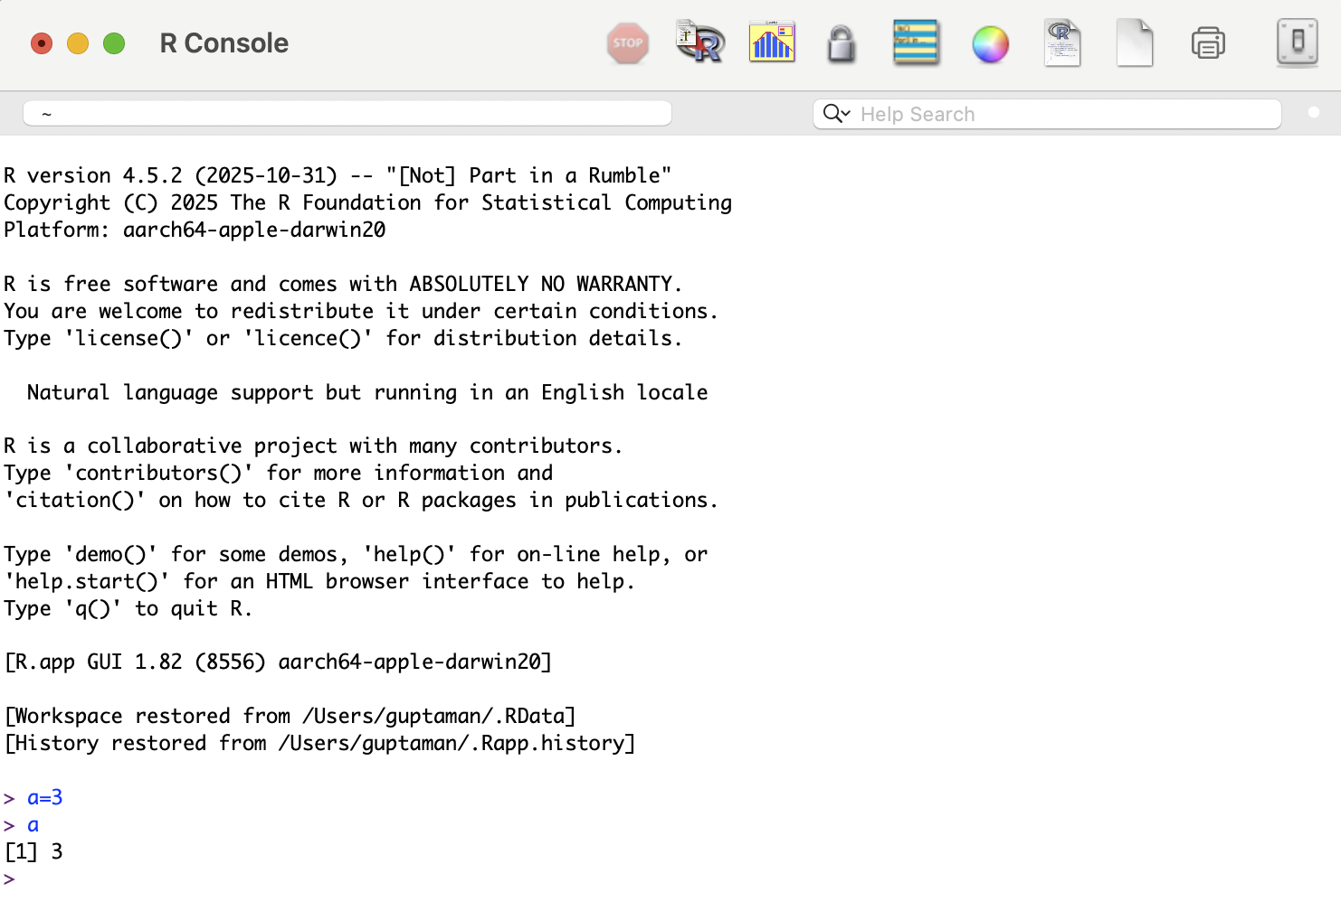
Why we need interface like RStudio?
R: Powerful tool for data analysis and visualization

Slide 7
Why interface like RStudio?
R: Powerful tool for data analysis and visualization
Challenge: Basic console can be messy and difficult to navigate
Solution: Interface like RStudio provides an organized interface for efficient and reproducible workflows
Notes:
This is how the R console look like
Even though
R is a Powerful tool for data analysis and visualization
Major Challenge is the Basic console can be messy and difficult to navigate
One possible solution can be Interface like RStudio that provides an organized interface for efficient and reproducible workflows

Slide 8
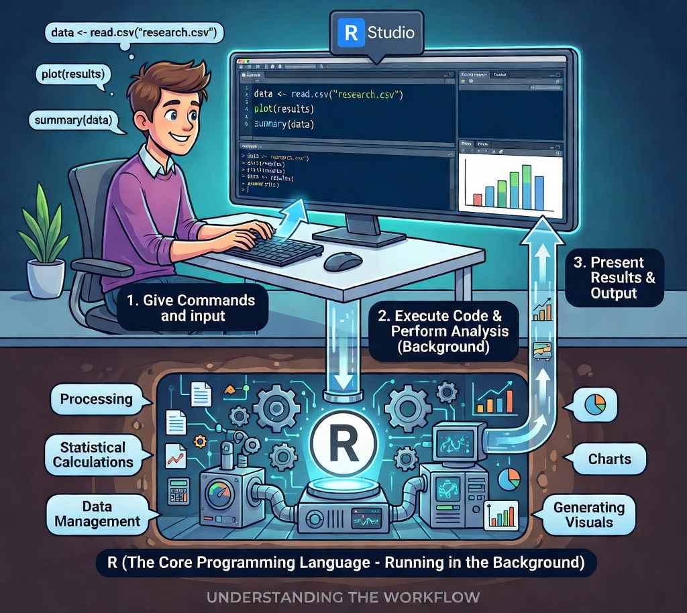
RStudio is the interface and R is the engine
Credit: Grok

Slide 9
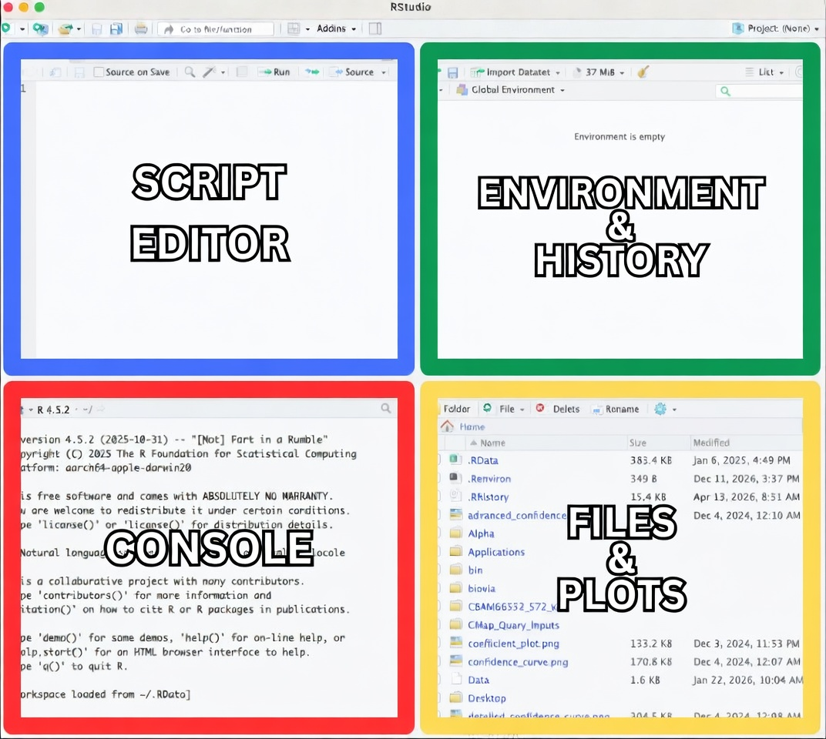
Walk through Rstudio

Slide 10
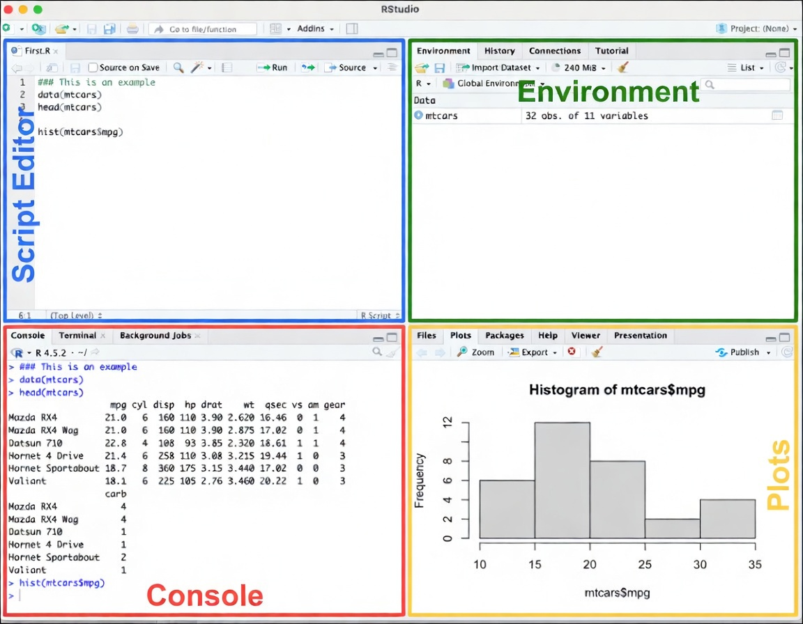
Walk through Rstudio

Slide 11
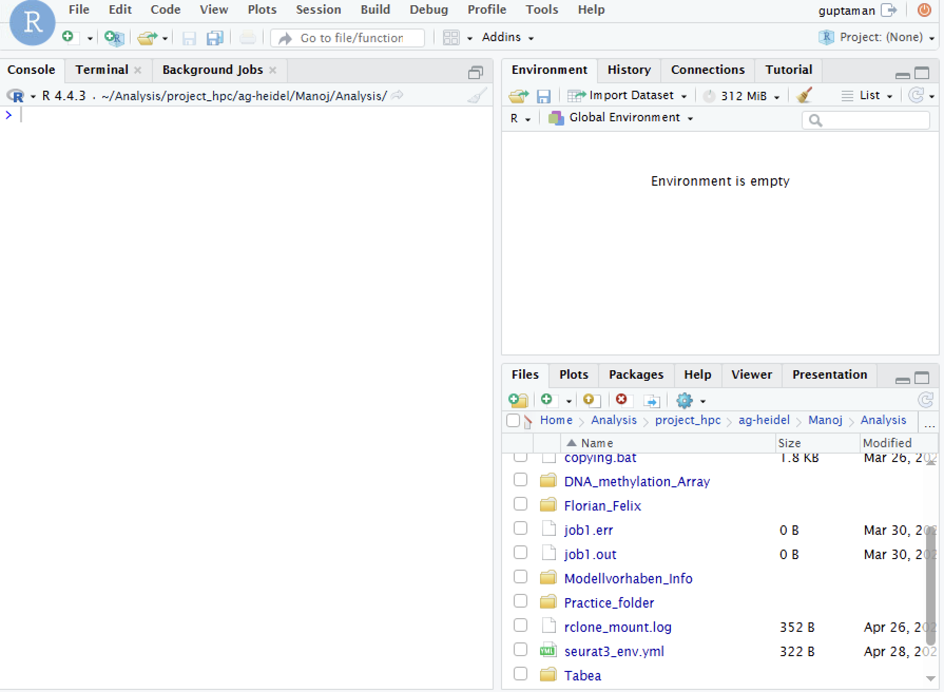
Creating Working Directory

Slide 12
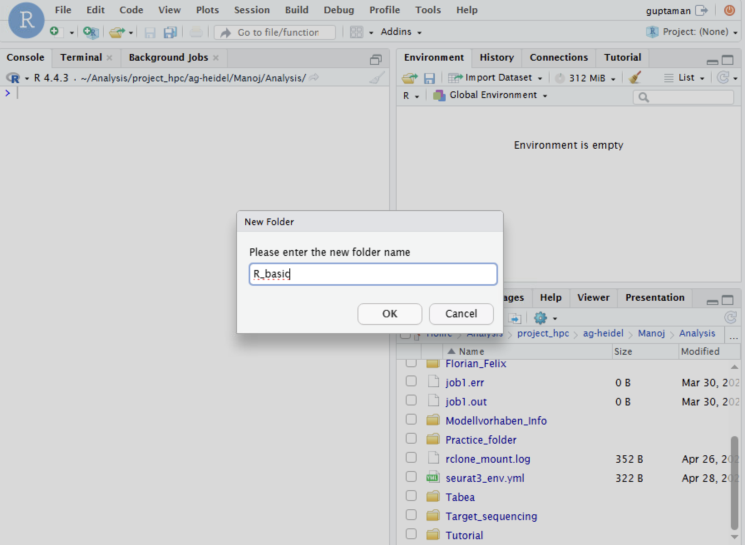
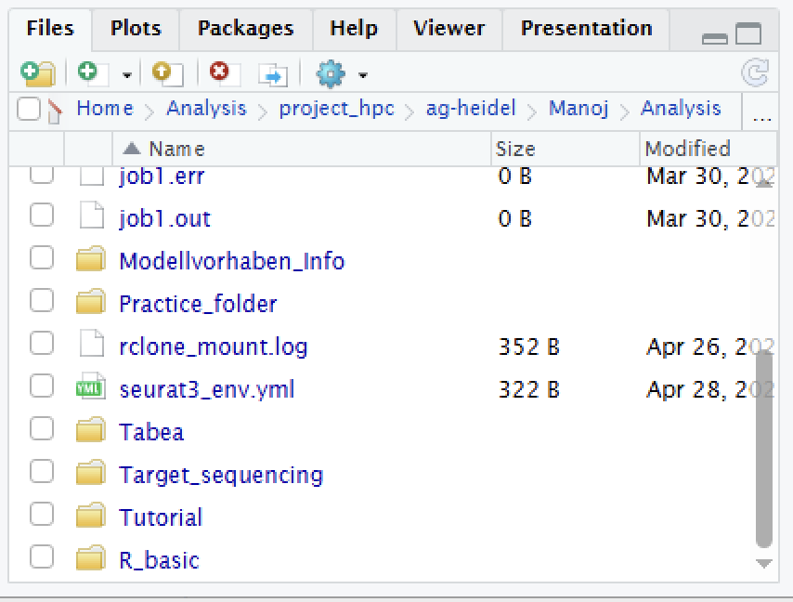

Creating Working Directory
Notes:
So now once we are done with creating the directory
We now set the path to the directory

Slide 13
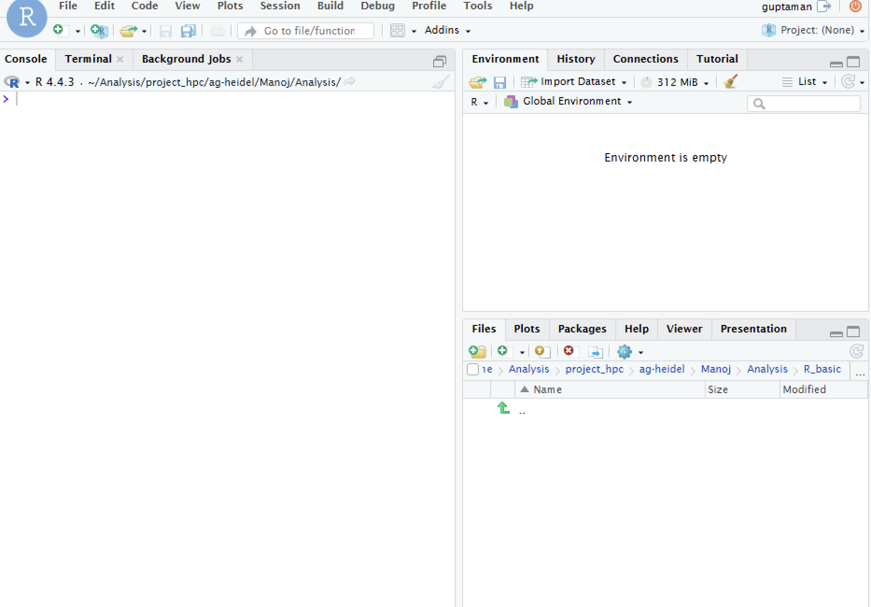
Setting path to the working directory
Notes:
So now once we are done with creating the directory
We now set the path to the directory

Slide 14
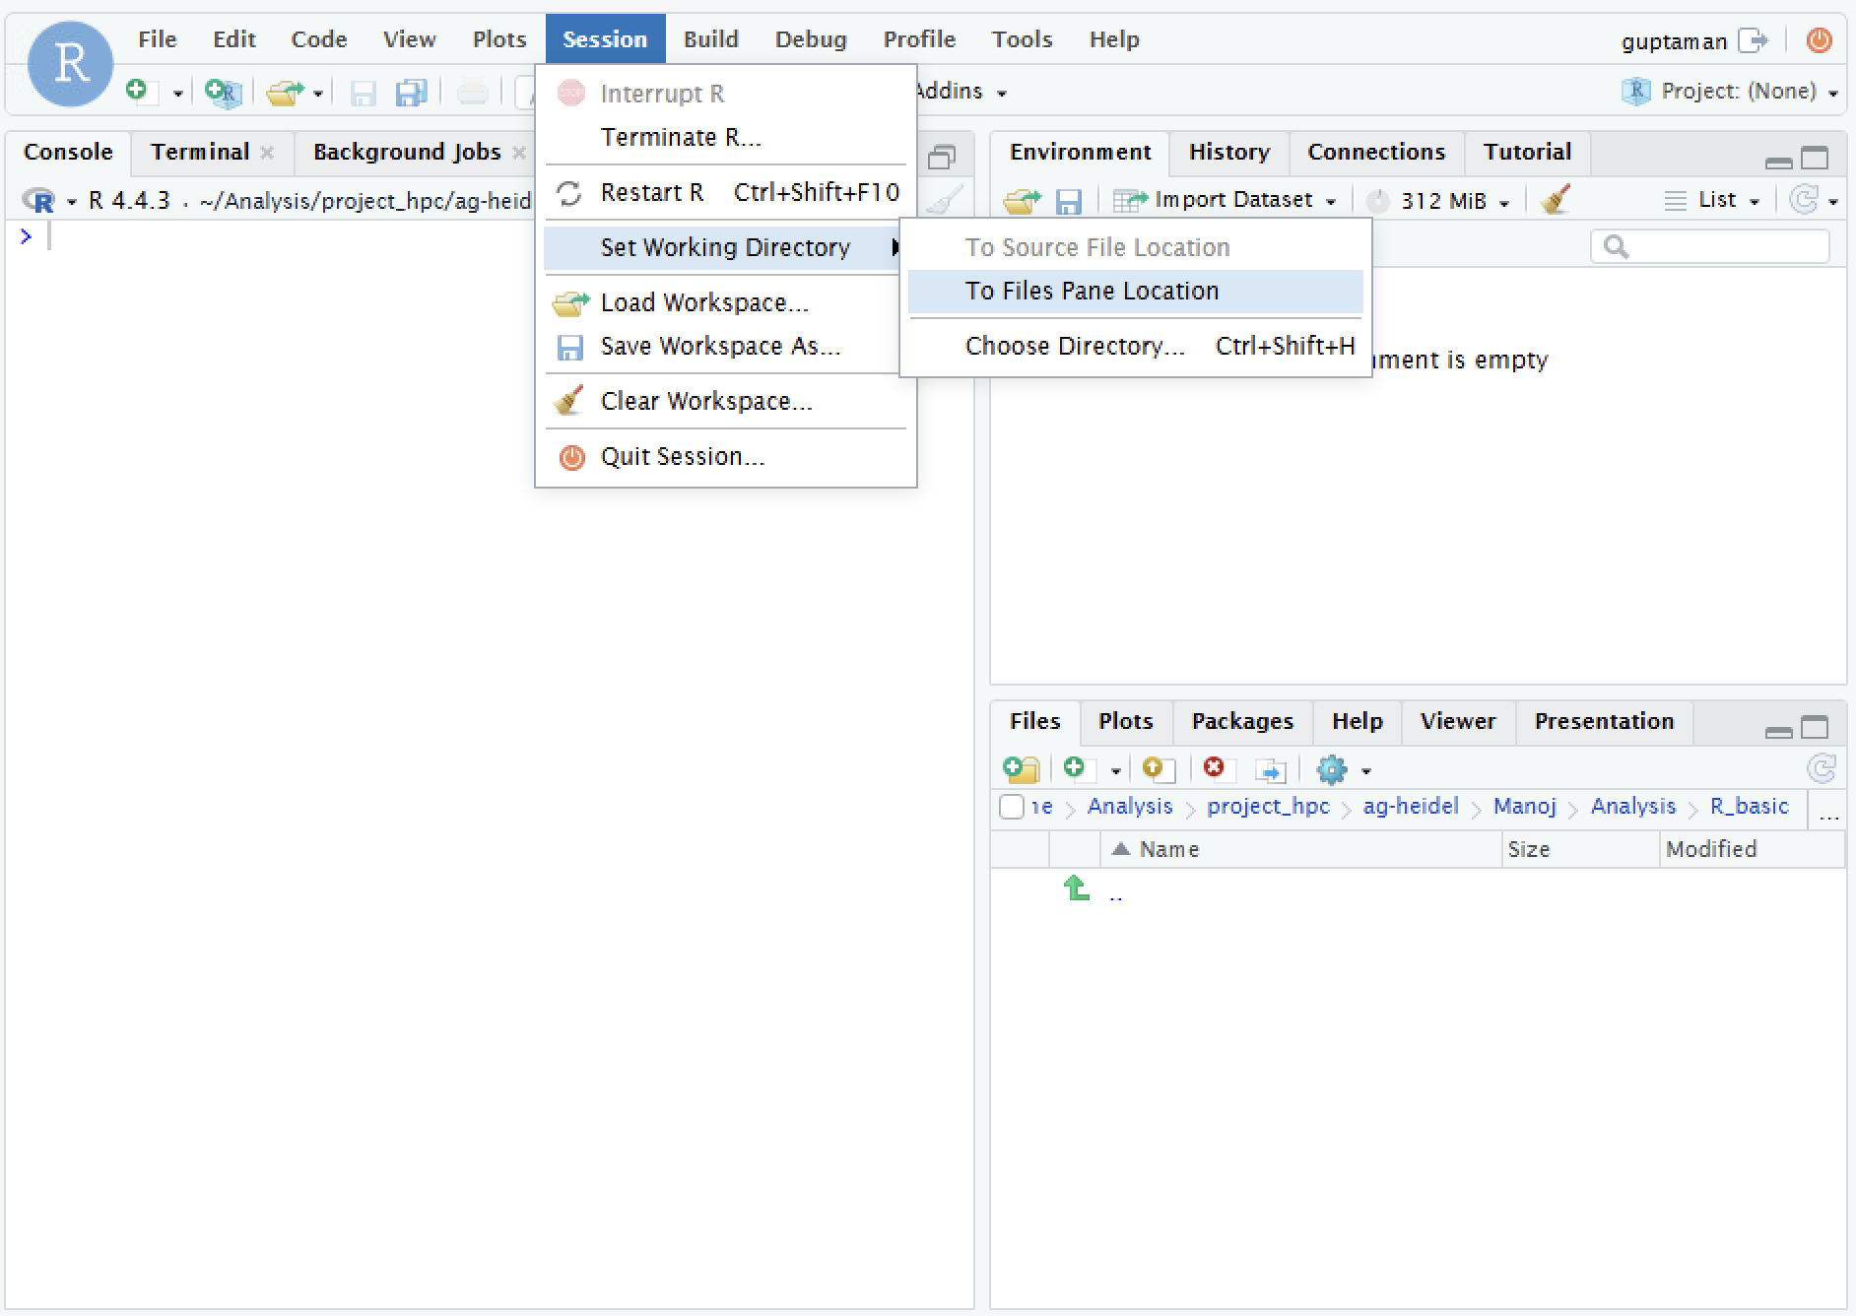
Setting path to the working directory
Notes:
So now once we are done with creating the directory
We now set the path to the directory

Slide 15
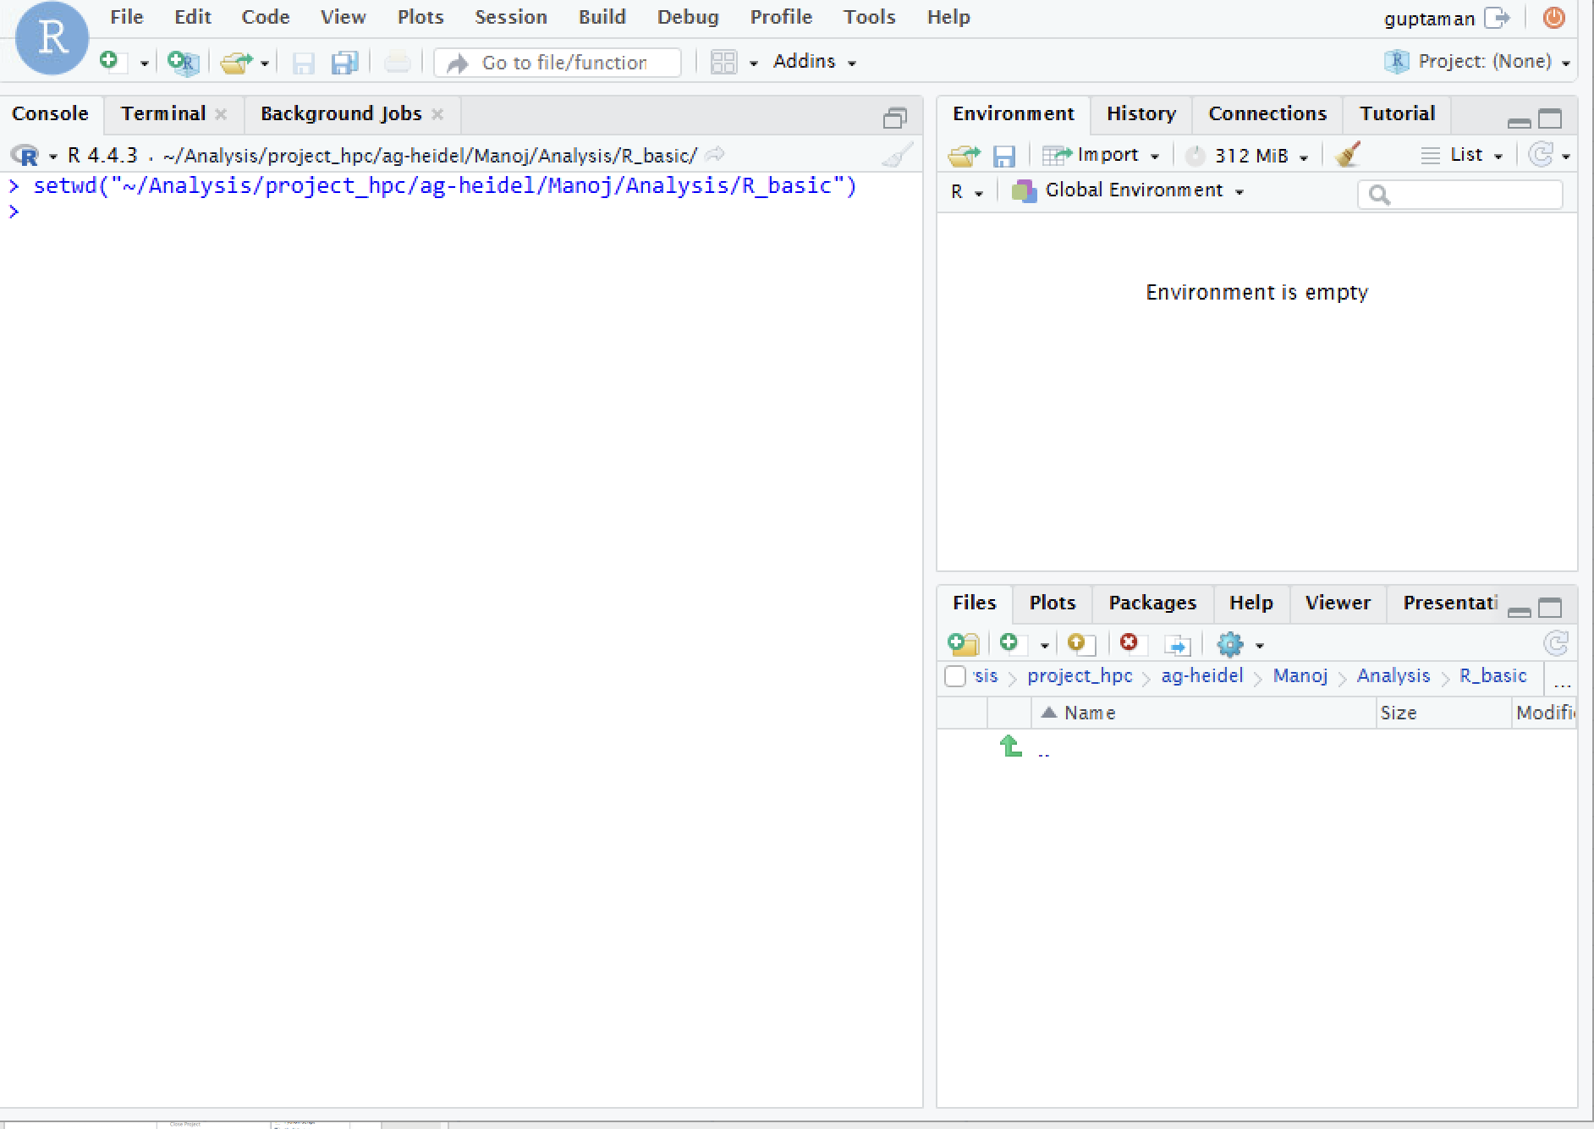
Setting path to the working directory
Notes:
So now once we are done with creating the directory
We now set the path to the directory

Slide 16
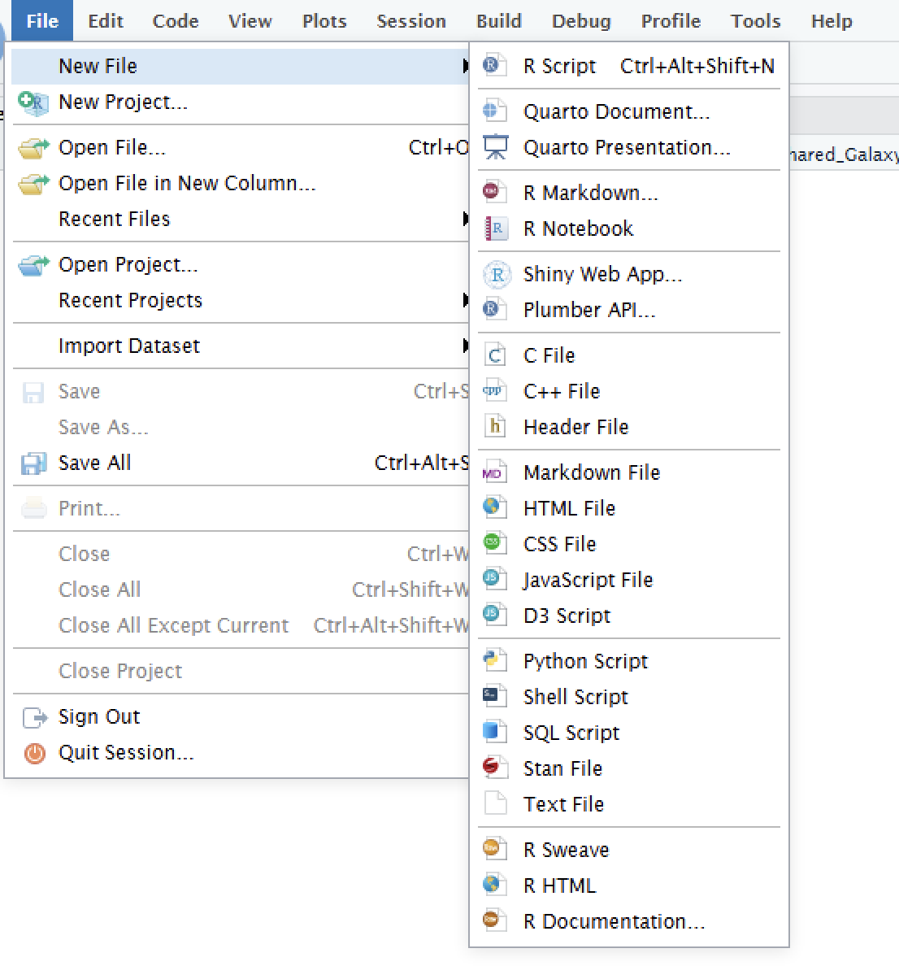
Creating your first R script

Slide 17
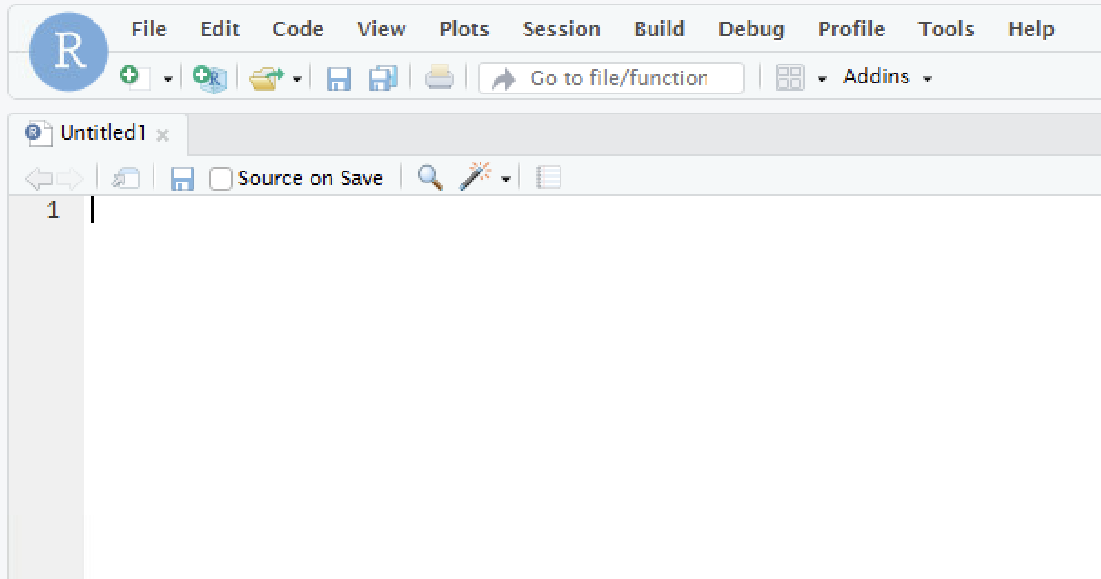
Creating your first R script

Slide 18
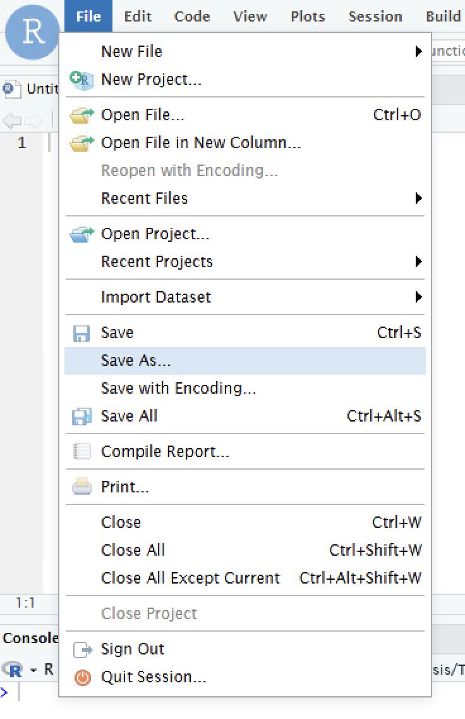

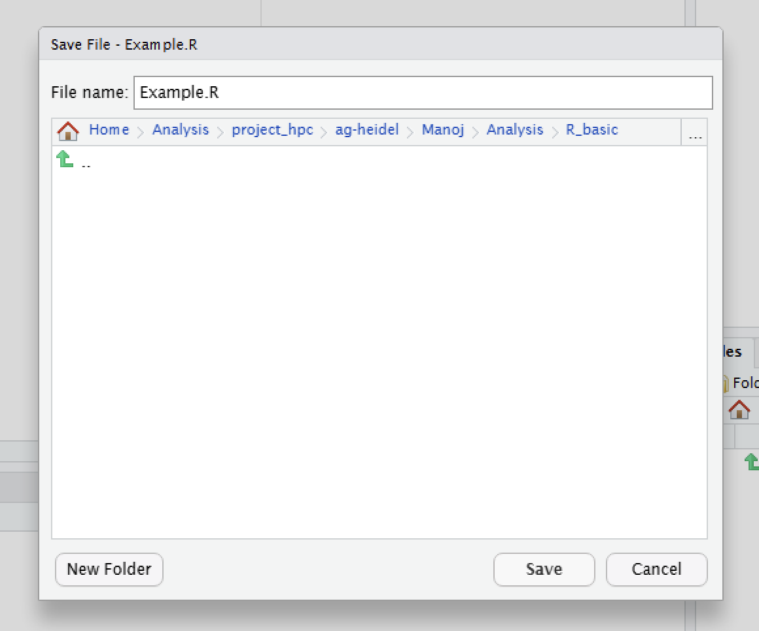


Creating your first R script

Slide 19
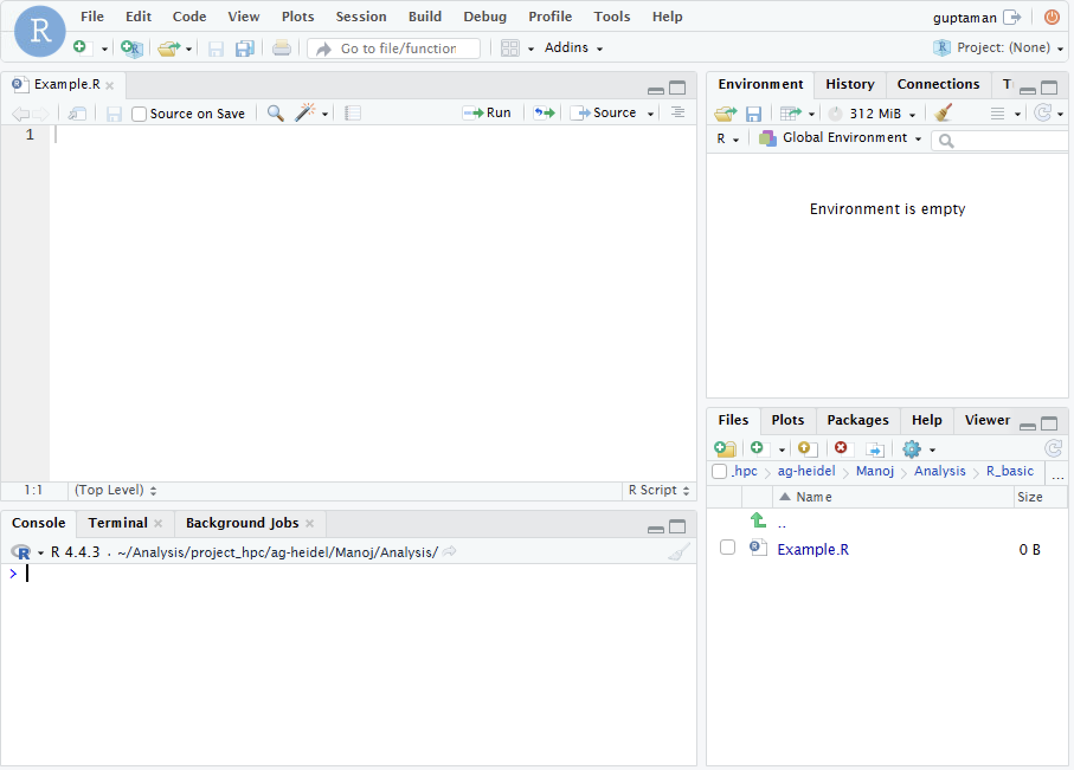
Creating your first R script

Slide 20
Recap
Created Working folder
Set the path to the Working folder
Created the first R script, named, Example.R

Slide 21
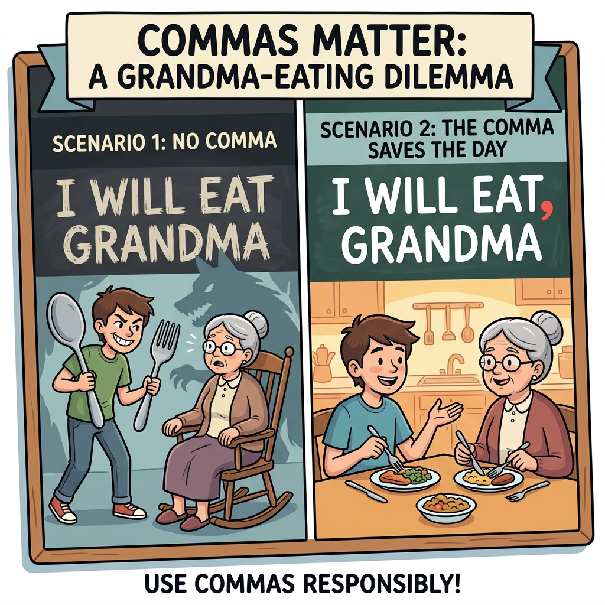
Syntax
Credit: NanoBanana

Slide 22
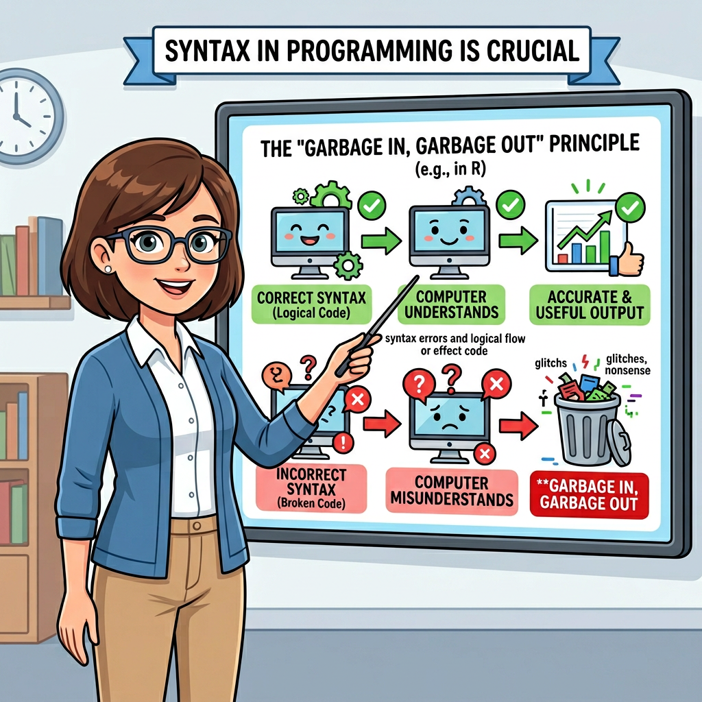
Syntax
Credit: NanoBanana

Slide 23
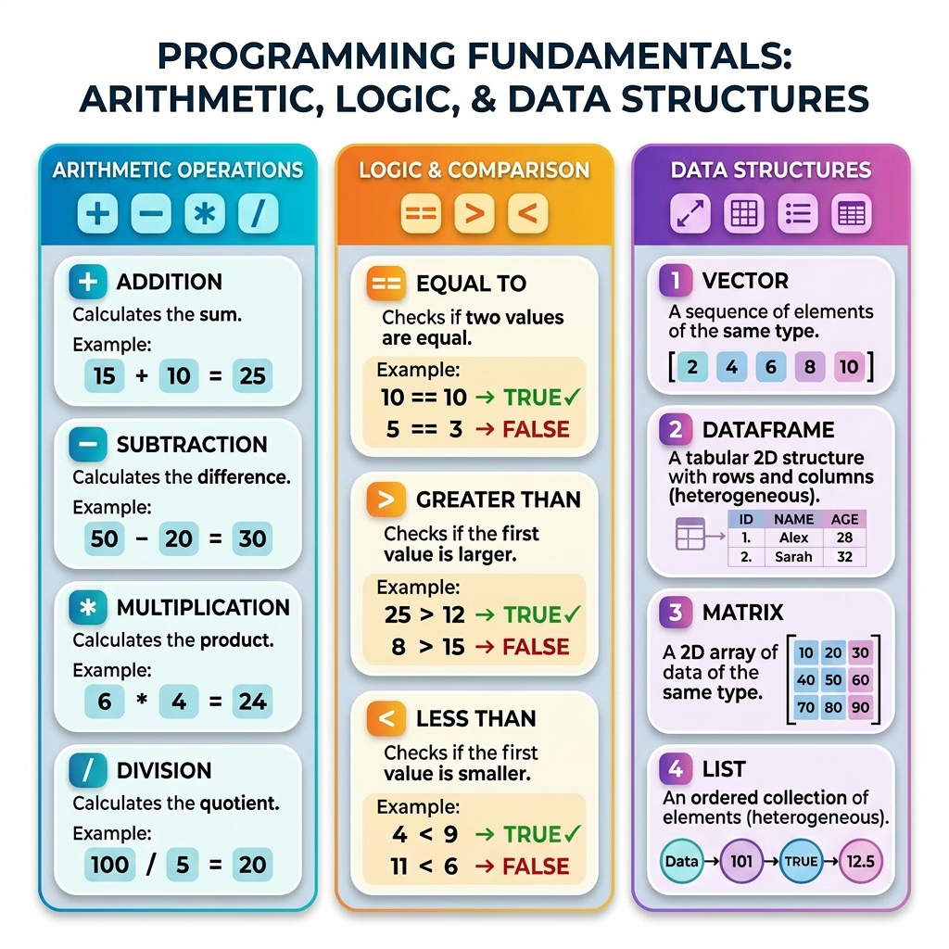
Syntax
Credit: NanoBanana

Slide 24
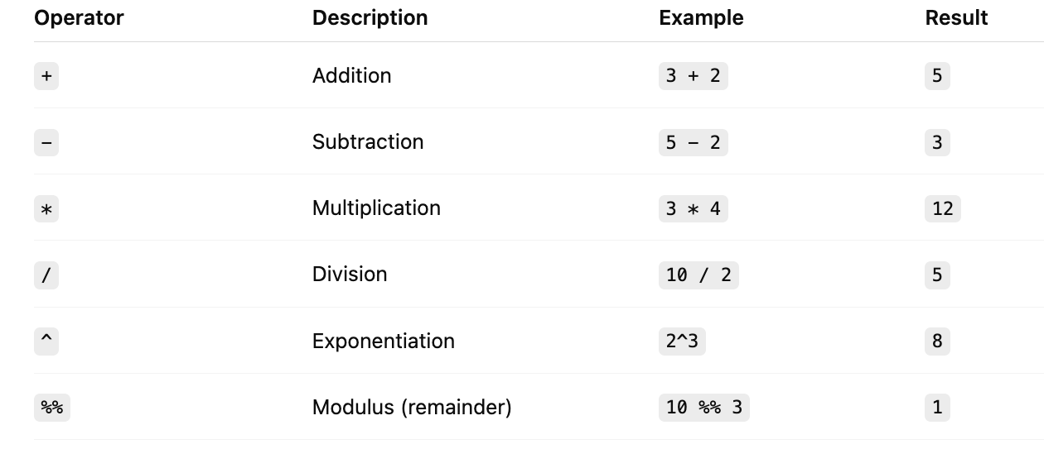
Arithmetic Operators in R

Slide 25
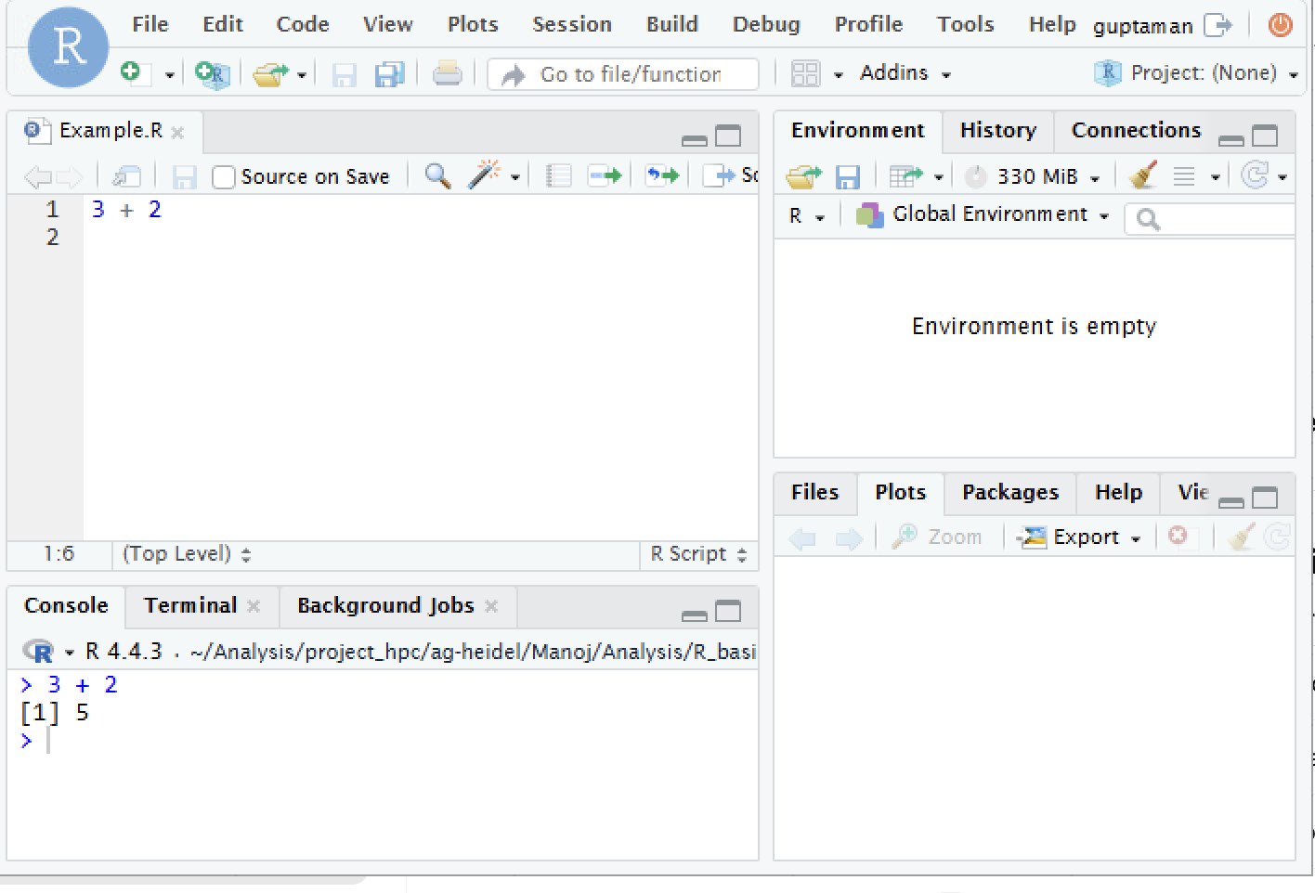
Arithmetic Operators in R

Slide 26
Arithmetic Operators in R
Try all operation in the R studio

Slide 27
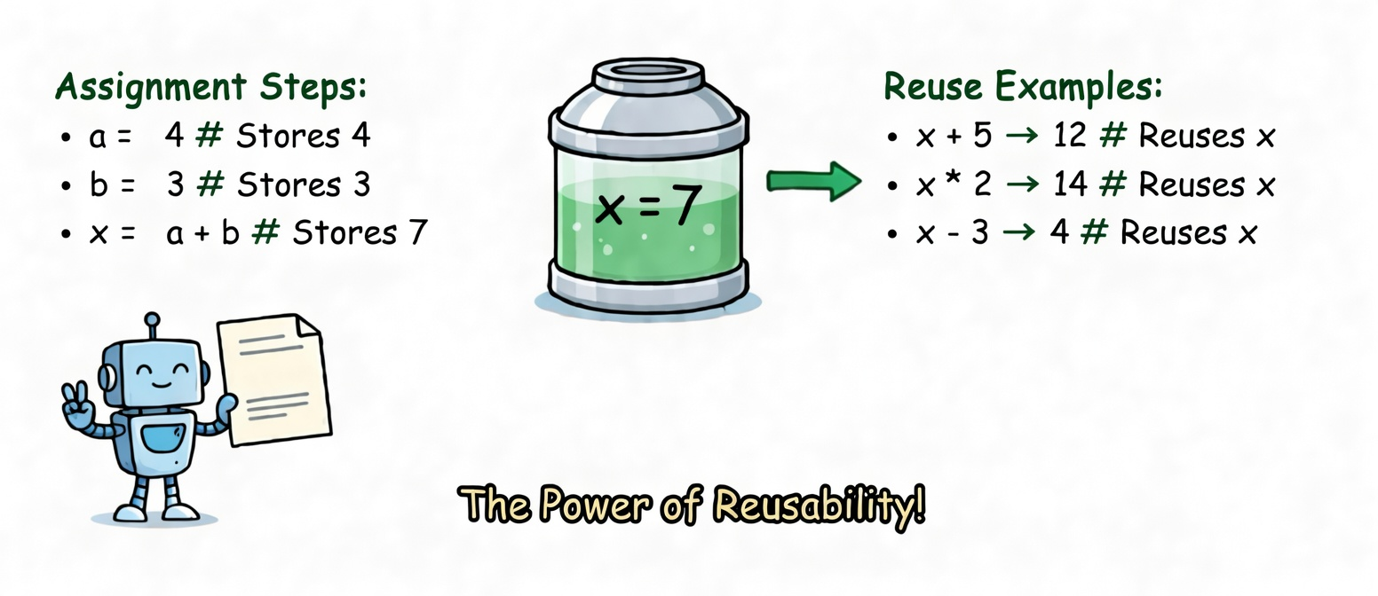
Assigning Values in R
Credit: Grok
Credit: Grok

Slide 28
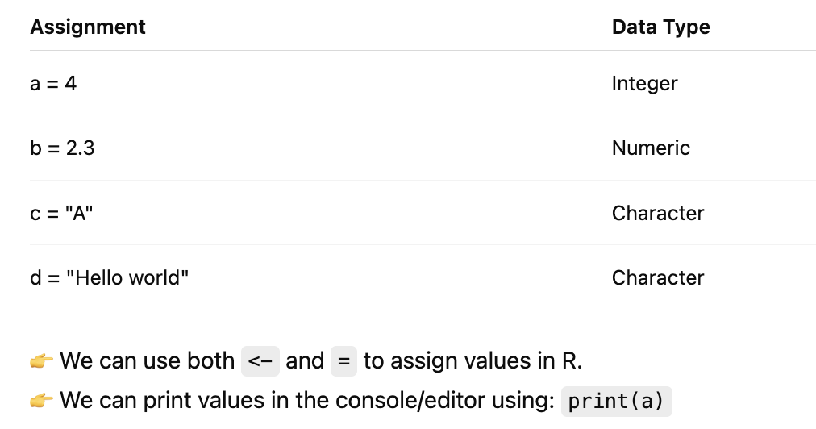
Assigning Values in R

Slide 29
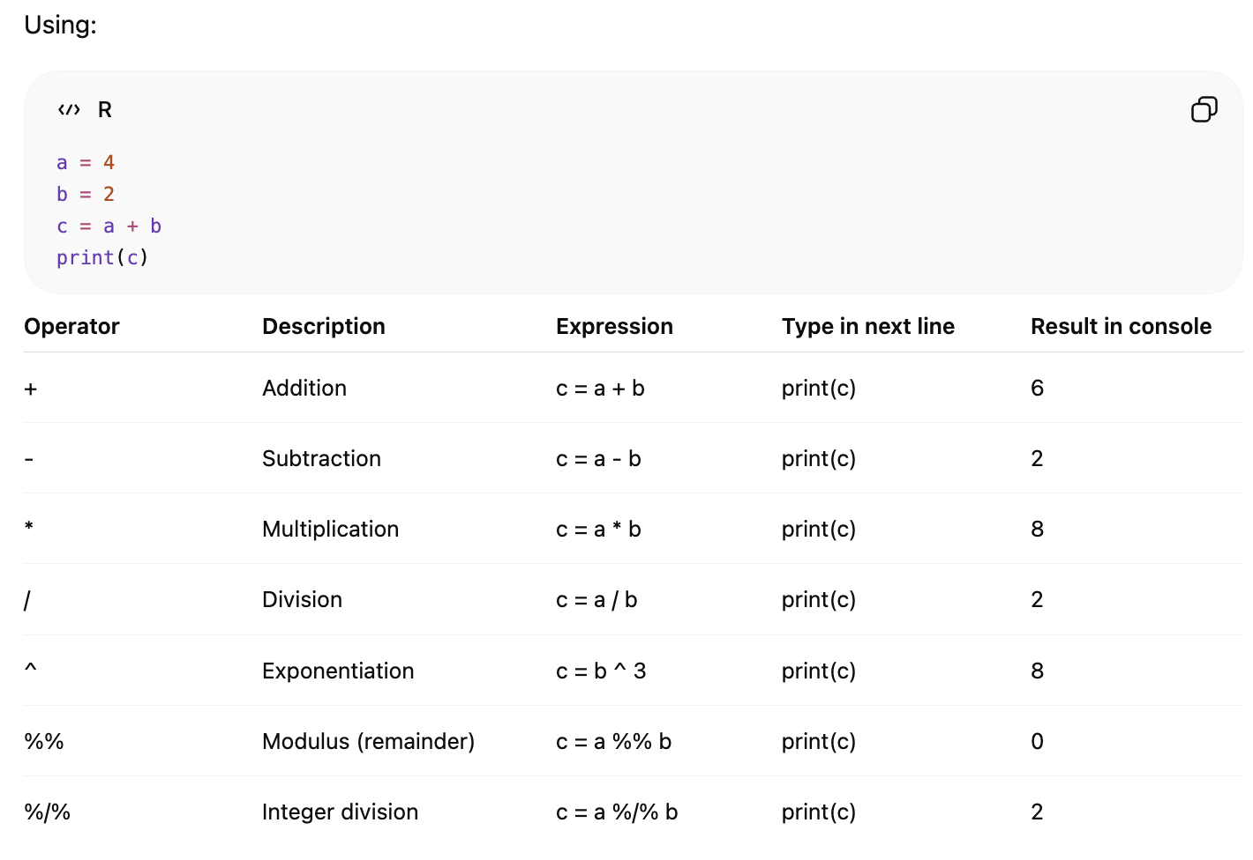
Arithmetic Operators in R
Try all operation in the R studio

Slide 30
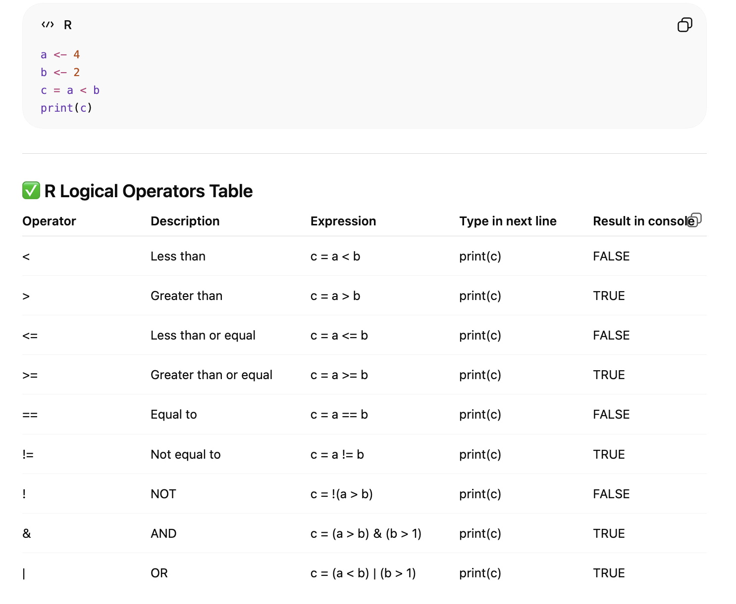
Logic Operators in R

Slide 31
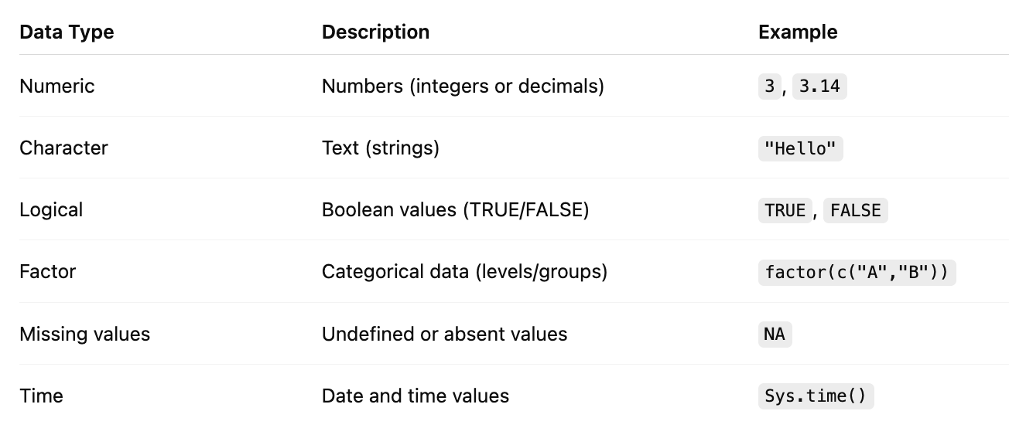
Basic Data Types in R
In R, anything written inside inverted commas (" ") is treated as text (character data), not a variable or number, and you can use it to pass any information as a string.

Slide 32
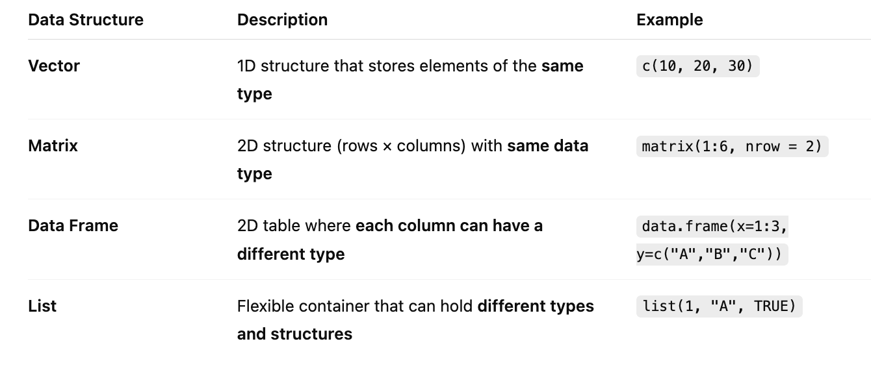
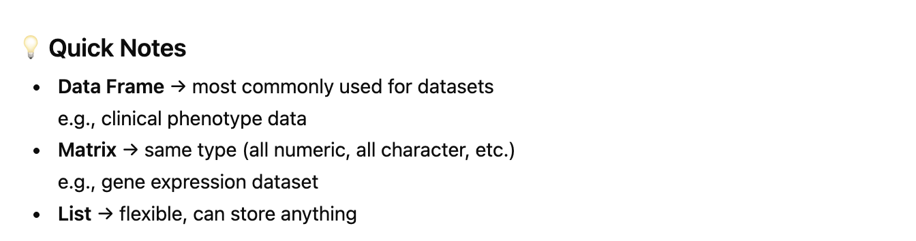
Data Structures in R

Slide 33


#Hash power:
Credit: Google.com

Slide 34
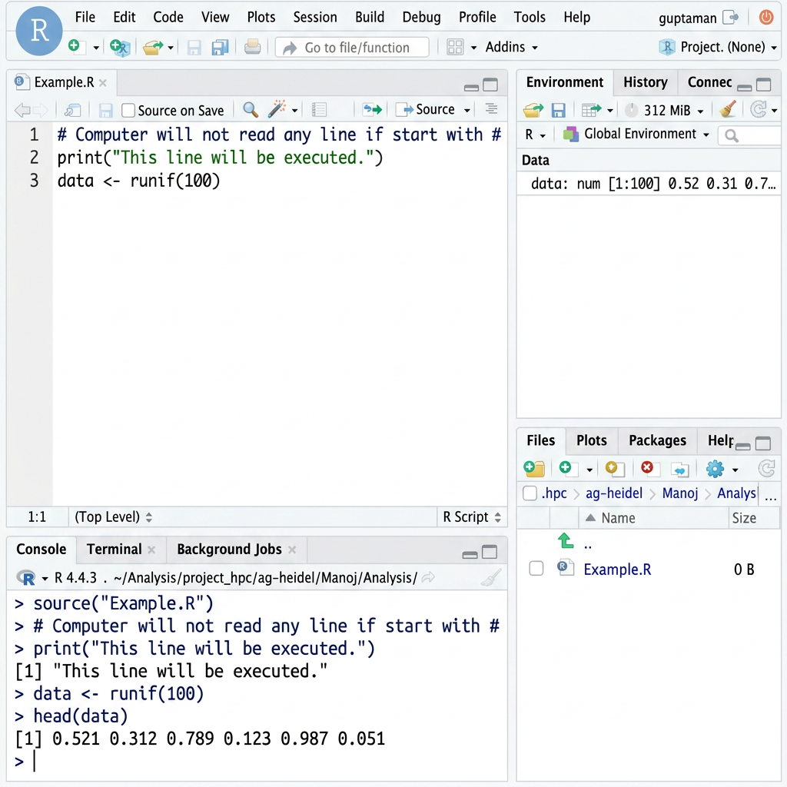
#Hash power:
R will not read any line if start with #
We can use this as a user note: like website link or other information

Slide 35
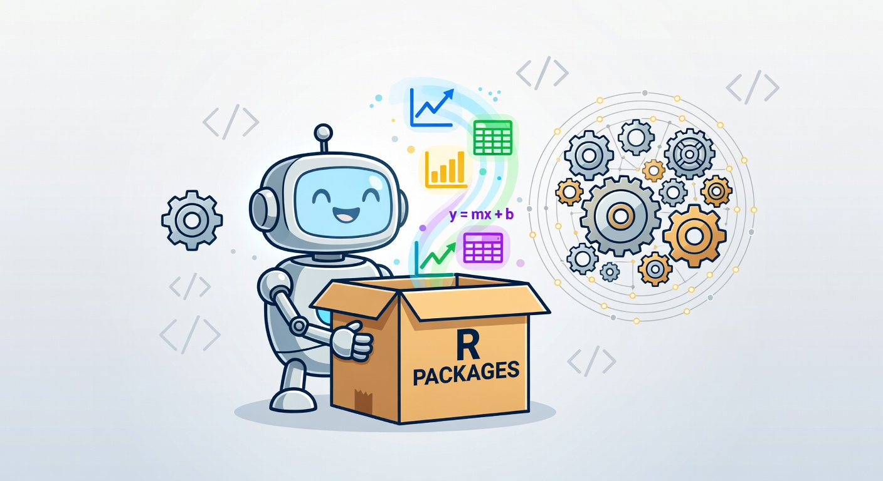
R packages
An R package is a collection of functions, data, documentation, and tests bundled together in a standardized format.
It allows developers and users to:
Share code easily
Reuse solutions across projects
Extend R’s core functionality dramatically

Slide 36
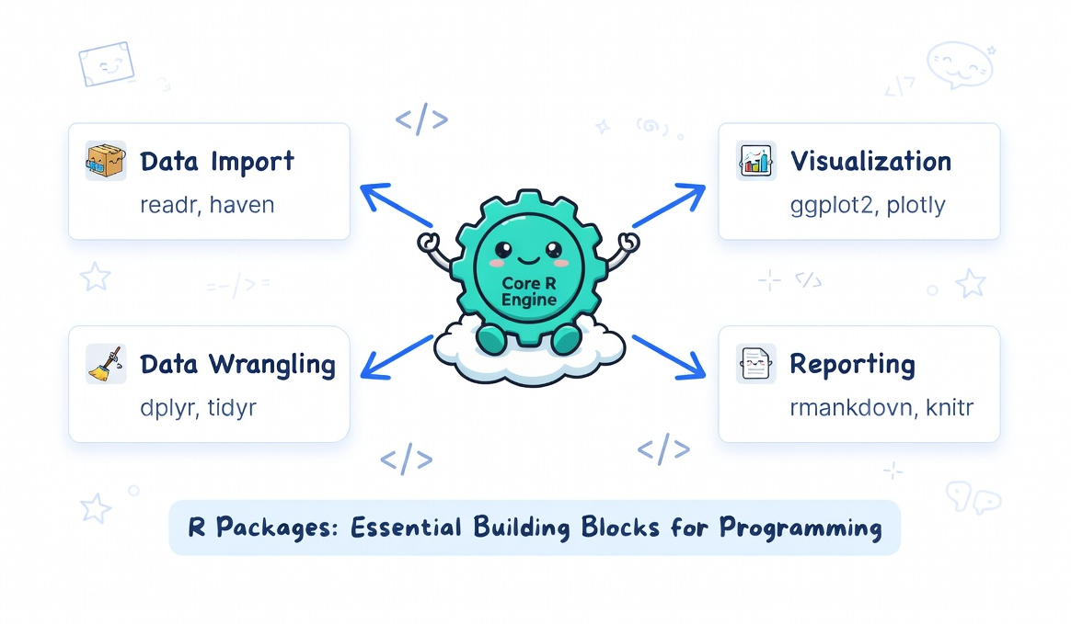
R packages

Slide 37
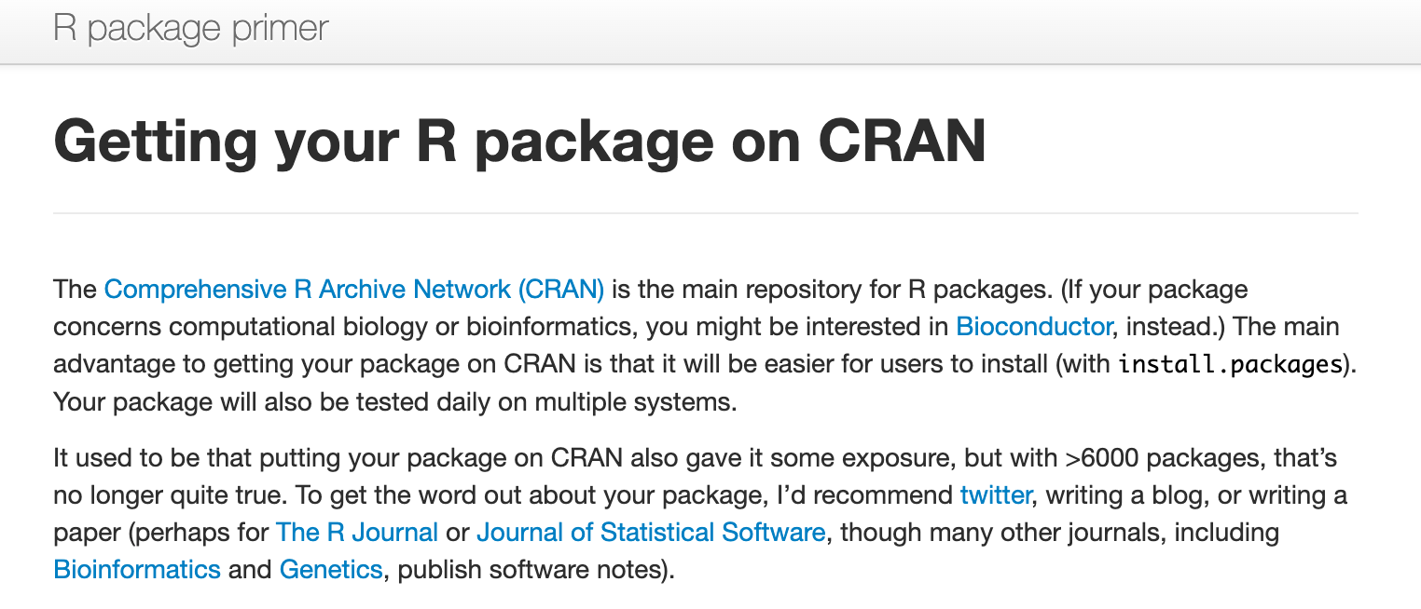
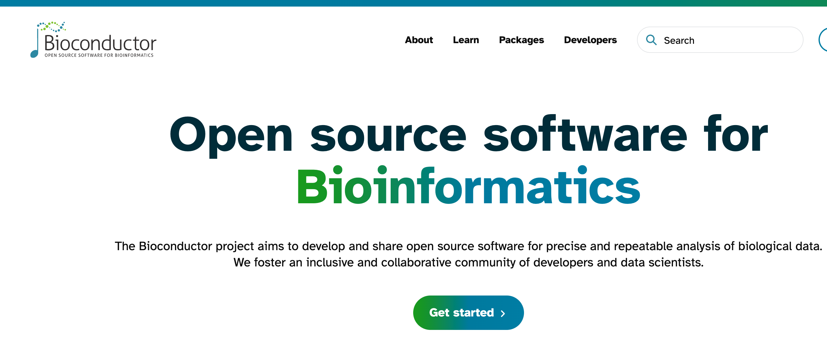
R packages

Slide 38
Recap
Created Working folder
Set the path to the Working folder
Created the first R script, named, Example.R
Syntax in R
Hash tag is important for commenting
R packages have predefined function and can be reused

