Slide 1
What is Cell ?
where a row and a column intersect, serving as the basic storage unit for data like text, numbers, or formulas.
Cell = B2
 | A | B | C | D | E
1
2 |  | upGrad
3

Slide 2
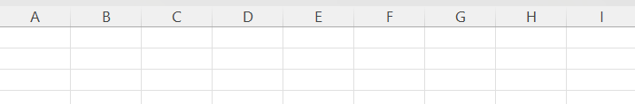
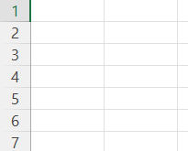
What is Columns ?
a collection of cells identified by an alphabetical letter at the top of the worksheet. arranged vertically.
What is Row?
a horizontal series of cells identified by a unique number.

Slide 3
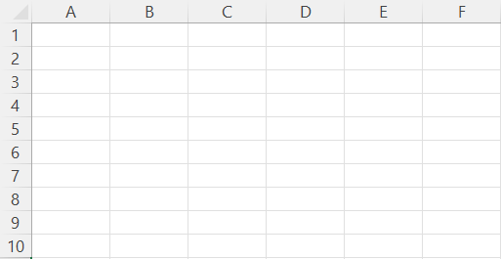
What is Table?
Rows & columns combinations
which provides a structured, a container for your data that offers automatic formatting, filtering, formula.
10,48,576 rows and 16,384 columns.

Slide 4
What is Excel ?
Excel is a Microsoft software program tool
that creates spreadsheets for organizing, analyzing, and storing multiple type of the data which is bases on rows and columns combination.
It’s a relation database.

