Slide 1

Heart Disease Prediction using Machine Learning
Manoj Gowda B Y · B.E. Computer Science Engineering (AI & ML)
Don Bosco Institute of Technology · Internship Report – July 2026

Slide 2

PROJECT OVERVIEW
Why Early Prediction Matters
The Challenge
The Solution
Cardiovascular disease — leading global cause of death; early detection saves lives
ML models trained on clinical data for accurate, scalable risk prediction
The Outcome
Clinical decision support tool for faster, data-driven recommendations

Slide 3

PROBLEM STATEMENT
Gaps in Traditional Cardiac Diagnosis
Current Challenges
Manual, time-consuming diagnostic workflows
Subjective interpretation; high variability
Limited accessibility in underserved regions
Research Motivation
Automate prediction using patient clinical data
Reduce diagnostic errors with interpretable ML
Enable scalable, cost-effective screening

Slide 4
OBJECTIVES
Project Goals & Deliverables
01
02
03
Data Preprocessing
Exploratory Data Analysis
Model Comparison
Clean, encode, and standardize clinical features
Uncover patterns and correlations in patient data
Evaluate 6 ML algorithms on multiple metrics
04
05
Hyperparameter Tuning
Streamlit Deployment
Optimize models via GridSearchCV
Interactive web app for real-time prediction

Slide 5
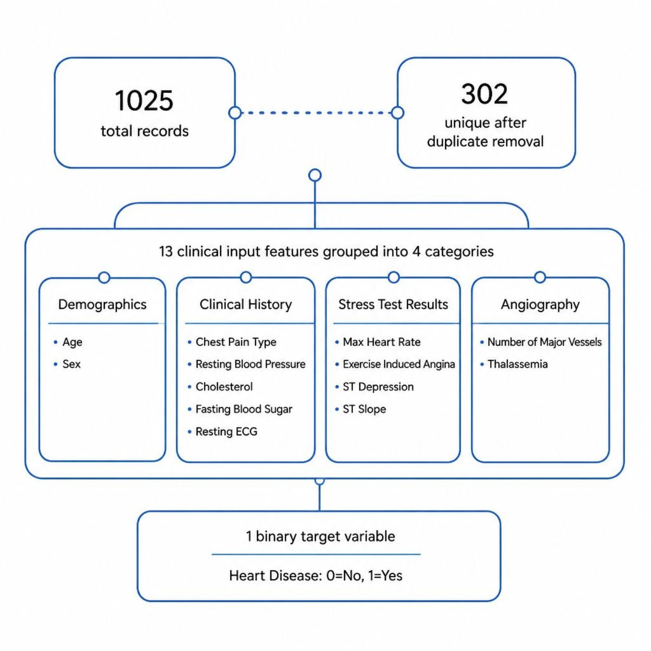
DATASET
UCI Heart Disease Dataset
Dataset at a Glance
1,025 records → 302 unique (after deduplication)
13 clinical features across 4 categories
Binary target: 0 = No Heart Disease, 1 = Heart Disease
Feature Categories
Demographics · Clinical History
Stress Test Results · Angiography

Slide 6
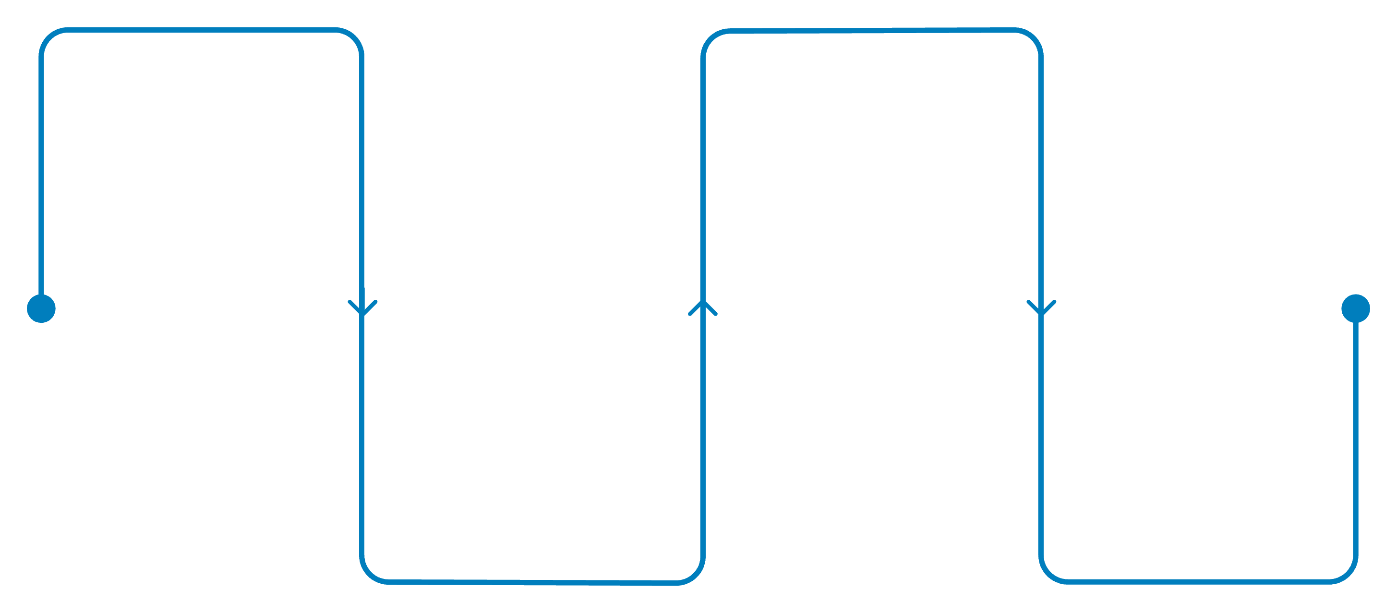
METHODOLOGY
End-to-End ML Pipeline
Data Prep
Modeling
Collect, clean, and engineer features
Train, tune, and evaluate models
Analysis
Deployment
Exploratory data analysis
Serve via Streamlit web app
A structured 8-step pipeline ensures data quality, rigorous model evaluation, and a production-ready deployment for clinical decision support.

Slide 7
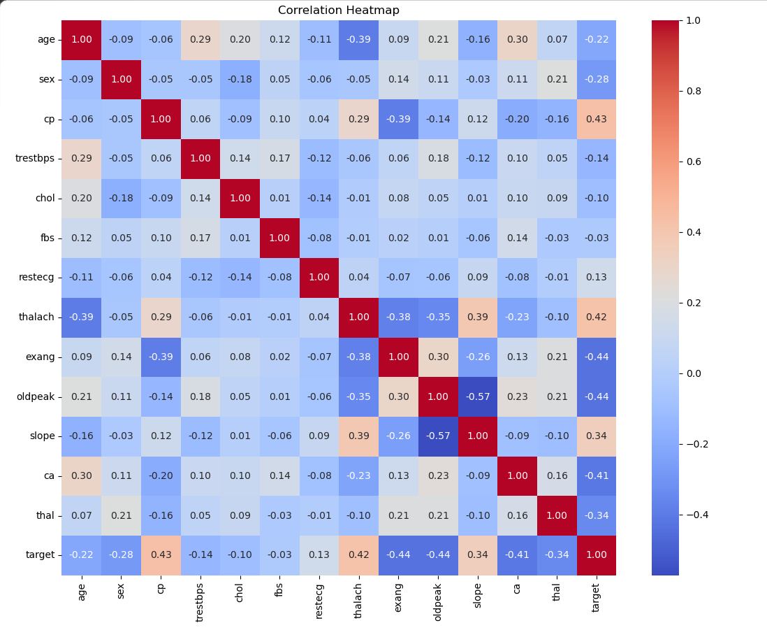
DATA PREPROCESSING & EDA
Data Preparation & Insights
Preprocessing Steps
Missing value imputation
Duplicate removal — 1,025 → 302 records
Outlier treatment · Categorical encoding
Feature standardization
EDA Highlights
Correlation heatmap for feature relationships
Target distribution — class balance analysis

Slide 8
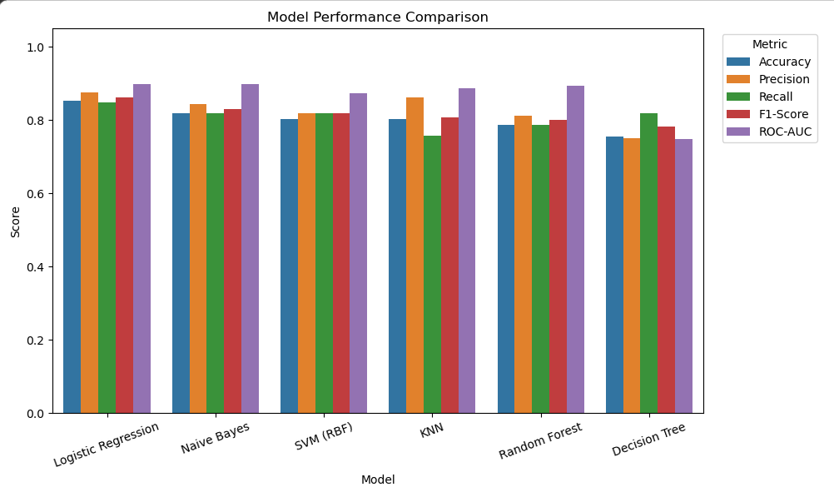

MODEL COMPARISON
Baseline Model Performance
Best Baseline: Logistic Regression
Top accuracy and F1-score — selected for hyperparameter tuning and deployment.
SVM achieved the highest ROC-AUC among all baselines.

Slide 9
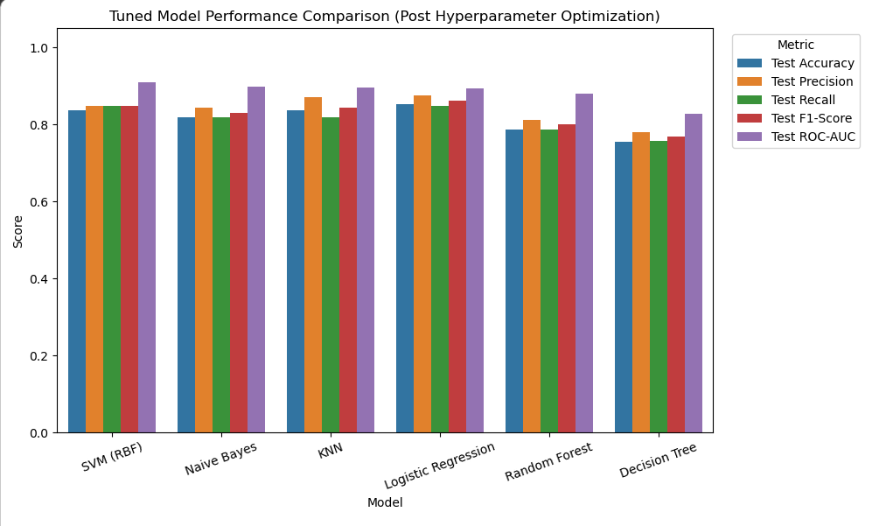
HYPERPARAMETER TUNING
Optimization & Final Model Selection
Tuning Approach
GridSearchCV with 5-Fold Stratified CV
Optimized: LR, SVM, KNN, Random Forest
Why Logistic Regression?
Highest accuracy: 85.25%
Best precision & F1-score
Interpretable coefficients for clinical use

Slide 10
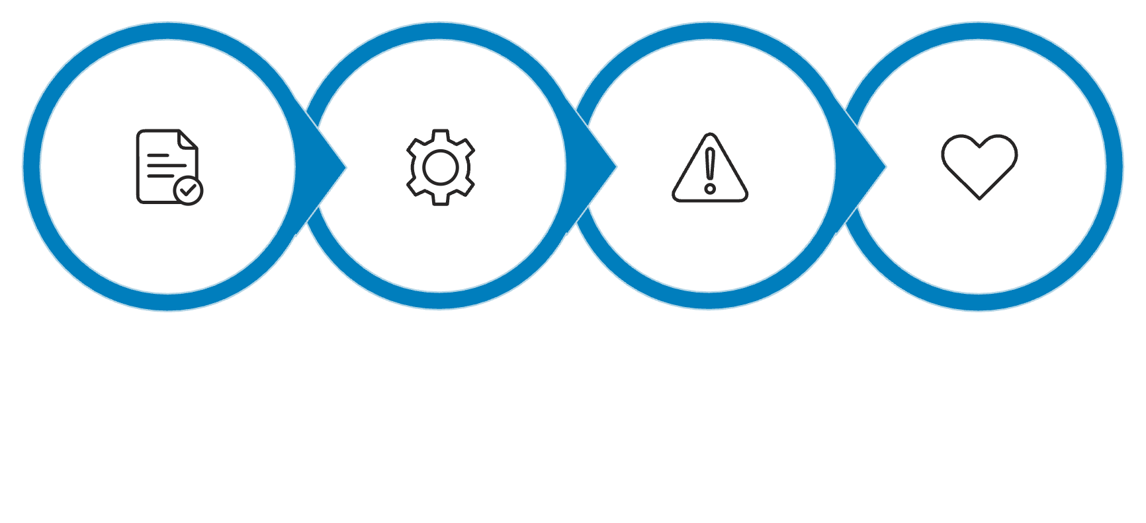
DEPLOYMENT & INSIGHTS
Streamlit App & Key Predictors
User Input
ML Pipeline
Risk Category
Recommendation
Interactive Streamlit app with real-time prediction, risk categories, and health recommendations.
Top Predictors
Conclusion & Future Work
Chest Pain Type
Thalassemia
Max Heart Rate
Major Vessels · ST Depression
LR achieved 85.25% accuracy
Future: SHAP explainability, larger datasets, ensemble models, clinical deployment
Thank You
Manoj Gowda B Y · Don Bosco Institute of Technology

