Slide 1

Predictive Analytics for Customer Behavior
Customer Behavior Analysis & Churn Prediction — Internship Project
Prepared by: Rakesh B V
B.E. Electronics And Communication Engineering
Don Bosco Institute of Technology

Slide 2
PROJECT OVERVIEW
Understanding the Business Problem
Customer churn — the rate at which customers stop doing business with a company — is one of the most critical challenges in the telecom and service industries. Predictive analytics leverages historical data and machine learning to identify at-risk customers before they leave, enabling proactive retention strategies.
Project Objectives
Dataset at a Glance
Analyze customer behavior patterns
Identify key churn drivers
Build and compare ML models
Deliver actionable business insights
7,043 customers in the dataset
33 features covering demographics, services, billing, and tenure
Target variable: Churn (Yes/No)
Source: Publicly available telecom customer dataset

Slide 3

METHODOLOGY
End-to-End Project Workflow
This project follows a structured data science pipeline — from raw data collection through model deployment — ensuring reproducibility, rigor, and business relevance at every stage.
Exploratory Analysis
Data Collection
Gather raw data from sources
Discover patterns and insights
Feature Engineering
Data Cleaning
Clean and preprocess datasets
Create predictive features
Each stage builds on the previous one: clean data enables meaningful EDA, which informs feature engineering, which directly impacts model quality. The final business recommendations translate model outputs into strategic actions.

Slide 4
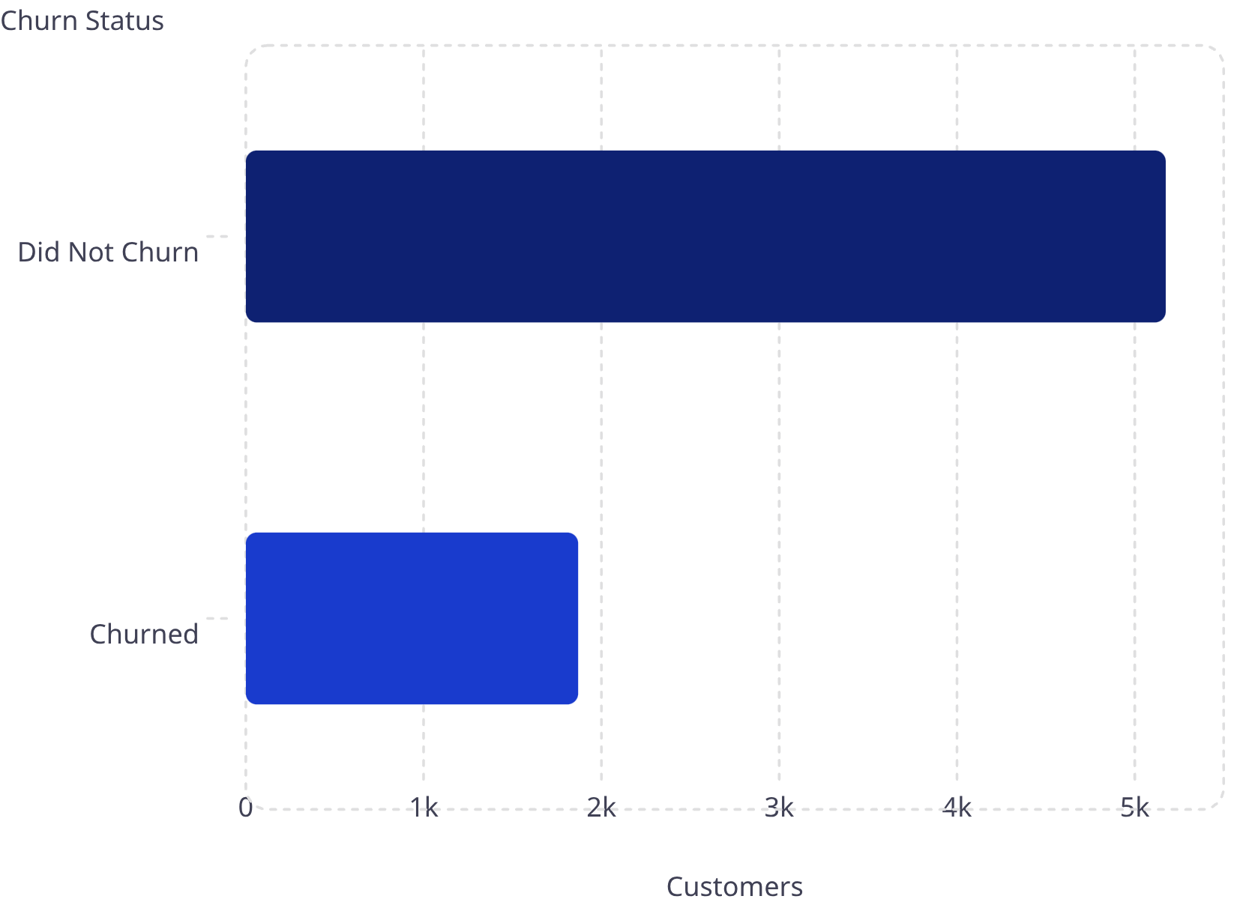
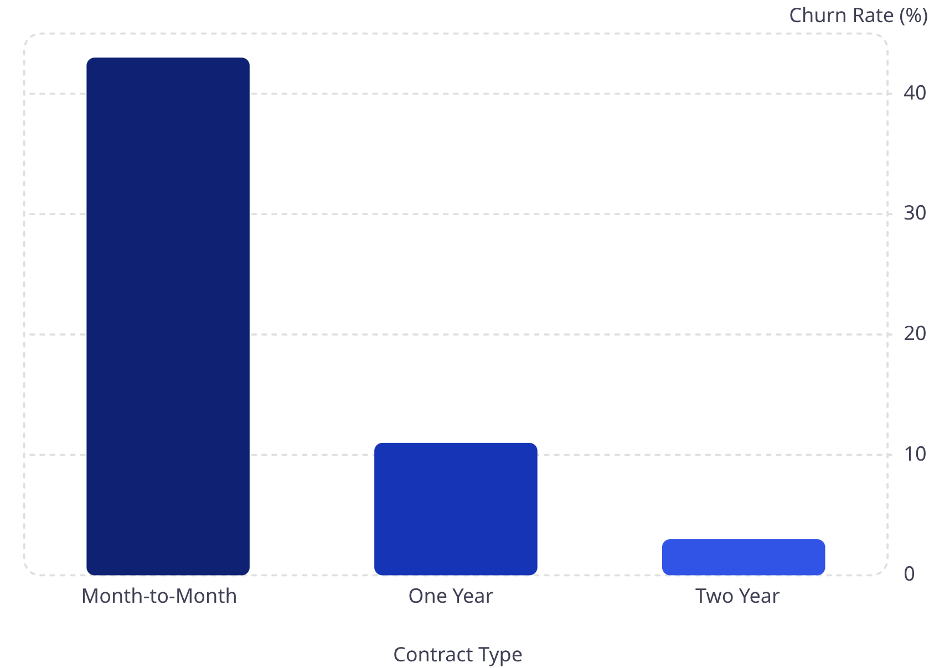
EXPLORATORY DATA ANALYSIS
What the Data Reveals
EDA uncovered critical patterns in customer demographics, service usage, and billing behavior — forming the analytical foundation for churn prediction.
Churn Distribution
Contract Type vs Churn Rate
Monthly Charges
Customer Tenure
Higher charges correlate strongly with churn — customers paying above ₹6,000/month are at elevated risk.
Churned customers averaged just 15 months tenure vs. 33 months for retained customers.
Payment Method
CLTV Impact
Electronic check users churn at nearly 2× the rate of bank transfer or auto-pay customers.
Low Customer Lifetime Value combined with high monthly charges is a strong churn signal.

Slide 5
KEY INSIGHTS
What Drives Customer Churn?
EDA surfaced six high-confidence churn drivers that directly informed feature selection and model design.
Overall Churn Rate: 26.5%
Tenure is the Strongest Predictor
Over 1 in 4 customers churned — a significant revenue risk demanding immediate intervention.
Customers with less than 12 months of tenure are disproportionately likely to churn, signaling weak early engagement.
Higher Charges = Higher Risk
Month-to-Month Contracts Are Vulnerable
Monthly charges above the median significantly increase churn probability, especially without contract commitment.
43% churn rate vs. just 3% for two-year contracts — flexibility comes at a retention cost.
Electronic Check Users at Risk
Fiber Optic Customers Need Attention
Manual payment methods signal lower engagement; auto-pay customers churn far less frequently.
Despite premium service, fiber optic subscribers show elevated churn — likely due to unmet expectations.

Slide 6
FEATURE ENGINEERING & ML
Building the Predictive Models
Data Preparation Pipeline
Models Trained
Logistic Regression — Interpretable baseline with probabilistic outputs
Decision Tree — Rule-based model capturing non-linear patterns
Random Forest — Ensemble of trees for robust, low-variance predictions
Data Encoding
Categorical variables (contract type, payment method, internet service) were one-hot encoded for model compatibility.
Feature Scaling
Random Forest was selected as the primary model due to its ability to handle feature interactions, reduce overfitting, and provide feature importance scores.
Numerical features (tenure, monthly charges, CLTV) were standardized to prevent scale bias in model training.
Train-Test Split (80:20)
80% of data used for training, 20% held out for unbiased evaluation of generalization performance.

Slide 7
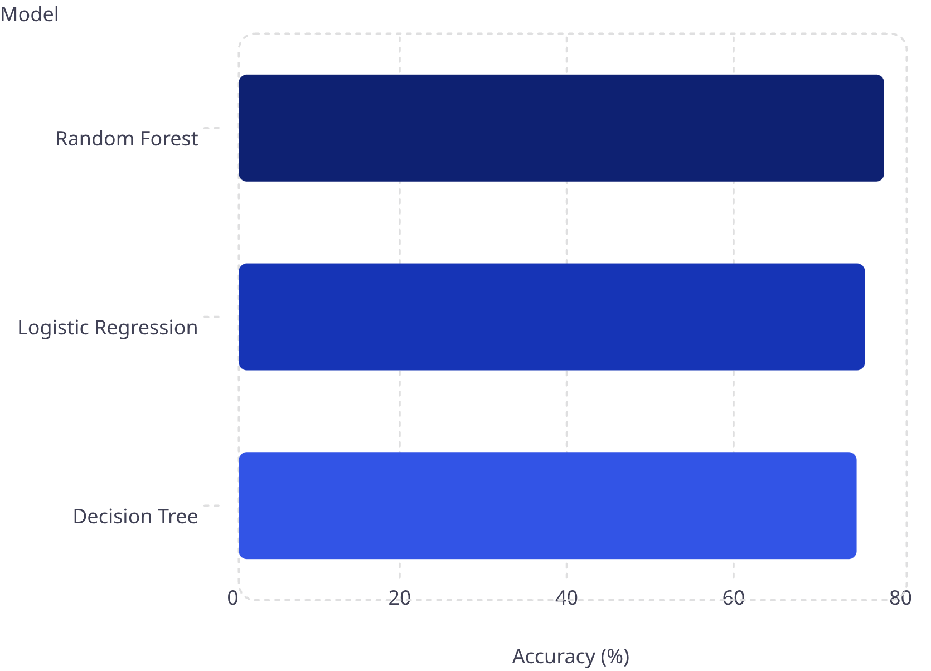
MODEL PERFORMANCE
Comparing Model Results
All three models were evaluated on Accuracy and ROC-AUC score using the held-out 20% test set. Random Forest emerged as the best-performing model, achieving the highest scores on both metrics.
Model
Accuracy
ROC-AUC Score
Random Forest ⭐
77.3%
0.852
Logistic Regression
75.0%
0.850
Decision Tree
74.0%
0.837
Why Random Forest Won
Ensemble approach reduces overfitting
Handles class imbalance effectively
Provides feature importance rankings
Robust to outliers and noise

Slide 8
BUSINESS RECOMMENDATIONS
Turning Insights into Action
The model's predictions and EDA findings translate directly into six targeted retention strategies — each addressing a specific churn driver identified during analysis.
Proactive Retention Outreach
Personalized Marketing Campaigns
Trigger personalized retention offers for customers showing early churn signals — especially within the first 12 months.
Segment customers by tenure, charges, and service type to deliver relevant, timely offers that increase engagement.
Promote Long-Term Contracts
Encourage Auto-Payment
Incentivize upgrades from month-to-month to annual or two-year plans with discounts or bundled services.
Migrate electronic check users to automatic payment methods through small incentives or simplified onboarding.
Improve Customer Support
Focus on High-Value Customers
Fiber optic customers report higher dissatisfaction — invest in dedicated support and service quality improvements.
Prioritize retention efforts on high-CLTV customers, as their churn has the greatest revenue impact.

Slide 9
CONCLUSION
Key Takeaways
This project demonstrates how predictive analytics transforms raw customer data into strategic business intelligence — enabling proactive, data-driven retention decisions.
1
Customer Behavior Successfully Analyzed
Comprehensive EDA on 7,043 customers across 33 features revealed clear, actionable churn patterns.
2
Six Key Churn Drivers Identified
Tenure, contract type, monthly charges, payment method, fiber optic service, and CLTV were confirmed as primary churn factors.
3
Random Forest Achieved Best Performance
With 77.3% accuracy and 0.852 ROC-AUC, Random Forest outperformed Logistic Regression and Decision Tree baselines.
4
Predictive Analytics Drives Retention
The model enables early identification of at-risk customers, allowing timely, targeted intervention before churn occurs.
5
Supports Data-Driven Business Decisions
Recommendations are grounded in empirical evidence, giving leadership a clear roadmap to reduce churn and increase CLTV.

Slide 10


Thank You
Questions & Answers
This presentation summarized an end-to-end predictive analytics project — from data exploration to model deployment and business recommendations. I welcome your questions, feedback, and discussion.
Prepared By
Institution
Rakesh B V
B.E. Electronics And Communication Engineering
Don Bosco Institute of Technology
Affiliated to VTU, Bengaluru
Project Focus
Customer Churn Prediction
Predictive Analytics & Machine Learning
This project was conducted as part of an academic internship program. All models and insights are based on publicly available telecom customer data.

