Slide 1
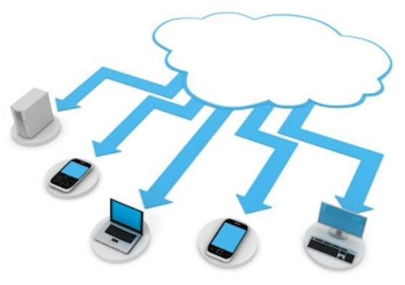
Video Transcoding Application using Elastic Transcoder,S3,RDS,Elastic Beanstalk,SES and SNS
Submitted by: Team#4 Manoj Gyanani, Yan Zhu, Yashi Kamboj CS Dept., SJSU

Slide 2
Introduction:
An application for converting audio/video files from one format to another.
Any user can visit site and upload the file to be converted.
Its available for everyone. Any user can register and leverage the application.
The user receives an email when the transcoding is complete.
Also, the supporting team will receive an email regarding the job under process. The status of success/ failure along with other technical details is received by them. Hence, debugging is easier in case of an issue.

Slide 3



Technologies Used:
Accessing AWS Services
Java
J2EE(Servlets 3.0)
Client Side
JSP Pages
Struts 2.0
Server
Tomcat Server 7.0

Slide 4
Application Flow: User Login/Register
New User
Yes
Register
No
Yes
Enter Email and Password
Existing Account
No
Correct Info
No
Yes
Home page
Activate

Slide 5
Transcoding a File:
Registered User
Login
Guest User
Choose File to Upload
Submit
Logged In
Enter Email
No
Yes
Start Conversion
Activate Email
Download File

Slide 6
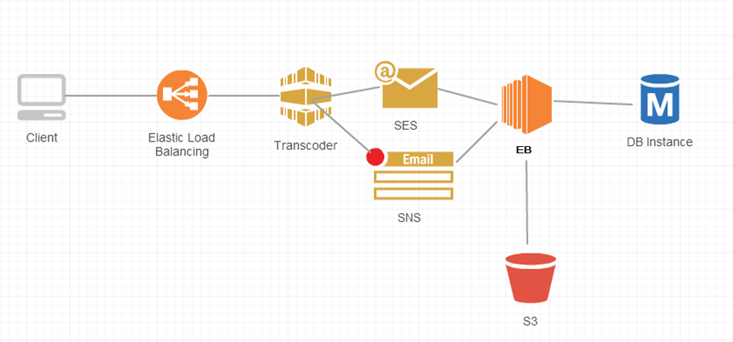


Architectural Design of the System:

Slide 7

AWS Features Used:
Simple Storage Service(S3):
Store the files uploaded by user and the output produced by the transcoder
Elastic Transcoder:
Convert input file from one format to another
Simple Email Service(SES):
Send email to the user upon completion of the conversion job
Simple Notification Service(SNS):
Send notifications to the supporting team regarding flow of transcoding job
RDS(My SQL)
This serves as the database of our application
Beanstalk:
For Deployment and Management

Slide 8
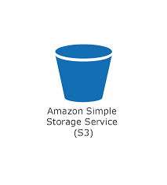
Simple Storage Service(S3):
Highly Scalable
Secure
Bucket-Concept
File of user gets uploaded in S3
Upon conversion, the output file gets stored in S3
Provided to user through UI, where the user has an option to download the file.

Slide 9

Elastic Transcoder:
Media transcoding in the cloud
Highly Scalable: Transcoding pipelines enable you to perform multiple transcodes in parallel.
Managed: Transcoder enables you to focus on your content rather than on managing transcoding software in a distributed cloud-based environment.
Easy to use: Pre defined presets makes it easier to use for first time users.
Secure: AWS S3 buckets are used to keep input and output files.
Pipeline Concept

Slide 10
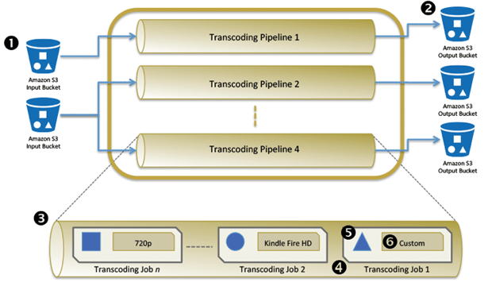
Elastic Transcoder(Continued):

Slide 11
Elastic Transcoder(Continued):
Simply create a pipeline and specify the input and output buckets to it.
Add the transcoding “job” specifying the location of your source media file to your pipeline.
Choose from the presets available for converting file format or the developer also has an option to create their own preset.
Amazon Elastic Transcoder provides an important media building block for creating end-to-end media solutions on AWS
It can be integrated with SES and SNS, which we shall explore in the subsequent slides.

Slide 12
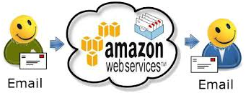
Simple Email Service(SES):
Cost-effective outbound-only email-sending service.
High Deliverability
Notifications: Sends the bounce and complaint messages in one of two ways:
By email
Amazon Simple Notification Service(SNS) (Discuss Next)
Multiple Email-Sending Interfaces
SES Console
SMTP Interface
Amazon SES Query API(used)
We have leveraged this AWS service to send an Email to user informing the completion of job.

Slide 13
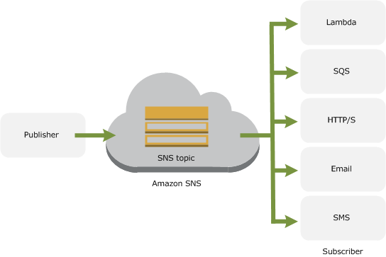
Simple Notification Service(SNS):
Push Notification Service for sending messages to an individual or group of recipients.
Sends SMS messages to mobile device users in the US or to email recipients worldwide.
Fast, Flexible, Fully-Managed
We have implemented email service to Support & Administration team ensuring proper functioning of the application.
The email received contains the technical details of the job and the status: Processing,Completed or Error. (Sample on next slide)

Slide 14
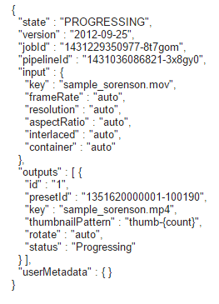
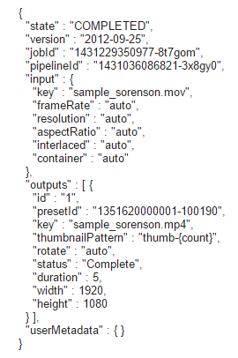
Simple Notification Service(SNS): (Continued)

Slide 15

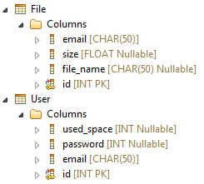
Amazon RDS(MY SQL):
Easy to set up, operate, and scale a relational database in the cloud.
Provides access to MySQL, Oracle, Microsoft SQL Server, PostgreSQL
Compatible with existing tools and applications
We have Two tables in our application:
File for storing user and conversion files information
User for storing user information

Slide 16

Elastic Beanstalk:
Service for deploying and scaling web applications and services developed with Java
Simply upload the code and it automatically handles the deployment
Provides capacity provisioning, load balancing and autoscaling
Number of tools to create application versions: AWS Management Console, Git deployment and CLI, AWS Toolkit for Eclipse
We used Toolkit for Eclipse to develop the code and then deployed it in Elastic Beanstalk.

Slide 17
Conclusion:
Future Work:
Using this simple application, a user can easily convert media(audio/video) files from one format to another.
Secure content because of S3 usage
Making use of SES and SNS for sending emails
Elastic Beanstalk provides with Load balancing and Autoscaling
Support multiple file formats, such as image and document formats.
Provide more options for storing output files, e.g. save the file in dropbox

Slide 18
References:
AWS Documentation:http://aws.amazon.com/documentation/
JAVA:http://docs.oracle.com/javaee/6/tutorial/doc/bnafd.html
Struts 2:http://struts.apache.org/
JDBC:http://docs.oracle.com/javase/tutorial/jdbc/basics/prepared.html

Slide 19

Thank You!

