Slide 1
KPMG
Challenge #1
A 3-tier environment – Cloud hosted social media web application

Slide 2
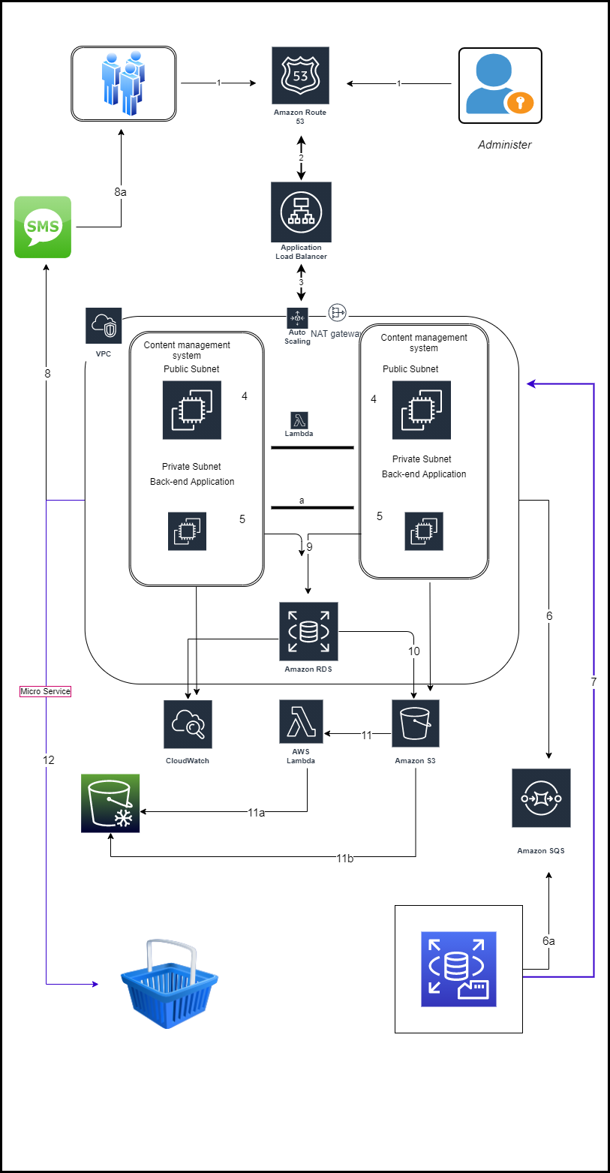
Architectural Design

Slide 3





Technical enablers
This section details about individual AWS components which are used to accomplish the project goals .
Improved collaboration & connectivity
Increased digitalization with AWS
High availability & scalability
Increased digital connect
higher networking among students
AWS Components
Route 53 service has been used to resolve DNS requests between microservices within the application/entities.
AWS Auto Scaling is used to monitor our applications and automatically adjusts capacity to maintain steady, predictable performance at the lowest possible cost.
Route 53
Auto Scaling
Load balancers were setup for both user load across the application and for load on internal services
A Lambda function was developed to manage capacity of our containers, based on capacity the Lambda function spins new instances of EC2s.
Load balancer
Lambda
VPC
VPC is used to build a virtual network in the AWS cloud.
Amazon RDS
Amazon Relational Database Service (RDS) is used as a collection of managed services that makes it simple to set up, operate, and scale databases in the cloud.

Slide 4
Technical enablers contd.
AWS Components
CloudWatch service was used to monitor all the services and ensure there are no security breaches.
Microservices
A variant of the service-oriented architecture structural style – arranges an application as a collection of loosely-coupled services.
CloudWatch
Amazon S3 is used as an object storage service that offers industry-leading scalability, data availability, security, and performance
IAM
AWS Identity and Access Management (IAM) provides fine-grained access control across all of AWS. With IAM, we specified who can access which services and resources, and under which conditions. With IAM policies, we managed permissions to your workforce and systems to ensure least-privilege permissions.
Amazon S3
SQS is used to decouple application components so that they run and fail independently, increasing the overall fault tolerance of the system.
Amazon SQS

Slide 5
Thank You

