Slide 1
EET 4501 Prompt Engineering Techniques
Spring 2026
Manoj Kumal, PhD student
Dept. of Applied Computing
Michigan Tech

Slide 2

Agenda
LLM
Why Prompting
Prompt
Prompting Techniques

Slide 3
Large Language Model(LLM)
Notes:
.. Diaeresis

Slide 4
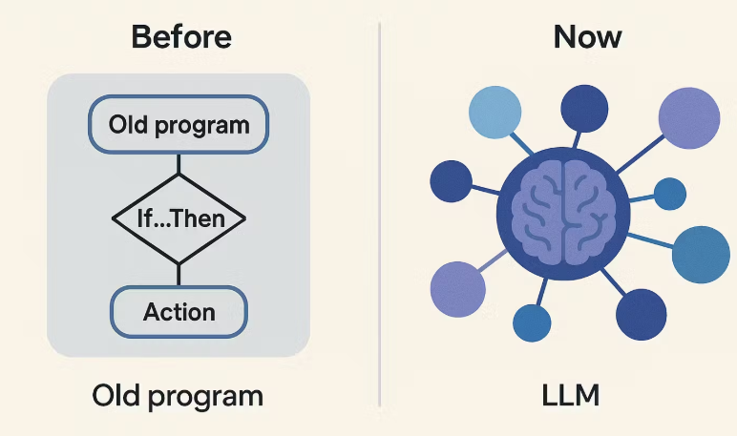
How AI understand text?
source: https://www.swiftask.ai/blog/what-is-an-llm
Notes:
old AI: Relied on rules, keywords, and simple statistics, ignored deep context, Now: Understand words based on surrounding context

Slide 5

What is exactly LLM?
source: https://imgflip.com/i/82cixh
Notes:
An LLM (Large Language Model) is an AI model trained on massive amounts of text to understand, generate, and reason with human language.

Slide 6
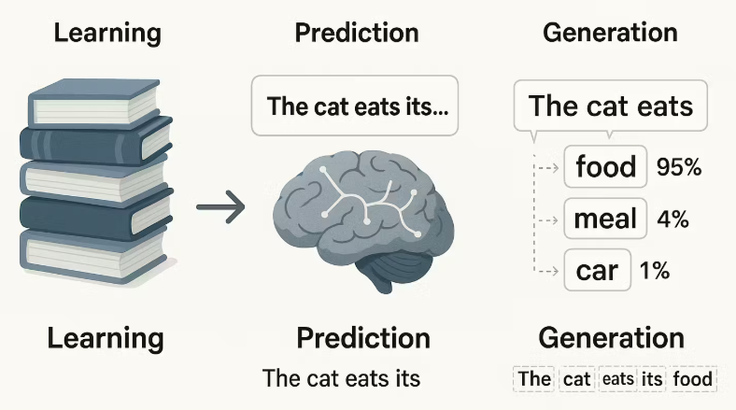
How a large language model works?
source: https://www.swiftask.ai/blog/what-is-an-llm
Notes:
It learns patterns, Context-aware, neural network based architecture, general purpose tasks like QA, summarization, translation, coding etc.

Slide 7
Why Prompting Matters
Notes:
.. Diaeresis

Slide 8
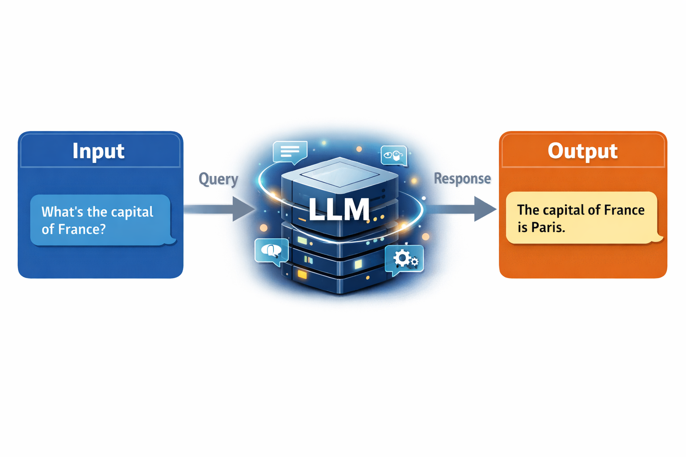
Simple Prompts
Notes:
Usually, a query is passed to the LLM as text input. The LLM analyzes the query and its context and It generates an answer based on learned knowledge.

Slide 9
Why Prompting Matters?
It determines the quality of the AI’s output.
It saves time and effort by reducing the need for repeated questions.
It reduces incorrect or irrelevant answers.
It helps the AI better understand and match the user’s intent.
It ensures the output follows the desired format (bullets, code, summary, json etc).
Notes:
Prepare to exam, eager learner will study all material and learn (long training time (study time) and short test time). Lazy learner will not study but get all material and find similar problems.
K-Nearest Neighbors (KNN) is an instance-based learning algorithm, meaning it does not explicitly learn a model during training but instead memorizes the training data and makes predictions based on similarity.

Slide 10
Prompt
Notes:
.. Diaeresis

Slide 11
What is prompt?
A prompt is the input or instruction given to an AI or LLM.
It tells the AI what task to perform.
A prompt can be a question, command, or description.
The quality of the prompt affects the quality of the output.
Clear and specific prompts produce better and more accurate responses.
A prompt acts as a guide for the AI’s response
Notes:
K-Nearest Neighbors (KNN) is considered a non-parametric algorithm, meaning it does not make strong assumptions about the underlying data distribution. Instead, it relies on the training data itself to make predictions.
Why is KNN Non-Parametric?
No Fixed Number of Parameters:
In parametric algorithms (e.g., linear regression, logistic regression), the model has a fixed number of parameters (like weights and biases) that are learned from the data.
KNN does not learn a fixed set of parameters; instead, it stores the entire dataset and uses it to classify new instances.

Slide 12
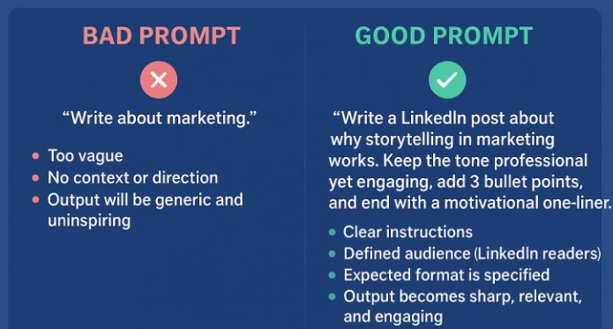
BAD PROMPT Vs GOOD PROMPT
source: https://good-prompt-vs-bad-prompt-why-it-matters
Notes:
Bad Prompt
Vague or unclear instructions
Missing context or constraints
Leads to generic or incorrect answers
Requires multiple follow-up questions
Good Prompt
Clear and specific instructions
Provides necessary context or examples
Produces accurate and relevant answers
Saves time and reduces errors

Slide 13
Prompting Techniques
Notes:
.. Diaeresis

Slide 14
Zero-Shot Prompting
The AI is given only a task, with no examples.
The model relies on its pre-trained knowledge.
Fast and simple to use.
Works well for common or straightforward tasks.
Notes:
K-Nearest Neighbors (KNN) is considered a non-parametric algorithm, meaning it does not make strong assumptions about the underlying data distribution. Instead, it relies on the training data itself to make predictions.
Why is KNN Non-Parametric?
No Fixed Number of Parameters:
In parametric algorithms (e.g., linear regression, logistic regression), the model has a fixed number of parameters (like weights and biases) that are learned from the data.
KNN does not learn a fixed set of parameters; instead, it stores the entire dataset and uses it to classify new instances.

Slide 15
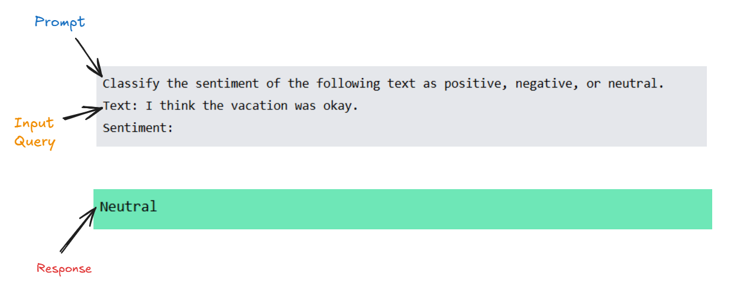
Zero-Shot Prompting Example
Notes:
Zero-shot Prompting
The model is given only a task description, with no examples.
It relies entirely on its pretrained knowledge to respond.
Example: “Classify the sentiment of this text.”

Slide 16
Few-Shot Prompting
The AI is given a few examples along with the task.
Examples show the expected style, format, or logic.
Produces more accurate and consistent results.
Useful for complex or structured tasks.
Notes:
K-Nearest Neighbors (KNN) is considered a non-parametric algorithm, meaning it does not make strong assumptions about the underlying data distribution. Instead, it relies on the training data itself to make predictions.
Why is KNN Non-Parametric?
No Fixed Number of Parameters:
In parametric algorithms (e.g., linear regression, logistic regression), the model has a fixed number of parameters (like weights and biases) that are learned from the data.
KNN does not learn a fixed set of parameters; instead, it stores the entire dataset and uses it to classify new instances.

Slide 17
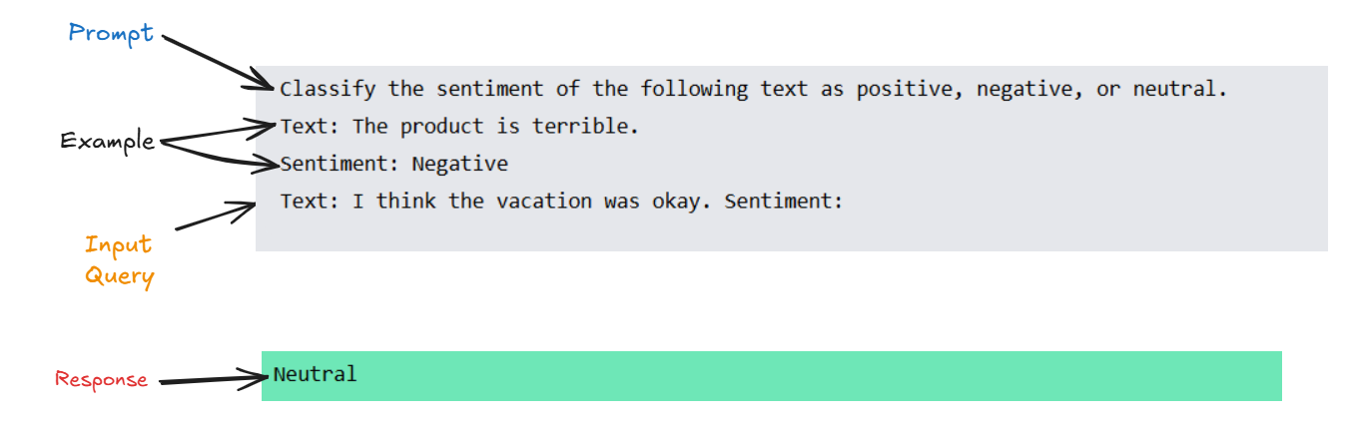
Few-Shot Prompting Example
Notes:
Few-shot Prompting
The model is given a task along with a few examples.
Examples help the model understand the desired format and behavior.
Example: Showing 2–3 labeled sentiment examples before asking a new one.

Slide 18
Chain of Thought(CoT) Prompting
It encourages the AI to think step by step before giving the final answer.
It improves performance on reasoning and problem-solving tasks.
It helps the AI handle complex or multi-step questions.
It makes the reasoning process more transparent and understandable.
It reduces errors by guiding the model through logical steps.
Notes:
K-Nearest Neighbors (KNN) is considered a non-parametric algorithm, meaning it does not make strong assumptions about the underlying data distribution. Instead, it relies on the training data itself to make predictions.
Why is KNN Non-Parametric?
No Fixed Number of Parameters:
In parametric algorithms (e.g., linear regression, logistic regression), the model has a fixed number of parameters (like weights and biases) that are learned from the data.
KNN does not learn a fixed set of parameters; instead, it stores the entire dataset and uses it to classify new instances.

Slide 19
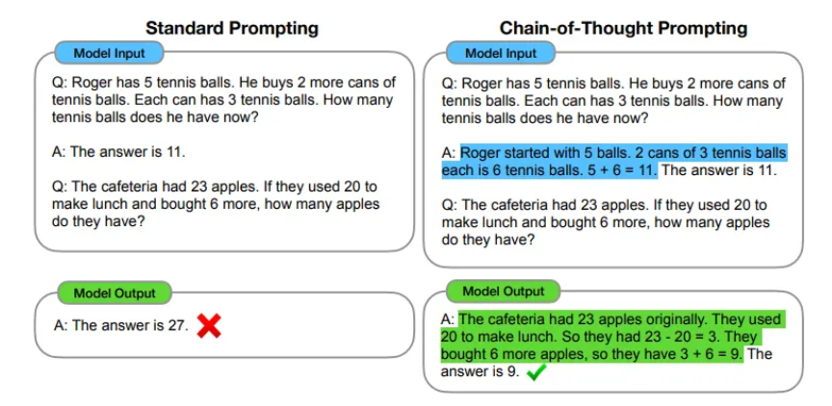
Chain of Thought(CoT) Prompting
source: https://arxiv.org/abs/2201.11903
Notes:
Chain-of-Thought Prompting
Encourages the model to reason step by step before giving the final answer.
Improves performance on complex reasoning and math problems.

Slide 20
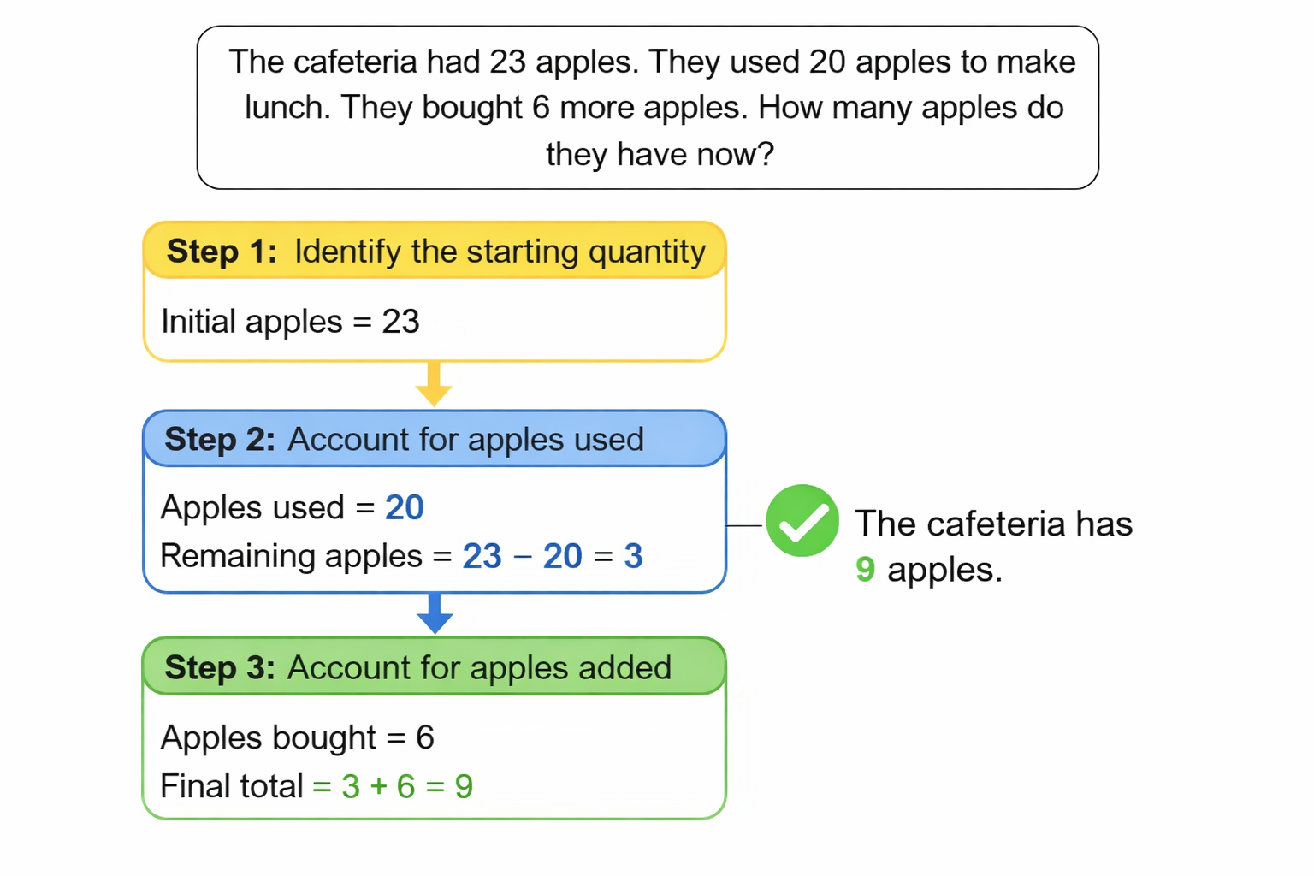
Chain of Thought(CoT) Prompting Example
Notes:
Why is KNN Non-Parametric?
No Fixed Number of Parameters:
In parametric algorithms (e.g., linear regression, logistic regression), the model has a fixed number of parameters (like weights and biases) that are learned from the data.
KNN does not learn a fixed set of parameters; instead, it stores the entire dataset and uses it to classify new instances.

Slide 21
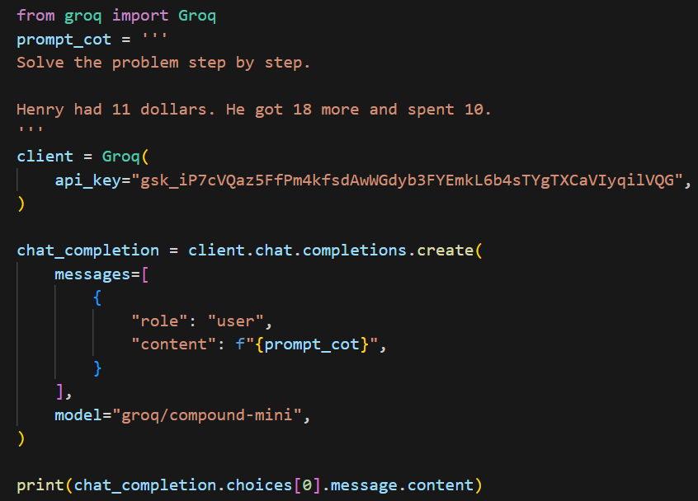
Chain of Thought(CoT) Prompting Example- code
Notes:
Why is KNN Non-Parametric?
No Fixed Number of Parameters:
In parametric algorithms (e.g., linear regression, logistic regression), the model has a fixed number of parameters (like weights and biases) that are learned from the data.
KNN does not learn a fixed set of parameters; instead, it stores the entire dataset and uses it to classify new instances.

Slide 22
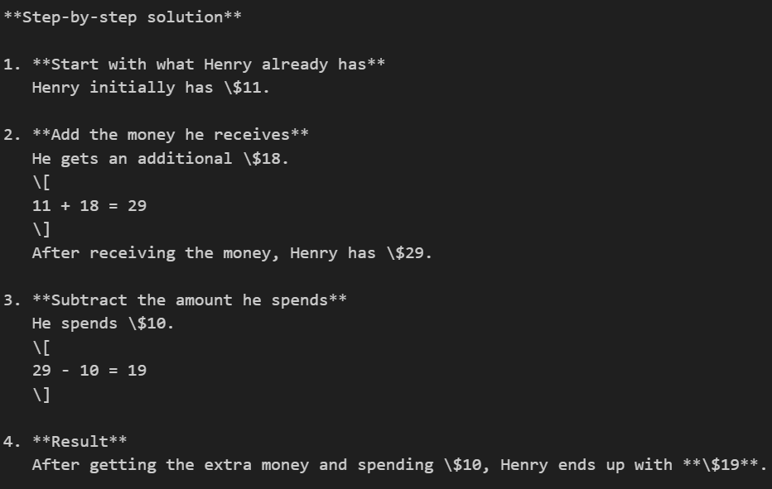
Chain of Thought(CoT) Prompting Example- output
Notes:
Why is KNN Non-Parametric?
No Fixed Number of Parameters:
In parametric algorithms (e.g., linear regression, logistic regression), the model has a fixed number of parameters (like weights and biases) that are learned from the data.
KNN does not learn a fixed set of parameters; instead, it stores the entire dataset and uses it to classify new instances.

Slide 23
Self Consistency
The model generates several different reasoning paths for the same question rather than just one.
It encourages the AI to approach the problem from different angles by slightly varying its logic each time.
The final answer is chosen based on which result appears most frequently across all the attempts.
It filters out "hallucinations" or random logic slips, as incorrect paths rarely lead to the same wrong answer.
It is most effective for math, coding, and common-sense reasoning where a definitive correct answer exists

Slide 24
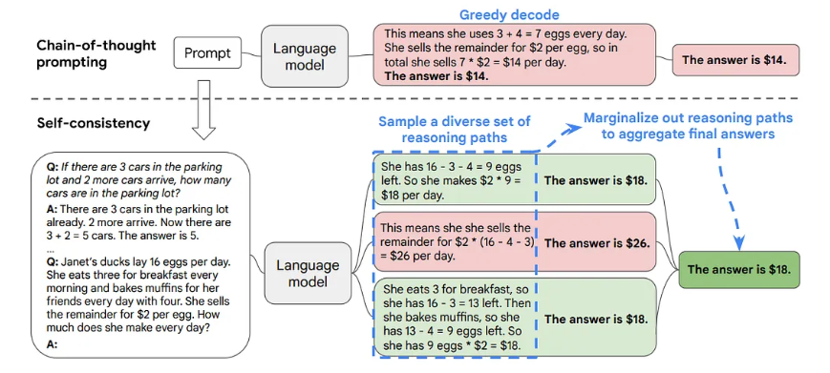
Self Consistency
source: https://arxiv.org/abs/2203.11171
Notes:
Self-Consistency Prompting
The model generates multiple reasoning paths for the same question.
The final answer is chosen based on the most consistent result across responses.

Slide 25
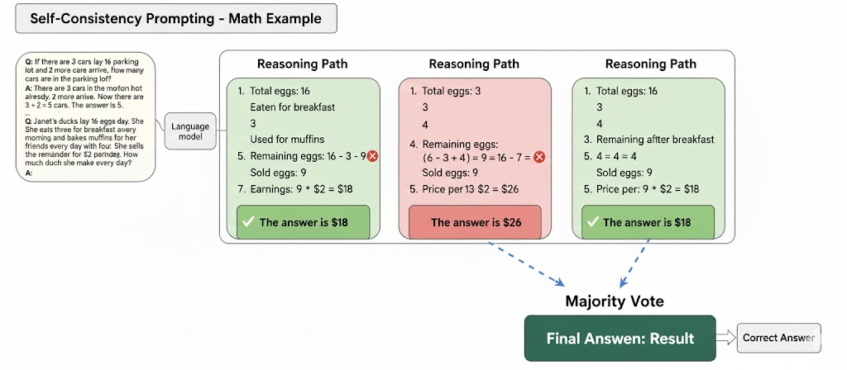
Self Consistency
Notes:
Why is KNN Non-Parametric?
No Fixed Number of Parameters:
In parametric algorithms (e.g., linear regression, logistic regression), the model has a fixed number of parameters (like weights and biases) that are learned from the data.
KNN does not learn a fixed set of parameters; instead, it stores the entire dataset and uses it to classify new instances.

Slide 26
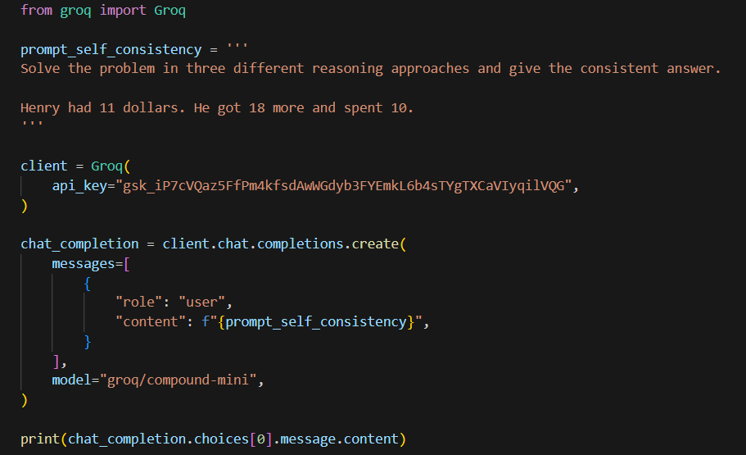
Self Consistency Prompting Example- code
Notes:
Why is KNN Non-Parametric?
No Fixed Number of Parameters:
In parametric algorithms (e.g., linear regression, logistic regression), the model has a fixed number of parameters (like weights and biases) that are learned from the data.
KNN does not learn a fixed set of parameters; instead, it stores the entire dataset and uses it to classify new instances.

Slide 27
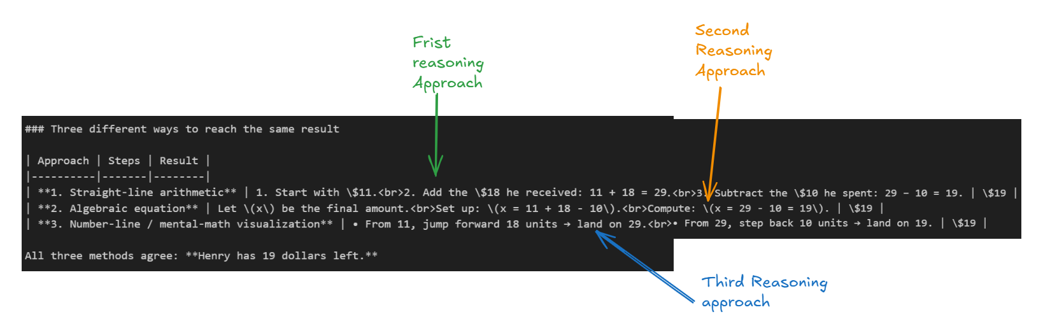
Self Consistency Prompting Example- output
Notes:
Why is KNN Non-Parametric?
No Fixed Number of Parameters:
In parametric algorithms (e.g., linear regression, logistic regression), the model has a fixed number of parameters (like weights and biases) that are learned from the data.
KNN does not learn a fixed set of parameters; instead, it stores the entire dataset and uses it to classify new instances.

Slide 28
ReAct Prompting
ReAct stands for Reasoning and Acting, where the model alternates between thinking and taking actions.
It allows the model to reason step by step and then interact with tools or environments.
ReAct improves performance on multi-step and decision-making tasks.
It helps the model correct itself by using observations from actions.
ReAct prompting is useful in tasks like question answering, planning, and tool-based problem solving.
Notes:
Why is KNN Non-Parametric?
No Fixed Number of Parameters:
In parametric algorithms (e.g., linear regression, logistic regression), the model has a fixed number of parameters (like weights and biases) that are learned from the data.
KNN does not learn a fixed set of parameters; instead, it stores the entire dataset and uses it to classify new instances.

Slide 29
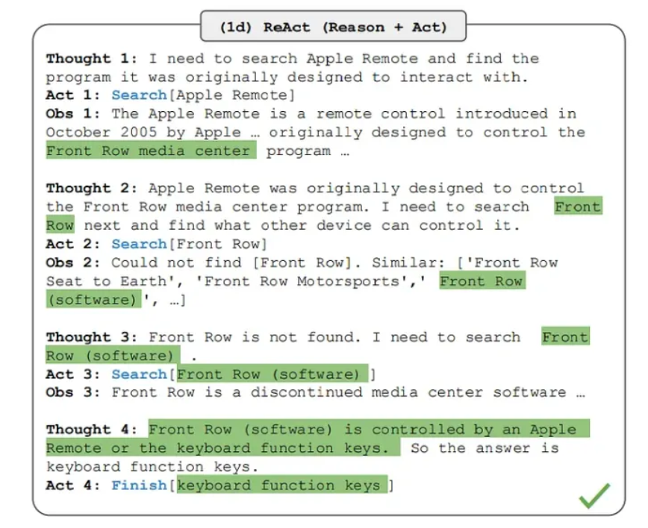
ReAct Prompting
source: https://arxiv.org/abs/2210.03629
Notes:
ReAct Prompting (Reason + Act)
Combines reasoning steps with actions (e.g., tool use or information retrieval).
Allows the model to think, act, observe, and refine its answer iteratively.

Slide 30
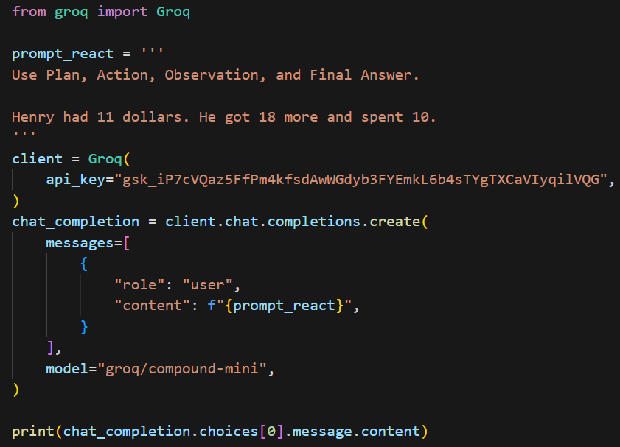
ReAct Prompting Example - Code
Notes:
ReAct Prompting (Reason + Act)
Combines reasoning steps with actions (e.g., tool use or information retrieval).
Allows the model to think, act, observe, and refine its answer iteratively.

Slide 31
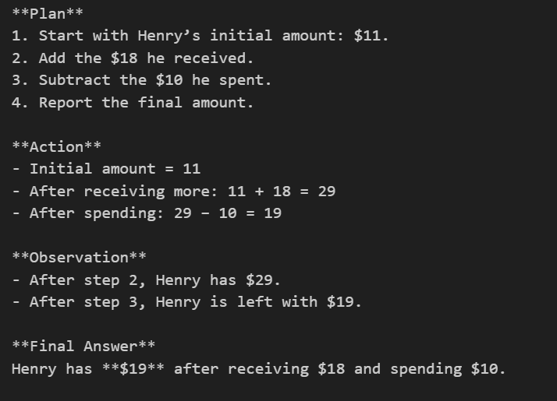
ReAct Prompting Example - Code
Notes:
ReAct Prompting (Reason + Act)
Combines reasoning steps with actions (e.g., tool use or information retrieval).
Allows the model to think, act, observe, and refine its answer iteratively.

