Slide 1
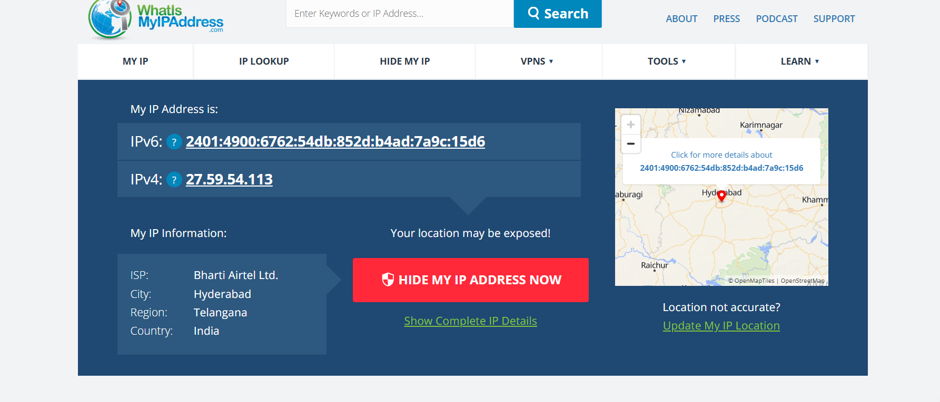
Before Using VPN

Slide 2
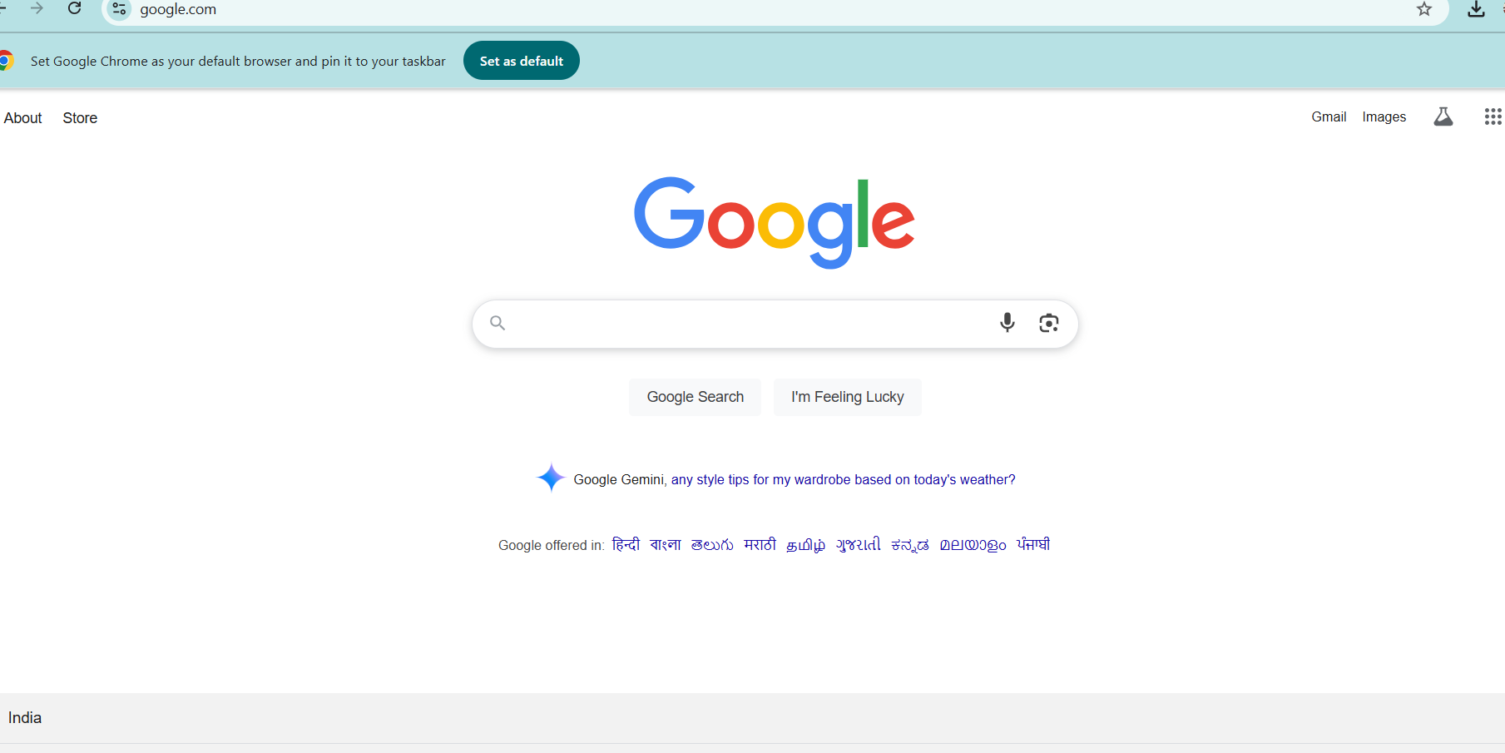

Slide 3
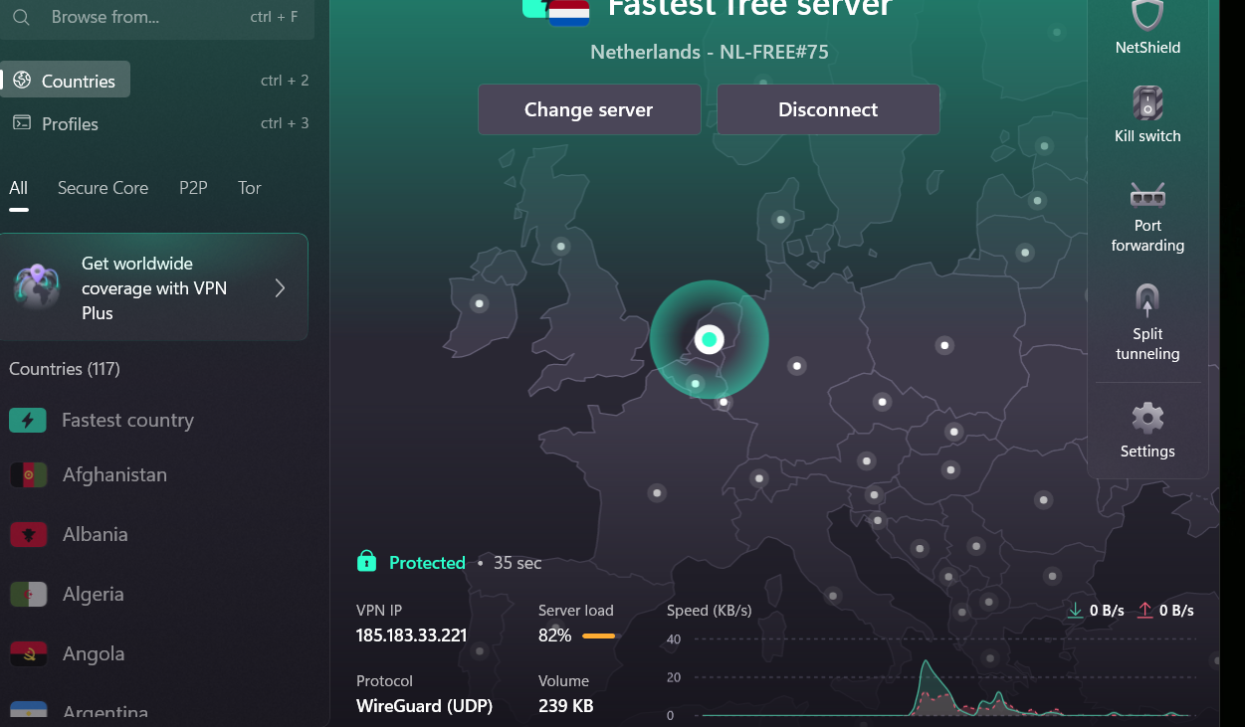
After Using VPN

Slide 4
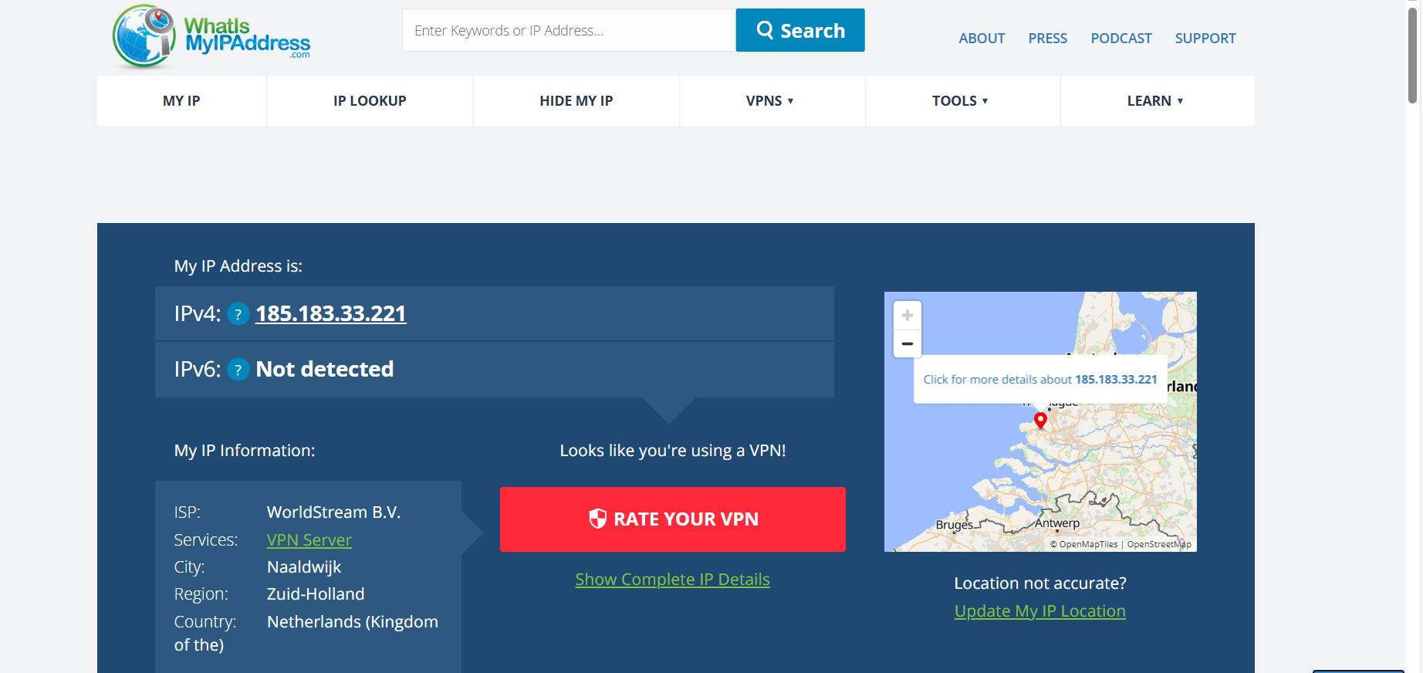

Slide 5
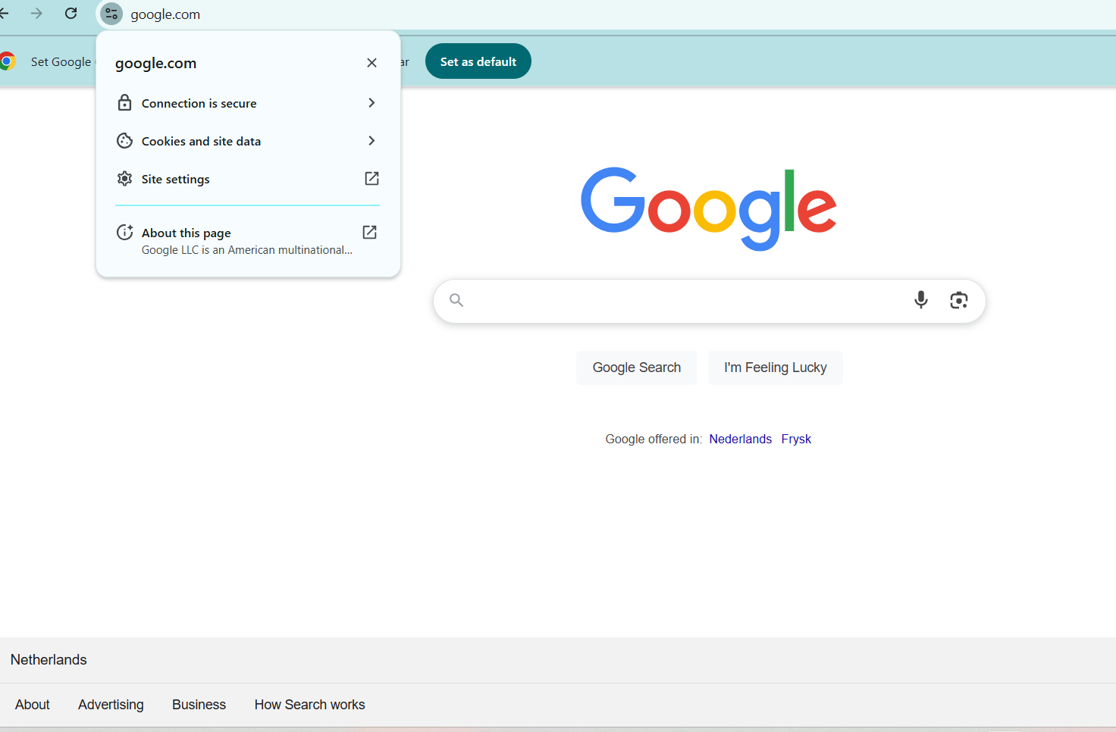
After using vpn I found the network is slow
Ip address and location had changed as seen in the above screenshots

