Slide 1
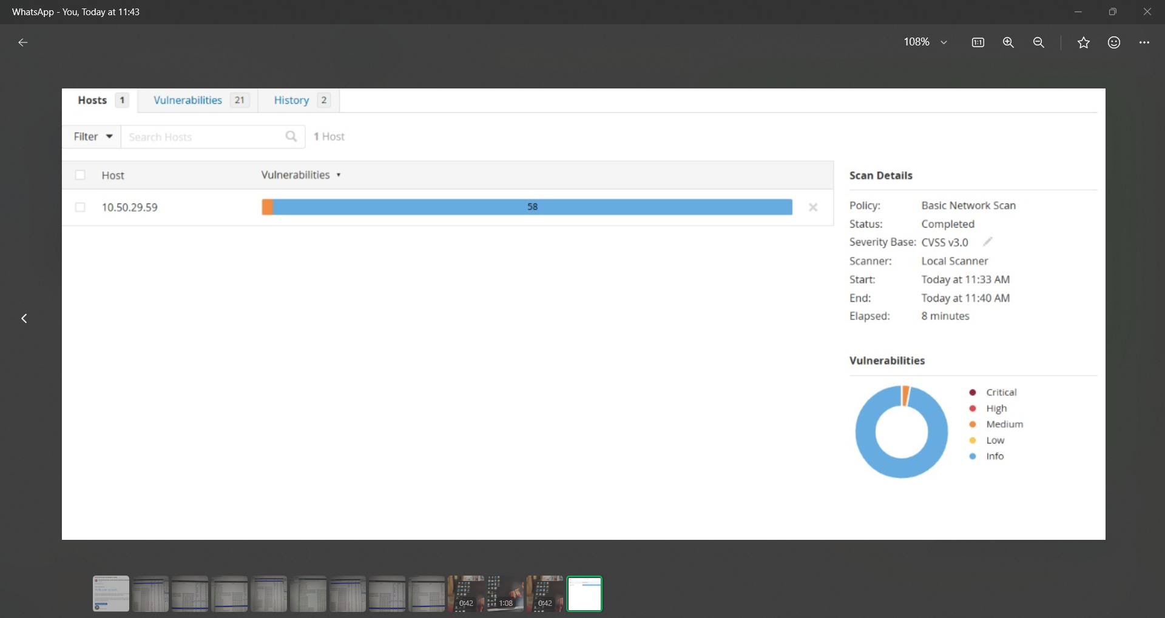
Vulnerability scan report

Slide 2
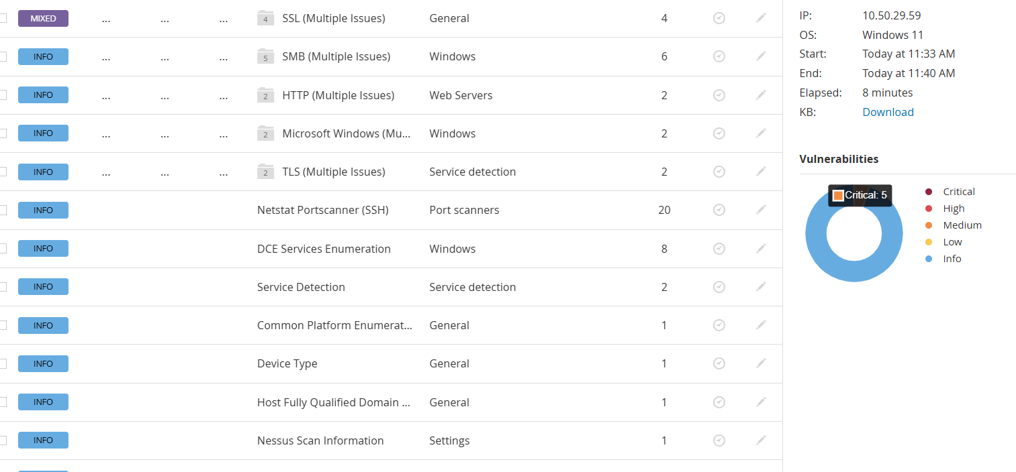
List of Vulnerabilities

Slide 3
