Slide 1


OLYMPICS
2020 MEDAL
REPORT
PRESENTED BY
MANOJKUMAR

Slide 2
SHORT INTRODUCTION
Tokyo
2020
Date23 JULY - 8 AUGUST
Country JAPAN
Athletes 11417
Teams 206
Events 339

Slide 3
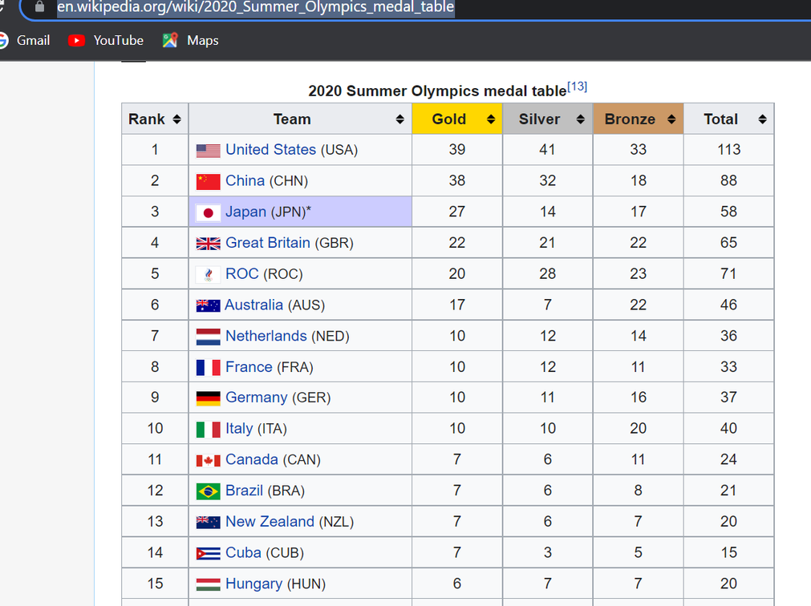
DATA SOURCE
Here Taken Olympics 2020 Medals data to create Power BI report
https://en.wikipedia.org/wiki/2020_Summer_Olympics_medal_table

Slide 4
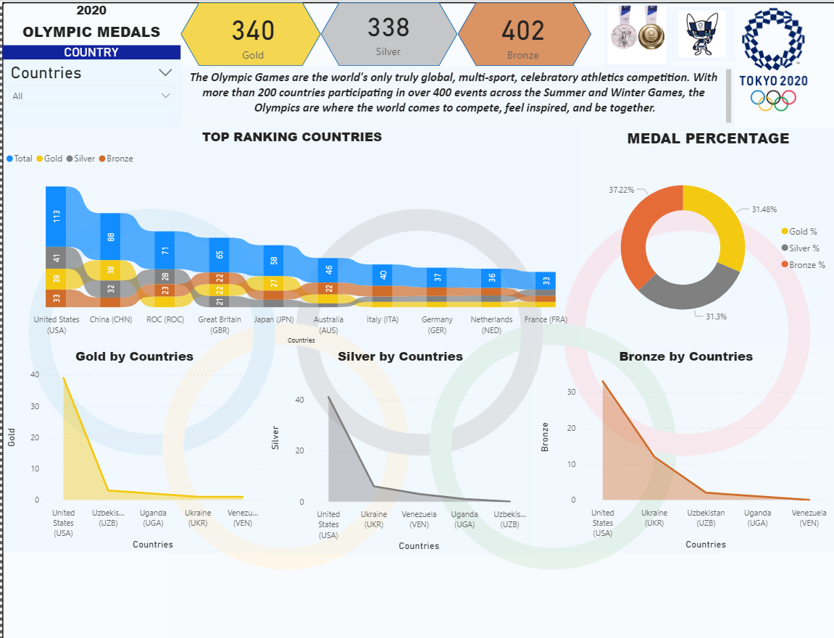
REPORT

Slide 5
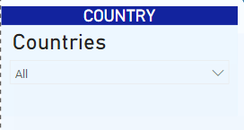
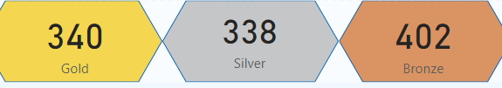
Add Slicer
To select countries
Cards
View Gold, Silver, Bronze Counts
Here is overall gold, silver and bronze counts

Slide 6
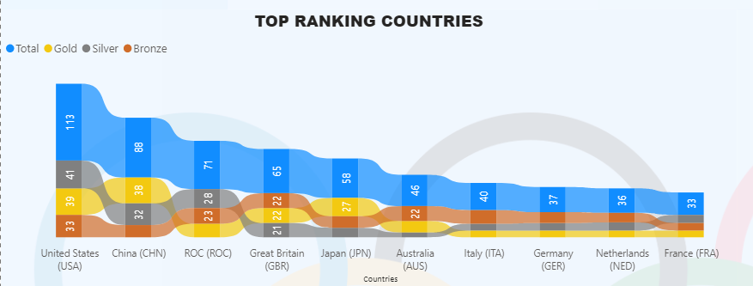
Displayed Top 10 Ranking countries with medals total count
United states is one of the top ranking country in Olympic 2020.
And individual gold , silver and bronze count

Slide 7
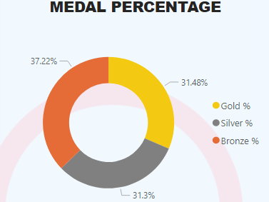
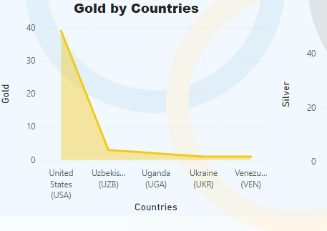
The overall percentage of gold, silver and bronze
The countries list who got gold medals higher count.
Here Top 5 countries leading with gold medals are USA, UZE, UGA, UKR and VEN.

Slide 8
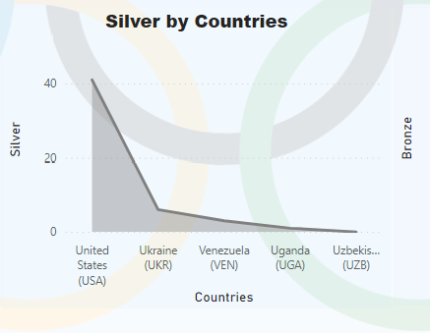
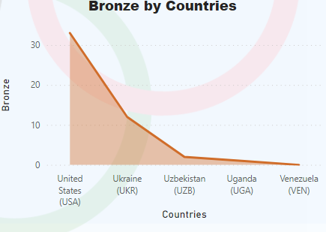
The Countries USA, UKR,VEN,UGA and UZB having high silver medals
The countries which have bronze medal high.
USA, UKR, UZB, UGA next VEN

Slide 9

THANK YOU

