Slide 1
Digital Portfolio
STUDENT NAME: MANOJKUMAR.G
REGISTER NO AND NMID: ED2F18FB4A96339BEB0426905C5F5EF0
DEPARTMENT: BSC
COLLEGE:Prince shri Balaji Arts and Science college / university of madras

Slide 2
PROJECT TITLE
STUDENT DIGITAL PORTFOLIO

Slide 3


AGENDA
Problem Statement
Project Overview
End Users
Tools and Technologies
Portfolio design and Layout
Features and Functionality
Results and Screenshots
Conclusion
Github Link
3/21/2024 Annual Review

Slide 4

PROBLEM STATEMENT
In today’s digital era, many students struggle to effectively showcase their skills, academic achievements, and personal growth in a structured and accessible way. Traditional methods, such as paper files or basic resumes, often fail to represent a student’s full potential and are difficult to update or share. There is a growing need for a digital platform where students can organize, display, and share their work easily with teachers, peers, colleges, and employers.

Slide 5

PROJECT OVERVIEW
This project is a personal portfolio website created using HTML, CSS , and JavaScript.
It showcases my profile, skills, and projects with a clean and responsive design.
The site includes sections like About Me, My Projects, and a Contact Form for easy interaction.
It serves as a platform to highlight my web development learning journey and projects.

Slide 6

WHO ARE THE END USERS?
If the end users are students, they could be:
1. Classmates or friends – who want to see your projects for ideas or inspiration.
2. Team members – collaborating with you on group projects or hackathons.
3. Junior students – learning from your code and portfolio structure.
4. Peers in tech communities – connecting for networking, knowledge sharing, or project collaboration

Slide 7

TOOLS AND TECHNIQUES
HTML – to structure the content of the website.
CSS – for styling, layout, and color themes.
JavaScript – for interactivity, such as the menu toggle and form behavior.
Mention code editor CODEPEN (GitHub Pages))

Slide 8
POTFOLIO DESIGN AND LAYOUT
1. Header – Links for Home, About, Projects, and Contact.
2. Hero Section – Introduction with your name, tagline, and a "View My Work" button.
3. About Me Section – Profile photo, brief bio, and academic details.
4. Projects Section – Cards for Project 1, Project 2, and Project 3 with short descriptions.
5. Contact Form – Simple form with fields for name, email, and message plus a send button.
8

Slide 9
FEATURES AND FUNCTIONALITY
Responsive Design – Works smoothly on mobile, tablet, and desktop devices.
Clean Navigation – Easy-to-use menu for quick access to sections like About, Projects, and Contact.
Interactive UI – Buttons and links with hover effects for a modern look.
Smooth Scrolling – Seamless transition between sections when clicking navigation links.
Clickable Links – Projects link to live demos or code repositories.

Slide 10
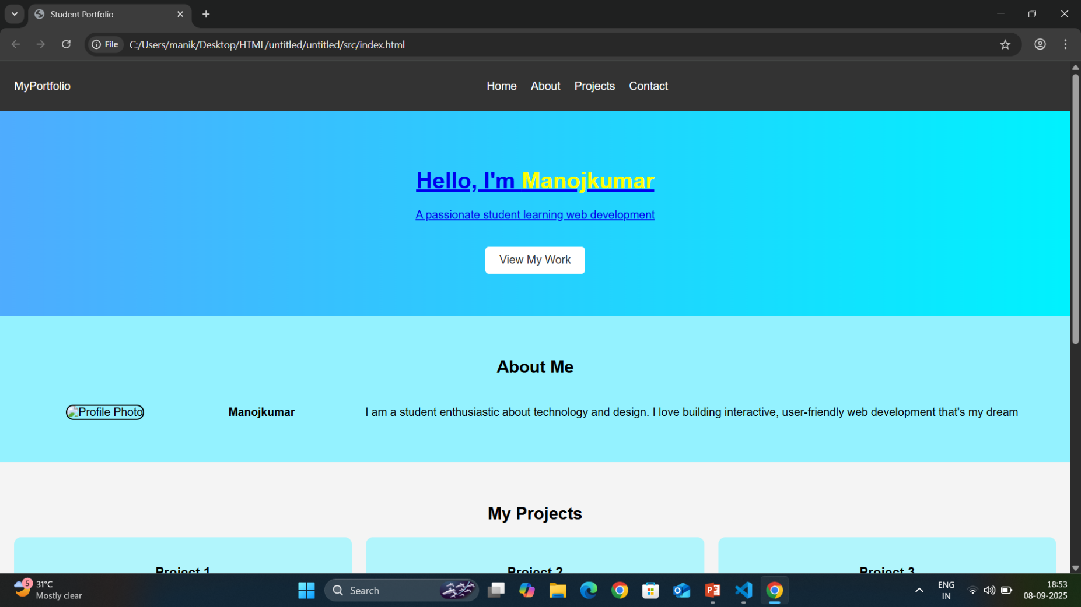

RESULTS AND SCREENSHOTS
3/21/2024 Annual Review
10

Slide 11
CONCLUSION
This portfolio project effectively showcases my skills, projects, and learning journey in web development. It provides a clean, responsive, and user-friendly platform for students, recruiters, and peers to explore my work. Through this project, I have gained practical experience in HTML, CSS, and JavaScript, as well as in responsive design techniques. This portfolio will continue to grow and improve as I enhance my skills and complete more projects.
11

