Slide 1


Online Food Application
TASTY_FOOD

Slide 2


List of Modules
Admin Module
Customer module
Chat bot
SSO(Single Sign On)
Add Cart
Order History
Order Management
Restaurant Management
Payment Module

Slide 3
Module Description
Main objective of Project:
It ensures prices are accurate and there's less room for error when it's time to settle the bill.
Efficient customer and order management
Makes the ordering process easier

Slide 4
List of Sub Modules
List of Sub Modules:
User Login
Product and Order Management
Restaurant Login
Restaurant Management
Used CRUD

Slide 5
Admin Login
Definition
To set a Credentials where it grants access to an area requiring for authorization.
A admin account is used by the manager to maintain the restaurants and products.
Details of Sub Modules
Using getter setter method creating a Id’s and Storing it in the MYSQL database using CRUD operation
And All these operations are approached by Hibernate and SpringBoot

Slide 6
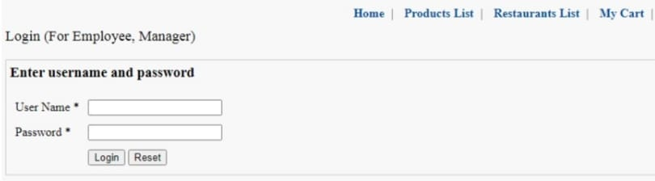
Single Sign On
Single sign-on (SSO) is an authentication method that enables users to securely authenticate with multiple applications and websites by using just one set of credentials.
Sub Module Details
Using Google OAuth Connection admin credentials and other private details are created and registered in this Single Sign On.

Slide 7
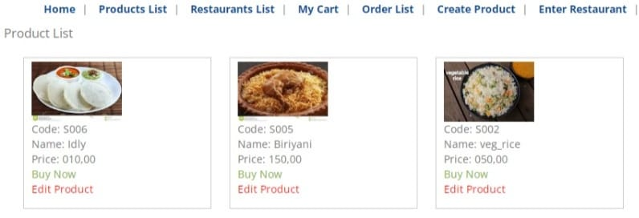
Product and Order Management
In this module, we have two main roles.
One is the Admin who will add and edit products based on the category, view orders and etc.
Another is the customer who will order products and their order details will be displayed and stored.

Slide 8
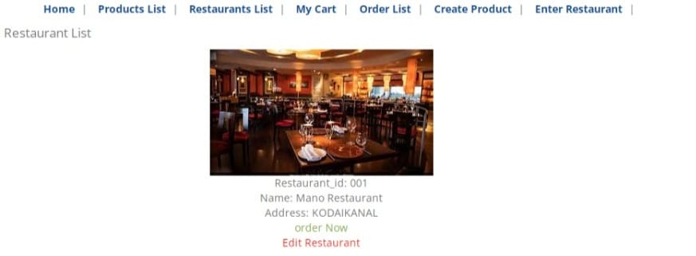
Restaurant Management
Description:
The Admin can add and edit restaurants based on the type, menu and etc.
Another is the customer can order foods based on restaurant also.

Slide 9
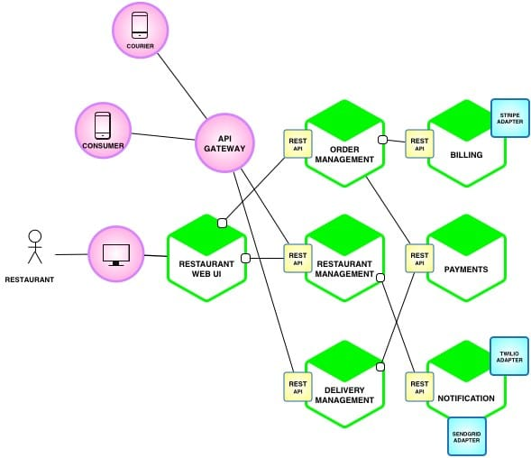
Project Overview
Project Architecture Diagram

Slide 10
THANK YOU

