Slide 1


Project: Spotify Artist Collaborations.
Manoj Nethenahalli Dhanpal -611794
Varad Santosh Kulkarni - 612254
Richart Seel - 598756
16-01-25

Slide 2
Dataset “nodes.csv”
1. nodes.csv
nodes.shape = (156422,6)
Attributes | Object_type | is_null
spotify_id | object | 0
name | object | 4
followers | float64 | 4
popularity | int64 | 0
genres | object | 0 but we have [] strings
chart_hits | object | 136778

Slide 3
Pre-processing the dataset nodes.csv
Removed the rows which has no artist “Name” and “Followers”
Filter out all non english names (found 143800 english names)
Extracted all the attributes except ‘chart_hits’ and stored in a csv (english_artist_with_followers.csv)
Extracted all records where ‘chart_hits’ attribute is not null and stored in a csv (artist_with_country_rank.csv)
Convert 193 country code to country names and assign respective rank.

Slide 4
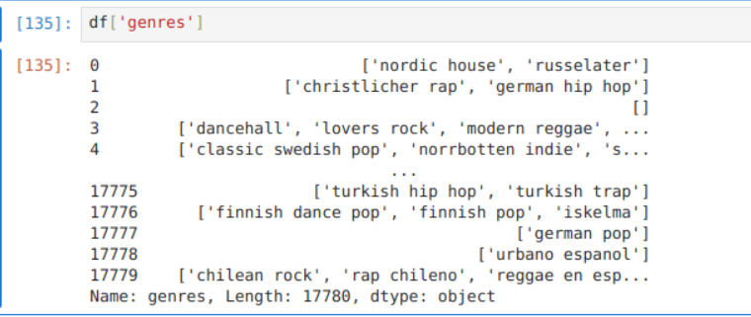
Pre-processing the dataset nodes.csv
Popularity attribute max value is 100 so it’s a percentile [0-100]
Country wise rank is between [1 to 379]
Filter and extract the genres and fill [] genres with ‘unknown’

Slide 5
Pre-processing the dataset nodes.csv
We have 2500+ unique genres so converting that to 15 prominent genres.
One-hot-encoding genres is better as it’s not an ordinal data.
By this data is completely cleaned.
The same process can be done for the english_artist_with_followers.csv file!

Slide 6
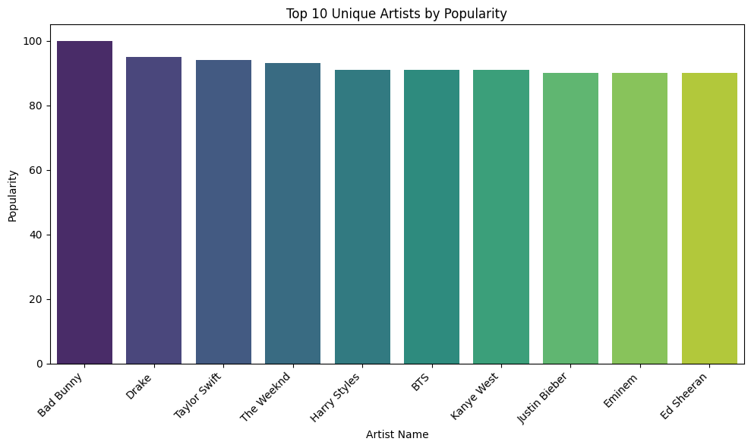
Top 10 artist with popularity.

Slide 7
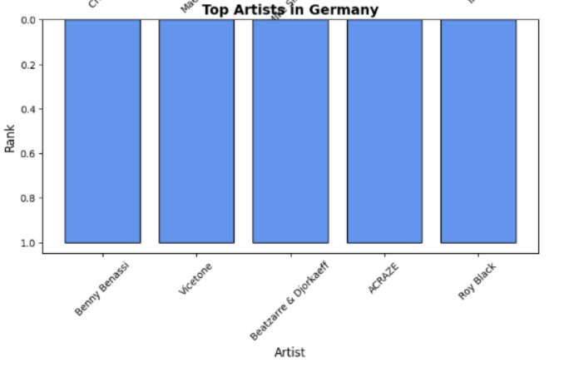
Top 10 artist with popularity in Germany

Slide 8
Dataset “edges.csv”
1. edges.csv
edges.shape = (300386,2)
Edges are undirected and id_0 <id_1 according to alphabetical order
Attributes | Object_types | is_null
id_0 (artist_a id) | object | 0
id_1 (artist_b id) | object | 0

Slide 9
Pre-processing the edges.csv dataset.
Creating a mapping spotify_id and names in nodes.csv
Create artist_a and artist_b attribute in edges.csv and map them from modes.csv
Remove null values ( count 27 in artist_a and count 37 in artist_b)
Filtering rows if both artist_a and artist_b are repeated more than ones (count 2677 duplicates)
Removing all other languages names except english ( We found 266046 english names)

Slide 10
What did we found ?
Successfully mapped the artist with the spotify id
.
Removed duplicates.
Keeping only English language for better results.
Found top 10 artists who had most collaborations with other artists.
Found around 25541 unique artists_a collaborated with artist_b

Slide 11
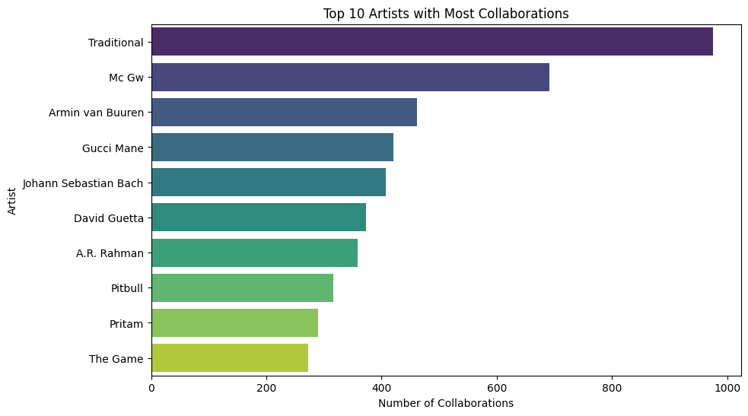
Most collaborative artists:

Slide 12

Questions:
We have 137k missing chart_hits out of 155k records which contain country and also weather the song rank in specific country.
Approach 1: we consider only 20k artists and find the collaboration with rank specific to country?
Pros: It will be not so complex.
Cons: Testing we may not get better results as artist name
Approach 2: we ignore chart_hits attribute and focus on global ranking and collaboration between the artist ?
Pros: Better training approach with 155k records.
Cons: We will not know whether the song will be ranked 1 or 200th in a specific country.

Slide 13



THANK YOU!

