Slide 1


Project: Artist Collaborations GNN
Manoj Nethehanalli Dhanpal -611794
Varad Santosh Kulkarni - 612254
Richart Seel - 598756
29-01-25

Slide 2
INTRODUCTION
Cleaned edges.csv and nodes.csv dataset.
Generate negative edges.
Perform Node2Vec.
Node Embeddings and Dimensity Reduction.
Train and Validate and Compare with GAT
Sample Prediction
Notes:
GAT: Graph Attention Network.

Slide 3
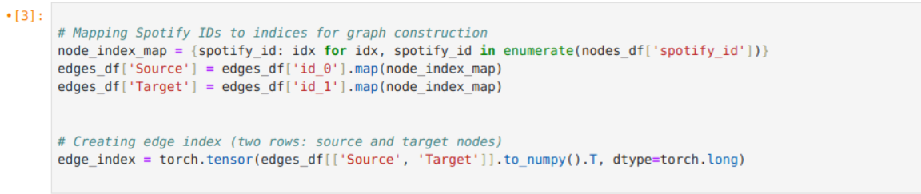
Import DataSet
Importing cleaned dataset.
Mapping spotify id to indices and constructing source and target attributes with artist Id.

Slide 4
Perform Node2Vec
RGraph Creation: Convert the edge list (`edge_index`) into a NetworkX graph.
Node2Vec Setup: Initialize Node2Vec with specific parameters to learn node embeddings.
Training: Fit the Node2Vec model to generate embeddings for each node based on random walks.
Handle Missing Nodes: Provide zero-vector embeddings for nodes not present in the model.
Store the final node embeddings in a `.npy` file
Save Embeddings:
Notes:
Purpose of Negative Edges: In many graph-based machine learning tasks, such as link prediction, models learn by distinguishing between positive examples (actual connections) and negative examples (non-existent connections). Negative edges help to train models by showing what a "non-connection" looks like.

Slide 5
Node2Vec HyperParameters.
Dimensions = 32
Walk_length = 10
Num_Walks = 50
Return Parameter (P) = 1
In-out Parameter (Q) = 1
Notes:
Each node represent 32 dimensional vector, walk_length 10 means each walk will consists of 10 nodes including starting node.
Every node in the graph will perform 50 Random walks of length 10 will be initiated.
Return parameter P controls likelihood and 1 indicates that the walk is neither biased towards returning nor discouraged to backtracking.
In-out parameter Q, controls the likelihood of the visiting new nodes, 1 makes the walk unbiased between BFS and DFS exploration.

Slide 6
Node Embedding dimension reduction.
Perplexity_value: 5 for t-SNE to balance local and global data patterns, ensuring it's suitable for the subset size.
Dimensionality Reduction: Use t-SNE to effectively reduce high-dimensional node embeddings to 2D for visualization.
Subset Selection: Select the top 20 nodes.
Apply t-SNE: Perform dimensionality reduction on the selected node embeddings to extract meaningful 2D representations.
Scatter Plot: Create a 2D scatter plot to visually represent the reduced embeddings of the selected nodes.
Notes:
t-SNE (t-distributed Stochastic Neighbor Embedding) is a popular machine learning algorithm used for dimensionality reduction, especially effective in visualizing high-dimensional data

Slide 7
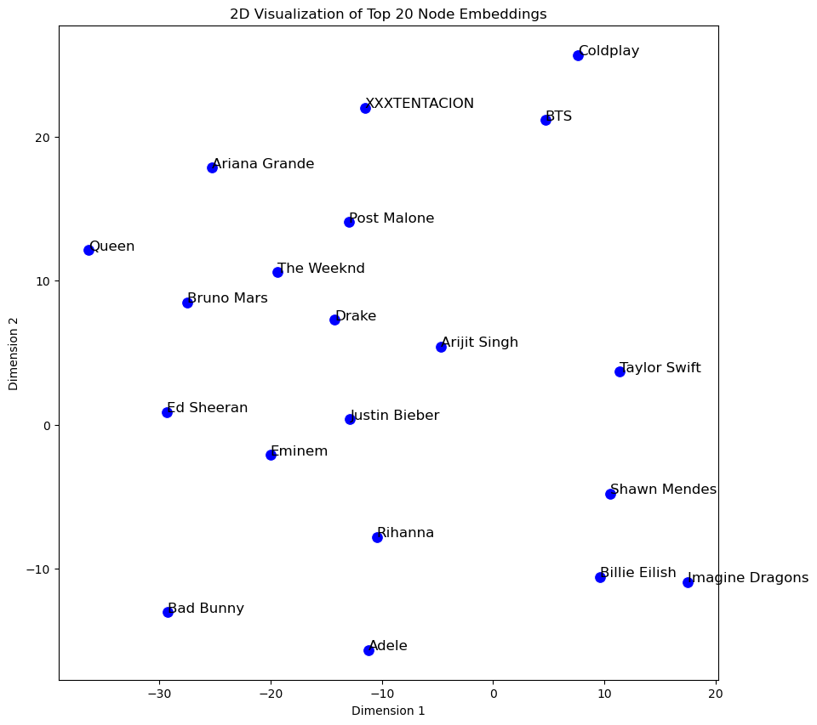
2D Visualization of Top 20 Node Embeddings

Slide 8
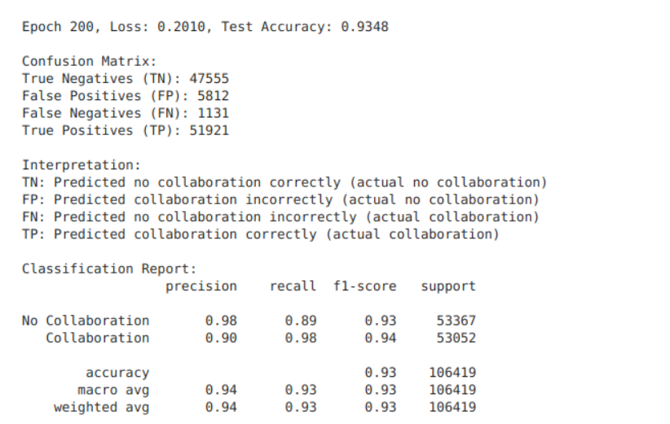
Train and Validate GNN Model
Notes:
Trained with all the dataset and kept 20% of the dataset for the validation, we got false positive of 5812 collaborations out of 100000+ trained data.

Slide 9
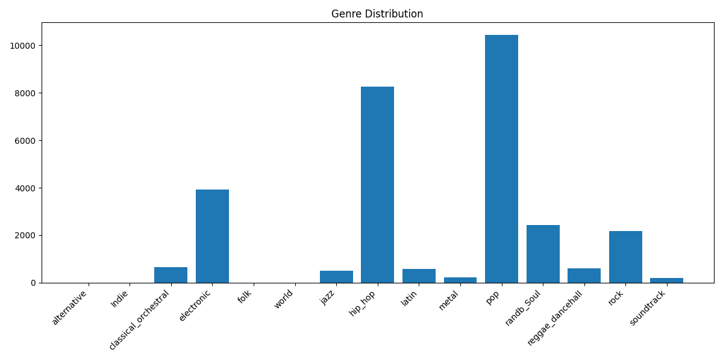
GAT (Graph Attention Network) Model

Slide 10
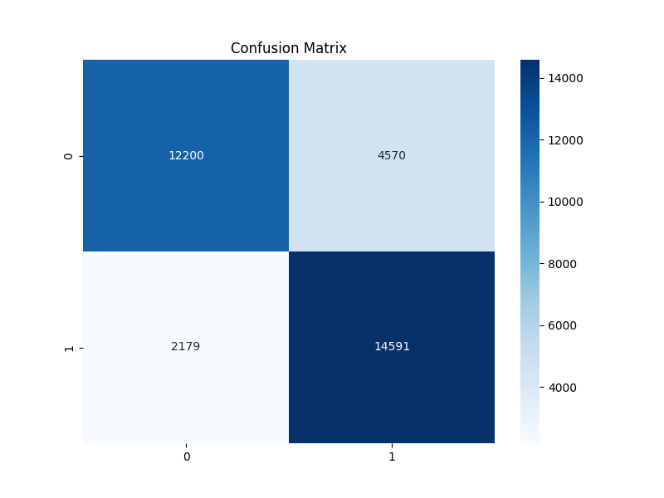
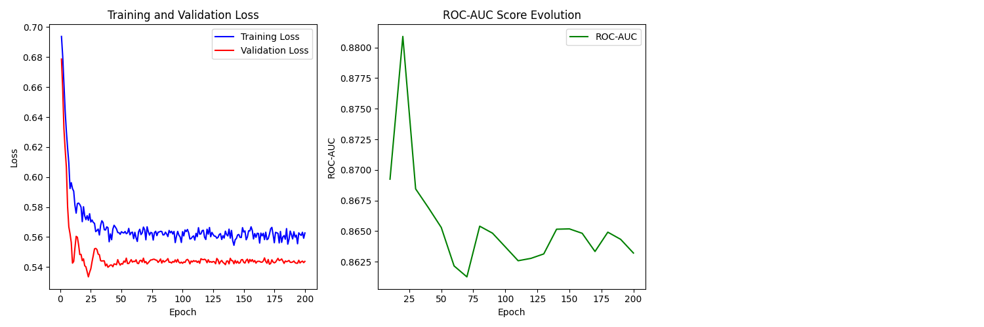
GAT (Graph Attention Network) Model

Slide 11
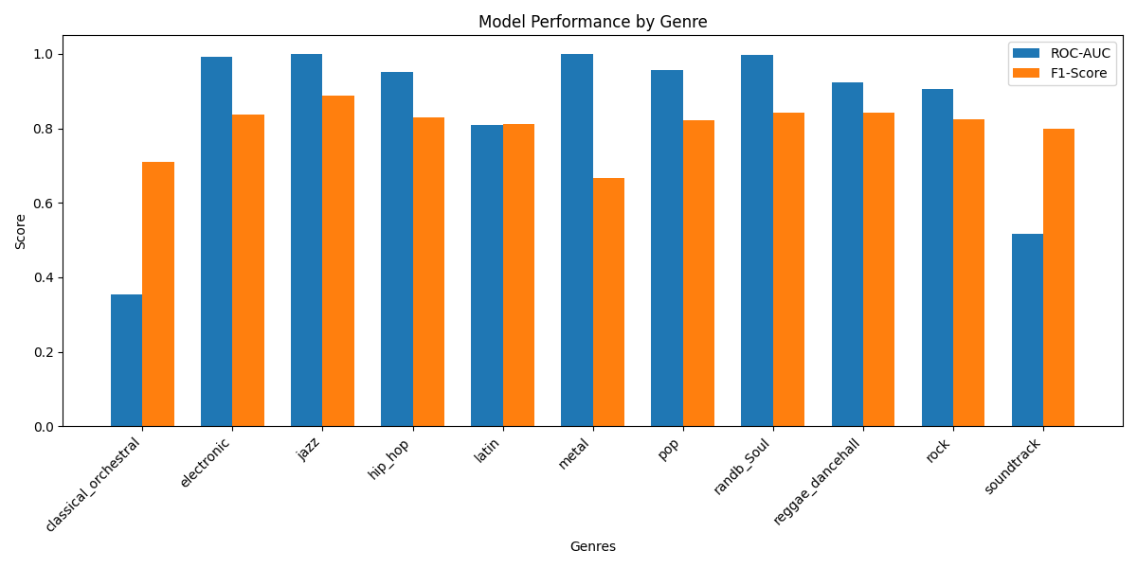
GAT (Graph Attention Network) Model

Slide 12
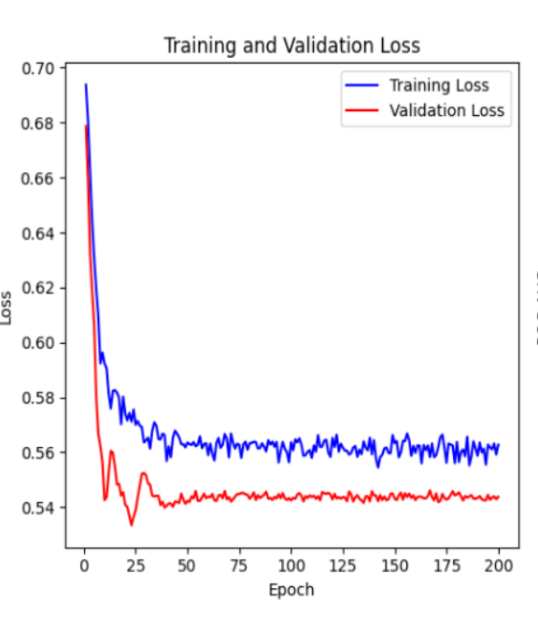
Comparing GAT (Left) and GNN (Right) Training loss.

Slide 13
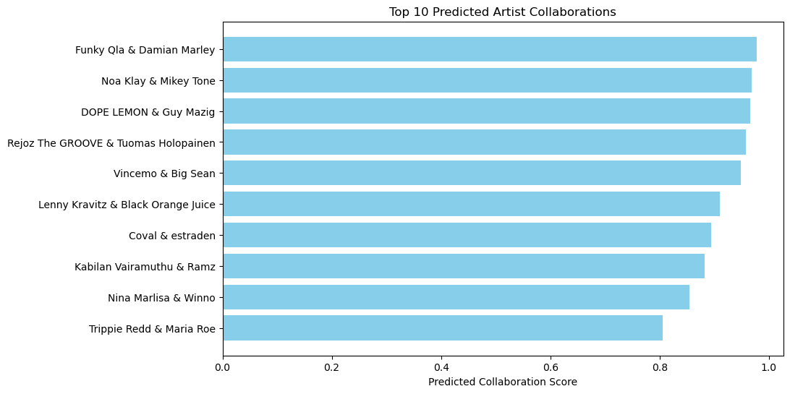
Prediction for 10 Artist Collaborations.
M

Slide 14
CONCLUSION
Created equal negative edges to avoid bias.
Performed Node2Vec.
Used Node embedding and reduced dimensity for simplicity.
Trained and Validated model.
Compared GNN and GAT
Predicted the top 10 collaborations.

Slide 15



THANK YOU!

