Slide 1
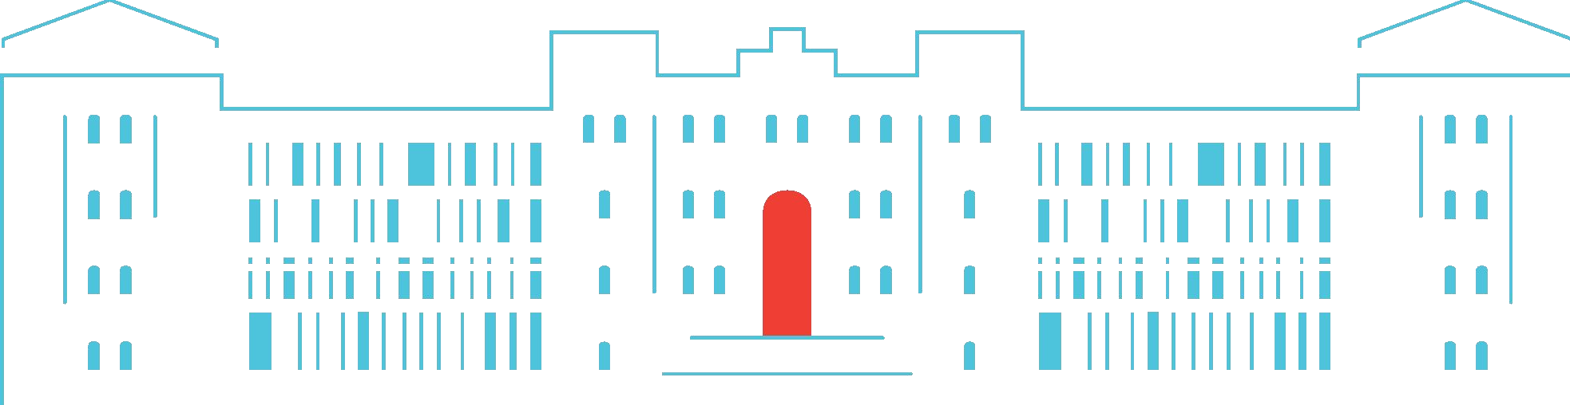

Project: Artist Collaborations GNN
Manoj Nethenahalli Dhanpal -611794
Varad Santosh Kulkarni - 612254
Richart Seel - 598756
29-01-25

Slide 2
INTRODUCTION
Cleaned edges.csv and nodes.csv dataset.
Generate negative edges.
Perform Node2Vec.
Node Embeddings and Dimensity Reduction.
Train and Validate and Compare with GAT
Sample Prediction
Notes:
GAT: Graph Attention Network.

Slide 3
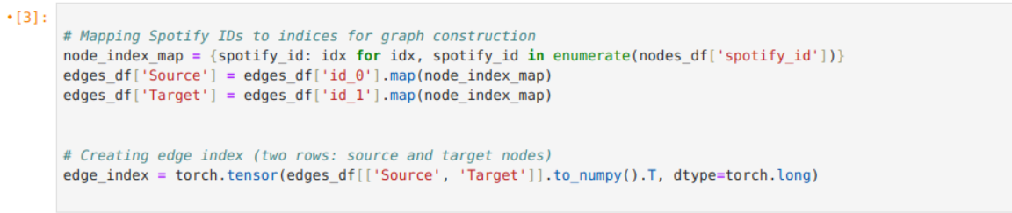
Import DataSet
Importing cleaned dataset.
Mapping spotify id to indices and constructing source and target attributes with artist Id.

Slide 4
Perform Node2Vec
RGraph Creation: Convert the edge list (`edge_index`) into a NetworkX graph.
Node2Vec Setup: Initialize Node2Vec with specific parameters to learn node embeddings.
Training: Fit the Node2Vec model to generate embeddings for each node based on random walks.
Handle Missing Nodes: Provide zero-vector embeddings for nodes not present in the model.
Save Embeddings.
Notes:
Purpose of Negative Edges: In many graph-based machine learning tasks, such as link prediction, models learn by distinguishing between positive examples (actual connections) and negative examples (non-existent connections). Negative edges help to train models by showing what a "non-connection" looks like.

Slide 5
Node Embedding dimension reduction.
Perplexity_value: 5 for t-SNE to balance local and global data patterns, ensuring it's suitable for the subset size.
Dimensionality Reduction: Use t-SNE to effectively reduce high-dimensional node embeddings to 2D for visualization.
Subset Selection: Select the top 20 nodes.
Apply t-SNE: Perform dimensionality reduction on the selected node embeddings to extract meaningful 2D representations.
Scatter Plot: Create a 2D scatter plot to visually represent the reduced embeddings of the selected nodes.
Notes:
t-SNE (t-distributed Stochastic Neighbor Embedding) is a popular machine learning algorithm used for dimensionality reduction, especially effective in visualizing high-dimensional data

Slide 6
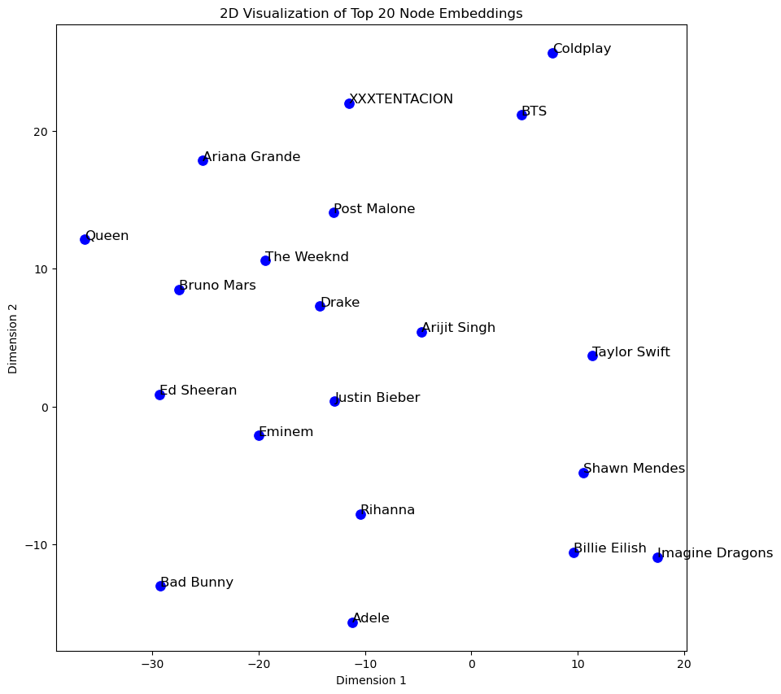
2D Visualization of Top 20 Node Embeddings

Slide 7
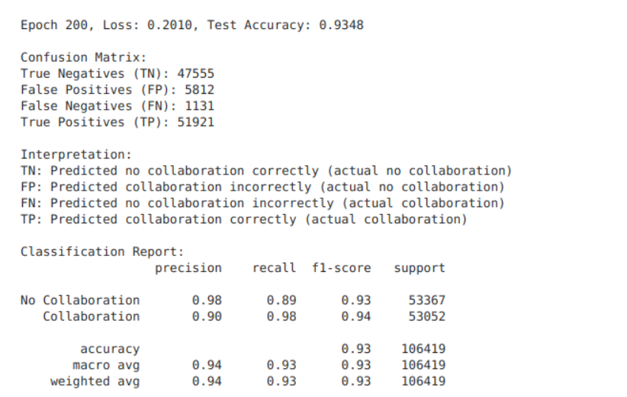
Train and Validate GNN Model
Notes:
Trained with all the dataset and kept 20% of the dataset for the validation, we got false positive of 5812 collaborations out of 100000+ trained data.

Slide 8
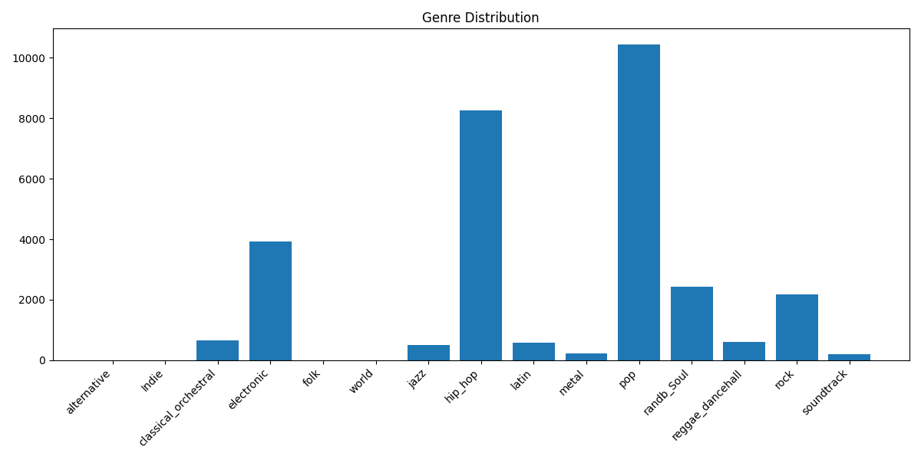
GAT (Graph Attention Network) Model

Slide 9
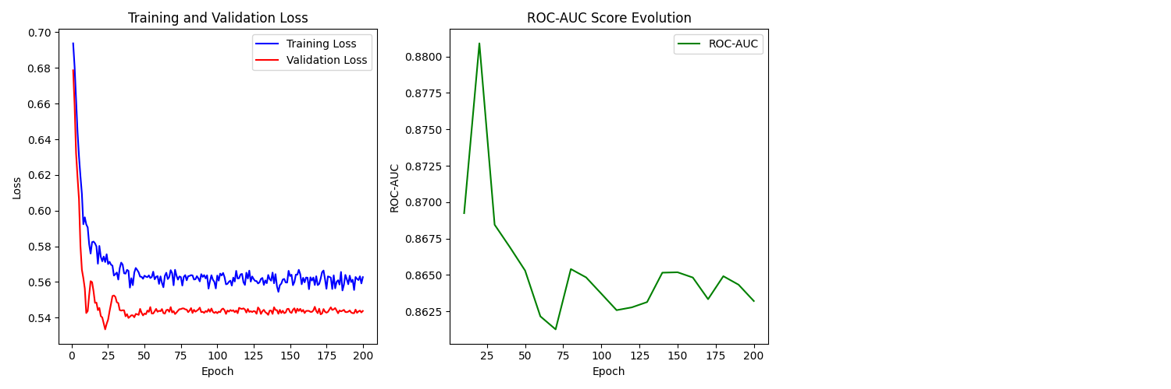
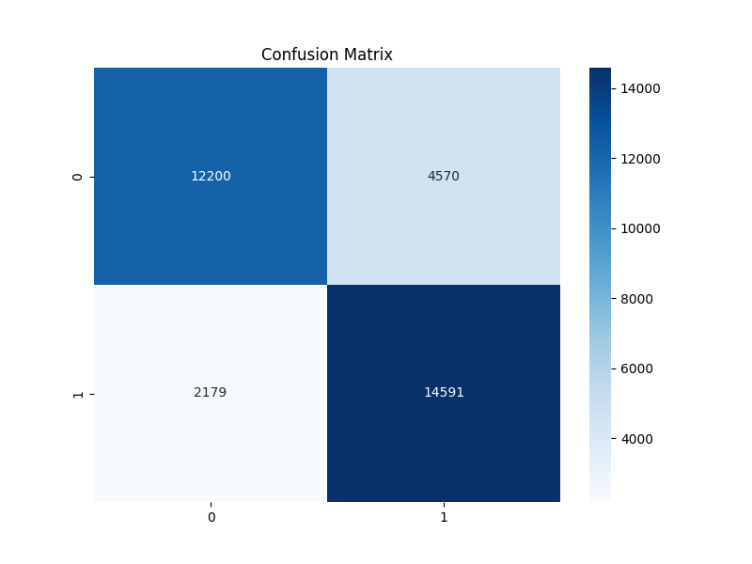
GAT (Graph Attention Network) Model

Slide 10
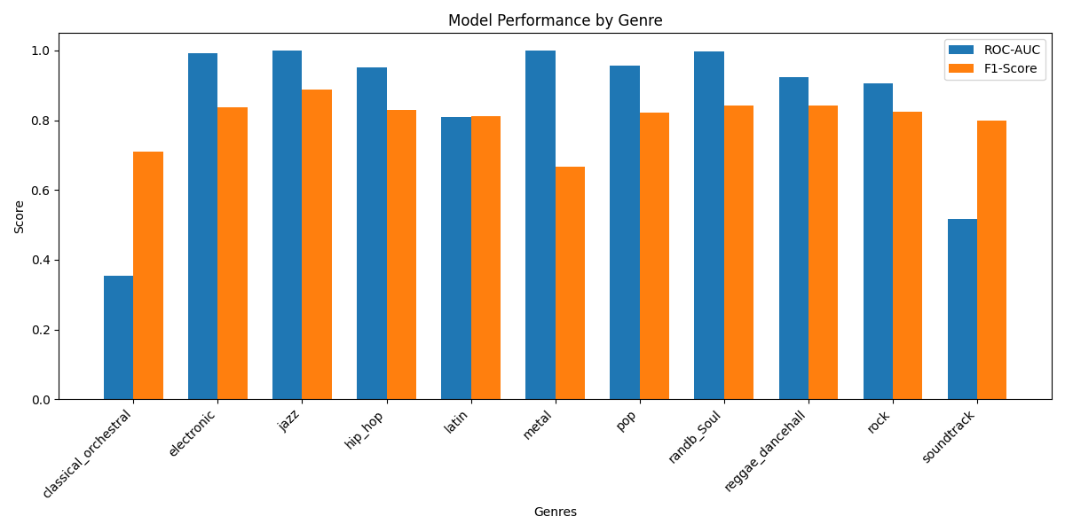
GAT (Graph Attention Network) Model

Slide 11
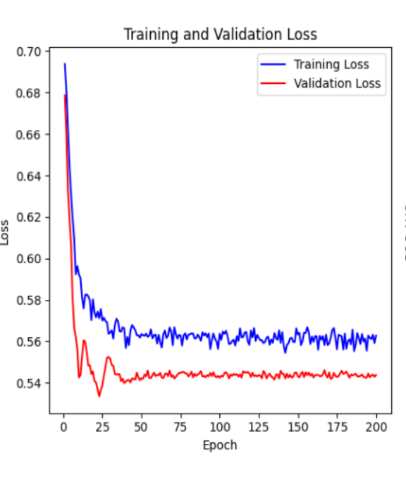
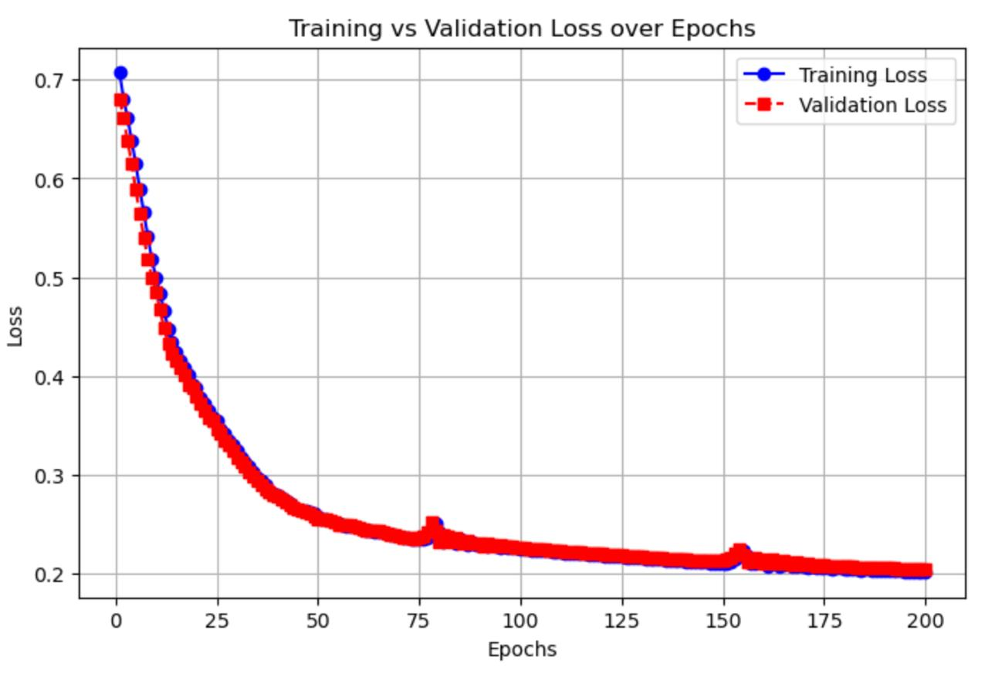
Comparing GAT (Left) and GNN (Right) Training loss.

Slide 12
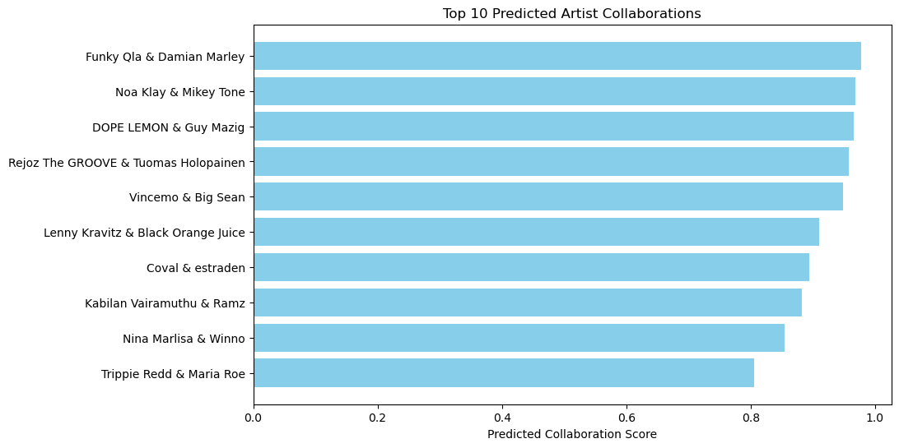
Prediction for 10 Artist Collaborations.
M

Slide 13
CONCLUSION
Created equal negative edges to avoid bias.
Performed Node2Vec.
Used Node embedding and reduced dimensity for simplicity.
Trained and Validated model.
Compared GNN and GAT
Predicted the top 10 collaborations.

Slide 14



THANK YOU!

