Slide 1
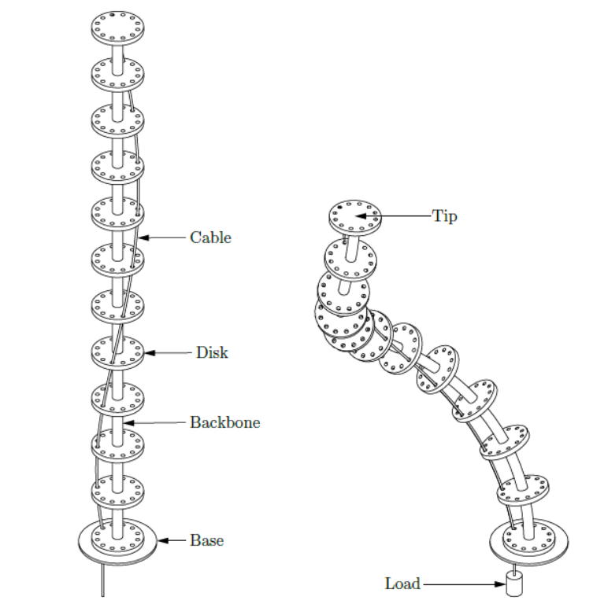
Dynamics modelling of a Continuum Robot
Static, Dynamic
  Cosserat rod
  Kirchhoff rod
MuJoCo Discretized models
Reduced order model using GVS
PCC/PCS
M Manoj Prabhakar
27479

Slide 2
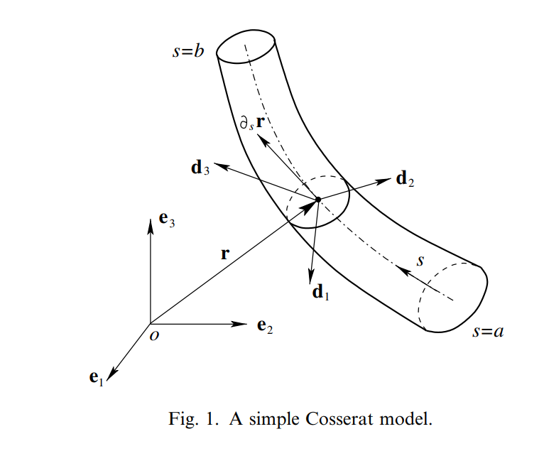
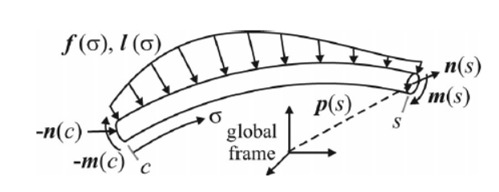
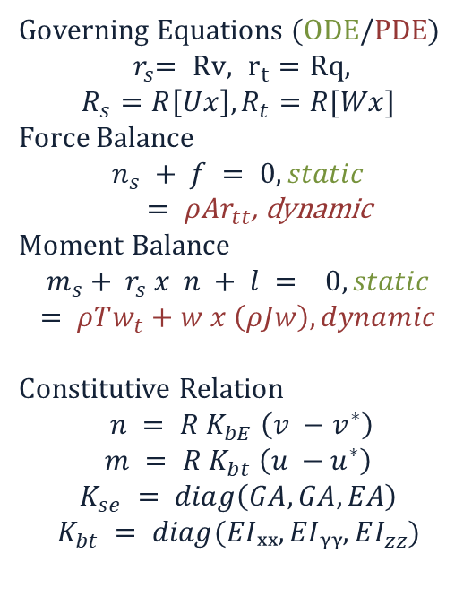
Full Cosserat rod model: six strain modes (bending, torsion, axial, shear)
Governing Equations (ODE/PDE)
$${ r}_{s}= Rv,{ r}_{t} =Rq,$$
$$R_{s}=R\left[Ux\right], R_{t}=R[Wx]$$
Force Balance
$$n_{s} + f = 0, static$$
$= ρAr_{tt}$, dynamic
Moment Balance
$$m_{s}+ r_{s} x n + l = 0, static$$
$$= ρTw_{t}+w x \left(ρJw\right), dynamic$$
Constitutive Relation
$$n = R K_{bE} \left(v −v^{∗}\right)$$
$$m = R K_{bt} \left(u −u^{∗}\right)$$
$$K_{se} = diag\left(GA, GA, EA\right)$$
$$K_{bt} = diag(EIₓₓ, EIᵧᵧ, EI_{zz})$$
R(s,t)
(s,t)
u, bending and torsional strains,
v, shear strains and axial extension.
n and m, are internal force and moment resultants.
f and l, external distributed force/moment enter through.
3

Slide 3
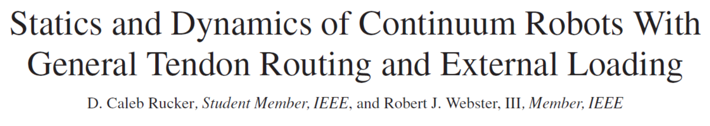
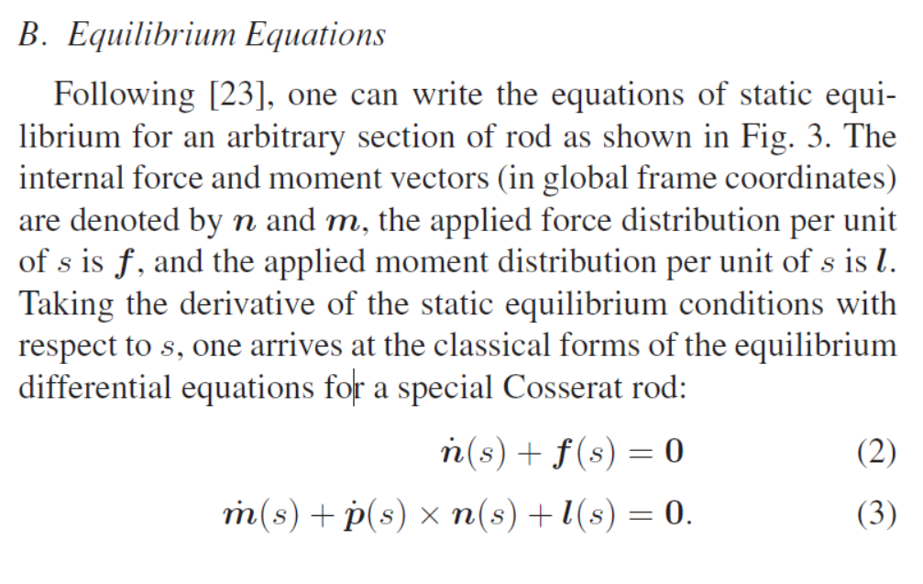
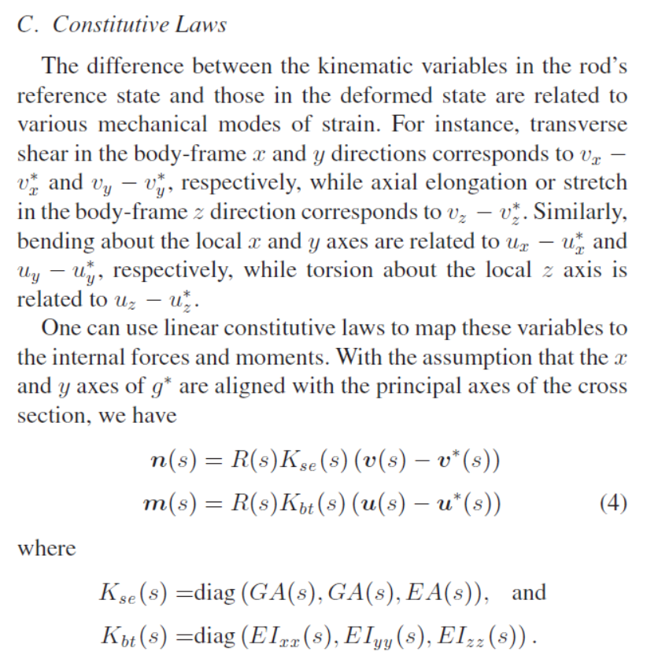
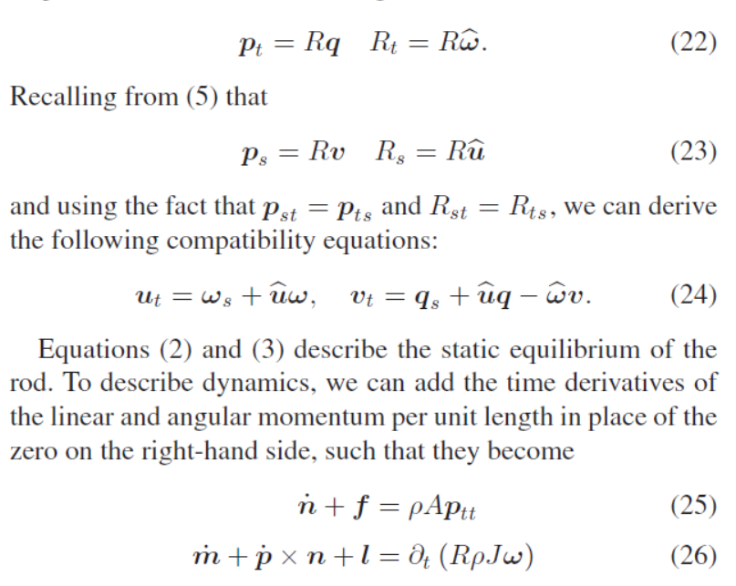

Slide 4
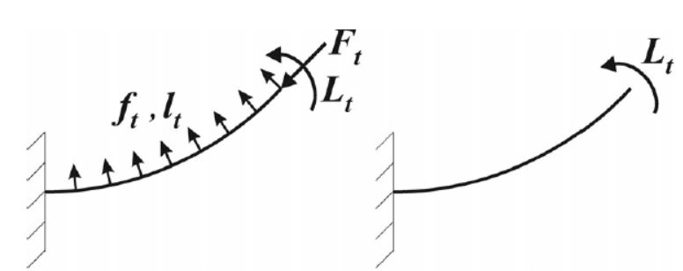
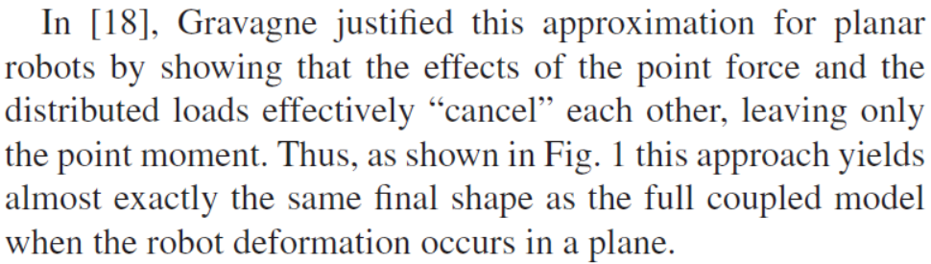
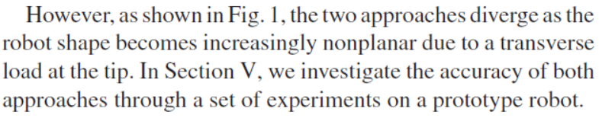
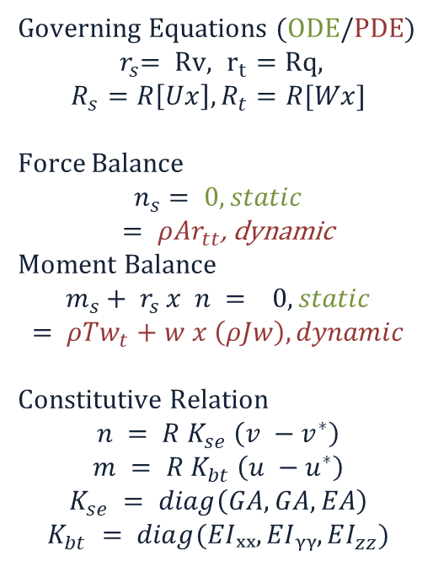
Cosserat rod model: With point moment loading
Governing Equations (ODE/PDE)
$${ r}_{s}= Rv,{ r}_{t} =Rq,$$
$$R_{s}=R\left[Ux\right], R_{t}=R[Wx]$$
Force Balance
$$n_{s}= 0, static$$
$= ρAr_{tt}$, dynamic
Moment Balance
$$m_{s}+ r_{s} x n = 0, static$$
$$= ρTw_{t}+w x \left(ρJw\right), dynamic$$
Constitutive Relation
$$n = R K_{se} \left(v −v^{∗}\right)$$
$$m = R K_{bt} \left(u −u^{∗}\right)$$
$$K_{se} = diag\left(GA, GA, EA\right)$$
$$K_{bt} = diag(EIₓₓ, EIᵧᵧ, EI_{zz})$$
Rucker .et al
For a straight undeformed rod: $u^{∗} = {\left[0,0,0\right]}^{T}, v^{∗}=[0,0,1]ᵀ$
3

Slide 5

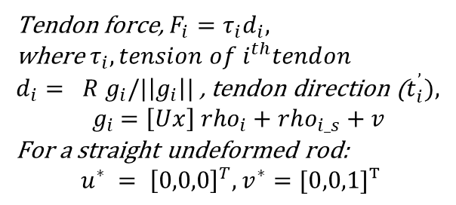
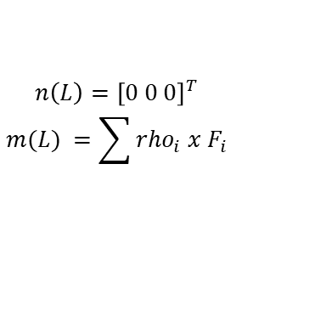
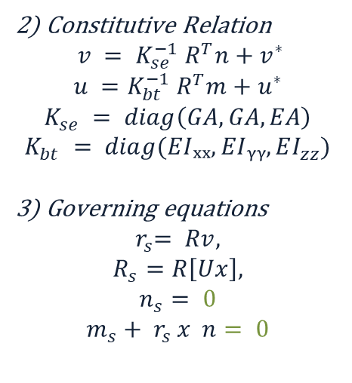




Cosserat rod model: With point moment loading
Static Equilibrium:
(t = 0)
y = [r, R, n ,m]
$$r\left(0\right)= {\left[0 0 0\right]}^{T} ;$$
$$R(0) = I$$
2) Constitutive Relation
$$v = {K_{se}^{−1} R}^{T}n+v^{∗}$$
$$u ={K_{bt}^{−1} R}^{T}m+u^{∗}$$
$$K_{se} = diag\left(GA, GA, EA\right)$$
$$K_{bt} = diag(EIₓₓ, EIᵧᵧ, EI_{zz})$$
3) Governing equations
$${ r}_{s}= Rv,$$
$$R_{s}=R\left[Ux\right],$$
$$n_{s}= 0$$
$$m_{s}+ r_{s} x n= 0$$
BVP
Shooting method
[ 1) guess n0, m0]
y0
No external loading
No distributed loading
ODE of
$$r_{s}, R_{s}, n_{s}, m_{s}$$
$$n\left(L\right)={\left[0 0 0\right]}^{T}$$
$$m(L) =\sum{rho_{i} x F_{i}}$$
4) IVP – RK45,RK4 etc.
Check error with knowns
n(L), m(L)
y(L)
$$rho_{i}$$
y(s)
Tendon force, $F_{i}=τ_{i}d_{i},$
where $τ_{i}, tension of i^{th}tendon$
$d_{i}= R g_{i}/|\left|g_{i}\right||$ , tendon direction ($t_{i}^{’}),$
$${ g}_{i} =\left[Ux\right] rho_{i}+rho_{i_s}+v$$
For a straight undeformed rod:
$$u^{∗} = {\left[0,0,0\right]}^{T}, v^{∗}=[0,0,1]ᵀ$$
$$r$$
$$t_{i}$$
r(L), R(L)
3

Slide 6

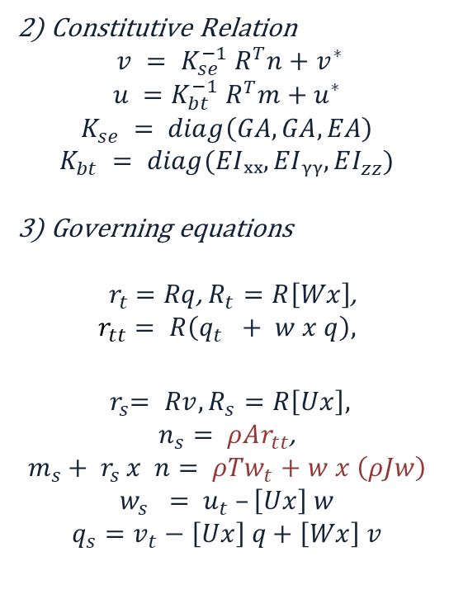
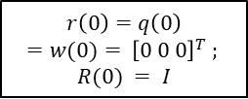
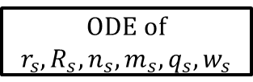
Cosserat rod model: With point moment loading
Dynamic Equilibrium:
(t > 0)
$$r\left(0\right)=q\left(0\right)$$
$$=w(0)= {\left[0 0 0\right]}^{T} ;$$
$$R(0) = I$$
2) Constitutive Relation
$$v = {K_{se}^{−1} R}^{T}n+v^{∗}$$
$$u ={K_{bt}^{−1} R}^{T}m+u^{∗}$$
$$K_{se} = diag\left(GA, GA, EA\right)$$
$$K_{bt} = diag(EIₓₓ, EIᵧᵧ, EI_{zz})$$
3) Governing equations
${ r}_{t} =Rq$, $R_{t}=R\left[Wx\right]$,
$$r_{tt}= R\left(q_{t} + w x q\right),$$
$${ r}_{s}= Rv, R_{s}=R\left[Ux\right],$$
$n_{s}= ρAr_{tt}$,
$$m_{s}+ r_{s} x n= ρTw_{t}+w x \left(ρJw\right)$$
$$w_{s} = u_{t} –\left[Ux\right] w$$
$$q_{s}=v_{t}−\left[Ux\right] q+\left[Wx\right] v$$
y = [r, R, q, w, n ,m]
BVP
Shooting method
[ 1) guess n0, m0]
y0
No external loading
No distributed loading
ODE of
$$r_{s}, R_{s}, n_{s}, m_{s}, q_{s}, w_{s}$$
$$n\left(L\right)={\left[0 0 0\right]}^{T}$$
$$m(L) =\sum{rho_{i} x F_{i}}$$
4) IVP – RK45,RK4 etc.
Check error with knowns
n(L), m(L)
y(L)
y(s)
$$r, R$$
r(L), R(L)
For a straight undeformed rod: $u^{∗} = {\left[0,0,0\right]}^{T}, v^{∗}=[0,0,1]ᵀ$
3

Slide 7
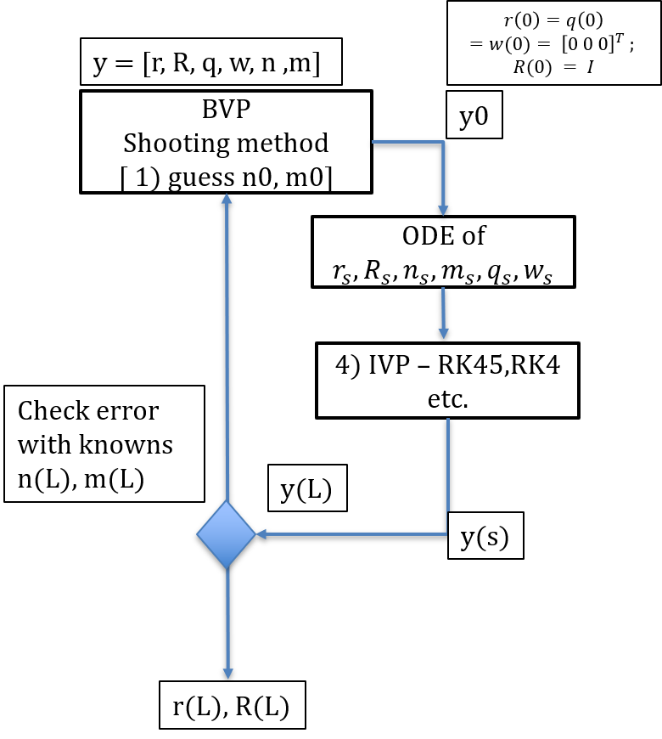
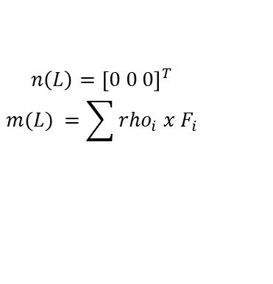
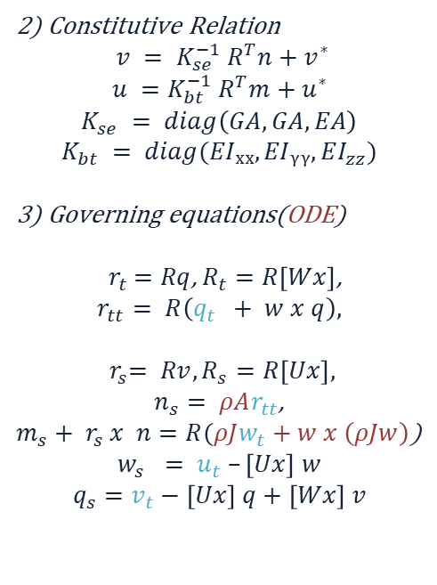
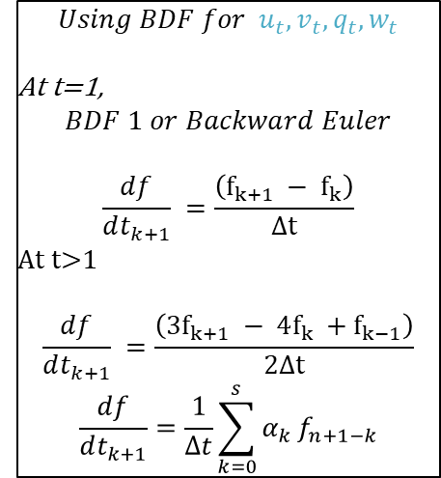
Cosserat rod model: With point moment loading
Dynamic Equilibrium:
(t > 0)
2) Constitutive Relation
$$v = {K_{se}^{−1} R}^{T}n+v^{∗}$$
$$u ={K_{bt}^{−1} R}^{T}m+u^{∗}$$
$$K_{se} = diag\left(GA, GA, EA\right)$$
$$K_{bt} = diag(EIₓₓ, EIᵧᵧ, EI_{zz})$$
3) Governing equations(ODE)
${ r}_{t} =Rq$, $R_{t}=R\left[Wx\right]$,
$$r_{tt}= R\left(q_{t} + w x q\right),$$
$${ r}_{s}= Rv, R_{s}=R\left[Ux\right],$$
$n_{s}= ρAr_{tt}$,
$m_{s}+ r_{s} x n=R(ρJw_{t}+w x \left(ρJw\right)$)
$$w_{s} = u_{t} –\left[Ux\right] w$$
$$q_{s}=v_{t}−\left[Ux\right] q+\left[Wx\right] v$$
Time discretisation
$$Using BDF for u_{t}, v_{t}, q_{t}, w_{t}$$
At t=1,
$$BDF 1 or Backward Euler$$
$$\frac{df}{dt_{k+1}} =\frac{\left(f_{k+1} − f_{k}\right)}{Δt}$$
At t>1
$$\frac{df}{dt_{k+1}} =\frac{\left(3f_{k+1} − 4f_{k} +f_{k−1}\right)}{2Δt}$$
$$\frac{df}{dt_{k+1}}=\frac{1}{Δt}\sum_{k=0}^{s}{α_{k}}f_{n+1−k}$$
$$n\left(L\right)={\left[0 0 0\right]}^{T}$$
$$m(L) =\sum{rho_{i} x F_{i}}$$
Space integral
For a straight undeformed rod: $u^{∗} = {\left[0,0,0\right]}^{T}, v^{∗}=[0,0,1]ᵀ$
BDF, Backward differentiation formula
3

Slide 8
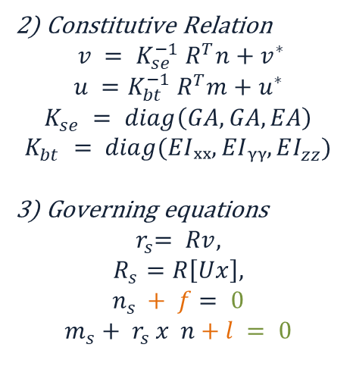

Cosserat rod model: With coupled loading
Static Equilibrium:
(t = 0)
y = [r, R, n ,m]
$$r\left(0\right)= {\left[0 0 0\right]}^{T} ;$$
$$R(0) = I$$
2) Constitutive Relation
$$v = {K_{se}^{−1} R}^{T}n+v^{∗}$$
$$u ={K_{bt}^{−1} R}^{T}m+u^{∗}$$
$$K_{se} = diag\left(GA, GA, EA\right)$$
$$K_{bt} = diag(EIₓₓ, EIᵧᵧ, EI_{zz})$$
3) Governing equations
$${ r}_{s}= Rv,$$
$$R_{s}=R\left[Ux\right],$$
$$n_{s }+ f= 0$$
$$m_{s}+ r_{s} x n+l = 0$$
BVP
Shooting method
[ 1) guess n0, m0]
y0
No external loading
Distributed loading
$$n\left(L\right)=\sum{F_{i}}$$
$$m(L) =\sum{rho_{i} x F_{i}}$$
ODE of
$$r_{s}, R_{s}, n_{s}, m_{s}$$
4) IVP – RK45,RK4 etc.
Check error with knowns
n(L), m(L)
y(L)
$$rho_{i}$$
y(s)
Tendon force, $F_{i}=τ_{i}d_{i},$
where $τ_{i}, tension of i^{th}tendon$
$d_{i}= R g_{i}/|\left|g_{i}\right||$ , tendon direction ($t_{i}^{’}),$
$${ g}_{i} =\left[Ux\right] rho_{i}+rho_{i_s}+v$$
For a straight undeformed rod:
$$u^{∗} = {\left[0,0,0\right]}^{T}, v^{∗}=[0,0,1]ᵀ$$
$$r$$
$$t_{i}$$
r(L), R(L)
3

Slide 9
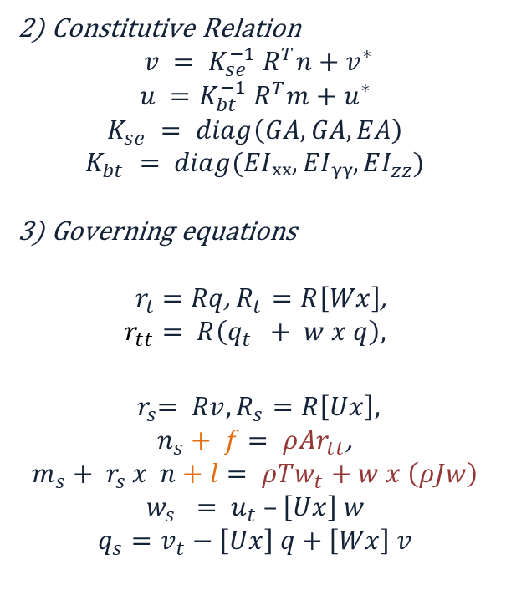
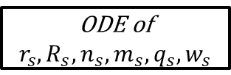
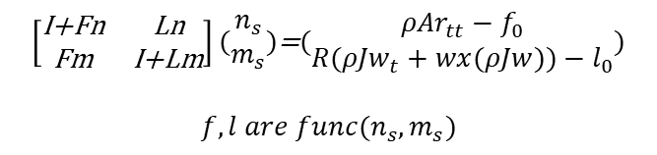
Cosserat rod model: With coupled loading
Dynamic Equilibrium:
(t > 0)
$$r\left(0\right)=q\left(0\right)$$
$$=w(0)= {\left[0 0 0\right]}^{T} ;$$
$$R(0) = I$$
2) Constitutive Relation
$$v = {K_{se}^{−1} R}^{T}n+v^{∗}$$
$$u ={K_{bt}^{−1} R}^{T}m+u^{∗}$$
$$K_{se} = diag\left(GA, GA, EA\right)$$
$$K_{bt} = diag(EIₓₓ, EIᵧᵧ, EI_{zz})$$
3) Governing equations
${ r}_{t} =Rq$, $R_{t}=R\left[Wx\right]$,
$$r_{tt}= R\left(q_{t} + w x q\right),$$
$${ r}_{s}= Rv, R_{s}=R\left[Ux\right],$$
$n_{s}+ f= ρAr_{tt}$,
$$m_{s}+ r_{s} x n+l= ρTw_{t}+w x \left(ρJw\right)$$
$$w_{s} = u_{t} –\left[Ux\right] w$$
$$q_{s}=v_{t}−\left[Ux\right] q+\left[Wx\right] v$$
y = [r, R, q, w, n ,m]
BVP
Shooting method
[ 1) guess n0, m0]
y0
No external loading
Distributed loading
$$n\left(L\right)=\sum{F_{i}}$$
$$m(L) =\sum{rho_{i} x F_{i}}$$
ODE of
$$r_{s}, R_{s}, n_{s}, m_{s}, q_{s}, w_{s}$$
4) IVP – RK45,RK4 etc.
Check error with knowns
n(L), m(L)
y(L)
y(s)
$$\left[\begin{matrix}\text{I+Fn} & \text{Ln} \\ \text{Fm} & \text{​​​​I+Lm}\end{matrix}\right](\begin{matrix}n_{s} \\ m_{s}\end{matrix})\text{=}(\begin{matrix}ρ{Ar}_{tt}−f_{0} \\ {R(ρJw}_{t}+wx(ρJw))−l_{0}\end{matrix})$$
$$f,l are func(n_{s},m_{s})$$
$$r, R$$
r(L), R(L)
For a straight undeformed rod: $u^{∗} = {\left[0,0,0\right]}^{T}, v^{∗}=[0,0,1]ᵀ$
3

Slide 10
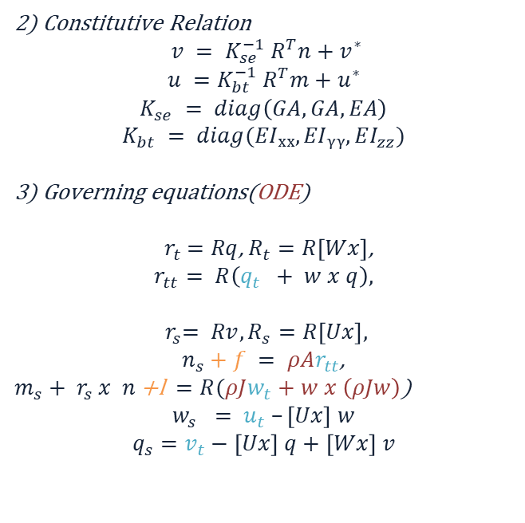

Cosserat rod model: With coupled loading
Dynamic Equilibrium:
(t > 0)
Time discretisation
$$Using BDF for u_{t}, v_{t}, q_{t}, w_{t}$$
At t=1,
$$BDF 1 or Backward Euler$$
$$\frac{df}{dt_{k+1}} =\frac{\left(f_{k+1} − f_{k}\right)}{Δt}$$
At t>1
$$\frac{df}{dt_{k+1}} =\frac{\left(3f_{k+1} − 4f_{k} +f_{k−1}\right)}{2Δt}$$
$$\frac{df}{dt_{k+1}}=\frac{1}{Δt}\sum_{k=0}^{s}{α_{k}}f_{n+1−k}$$
2) Constitutive Relation
$$v = {K_{se}^{−1} R}^{T}n+v^{∗}$$
$$u ={K_{bt}^{−1} R}^{T}m+u^{∗}$$
$$K_{se} = diag\left(GA, GA, EA\right)$$
$$K_{bt} = diag(EIₓₓ, EIᵧᵧ, EI_{zz})$$
3) Governing equations(ODE)
${ r}_{t} =Rq$, $R_{t}=R\left[Wx\right]$,
$$r_{tt}= R\left(q_{t} + w x q\right),$$
$${ r}_{s}= Rv, R_{s}=R\left[Ux\right],$$
$n_{s}+f = ρAr_{tt}$,
$m_{s}+ r_{s} x n \text{+}\text{l} =R(ρJw_{t}+w x \left(ρJw\right)$)
$$w_{s} = u_{t} –\left[Ux\right] w$$
$$q_{s}=v_{t}−\left[Ux\right] q+\left[Wx\right] v$$
$$n\left(L\right)=\sum{F_{i}}$$
$$m(L) =\sum{rho_{i} x F_{i}}$$
Space integral
For a straight undeformed rod: $u^{∗} = {\left[0,0,0\right]}^{T}, v^{∗}=[0,0,1]ᵀ$
BDF, Backward differentiation formula
3

Slide 11

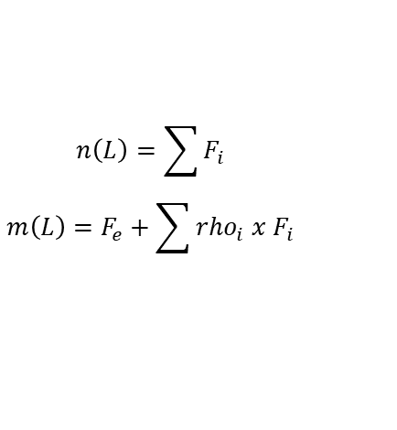
Cosserat rod model: With coupled loading
Dynamic Equilibrium:
(t > 0)
$$r\left(0\right)=q\left(0\right)$$
$$=w(0)= {\left[0 0 0\right]}^{T} ;$$
$$R(0) = I$$
2) Constitutive Relation
$$v = {K_{se}^{−1} R}^{T}n+v^{∗}$$
$$u ={K_{bt}^{−1} R}^{T}m+u^{∗}$$
$$K_{se} = diag\left(GA, GA, EA\right)$$
$$K_{bt} = diag(EIₓₓ, EIᵧᵧ, EI_{zz})$$
3) Governing equations
${ r}_{t} =Rq$, $R_{t}=R\left[Wx\right]$,
$$r_{tt}= R\left(q_{t} + w x q\right),$$
$${ r}_{s}= Rv, R_{s}=R\left[Ux\right],$$
$n_{s}+ f= ρAr_{tt}$,
$$m_{s}+ r_{s} x n+l= ρTw_{t}+w x \left(ρJw\right)$$
$$w_{s} = u_{t} –\left[Ux\right] w$$
$$q_{s}=v_{t}−\left[Ux\right] q+\left[Wx\right] v$$
y = [r, R, q, w, n ,m]
BVP
Shooting method
[ 1) guess n0, m0]
y0
External loading
Distributed loading
ODE of
$$r_{s}, R_{s}, n_{s}, m_{s}, q_{s}, w_{s}$$
$$n\left(L\right)=\sum{F_{i}}$$
$$m\left(L\right)=F_{e}+\sum{rho_{i} x F_{i}}$$
4) IVP – RK45,RK4 etc.
Check error with knowns
n(L), m(L)
y(L)
y(s)
$$r, R$$
r(L), R(L)
For a straight undeformed rod: $u^{∗} = {\left[0,0,0\right]}^{T}, v^{∗}=[0,0,1]ᵀ$
3

Slide 12
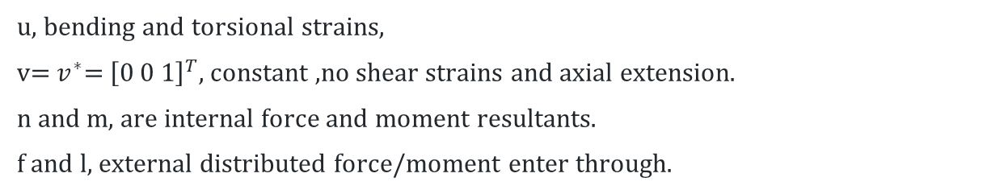
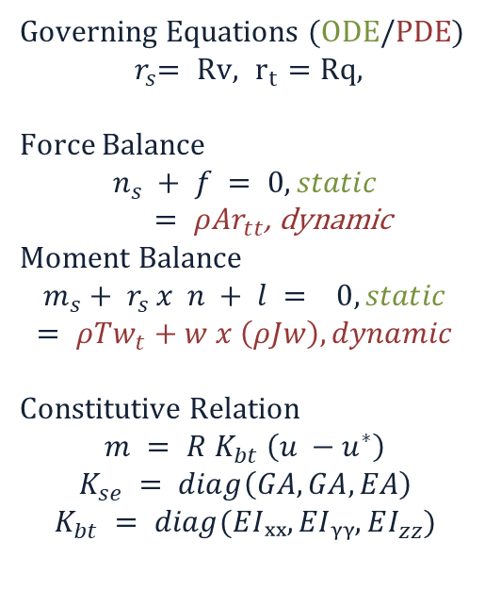
Kirchhoff rod model: three strain modes (bending, torsion)
Governing Equations (ODE/PDE)
$${ r}_{s}= Rv,{ r}_{t} =Rq,$$
Force Balance
$$n_{s} + f = 0, static$$
$= ρAr_{tt}$, dynamic
Moment Balance
$$m_{s}+ r_{s} x n + l = 0, static$$
$$= ρTw_{t}+w x \left(ρJw\right), dynamic$$
Constitutive Relation
$$m = R K_{bt} \left(u −u^{∗}\right)$$
$$K_{se} = diag\left(GA, GA, EA\right)$$
$$K_{bt} = diag(EIₓₓ, EIᵧᵧ, EI_{zz})$$
R(s,t)
(s,t)
u, bending and torsional strains,
v=${ v}^{∗}\text{= }{\left[0 0 1\right]}^{T}$, constant ,no shear strains and axial extension.
n and m, are internal force and moment resultants.
f and l, external distributed force/moment enter through.
Other all implementations are same
3

Slide 13
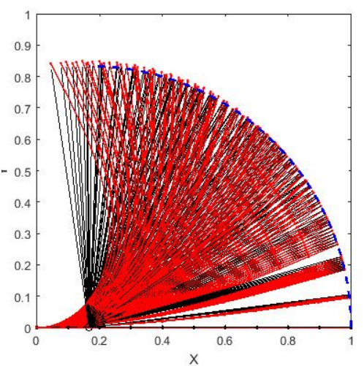
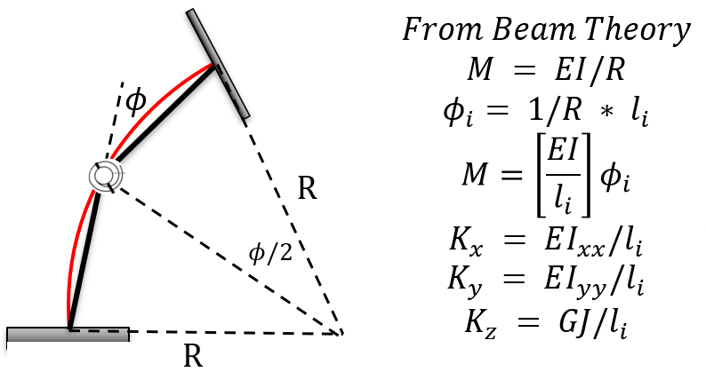
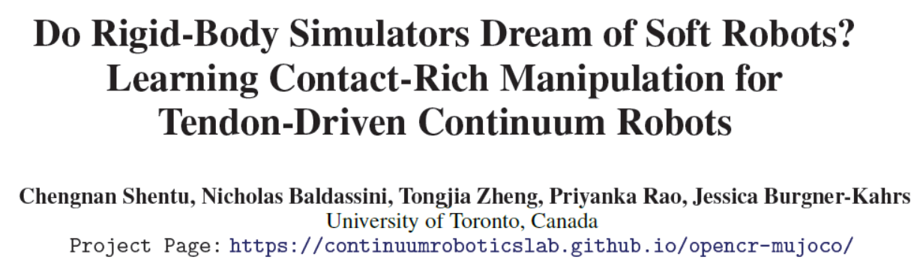
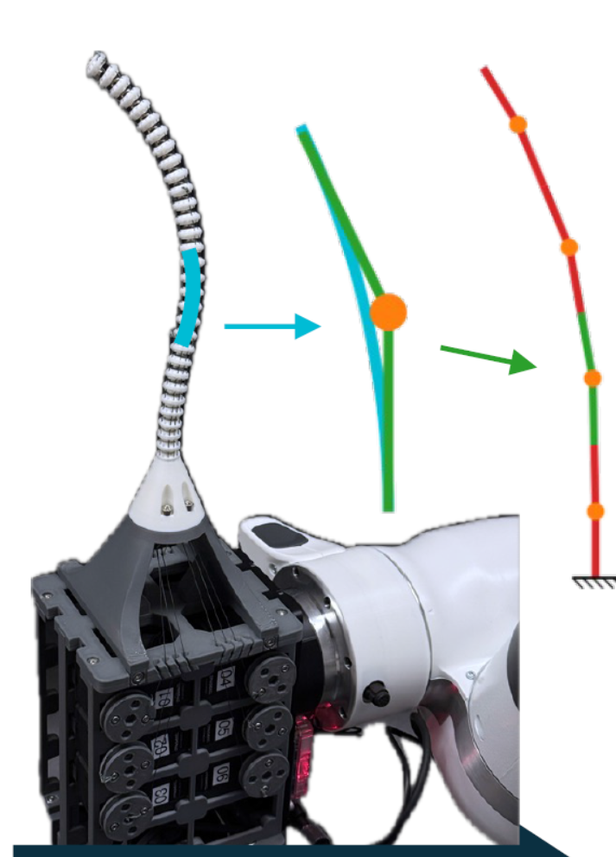
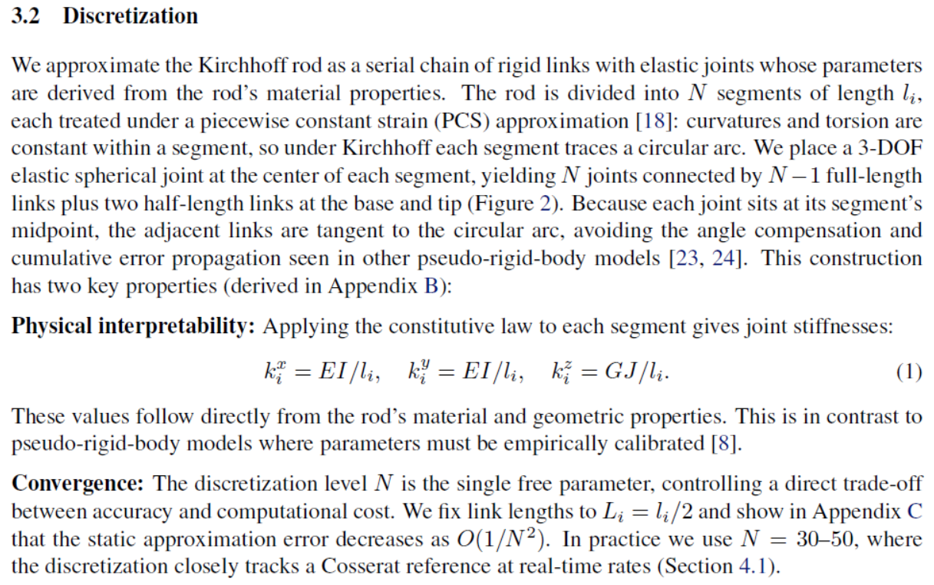
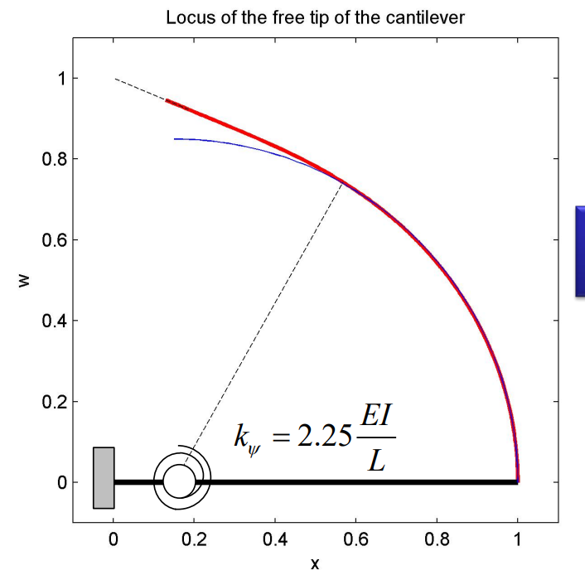

Similar approximation
OpenCR Mujoco: Kirchhoff rod with PCS modelling
Compliant Mechanism PRBM
$$l_{i}/2$$
OpenCR lab,University of Toronto, Canada
Ananthasuresh sir, IISc
PCS: Piecewise Constant Strain
PRBM: Pseudo rigid body model
3

Slide 14
Configuration of the setup:
E = 175MPa
mu = 0.45
N = 8 disk
r = 6mm
z
x
L = 400mm
y
(li = 5cm)
T2
z
T1
T3
t_r = 12mm
x
y

Slide 15
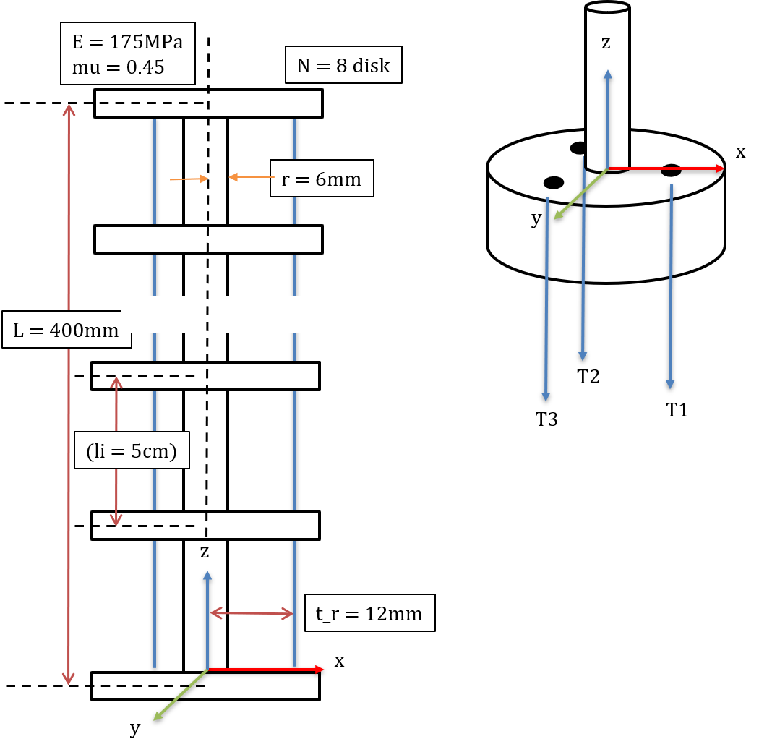
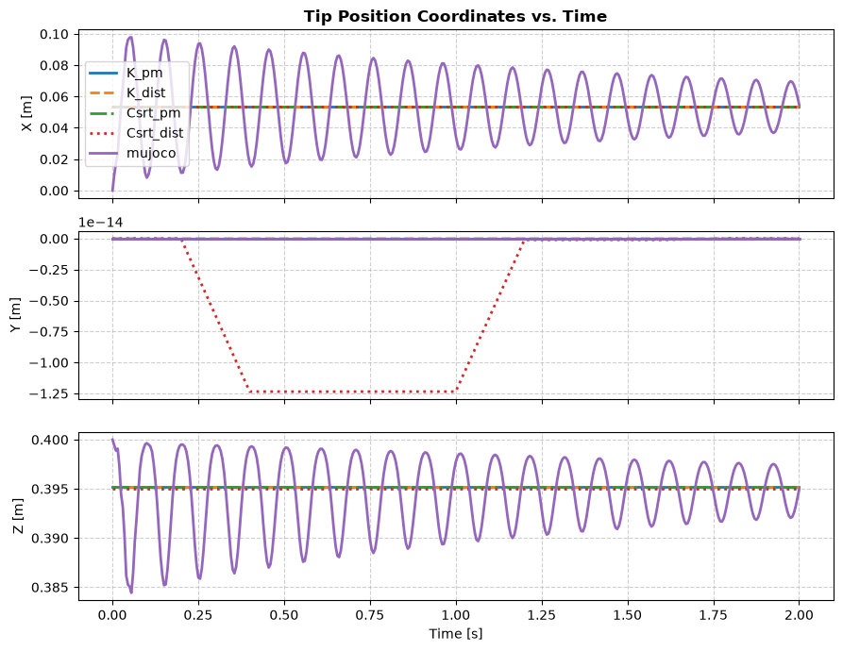
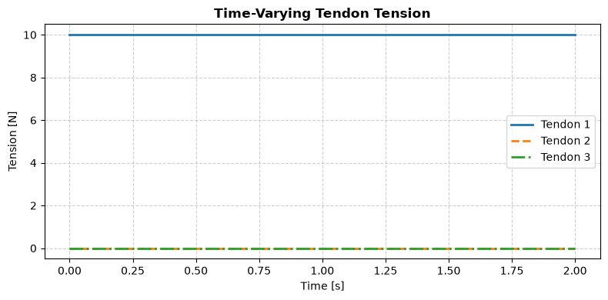
Load case: T1(t)= 10

Slide 16
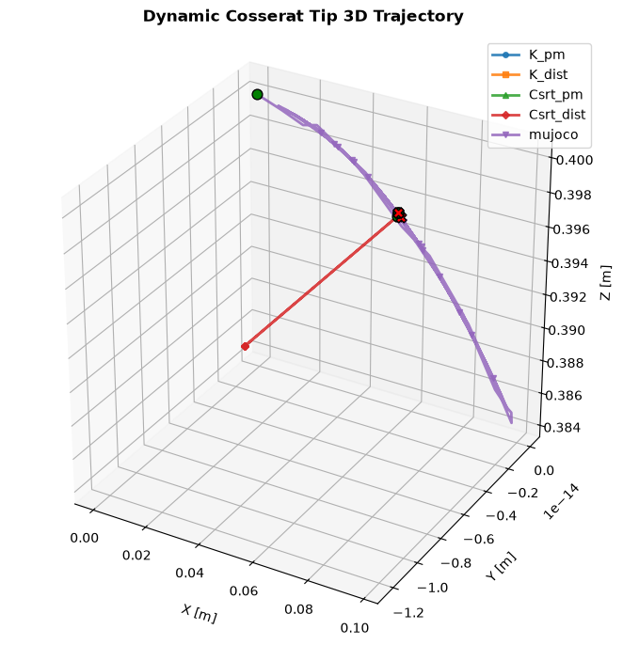
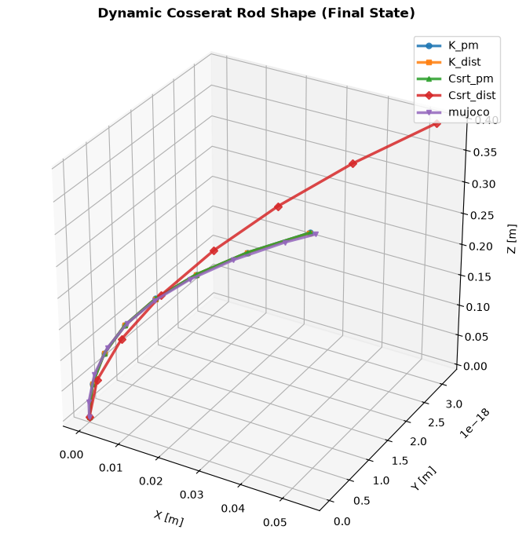
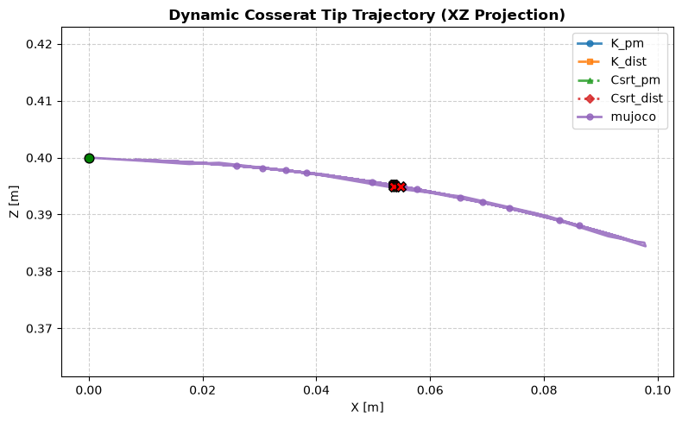
Load case: T1(t)= 10

Slide 17
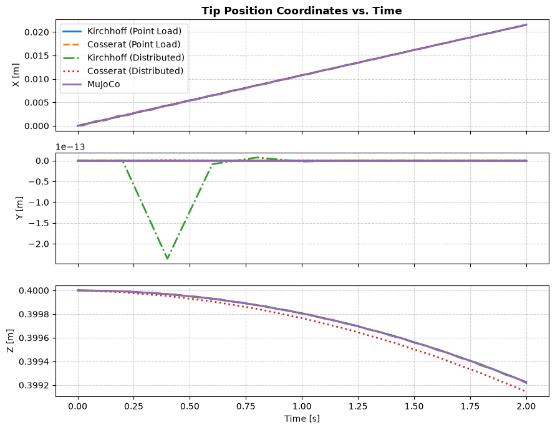
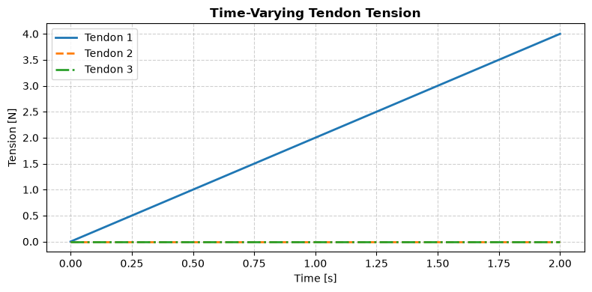
Load case 1: T1(t) = 2*t

Slide 18
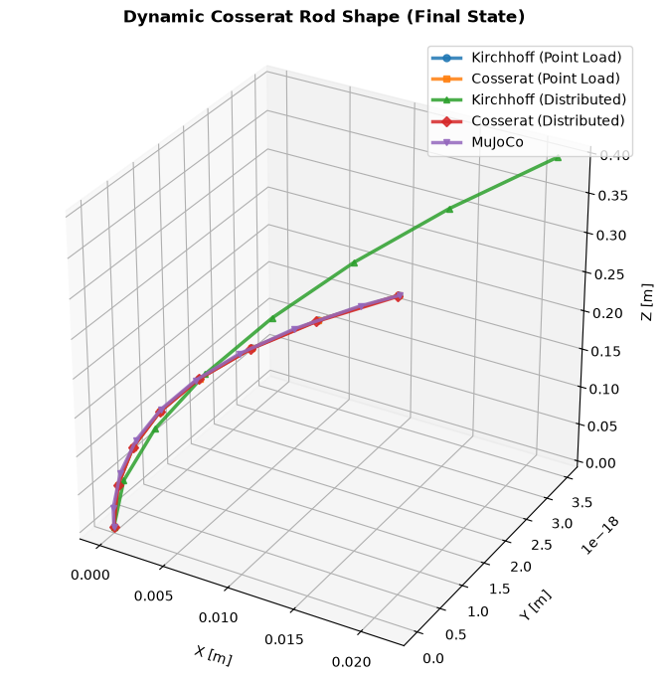
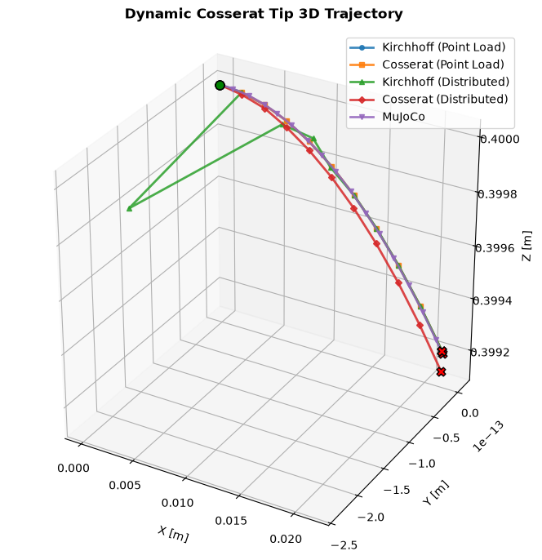
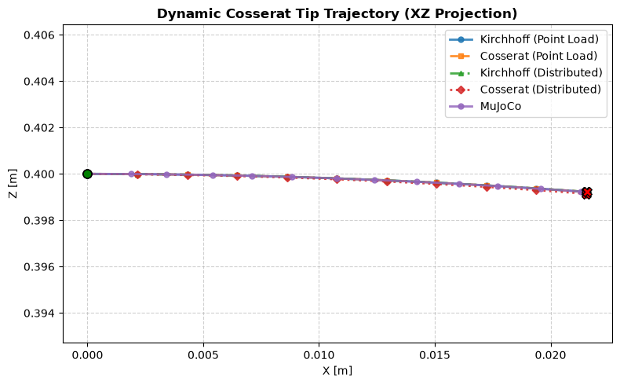
Load case 1: T1(t) = 2*t

Slide 19
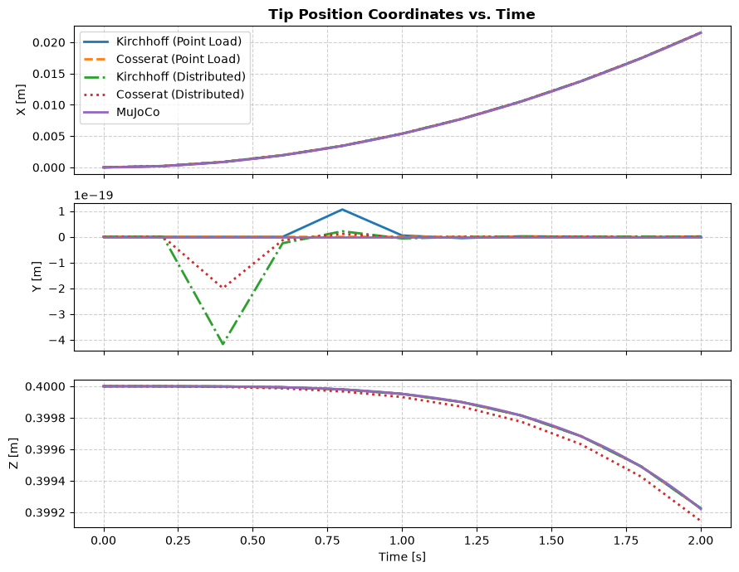
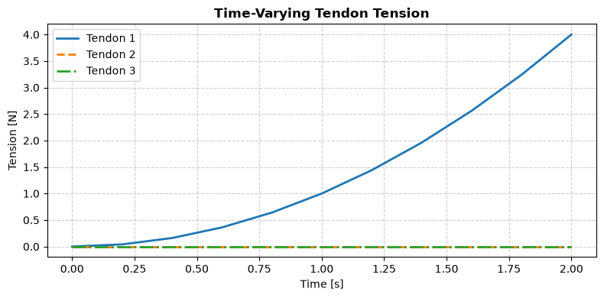
Load case 2: T1(t) = t^2

Slide 20



Load case 2: T1(t) = t^2

Slide 21



Load case 3: T1(t) = 10*abs(sin($πt))$

Slide 22



Load case 3: T1(t) = 10*abs(sin($πt))$

Slide 23


Load case 4: T1(t)= T2(t)= 2*t

Slide 24




Load case 4: T1(t)= T2(t)= 2*t

Slide 25


Load case 5: T1(t)= T2(t)= t^2

Slide 26




Load case 5: T1(t)= T2(t)= t^2

Slide 27



Load case 6: T1(t)= T2(t)= 10*abs(sin($πt))$

Slide 28




Load case 6: T1(t)= T2(t)= 10*abs(sin($πt))$

Slide 29


Load case 7: T1(t)= 10*abs(sin($πt));\text{T2(t)=10∗abs(}\text{cos}\text{(}πt))$

Slide 30




Load case 7: T1(t)= 10*abs(sin($πt));\text{T2(t)=10∗abs(}\text{cos}\text{(}πt))$

Slide 31


GVS / strain parameterization – Anup Theejo Mattew
Method for model order reduction
$$ξ(X,q,t)= ξ^{∗}(X) + Φ(X) q$$
$$g_{s} = g \left[ξx\right]$$
$$g=\left[\begin{matrix}R & r \\ 0 & 1\end{matrix}\right],ξ=\left({u^{T} \atop v^{T}}\right)$$
• Instead of discretizing the pose field directly, discretize the distributed strain field.
• q is the reduced generalized-coordinate vector.
• Φ(X) contains basis functions; basis choice determines where and how q changes the strain.
• Independent bases do not depend on q,t; dependent bases may be nonlinear and time-dependent.
10

Slide 32

Forward kinematics of the reduced model
From q → strain → pose
q → ξ(X,q,t) → g(X) ∈ SE(3) → p(X), R(X)
g(X+h) = g(X) exp(V(h)^∧)
• For variable strain, the GVS paper uses a Magnus-expansion-based recursive spatial integration.
• The rod is subdivided into small intervals; each interval contributes an exponential-map update.
16

Slide 33
Geometric Jacobian
η(X,q,q̇,t) = J(X,q,t) q̇ + ηᵗ(X,q,t)
η̇ = J q̈ + Z q̇ + ζᵗ
• J(X) ∈ R⁶×ⁿˡᵒᵈ maps generalized velocity to local body velocity twist.
• For independent bases: η = J q̇ and Z = J̇.
• For dependent bases, explicit time dependence introduces ηᵗ and ζᵗ.
• The Jacobian is evaluated at the spatial integration points used to build the dynamics.
Reduced-order dynamics
M(q)q̈ + C(q,q̇)q̇ + K(q) + Dq̇ = B(q)u + F(q,q̇,t)
M = Σ∫ Jᵀ M_s J dX
C = Σ∫ Jᵀ(ad_η* M_s J + M_s J̇)dX
K = Σ∫ Φᵀ Σ Φ dX, D = Σ∫ Φᵀ Γ Φ dX
• B maps tendon/actuator inputs into generalized forces; F contains external loads.
• Spatial integration accumulates contributions from every computational point.
17
18

Slide 34
Computational loop implemented in the notebook
1
q, q̇, t
2
initialize M,C,K,D,B,F
3
spatially recurse g, J, η, J̇ / Z
4
integrate each contribution over X
Using magnus expansion
5
solve q̈ = M⁻¹(Bu+F−Cq̇−K−Dq̇)
6
time integrator → next q,q̇
19

Slide 35
References
• Rucker & Webster III (2011), Statics and Dynamics of Continuum Robots With General Tendon Routing and External Loading.
• Mathew et al. (2025), Reduced order modeling of hybrid soft-rigid robots using global, local, and state-dependent strain parameterization.
• Shentu et al. (2026), Do Rigid-Body Simulators Dream of Soft Robots? Learning Contact-Rich Manipulation for Tendon-Driven Continuum Robots.
25

Slide 36
Worked on
Full Cosserat and Kirchoff model against the current RK45/BVP implementation.(Static and Dynamic)
OpenCR-MuJoCo : Kirchhoff rod PCS approximation for forward kinematics and inverse kinematics and dynamics by jacabian within the mujoco engine.
Reduced order modelling, GVS basis functions: Legendre, Fourier, FEM-like, Gaussian/dependent.
Further
SoRosim reduced order model
Design idea of the robot setup
24

Slide 38
19. Basis choices in the notebook / SoRoSim framework
Model family comparison
Model
Strain representation
DoF
Typical use
PCC
Circular-arc curvature
Very low
Simple shape / FK
PCS
Piecewise constant 6D strain
Low–medium
General section strain
Legendre
Global orthogonal polynomial
Medium
Distributed loads
Fourier
Global harmonic
Medium
Periodic strain
FEM-like
Local nodal strain
Medium–high
Contact/local deformation
Gaussian dependent
q,t-dependent localized
Very low
Known localized actuation
20

Slide 39
22. How the models connect to thesis control
Forward → inverse → trajectory tracking
Desired tip pose
Inverse problem
Mechanical model
p_d(t), R_d(t)
find q or tendon tensions
T → loads → ξ → g
Forward kinematics
Error
Controller
g → p_tip, R_tip
e = [p_d−p, orientation error]
update T(t) / u(t)
23

Slide 40




$$From Beam Theory$$
$$φ$$
R
$$φ/2$$
R

