Slide 1

Mobile Marketplace for Wholesale Buyers to Promote Inclusive Economic Growth and Digital Innovation
Course Code: ITA0326 | Course Name: Mobile Computing
Supervised By: K Premkumar
Presented by:
D Karthik (192311320)
A Manoj Reddy (192311171)
M Pavan Kalyan (192312178)

Slide 2


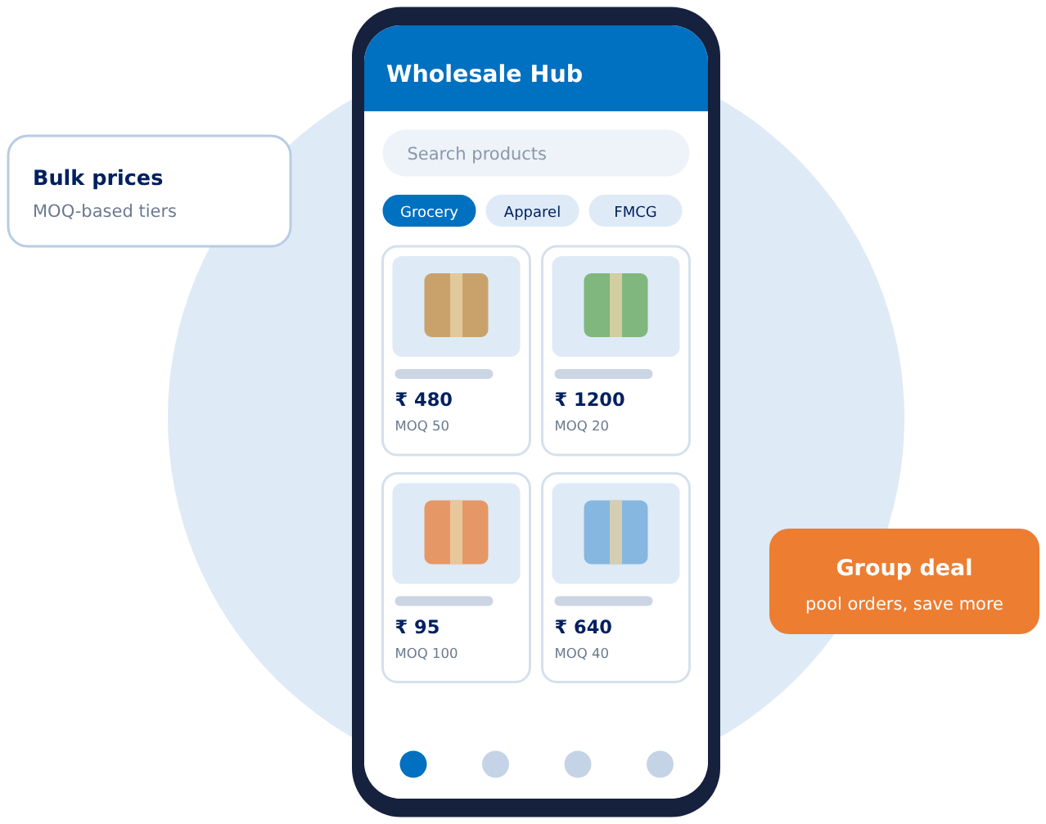
Introduction and Background
Wholesale trade is the backbone of retail supply: small retailers, kirana stores and MSMEs buy goods in bulk from distributors and manufacturers.
Most bulk deals still run on phone calls, chat groups and middlemen, so prices are opaque and agreements are not recorded.
Smartphones are now the main internet device for small businesses, making mobile-first commerce the natural fit.
This project builds one cross-platform (Android and iOS) wholesale marketplace app from a single codebase.
Three focus modules: price negotiation, camera-based product listings and group buying.
Illustrative app home screen

Slide 3
Problem Statement
Small and mid-sized wholesale buyers lack a mobile platform where they can negotiate bulk prices transparently, inspect products visually before ordering, and combine small orders to reach supplier minimum order quantities (MOQs). As a result they pay more, risk receiving goods that differ from expectations, and miss out on wholesale discounts.
1
No transparent bulk pricing
2
Products cannot be inspected
3
Minimum order barrier
Rates are fixed or settled over calls and chats. Buyers cannot easily counter-offer or track what was agreed.
Listings carry weak or no photos, so buyers risk receiving goods that differ from what they expected.
Small buyers cannot meet MOQs alone, so they miss the discounts that large buyers receive.
Addressed by Module 1
Addressed by Module 2
Addressed by Module 3

Slide 4
Motivation and Need for the Project
1
Inclusive economic growth
2
Mobile-first reality
Gives small retailers and MSMEs access to wholesale prices and suppliers on a par with large buyers (aligned with UN SDG 8 and 9).
Smartphones are how small traders get online. One cross-platform app reaches Android and iOS users without two separate builds.
3
Fewer middlemen, fairer prices
4
Digital innovation in everyday trade
Direct buyer-seller negotiation and pooled orders cut layers of margin and make prices transparent.
Brings camera-based listings, structured negotiation and demand pooling into routine wholesale buying.

Slide 5
Objectives
1
To build a single-codebase, cross-platform mobile marketplace (Android and iOS) for wholesale buyers and sellers.
2
To enable bulk price negotiation through offers, counteroffers and a recorded offer history (Module 1).
3
To let sellers create visual listings by capturing photos with the camera or uploading from the gallery (Module 2).
4
To pool requests from multiple buyers so minimum order quantities are met and wholesale discounts unlocked (Module 3).
5
To promote inclusive economic growth by opening wholesale access to small and medium buyers.
6
To evaluate usability and performance (startup time, response time, task completion) on both platforms.

Slide 6
Literature Survey
S.No | Year | Author(s) | Venue | Technique / Key Finding | Limitation / Gap (Module)
1 | 2017 | Gallo, Randazzo, Gallo | arXiv:1711.02661 | e-Fair: aggregates buyers and sellers; optimises purchase and shipment (assignment and transshipment) with a Markov chain for arrivals | Evaluated by MATLAB simulation; no mobile app or negotiation (Module 3)
2 | 2018 | Ma, Mezghani, Wilber et al. | arXiv:1811.10648 | Inception v3 CNN (~87%) on ~75k listing images; good photos raise trust and odds of sale | Consumer second-hand goods, not wholesale (Module 2)
3 | 2021 | Bagga, Paoletti, Alrayes, Stathis | Autonomous Agents and Multi-Agent Systems, 35:27 | ANEGMA: actor-critic deep RL buyer agent for concurrent bilateral price negotiation | Simulated e-markets; single-issue (price) only (Module 1)
4 | 2024 | Wang, Shu, Liu, Xie, Wang | J. Retailing and Consumer Services, 81 | Experiments: initiator's account name affects willingness to join an online group purchase, via trust | Consumer social commerce; B2B pooling not studied (Module 3)
5 | 2024 | Chatterjee, Miller, Parepally | arXiv:2412.18690 | AgreeMate: LoRA fine-tuned LLaMA-3.2-3B buyer and seller agents, tested on Craigslist Bargaining | Course project; 30 test scenarios; small models repeat themselves (Module 1)
6 | 2024 | Tiwari et al. | Int. J. of Research, 11(3) | ONDC could make Indian e-commerce more inclusive for SMEs and consumers | Conceptual review; no negotiation or pooling features (Inclusion)
7 | 2025 | George, Kirubanand, Sandeep | IEEE ICCIST 2025 | Native vs Flutter vs React Native: startup 1.5 s / 2.4 s / 3.0 s; Flutter faster to develop | One expense-tracker app on one Android phone (Technology)
8 | 2026 | Liu, Chen, Xiao et al. | arXiv:2604.09855 | GRPO reinforcement learning trains an LLM buyer on real Amazon listings; beats larger models | Single seller model, 6-turn cap, two-party only (Module 1)

Slide 7
Existing System and its Limitations
Approach | How it works today | Limitations
Phone calls and chat groups | Buyers and distributors agree rates and orders by call or message. | No structured offer history; prices are opaque and hard to compare; manual order tracking.
Listing and directory portals | Sellers publish catalogues; buyers send enquiries, then trade offline. | Weak or text-only product images; enquiry-based pricing; no built-in negotiation or order flow.
Fixed-price B2B apps | Buyers order at listed prices, often with large minimum quantities. | Small buyers often cannot meet MOQs; little room to bargain; discounts favour big orders.
Research gap: no single mobile app combines structured price negotiation, camera-based visual listings and buyer demand pooling for small wholesale buyers.

Slide 8
Proposed System and Novel Features
1
Smart Wholesale Price Negotiator
2
Camera and Image Uploads
3
Smart Group Buying and Demand Pooling
Buyer proposes price and quantity
Seller accepts, rejects or counters
Full offer history; deal locks at the agreed price
Capture photos with the mobile camera
Or upload images from the gallery
Buyers inspect products before ordering
Combines requests from many buyers
Live progress toward the MOQ
Unlocks wholesale discount tiers
Novel features
Offer and counteroffer with recorded history
Camera-first listings with gallery fallback
Auto-pooled MOQ progress tracker
One codebase for Android and iOS

Slide 9
Proposed Methodology / Workflow
1 Register and choose role
Buyer or Seller account
2 Seller creates listing
Photo (camera/gallery), price, MOQ
3 Buyer browses and inspects
Views product photos and details
Module key
4 Choose buying mode
Module 1: Price negotiator
5a Negotiate (Module 1)
Offer, counteroffer, accept or reject
Bulk
Module 2: Camera and image uploads
Module 3: Group buying
Small qty
7 Order and notification
Confirmation sent to both parties
6 Deal agreed / MOQ reached
Final or discounted price locked
5b Join group pool (Module 3)
Quantities add up to the MOQ

Slide 10
System Architecture Diagram
Client Layer
Flutter app (Android + iOS)
Buyer screens
Browse, offer, join pool
Seller screens
Create listing, respond to offers
Device camera / gallery
Image capture and pick
API Layer
REST over HTTPS
REST API gateway: authentication (JWT) and role check
Service Layer
Business logic
Negotiation Service
Offers, counters, history
Image Service
Validate, compress, upload
Group Buying Service
Pools, MOQ, discounts
Order and Notification
Orders, alerts
Data and Cloud Layer
Storage and push
MySQL database
Cloud image storage
Push notifications (FCM)

Slide 11
Technologies, Software, Hardware and Tools
Software
Hardware
Flutter (Dart): cross-platform UI
Spring Boot (Java): REST API
MySQL: relational database
JSON over HTTPS (REST)
Android and iOS smartphones with camera
Development laptop (8 GB RAM or more)
Wi-Fi / mobile data for testing
Android emulator and iOS simulator
Tools
Libraries and Services
Android Studio and VS Code
Git and GitHub
Postman for API testing
Figma for UI wireframes
image_picker and camera plugins
Firebase Cloud Messaging (push)
Cloud object storage for images
JWT for authentication

Slide 12
Dataset or Data Collection Method
How data is collected
Data model (core entities)
Seed catalogue: sample wholesale products (grocery, FMCG, apparel) with prices and MOQ tiers.
Product images: photos captured in-app by camera or gallery during testing.
Synthetic transactions: simulated offers, counteroffers and group orders to test the logic.
Field input: short interviews with local wholesalers and retailers to validate requirements (planned).
Reference prices: public wholesale price listings for realistic ranges.
Entity | Key fields
Users | id, role (buyer/seller), name, phone
Products | id, seller, name, category, price, MOQ
Images | product id, image URL, source (camera/gallery)
Offers | product, buyer, quantity, price, status
Group pools | product, target qty, joined qty, deadline
Orders | buyer, product, final price, status

Slide 13
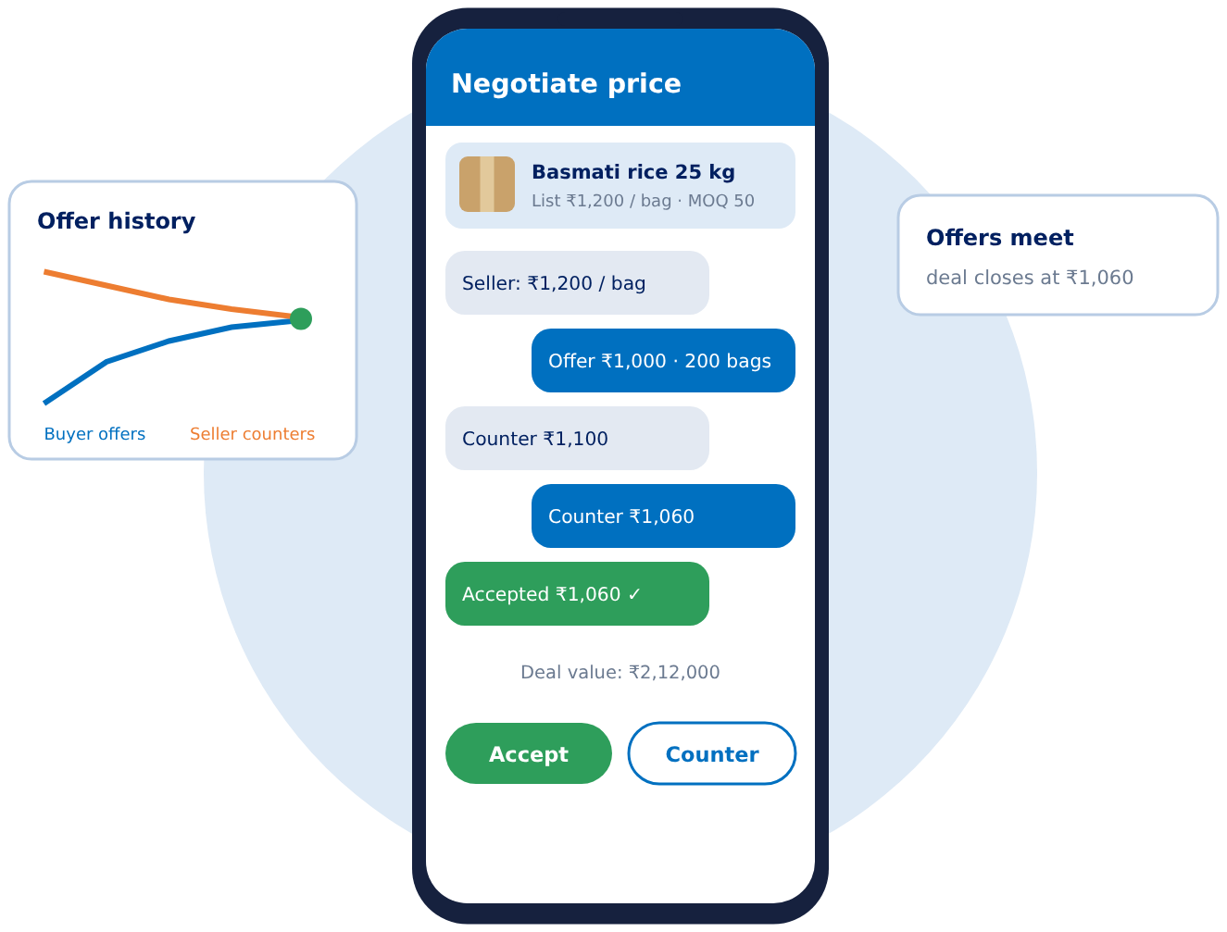
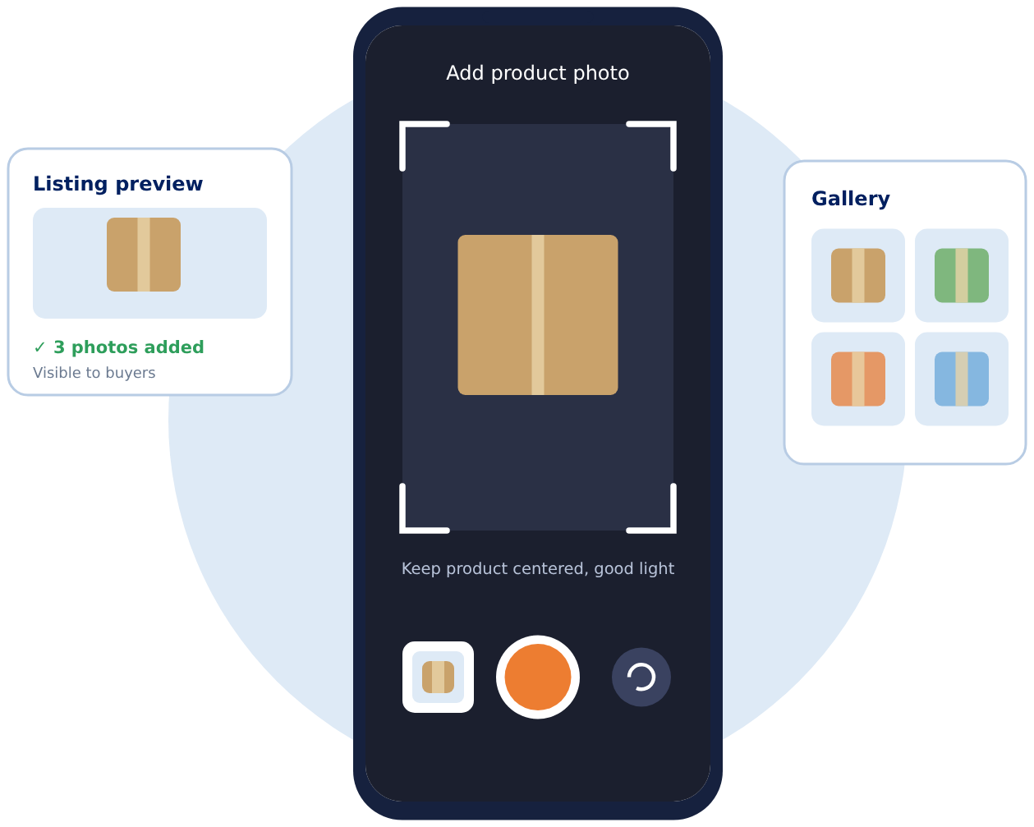
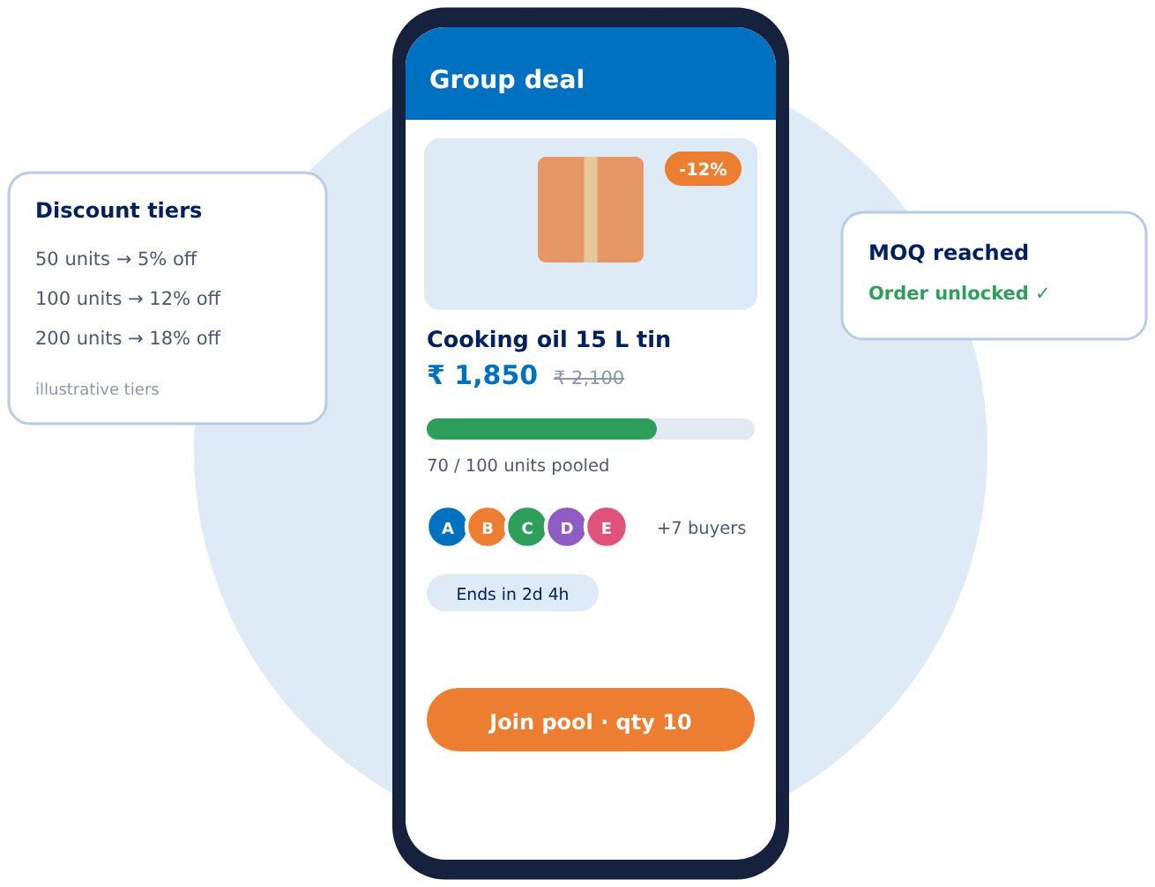
Module-wise Design
Module 1: Smart Wholesale Price Negotiator
Input: product, quantity and the buyer's offered price.
Process: seller accepts, rejects or counters; each step is stored as an offer record; negotiation ends at an agreed price or expires.
Output: locked deal price and an order request.
Module 2: Camera and Image Uploads
Input: photo from the mobile camera or an image from the gallery.
Process: permission check, validate and compress, upload to cloud storage, link to the product listing.
Output: listing with an image gallery that buyers can inspect.
Module 3: Smart Group Buying and Demand Pooling
Input: purchase requests (product, quantity) from many buyers.
Process: quantities are pooled toward the MOQ target; discount tier applied; deadline closes the pool.
Output: unlocked wholesale price, consolidated order and notifications.

Slide 14
Current Progress and Future Work
Completed
In Progress
Future Work
Problem study and module finalization
Literature survey of 8 recent papers
System architecture and workflow design
Technology stack selection
Flutter UI screens for the three modules
Backend REST APIs and database schema
Camera and gallery upload integration
Offer and counteroffer logic
Real-time chat and push alerts for offers
UPI payments and delivery tracking
Regional-language support
AI price suggestions and demand forecasting
Usability testing with real wholesalers
Thank you | Questions?

