Slide 1
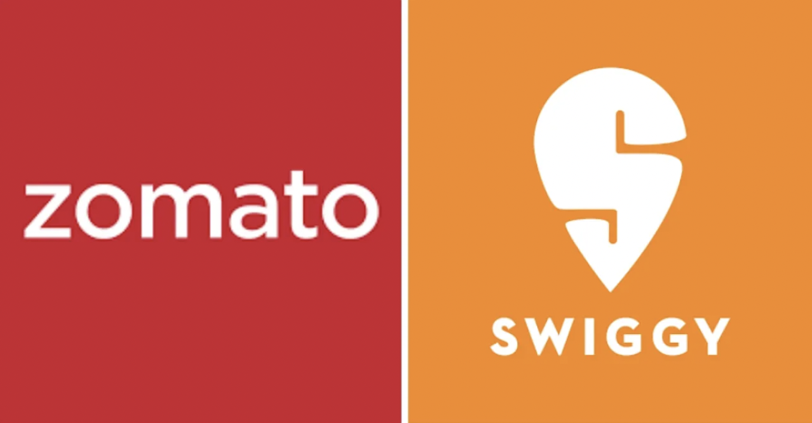
Zomato Sales Analysis
Manoj Reddy

Slide 2
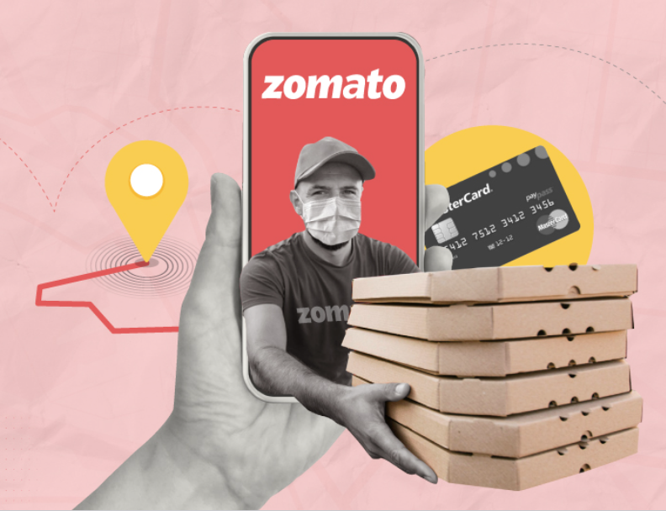
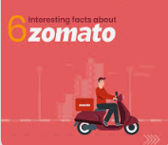
Around 2008, people in Delhi were fed up with manual searching of delivery menus of different restaurants around them. Deepinder Goyal and Pankaj Chaddah, the founders of Zomato made the most of this opportunity by launching a food directory service. They called it FoodieBay. In just 9 mthm, it became the largest and a popular restaurant directory in all of Delhi.
It’s revenue grew from Rs. 1,300 cr. in FY 2019 to Rs. 2,800 cr. in FY 2020. It is already profitable at EBITDA level in the food delivery business. During Q2 2019, it was burning about Rs. 290 cr. every month

Slide 3

PROBLEM STATEMENT
To identify optimal countries and cities for opening new restaurants by analysing existing restaurant performance, market demand, and economic factors, ensuring profitable and strategic expansion.

Slide 4

Data Cleaning and Processing
Total 15 countries, restaurant name, locality, cuisines it offer.
Dataset contains information about restaurant name, id, locality, longitude, latitude, date of opening,currency used, average cost of two, has online delivery service available or not
Data Cleaning and processes
Cuisines contains some null values which is handled by ifblank
Normalized currency with average cost of two people
Standardized date format in readable format
Processed various currencies and converted them into INR and USD for comparison.
Used LOOKUP functions to fetch the appropriate country codes.

Slide 5
Methodology
Data Cleaning - Using ifna() , trim, clear function to handle missing values
Data Preprocessing - Enhanced dataset with additional column name of country extracted using VLOOKUP to cross reference external data sets
Data Enrichment - Applied CONCATENATE, MID, FIND function to attain customized price value using currency and price
Descriptive Analysis - Employed PIVOT table to summarize key metrics and identify count of restaurants in each country, cities and price of each. It also helps in understanding which restaurant is highly rated and what factors affect it.
Visualization - creating dynamic charts and dashboards for data visualization.

Slide 6
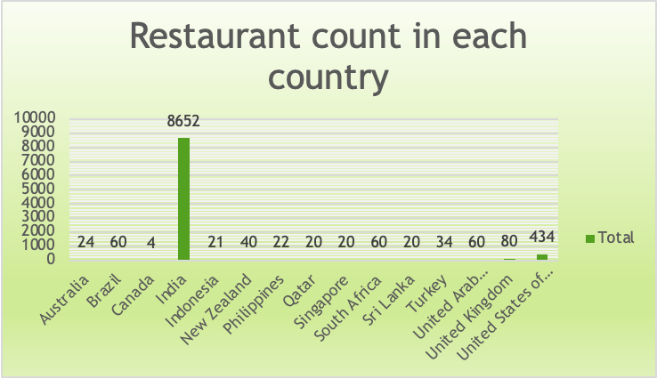
No. of Restaurants opened in each country
8,652 restaurants (90%+ of total) are in India, indicating a highly competitive food industry
434 restaurants are located in the USA, showing significant market presence.
Qatar & Sri Lanka Have Low Competition.Only 20 restaurants each → Indicating potential for new business expansion.These countries could be ideal for launching new restaurants with lower competition
Australia, Canada, Singapore, & New Zealand Have Minimal Presence .Fewer than 50 restaurants in each country → Scope for growth & expansion in these markets

Slide 7
India dominates with the highest number of restaurants, indicating strong Zomato market penetration and user engagement in the region.
UAE and USA follow as leading international markets, reflecting Zomato’s active expansion into high-density urban areas.
The diverse global footprint indicates that Zomato’s model is scalable across different culinary and economic markets.

Slide 8
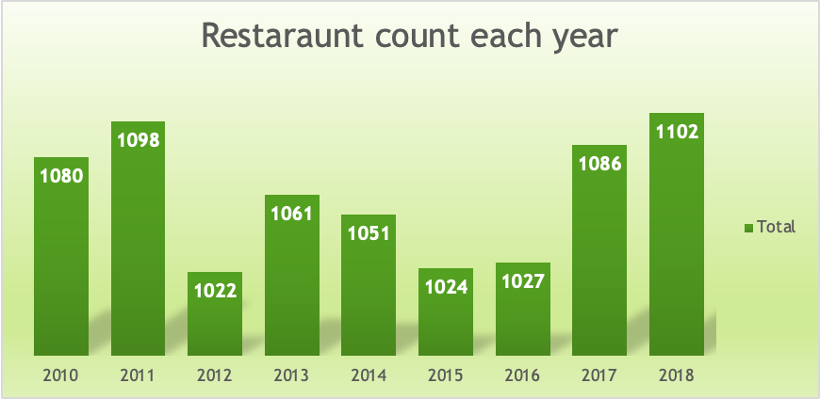
Restaurants opened each year
The number of restaurants opened each year remains relatively stable, averaging around 1,050 per year.Indicates a consistent demand for new restaurant ventures
2018 saw the highest number of restaurant openings, suggesting strong market confidence
2012 (1,022) and 2015 (1,024) had lower openings
A steady upward trend in recent years (2016-2018) indicates increasing opportunities for new restaurants.

Slide 9
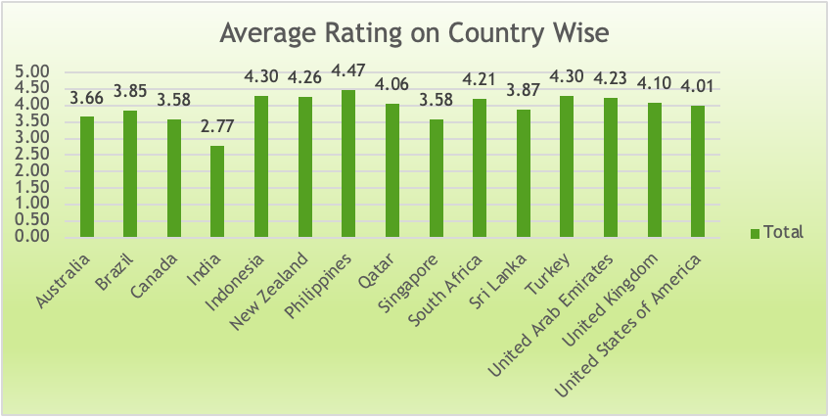
Consistent growth: The number of restaurants opened each year remains fairly stable, averaging around 1,050 per year, suggesting sustained demand in the market.
2018 recorded the highest openings (1,102), indicating strong market confidence and expansion opportunities that year.
Slight dips are seen in 2012 (1,022) and 2015 (1,024), which could reflect temporary saturation or economic influences.
The overall range of fluctuation is low, showing a mature and reliable market environment for new restaurant ventures.

Slide 10
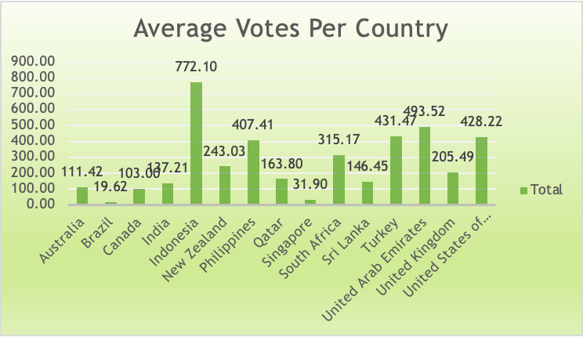
Indonesia Has the Highest Average Votes (772) which suggest higher engagement, indicating a strong food culture and active customer reviews.
United Arab Emirates (493) & Turkey (431) Also Show High Engagement. They have above-average customer voting patterns, suggesting strong customer interaction.
India Has a Moderate Voting Average (137).Despite India having the most restaurants (8,652), the average votes per restaurant remain moderate.This suggests either a dispersed market or less customer engagement in voting.
Countries with Low Engagement: Brazil (19), Singapore (31) Brazil & Singapore have the lowest average votes

Slide 11
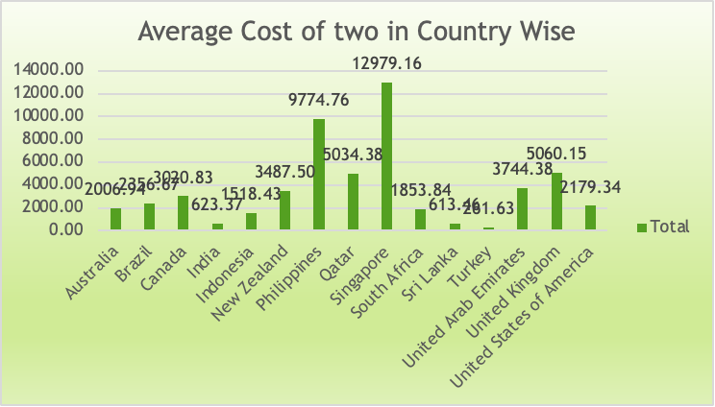
Current expenditure on food and measures to control
Highest Food Expenditure in the USA: The United States has the highest average dining cost (₹810.81), indicating a market suitable for premium restaurants and fine dining experiences.
Most Affordable Market in Turkey: Turkey has the lowest food expenditure (₹223.81), making it a prime location for budget-friendly or fast-casual dining options.
Moderate Costs in Other Countries: South Africa (₹623.86), Indonesia (₹666), Brazil (₹700), and Sri Lanka (₹508.85) fall within a moderate price range, providing flexibility for mid-range restaurant models.

Slide 12
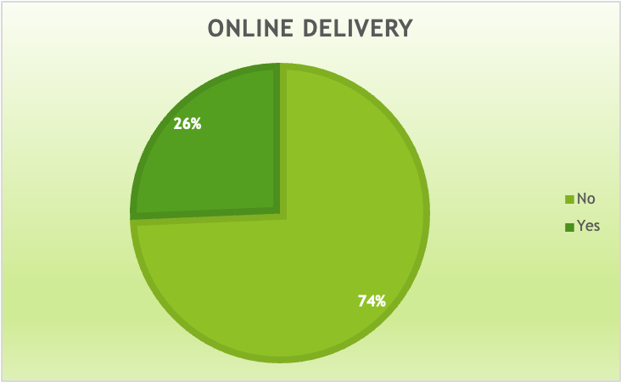
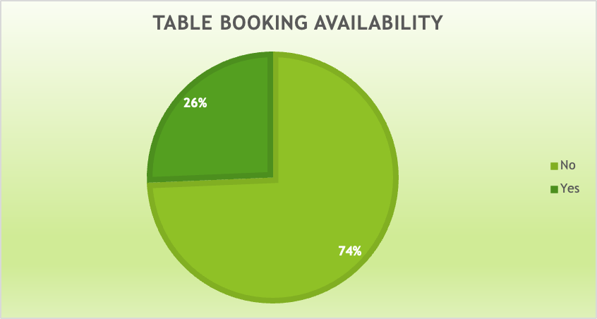
Effect of online delivery and table booking on ratings
Yes it affect customer rating
Insights
Online Delivery & Table Booking Can Impact Ratings
Higher Ratings for Restaurants with Online Services
Offering both delivery & table booking can increase customer engagement

Slide 13
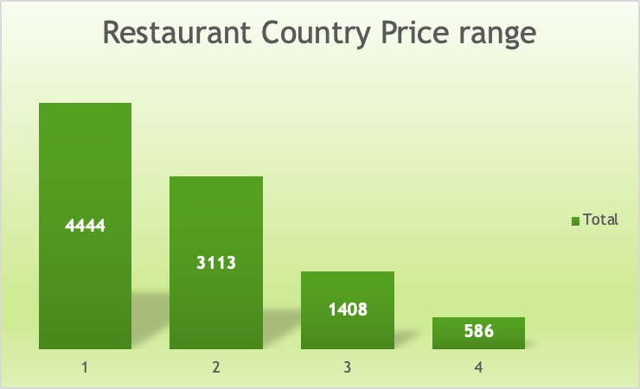
Restaurant Distribution according to price range
Insights-
India Dominates the Low-Price Market
Premium Dining is More Common in Brazil, Qatar, Singapore, and South Africa have a higher proportion of high-end restaurants (Price Range 4).
Canada, Indonesia, Philippines, Qatar, and Singapore have very few or no restaurants in Price Range 1
The United States and the United Kingdom show a relatively balanced spread across all price ranges, indicating diverse customer preferences.

Slide 14
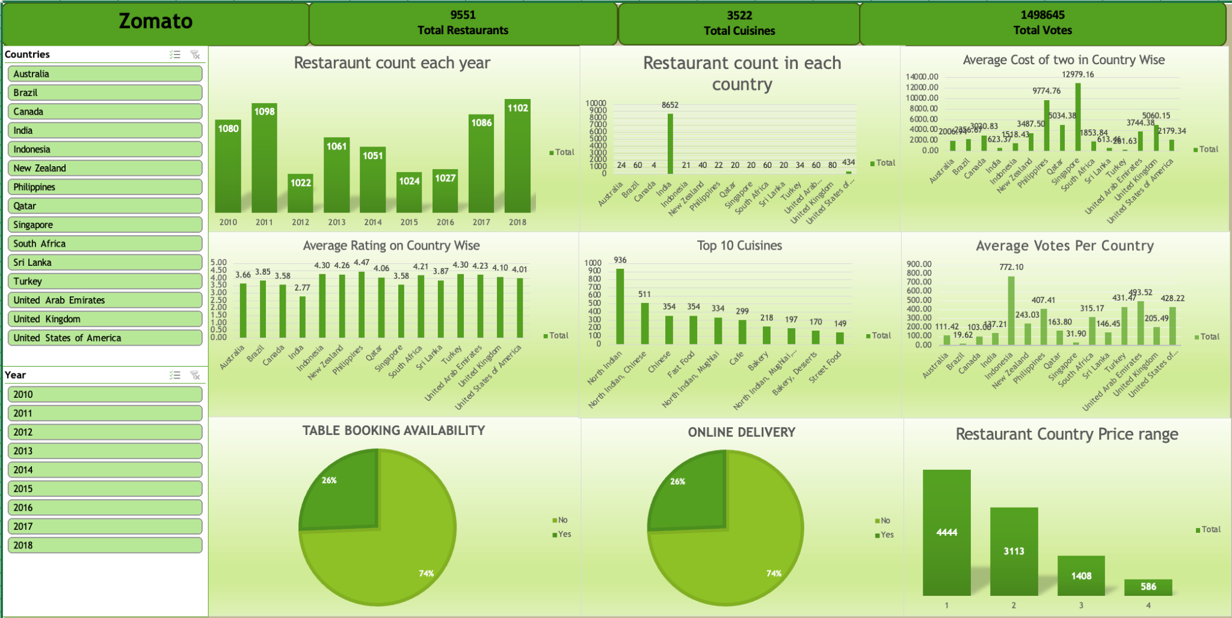
DASHBOARD

Slide 15
CONCLUSION
The selected countries and cities are based on the following criteria: each has fewer than 100 existing restaurants, average ratings of 3.9 or higher, an average expenditure of less than $60 for two people, and a minimum of 150 voters. These factors indicate strong market potential and favourable conditions for new restaurant openings.
South Africa: Cities like Cape Town, Johannesburg, Pretoria, Randburg, and Sandton are ideal for new restaurants, with a strong customer base and high average ratings.
Sri Lanka: Colombo stands out as a prime location, meeting all criteria for restaurant expansion with favourable ratings and manageable expenditure.
Turkey: Ankara and Istanbul are highly suitable, offering good ratings and reasonable costs, making them strategic choices for new ventures.
Brazil : Rio de janerio is highly suitable, offering rating of 4.2 and less competition
Indonesia : Bandung and Jakarta are best location for opening restaurant, with average rating of 4.2
United States of America - It provides vast market to expand with various cities like Dalton, Macon etc. and average price of two person is also low

Slide 16
THANK YOU

