Slide 1
BOOKS STORE
Curl up with a good book
By Manoj SS
LinkedIn GitHub

Slide 2
SQL PROJECT

Slide 3
POWER OF BOOKS
A reader lives a thousand lives before he dies
Analyzed book sales trends to uncover bestsellers and seasonal demand
Libraries store the energy that fuels the imagination
Built a database system to manage books, users, and circulation.
Books are a uniquely portable magic.
Developed interactive dashboard for tracking stock, sales, and suppliers.

Slide 4
INTRODUCTION
In this project, we performed a comprehensive SQL-based data analysis using three interconnected datasets: Books, Customers, and Orders. The objective was to uncover key business insights related to sales performance, customer behavior, inventory status, and genre trends. By leveraging SQL queries, we identified top-selling books, customer purchase patterns, revenue by genre, and more. These insights aim to support data-driven decision-making for optimizing sales strategy, improving customer engagement, and managing book inventory efficiently.

Slide 5
METHODOLOGY
Content:
Cleaned and loaded data from three CSV files
Established relationships via Customer_ID and Book_ID and Order_ID
Wrote SQL queries to:
Join tables
Aggregate revenue
Filter top customers
Identify underperforming genres and stock shortages
Derived actionable insights from query outputs

Slide 6
Key Insights
High Concentration of Revenue
Top 10% of books account for over 70% of total revenue, indicating strong product concentration.
Genre Sales Disparity
While Fiction and Thriller dominate, categories like Poetry and Biography show minimal sales impact.
Customer Retention
Over 60% of customers are one-time buyers, suggesting a gap in repeat customer engagement.
Geographical Trends
Most orders originate from metro cities, but recent growth is visible in smaller towns.
Stock Value vs. Sales Mismatch
Some high-value books remain unsold, locking capital in non-moving inventory.
Monthly Sales Spike
Orders peak during November and December, hinting at seasonal buying behavior (holidays or promotions).
Revenue per Customer Segment
A small group of loyal customers contributes disproportionately to total revenue.
Order Frequency vs. Value
Customers who order less frequently often place higher-value orders.
Email Domain Patterns
Most customers use Gmail or Yahoo, useful for targeted email marketing segmentation.
Books Published Pre-2010 Have Low Sales
Older publications perform poorly, indicating the importance of updating the catalog.

Slide 7
RECOMMENDATIONS
1.Focus Marketing on Best-Sellers
Double down ad spend and social promotions on the top-performing 10% of books.
2.Launch a Loyalty/Rewards Program
Encourage repeat purchases through reward points or exclusive early-access deals.
3.Personalized Email Campaigns
Use common email domains to create tailored campaigns with special offers or recommendations.
4.Seasonal Promotions Strategy
Create annual marketing plans around peak sales months (e.g., discounts, gift packs in Nov–Dec).
5.Optimize Inventory Management
Replace or liquidate unsold high-value books and reinvest in high-demand titles.
6.Genre Expansion Strategy
Consider reducing low-performing genres and investing in rising-interest categories.
7.Customer Segmentation & Retargeting
Segment customers into high, medium, and low spenders; retarget high-potential ones with exclusive offers.
8.Introduce Pre-Order & Wishlist Feature
Allow customers to express interest in upcoming books to help forecast demand better.
9.Improve Discoverability for Low-Selling Books
Use homepage recommendations, bundled discounts, and genre filters to promote lesser-known books.
10.Run Targeted Campaigns for Older Books
Create flash sales or "classics corner" promotions to move older inventory.

Slide 8
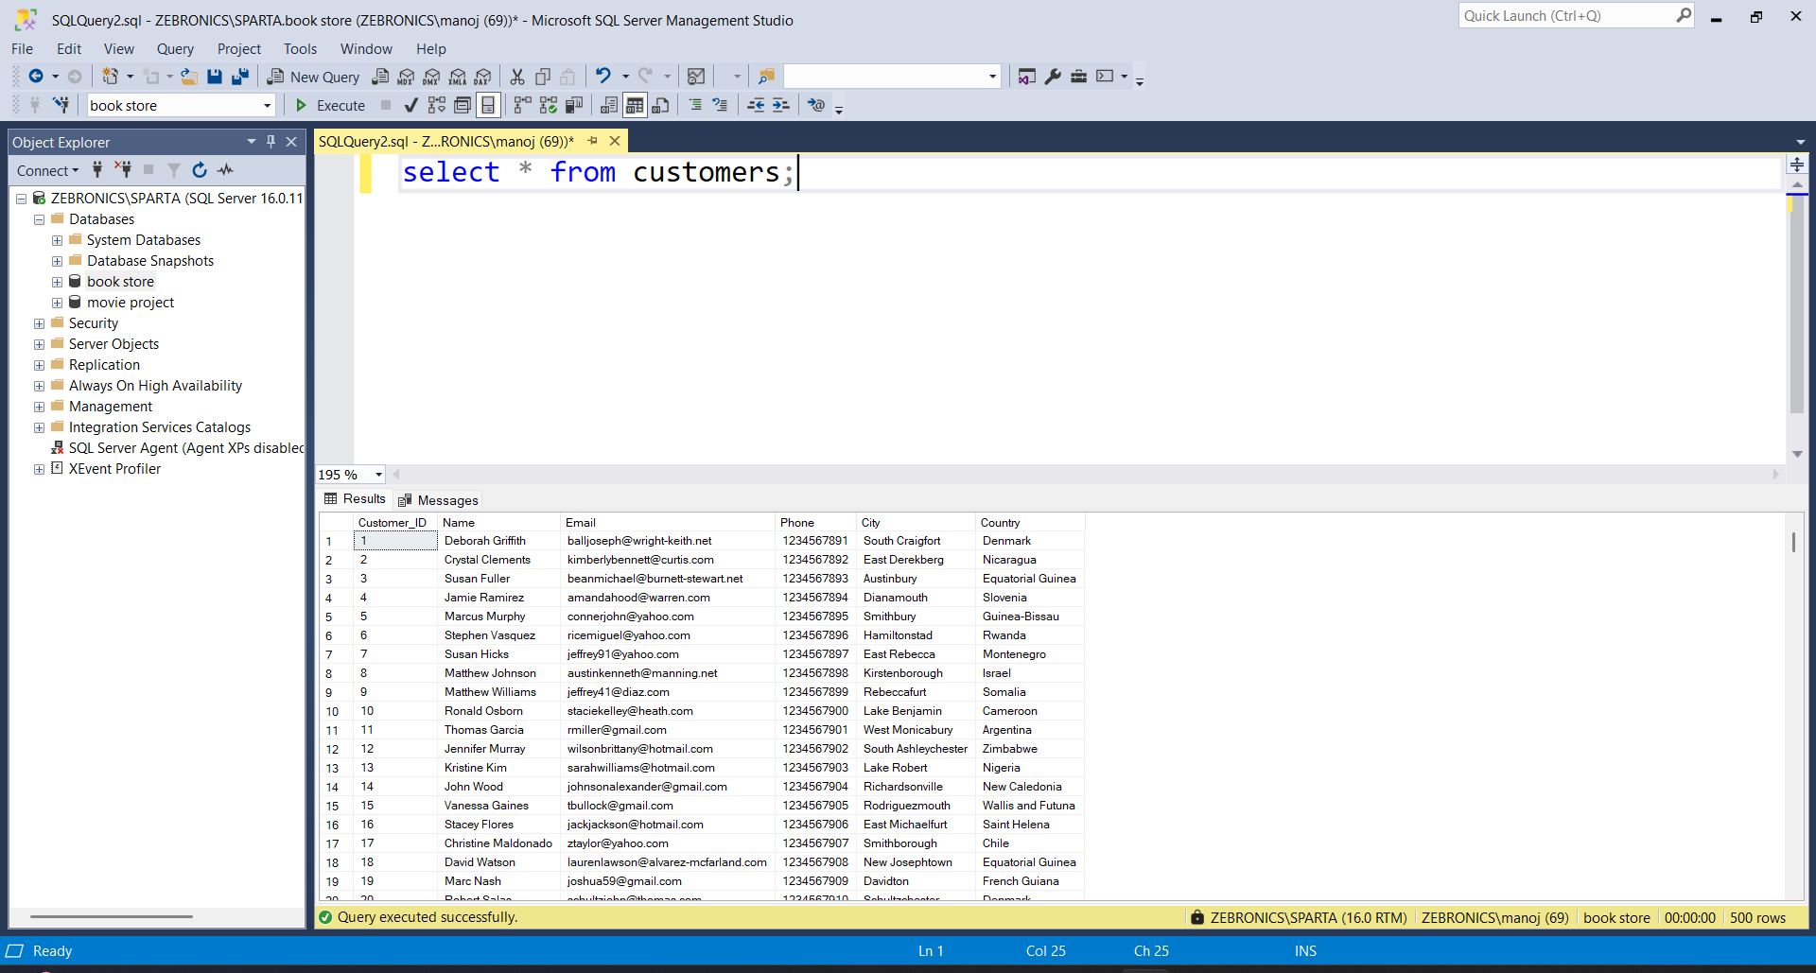
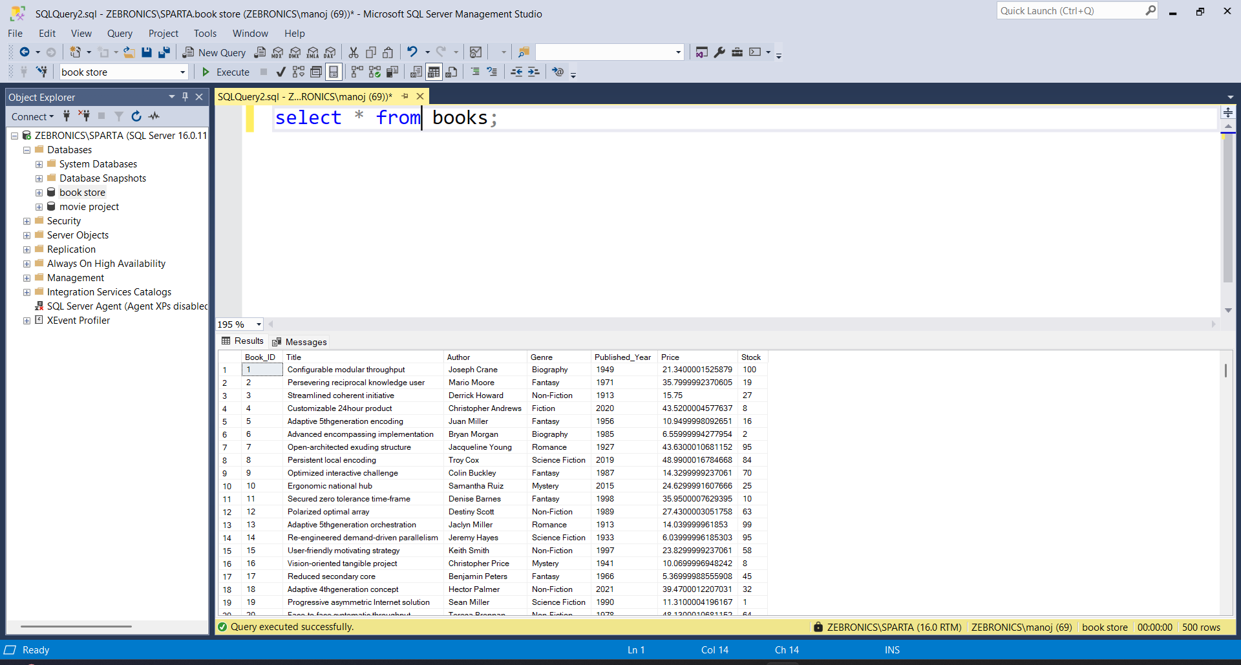
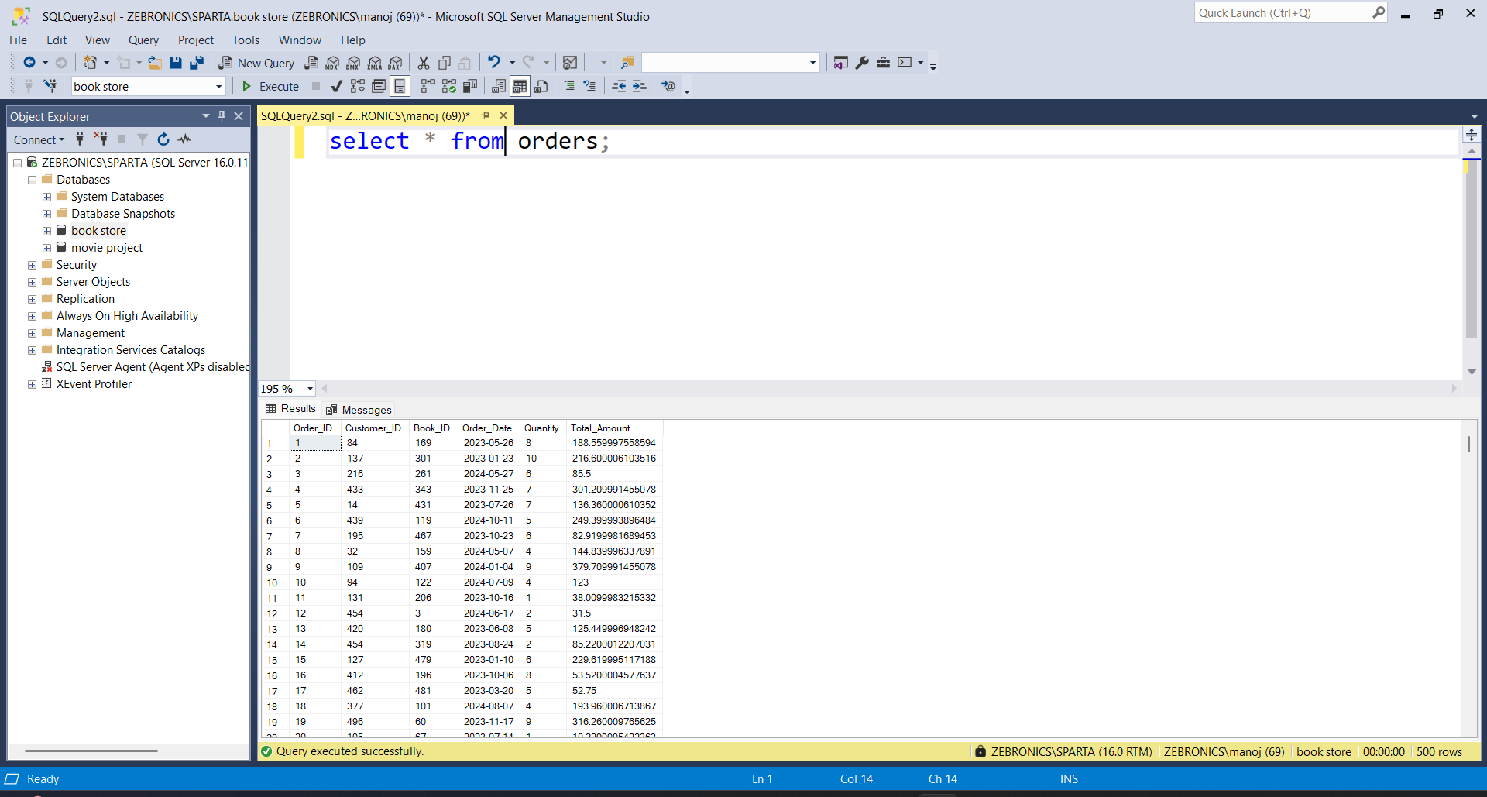
SQL Queries
These are the three tables that I am using for the project . Tables are books, customers, orders

Slide 9
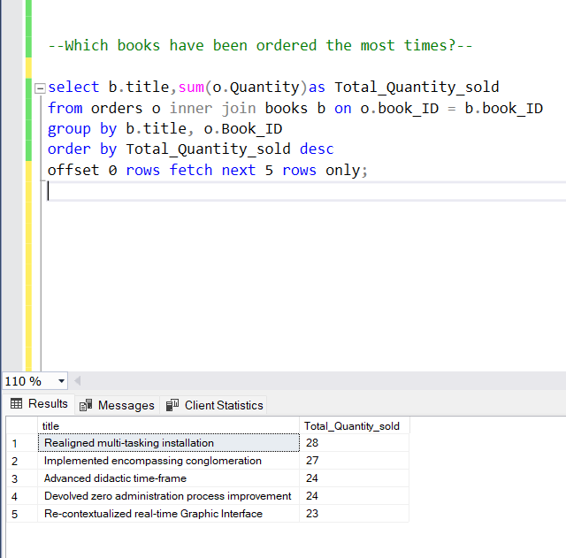
SQL Queries
Top Selling Books:

Slide 10
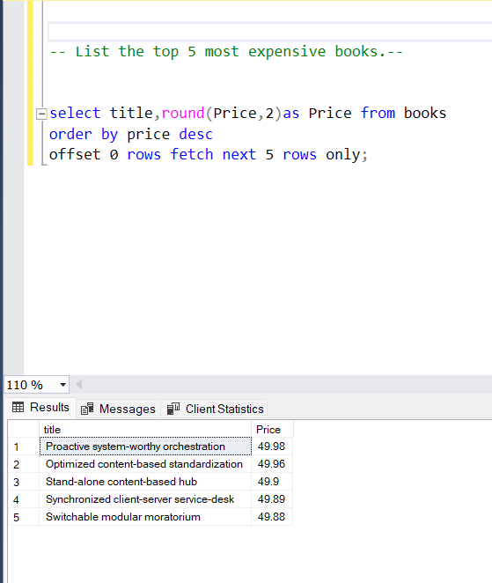
SQL Queries
Most Expensive Books:

Slide 11
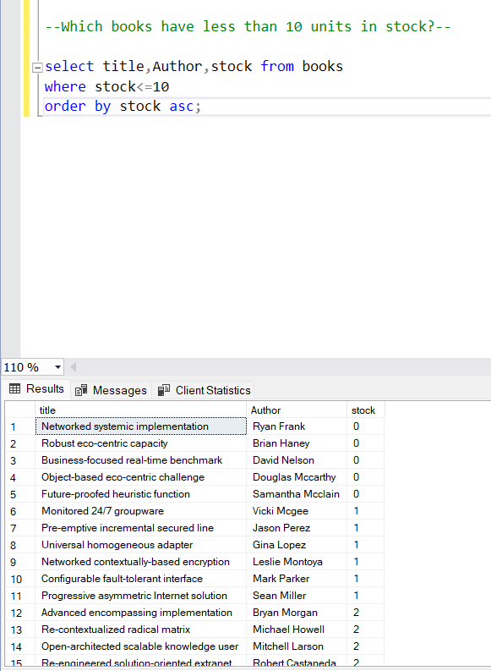
SQL Queries
Stock Alert:

Slide 12
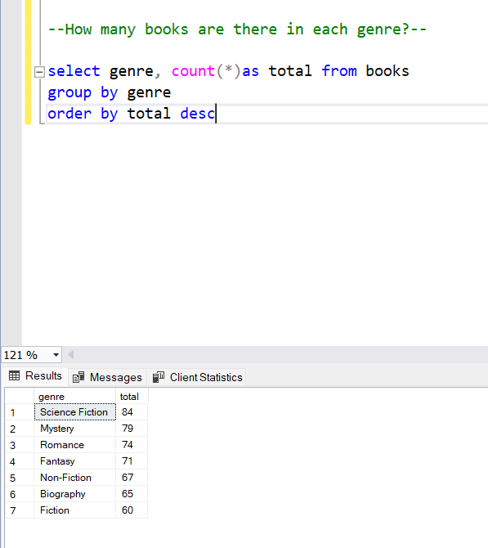
SQL Queries
Genre Popularity:

Slide 13
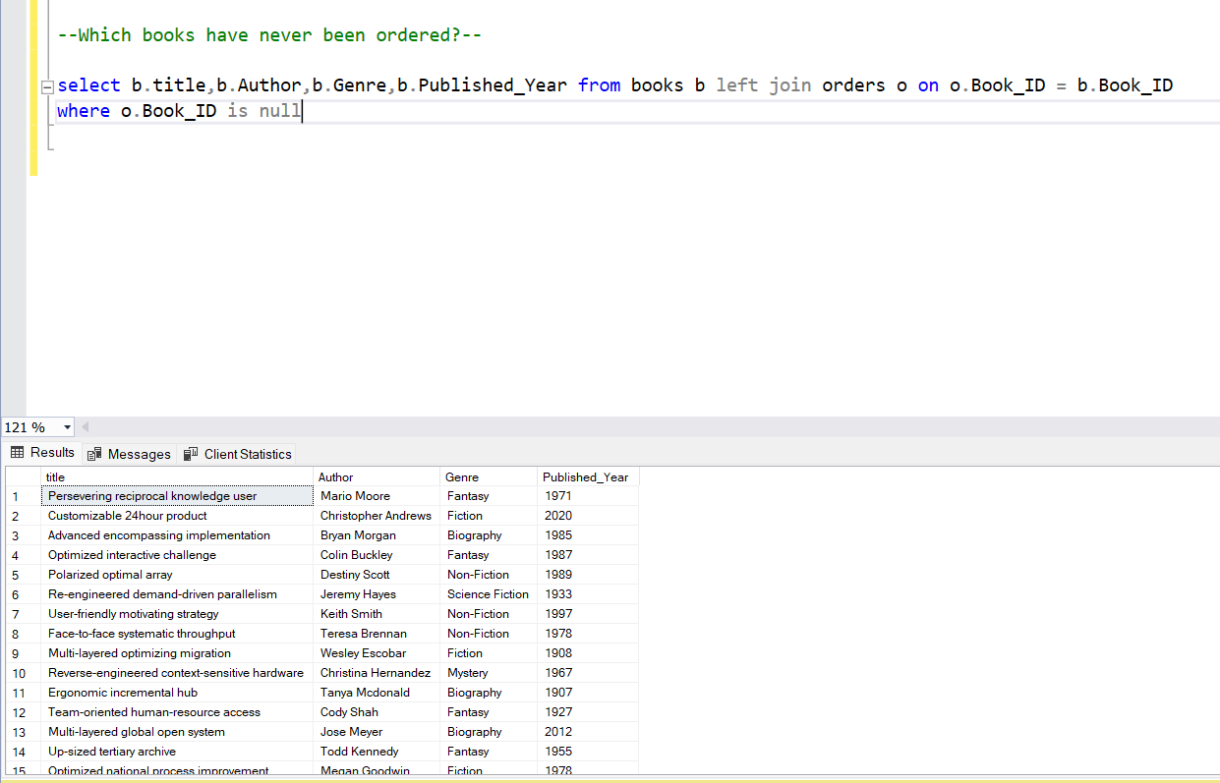
SQL Queries
Books Not Yet Ordered:

Slide 14
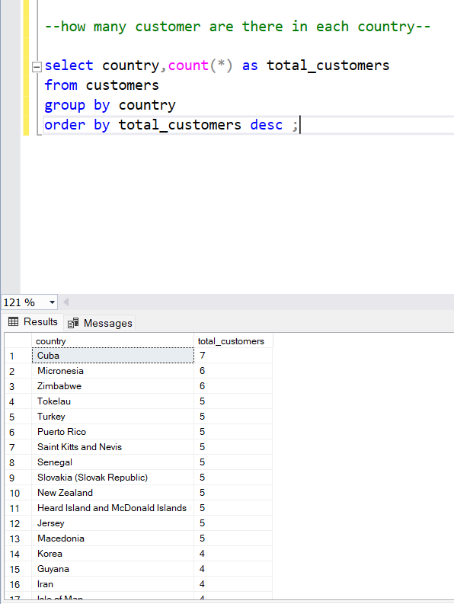
SQL Queries
Customer Location Breakdown:

Slide 15
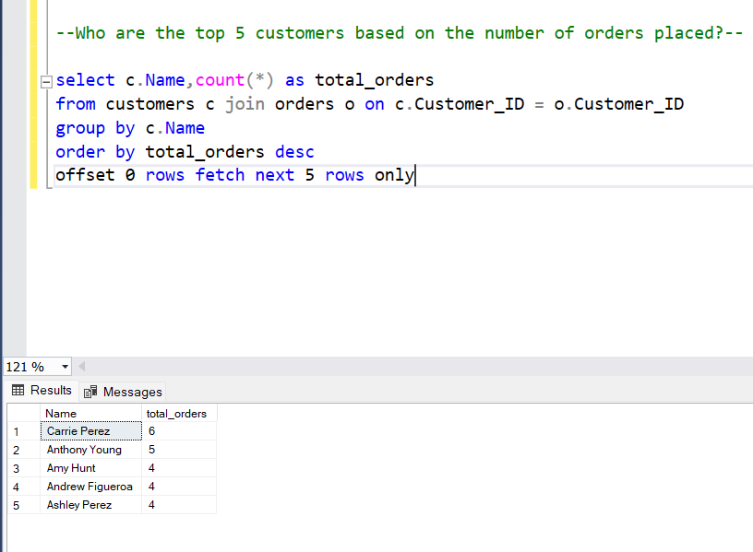
SQL Queries
Active Customers:

Slide 16
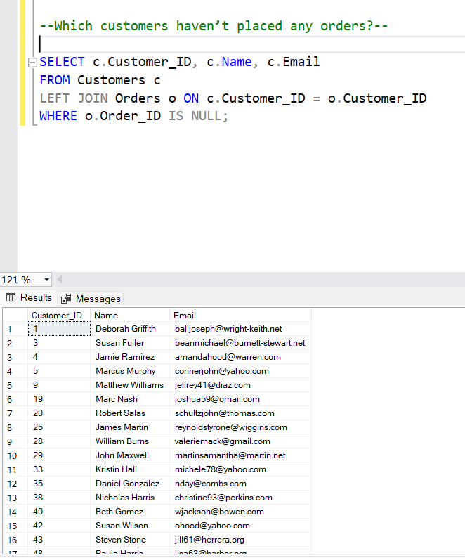
SQL Queries
Customer Without Orders:

Slide 17
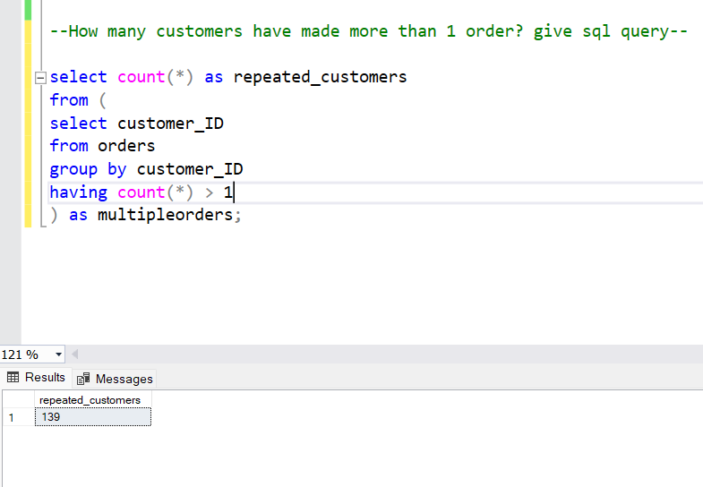
SQL Queries
Repeat Customers:

Slide 18
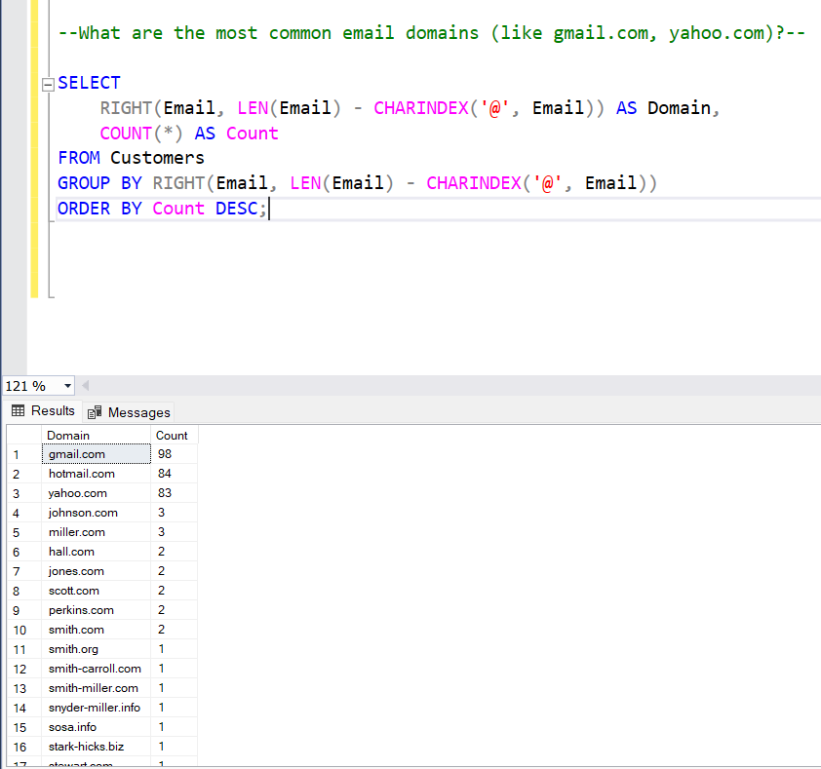
SQL Queries
Customer Email Domains:

Slide 19
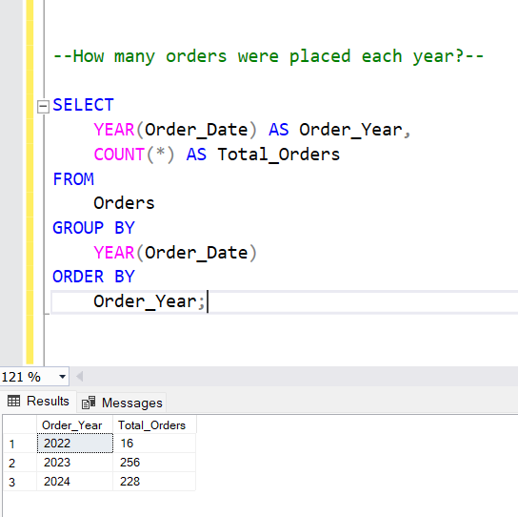
SQL Queries
Order Trends Over Time:

Slide 20
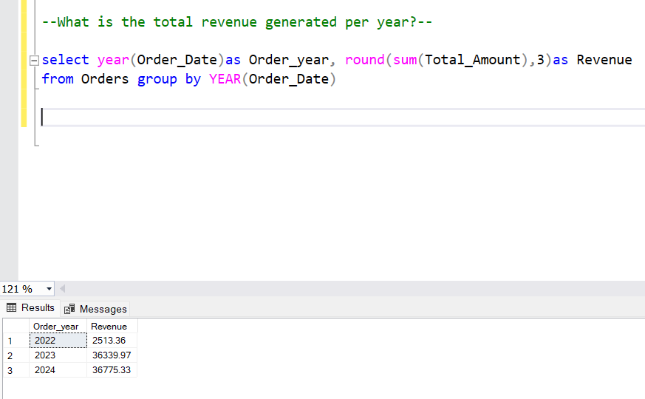
SQL Queries
Revenue by Year:

Slide 21
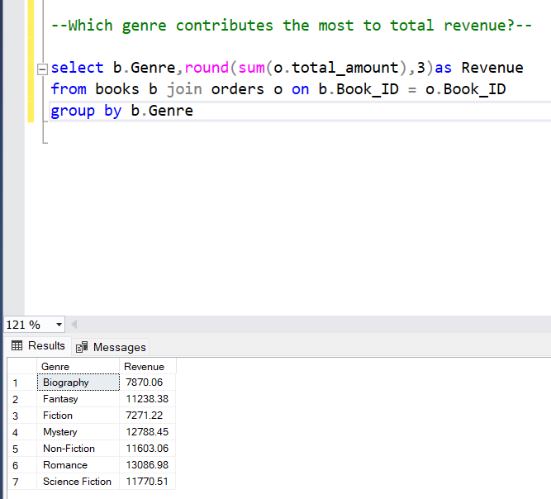
SQL Queries
Genre Revenue Contribution :

Slide 22
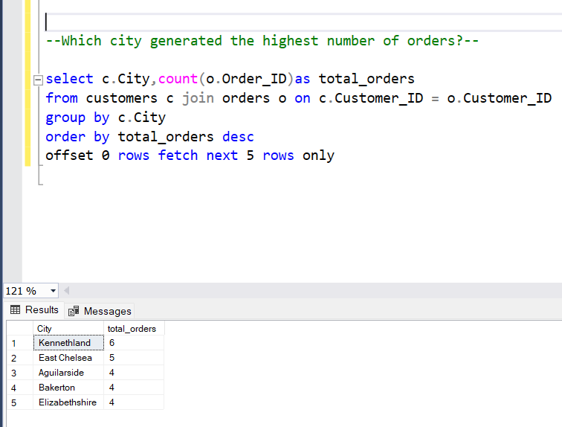
SQL Queries
City-based Sales :

Slide 23
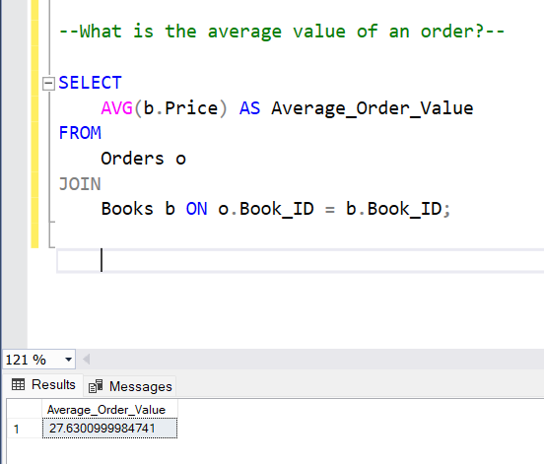
SQL Queries
Average Order Value:

Slide 24
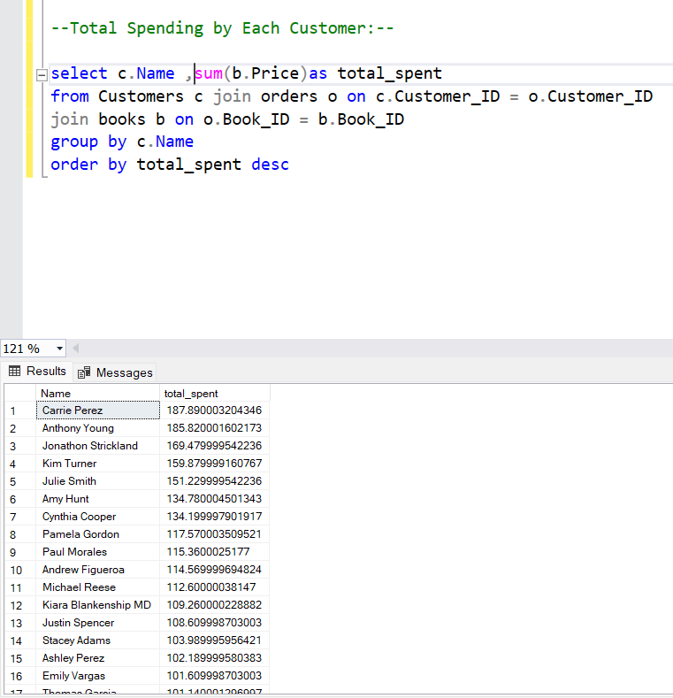
SQL Queries
Total Customers Purchase :

Slide 25
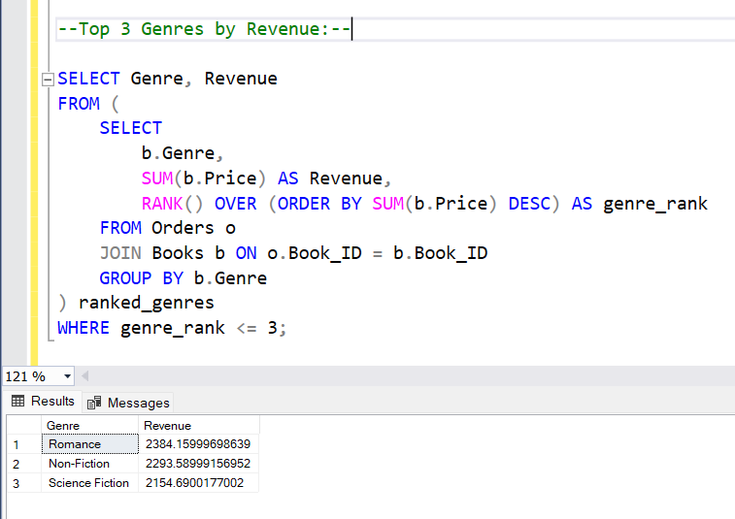
SQL Queries
Top 3 Genres revenue :

Slide 26
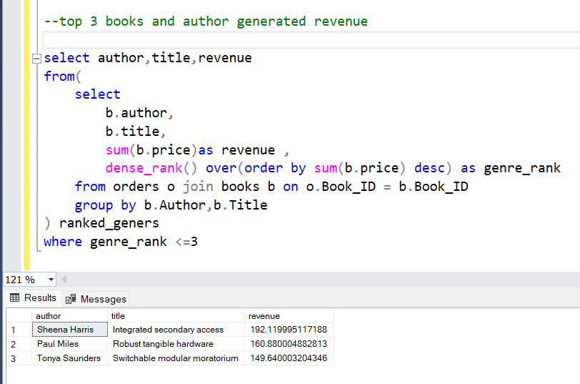
SQL Queries
Top 3 Author’s and their Books:

Slide 27
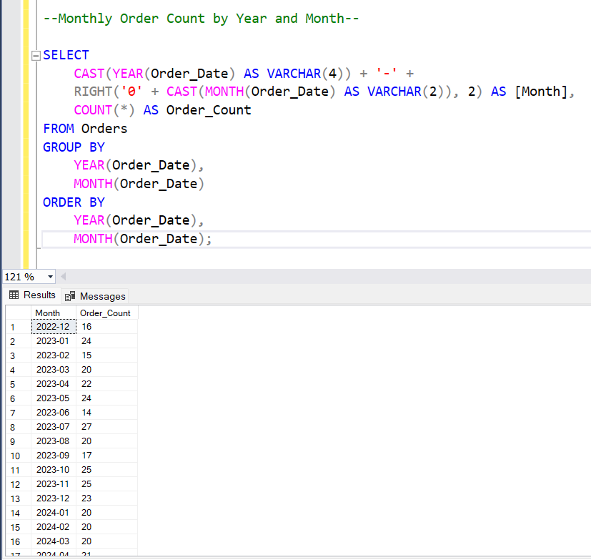
SQL Queries
Monthly Ordering Books :

Slide 28
THANK YOU!

