Slide 1
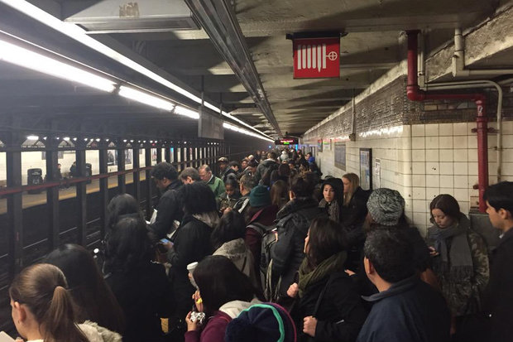
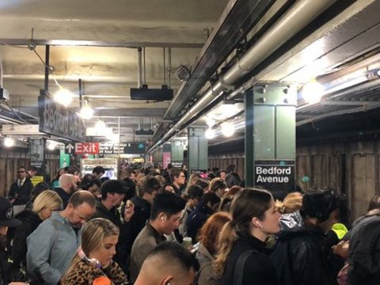
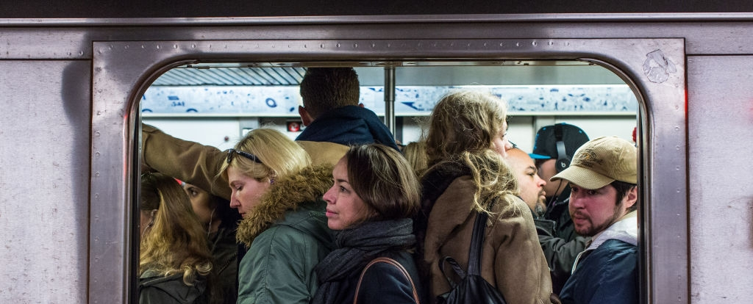
Morning Rush Hour in the Bedford Avenue Stop
Final Project by Manolis Manoli

Slide 2
Introduction and Goal
The Bedford Avenue L train station in Williamsburg has approximately an average of 27,000 daily users (1) on any given weekday. This makes it the second most frequented train station in Brooklyn - all that with only one platform serving both the Manhattan bound train and those that take passengers deeper into Brooklyn.
It is notorious for its delays and huge crowds on the small platform waiting until they can finally squeeze into a train - after seeing multiples pass with only a few waiting passengers being able to squeeze into the already overcrowded trains.
In the morning, the overwhelming amount of passengers will travel into Manhattan with those traveling into Brooklyn not experiencing shortage in space. In the evening the trains back into Brooklyn will be overcrowded with those from Brooklyn into Manhattan being below capacity. We will therefore simplify our investigation and only focus on modeling the Bedford Avenue platform and passengers traveling into Manhattan.
We want to see how the amount of people waiting varies throughout rush hour and how many trains operate at capacity.
(1) http://web.mta.info/nyct/facts/ridership/ridership_sub.htm

Slide 3
Assumptions
The L train has 8 cars with each car having 4 doors. We will model each of these 32 doors using a Normal Distribution. The mean and variance will depend on the time t and distributed N(mspace_t , vspace_t) where t are different time segments during the rush hour
According to the article "The Waiting Time Paradox, or, Why Is My Bus Always Late?" (2) the arrival time of trains is actually not Poisson distributed but rather normally distributed. This is due to the fact that arrival times of trains The trains arrive on average every 4 minutes a variance of 1.5 minutes - N(4,1.5).
We assume that at 7:30 there is no queue and any traveler will find space until that time
The traveler arrive at the train station with poisson distribution Pois(Lambda_t) where t are different time segments during the rush hour
Travelers will move to doors where there is still room (in reality sometimes the doors at the end of the platform will have space with most people trying to get into the train in the center)
(2) http://jakevdp.github.io/blog/2018/09/13/waiting-time-paradox/

Slide 4
Start
Flow Chart
We split rush hour into 4 phases:
T1 = 7:30 – 8:00
T2 = 8:00 – 9:00
T3 = 9:00 – 10:00
T4 = 10:00 – 11:00
Simulating minute by minute (t)
Simulate train arrival time:
Normal(mu,sigma)
Where the base case is:
mu = 5
sigma = 2
End
Simulate space on each train:
Normal(mu_i,sigma_i)
Where the base case is:
mu1 = 25, sigma1 = 10
mu2 = 7, sigma2 = 4
mu3 = 8, sigma3 = 5
mu4 = 30, sigma4 = 15
For each train arrival we will note if all passengers were able to travel or if some where not able to make it onto the train with variable full_train_t
Each minute we record people waiting:
how many people have entered the station and subtracting the number of passengers that were picked up in the subway:
pass_wait_t =
max[0, pass_wait_t-1 + pass_arrive_t – train_cap_t]
Simulate commuters arriving:
Poisson(lambda_i)
Where the base case per timeslot:
lambda1=40
lambda2=50
lambda3=40
lambda4=20

Slide 5
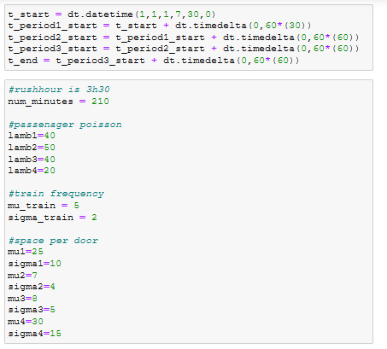
Implementation (1/7)
We start by defining the different sections of rush hour
Then we define all required inputs for the distributions we will need.

Slide 6
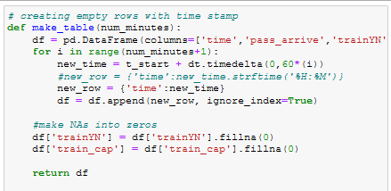
Implementation (2/7)
Then we create a table with one row for each minute within the rush hour and a column for each of the below attributes:
'time’
'pass_arrive’
'trainYN’
'train_cap’
'pass_wait’
'full_train'

Slide 7
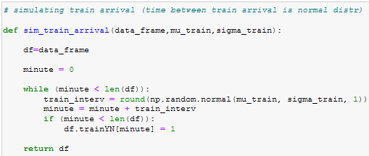
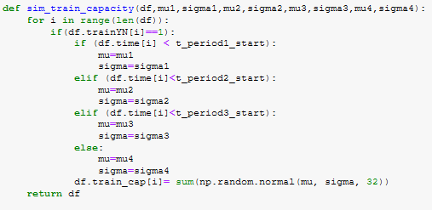
Implementation (3/7)
We simulate the subway by:
Simulating the arrival of subways
The time between two trains is actually normally distributed and not poisson as explained in http://jakevdp.github.io/blog/2018/09/13/waiting-time-paradox/
Simulating how many available spaces each door (subway has 32 doors)
Also for the availability of space we chose a normal distribution where mean and standard deviation are time dependent.

Slide 8
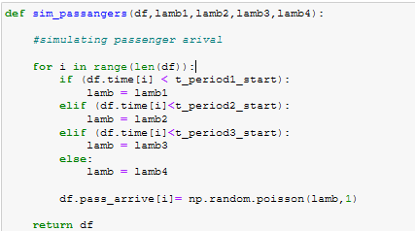
Implementation (4/7)
We simulate the flow of passengers using a Poisson distribution with a lambda value dependent on the time within the rush hour with the highest amount of subway users between 8 and 9

Slide 9
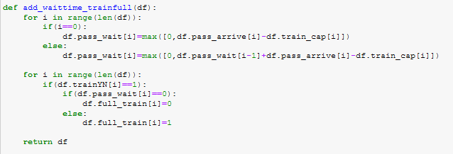
Implementation (5/7)
Finally we add two statistics:
The amount of passengers waiting at any time
Whether or not each train arriving into the station left the station at capacity

Slide 10
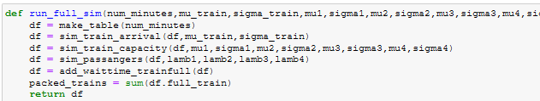
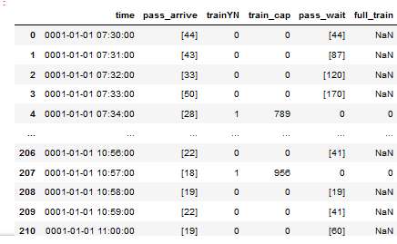
Implementation (6/7)
We create a function that iteratively goes through each of the previously mentioned functions to create the table shown on the bottom left side

Slide 11
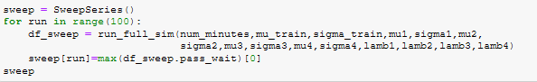
Implementation (7/7)
We can now use the packaged function to run 100 simulations .
This was chosen as it gives a sufficiently large dataset while not requiring increased computational power (100 iterations took my laptop about 5 minutes).

Slide 12
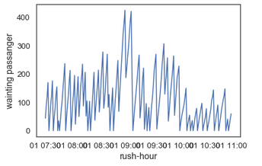
Passengers waiting in the Station
As it is well known that Bedford Avenue overcrowds very easily I wanted to show a timeline of people in the station according to the model.
It clearly shows that between 8:30 and 10:00 am you have the biggest chance of standing waiting until at least one train has left the station before you find a place

Slide 13
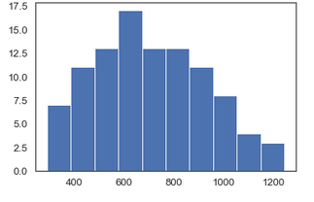
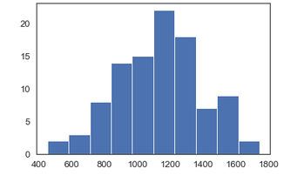
Stressing the System
In the main model we chose the mean of the Normal Distribution to be 5 minutes for the distance between two trains.
The histogram shows the maximum amount of passengers waiting at any time in Bedford Avenue for 100 simulations of a whole morning rush hour.
Most days will have about 600 people waiting on the platform with the maximum being at 1200 people.
Only a one minute increase to 6 minutes average distance between 2 trains almost doubles the mode of the graph to 1200 people waiting on a common day with up to 1700 people waiting in extreme cases.

Slide 14
Validity & Verification
Validation:
The average amount of passengers traveling on the subway in the model was around 7,800. Considering the total amount of people using Bedford Avenue is around 28,000 this makes sense: a quarter of travelers traveling during morning rush hour, a quarter of travelers traveling during evening rush hour and the remaining half entering and leaving Bedford Avenue in throughout the day.
The amount of people waiting at the station does seem very plausible as someone who tries to travel before 8:00 am but sometimes gets into the rush-hour crowd starting after 8:00am. It is almost exclusively the case that hundreds of people will be waiting and you will not be able to take the first train entering the station
Verification:
I ran every subfunction with a variety of inputs to find that they behaved as anticipated
More specifically, I ran all subfunctions with zero standard deviation (where applicable) and the results where as expected very predictable.

Slide 15
Conclusion
We found that the resulting number of trains and passengers matched those seen in real life
A latency of only 1 minute can double the expected amount of people waiting in the train station
The limitations due to train signaling does not allow for an increase in frequency, however we can see that this would potentially improve the situation drastically – so some investment into the infrastructure might make sense.

