Slide 1
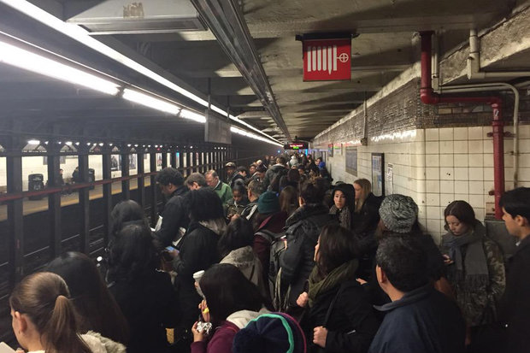
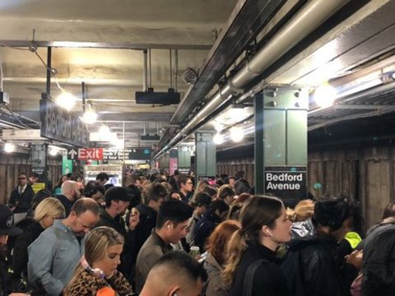
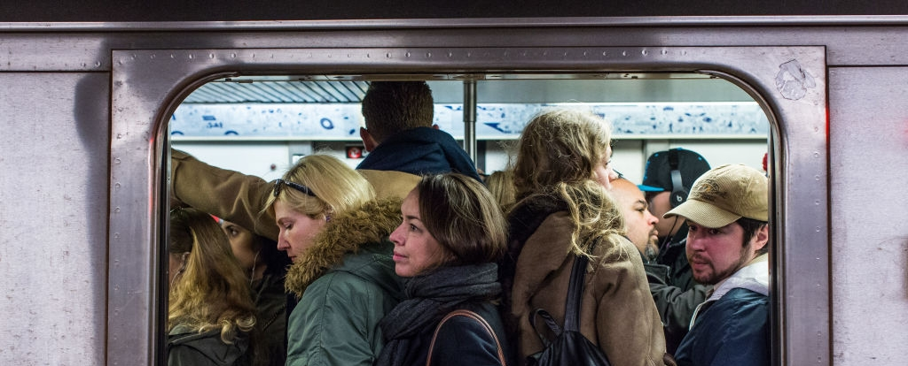
Morning Rush Hour in the Bedford Avenue Stop
Final Project by Manolis Manoli

Slide 2
Introduction
The Bedford Avenue L train station in Williamsburg has approximately an average of 27,000 daily users (1) on any given weekday. This makes it the second most frequented train station in Brooklyn - all that with only one platform serving both the Manhattan bound train and those that take passangers deeper into Brooklyn.
It is notorious for its delays and huge crowds on the small platform waiting until they can finally squeeze into a train - after seeing multiples pass with only a few waiting passangers being able to squeeze into the already overcrowded trains.
In the morning, the overwhelming amount of passangers will travel into Manhattan with those traveling into Brooklyn not experiencing shortage in space. In the evening the trains back into Brooklyn will be overcrowded with those from Brooklyn into Manhattan being below capacity. We will therefore simplify our investigation and only focus on modeling the Bedford Avenue platform and passangers traveling into Manhattan.
We want to see how the amount of people waiting varies throughout rush hour and how many trains operate at capacity.
(1) http://web.mta.info/nyct/facts/ridership/ridership_sub.htm

Slide 3
Introduction and Goal
The Bedford Avenue L train station in Williamsburg has approximately an average of 27,000 daily users (1) on any given weekday. This makes it the second most frequented train station in Brooklyn - all that with only one platform serving both the Manhattan bound train and those that take passengers deeper into Brooklyn.
It is notorious for its delays and huge crowds on the small platform waiting until they can finally squeeze into a train - after seeing multiples pass with only a few waiting passengers being able to squeeze into the already overcrowded trains.
In the morning, the overwhelming amount of passengers will travel into Manhattan with those traveling into Brooklyn not experiencing shortage in space. In the evening the trains back into Brooklyn will be overcrowded with those from Brooklyn into Manhattan being below capacity. We will therefore simplify our investigation and only focus on modeling the Bedford Avenue platform and passengers traveling into Manhattan.
We want to see how the amount of people waiting varies throughout rush hour and how many trains operate at capacity.
(1) http://web.mta.info/nyct/facts/ridership/ridership_sub.htm

Slide 4
Assumptions
The L train has 8 cars with each car having 4 doors. We will model each of these 32 doors using a Normal Distribution. The mean and variance will depend on the time t and distributed N(mspace_t , vspace_t) where t are different time segments during the rush hour
According to the article "The Waiting Time Paradox, or, Why Is My Bus Always Late?" (2) the arrival time of trains is actually not Poisson distributed but rather normally distributed. This is due to the fact that arrival times of trains The trains arrive on average every 4 minutes a variance of 1.5 minutes - N(4,1.5).
We assume that at 7:30 there is no queue and any traveler will find space until that time
The traveler arrive at the train station with poisson distribution Pois(Lambda_t) where t are different time segments during the rush hour
Travelers will move to doors where there is still room (in reality sometimes the doors at the end of the platform will have space with most people trying to get into the train in the center)

Slide 5
Start
Flow Chart
We split rush hour into 4 phases:
T1 = 7:30 – 8:00
T2 = 8:00 – 9:00
T3 = 9:00 – 10:00
T4 = 10:00 – 11:00
Simulating minute by minute (t)
Simulate train arrival time:
Normal(mu,sigma)
Where the base case is:
mu = 5
sigma = 2
End
Simulate space on each train:
Normal(mu_i,sigma_i)
Where the base case is:
mu1 = 25, sigma1 = 10
mu2 = 7, sigma2 = 4
mu3 = 8, sigma3 = 5
mu4 = 30, sigma4 = 15
For each train arrival we will note if all passengers were able to travel or if some where not able to make it onto the train with variable full_train_t
Each minute we record people waiting:
how many people have entered the station and subtracting the number of passengers that were picked up in the subway:
pass_wait_t =
max[0, pass_wait_t-1 + pass_arrive_t – train_cap_t]
Simulate commuters arriving:
Poisson(lambda_i)
Where the base case per timeslot:
lambda1=40
lambda2=50
lambda3=40
lambda4=20

