Slide 1


SMART INDIA HACKATHON 2024
AQI data acquisition
Problem Statement ID -1616
Problem Statement Title - The technological solutions for capturing AQI values through mobile and
other forms of stations
Theme - Clean & Green Technology
PS Category - Software
Team ID -29857
Team Name - Cybereign

Slide 2

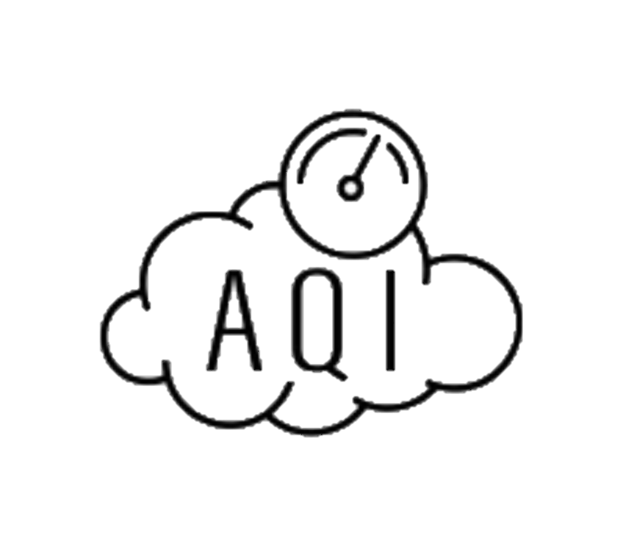






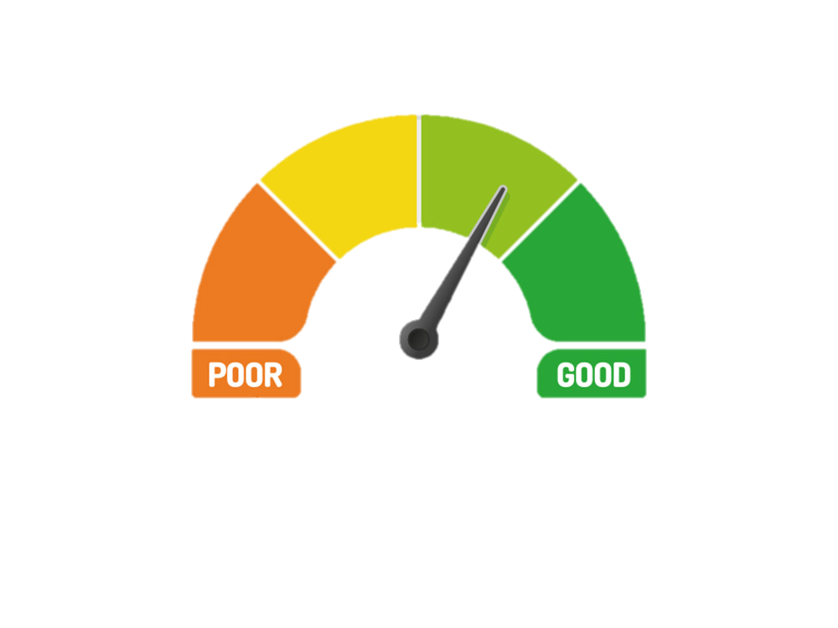
AQI data acquisition
Cybereign
Adding AQI instruments to public buses is a viable and innovative approach to monitoring air quality, and it can indeed work effectively. Here’s how it can contribute to the solution
More Representative Data: This method overcomes the issue of fixed stations providing localized
readings that may not be represent-ative of the wider area. By collecting data across a broad geographic area, the AQI data will be more accurate and reflective of the overall air quality. And it increases the Enhanced Data Coverage.
Reason for not capturing AQI through mobiles:::Real-time implementation of AQI sensors in Mobile devices is costly, and feasibility is low
High cost
AQI Data collection through Mobile
AQI data collection through buses.
Innovation and uniqueness:
Widespread Coverage : Public buses cover diverse city routes, ensuring comprehensive air quality . . . . monitoring.
Cost-Effective : Leverages existing infrastructure, reducing costs compared to drones or additional sensors.
Enhanced Data Accuracy : Continuous data collection across various locations improves reliability.
Holistic Environmental Monitoring : Captures air quality, humidity, temperature, and pressure data.
Integrated Traffic Insights : Combines air quality data with live bus tracking for deeper analysis.
Real-Time Public Updates : Instant data sharing through apps empowers citizens to make informed choices.

Slide 3
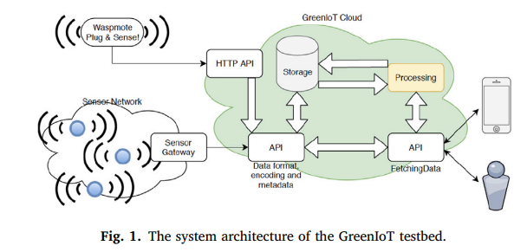













TECHNICAL APPROACH
Cybereign
Technologies to be used
For programming languages, using Python, Java, JavaScript, and frameworks like Django, React Native, MQTT, Firebase, and hardware such as Air Quality Sensors (e.g., PM2.5, PM10, NO2, CO2 sensors), GPS Modules, GSM/4G Modules, and Environmental Sensors.
Flow chart for data management and server
Methodology
Sending real time AQI data and other datas to server from various location
Data analysis and management are done
Server to Datas are processed and hosted
GSM 4G MODULE
Real time data of AQI updated to people along with extra features like bus location, humidity,pressure, temperature and traffic.
Accuracy and coverage area of data is increased.
To increase the range of sensor inlet pump is used .
ESP 32
MQ 131
MQ 135
The data was updated to people
Through apps
MQ 2

Slide 4
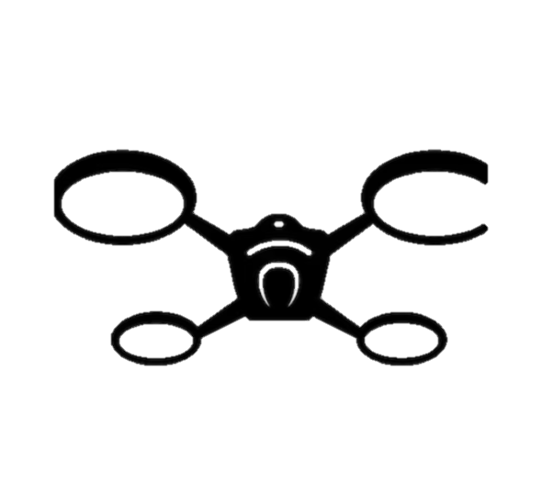

FEASIBILITY AND VIABILITY
Cybereign
Strategies for overcoming these
challenges
Use high-quality sensors with regular calibration.
Employ robust communication tech and fallback data storage.
Partner with agencies for funding and start with a pilot program.
Engage the public through awareness and transparent data sharing.
Potential challenges and risks
Sensor Accuracy : Maintaining accuracy in a mobile environment.
Data Transmission: Ensuring reliable real-time data transfer.
Costs : Managing sensor and system expenses.
Public Acceptance: Addressing privacy concerns and building trust
Solution to collect data during low transport rate and inaccessible areas
To tackle data collection challenges in rural and inaccessible areas, as well as during nighttime, we propose using drones to complement public buses. Drones can cover areas where buses can't reach and efficiently gather AQI data during low-pollution nighttime periods. In inaccessible areas, server data will identify locations for drone deployment, automating the process for future updates. This ensures comprehensive, cost-effective data collection compared to traditional methods..
Feasibility and Viability:
Adding AQI sensors to public buses is both feasible and viable. It efficiently leverages existing infrastructure, allowing for extensive air quality data collection across urban areas. Drones can supplement coverage in rural or inaccessible regions. While challenges like sensor accuracy, data transmission reliability, and costs exist, they can be managed with robust technology, strategic partnerships, and public engagement, making this a practical and sustainable solution for enhanced air quality monitoring.
Automate the drone using database to collect AQI data in different location
*Limited drones is required

Slide 5
IMPACT AND BENEFITS
Cybereign
Impact and Benefits: AQI Sensors on Public Buses
INNOVATION AND UNIQUENESS: Adding AQI sensors to public buses offers a cost-effective way to monitor air quality city-wide by leveraging existing infrastructure. Unlike fixed stations, buses provide widespread coverage, collecting data from diverse locations, leading to more accurate and representative results.
Key Benefits:
Enhanced Data Coverage: Real-time monitoring across multiple urban and suburban routes.
Cost-Effective: Uses the public bus network, reducing additional setup costs.
Improved Data Accuracy: Moveable sensors continuously collect comprehensive environmental data.
Public Awareness: Real-time data sharing through apps empowers citizens to make informed decisions.
Traffic Insights: Combines AQI data with bus tracking to analyze traffic-related pollution hotspots and public buses real time tracking.
Challenges & Solutions: To overcome sensor accuracy, transmission reliability, and public acceptance challenges, strategies include using high-quality sensors, robust communication tech, and public engagement. Drones can supplement data in rural or inaccessible areas.

Slide 6
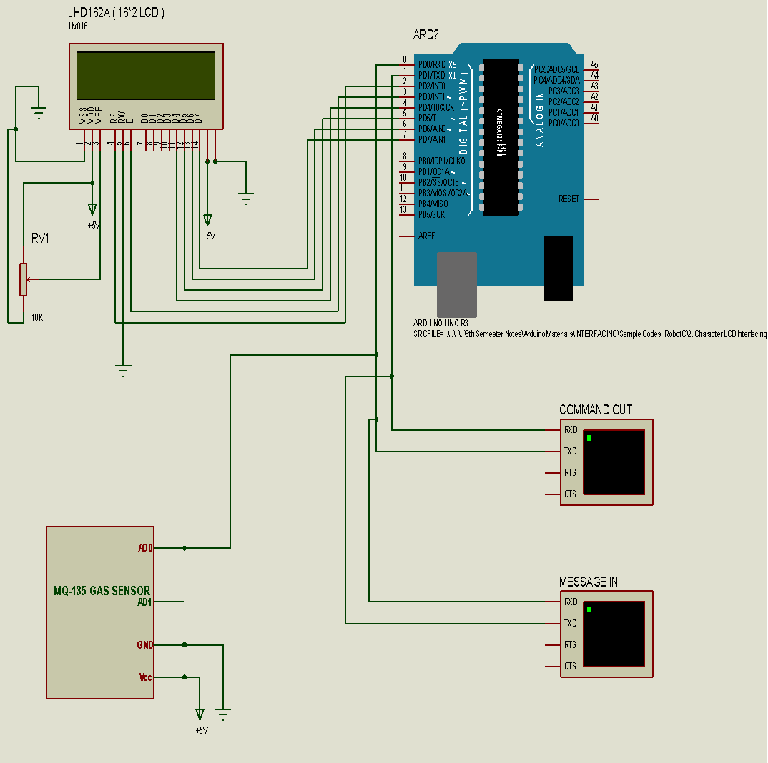
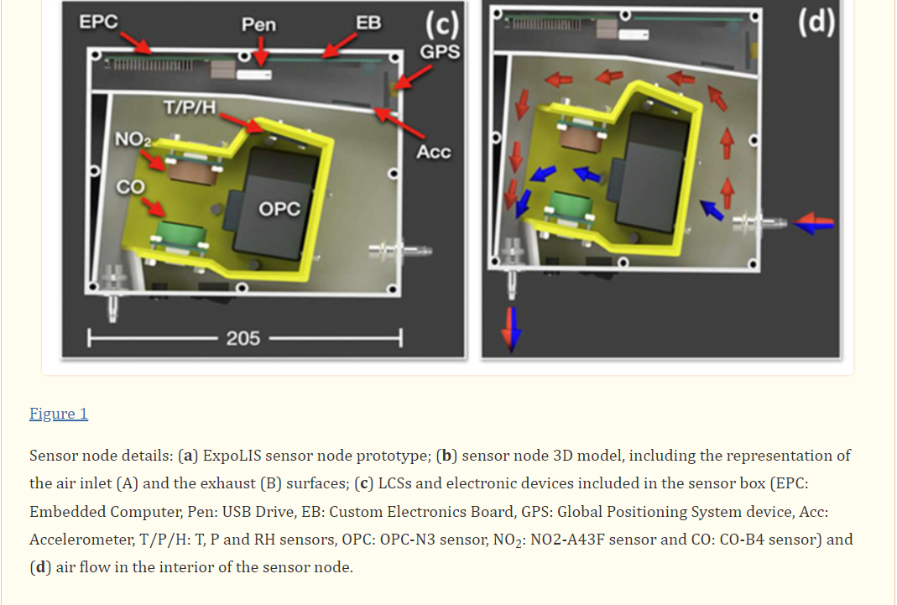
RESEARCH AND REFERENCES
Cybereign
1.https://www.researchgate.net/publication/337780520_IOT_based_Air_Quality_Monitoring_System_Using_MQ135_and_MQ7_with_Machine_Learning_Analysis
DOI:10.12694/scpe.v20i4.1561 RESEARCH OF MQ SENSORS
From this research article the MQ sensors have efficiency to detect the air pollution to increase the efficiency of MQ sensors the pumping system is added
2.https://github.com/harsharora94/Environment-Monitoring-System-Using-GSM-Web-Server
Git hub link for reference prototype model
3. https://en.wikipedia.org/wiki/Air_pollution_in_Delhi
Article that describes about serious of air pollution
4. https://www.ncbi.nlm.nih.gov/pmc/articles/PMC10002067/
Article that shows that implementation through buses
5.https://www.sciencedirect.com/science/article/pii/S2352864818302475
This paper presents an experimental study on real-time air pollution monitoring using wireless sensors on public transport vehicles. The study is part of the GreenIoT project in Sweden, which utilizes Internet-of-Things to measure air pollution level in the city center of Uppsala.
Circuit driagram for AQI
IOT

