Slide 1
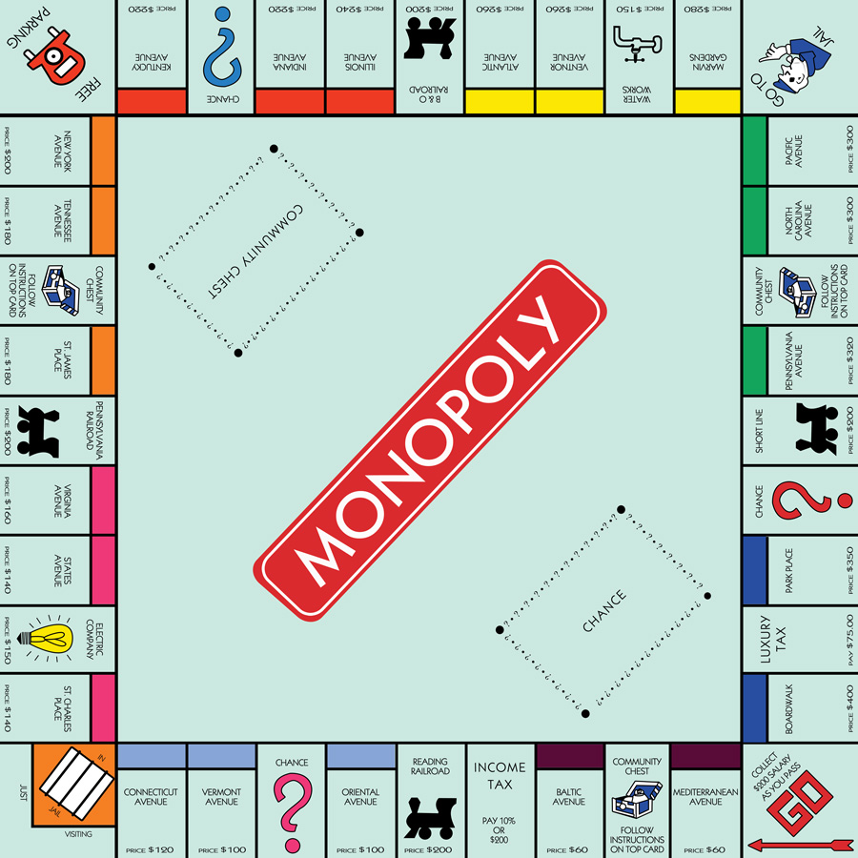
Board Games
Aline Barbiaux – Manon Libert

Slide 2
How board games …
Were invented
Have various types
Are used in education
Turned into a passion
Got computerized

Slide 3
Invention & History

Slide 4
Various types

Slide 5
What about education

Slide 6
Passionate people

Slide 7
Nerd Alert

